Slide 1
Nonparametric Methods: Nearest Neighbors and Kernels
Oliver Schulte
Deep Learning 880
Notes:
If you use “insert slide number” under “Footer”, that text box only displays the slide number, not the total number of slides. So I use a new textbox for the slide number in the master.

Slide 2
Instance-based Methods
Model-based methods:
  estimate a fixed set of model parameters from data.
  compute prediction in closed form using parameters.
Instance-based methods:
  look up similar “nearby” instances.
  Predict that new instance will be like those seen before.
  Example: will I like this movie?

Slide 3
Nonparametric Methods
Another name for instance-based or memory-based learning.
Misnomer: they have parameters.
Number of parameters is not fixed.
Often grows with number of examples:
  More examples ➔ higher resolution.

Slide 4
k-nearest neighbor classification

Slide 5
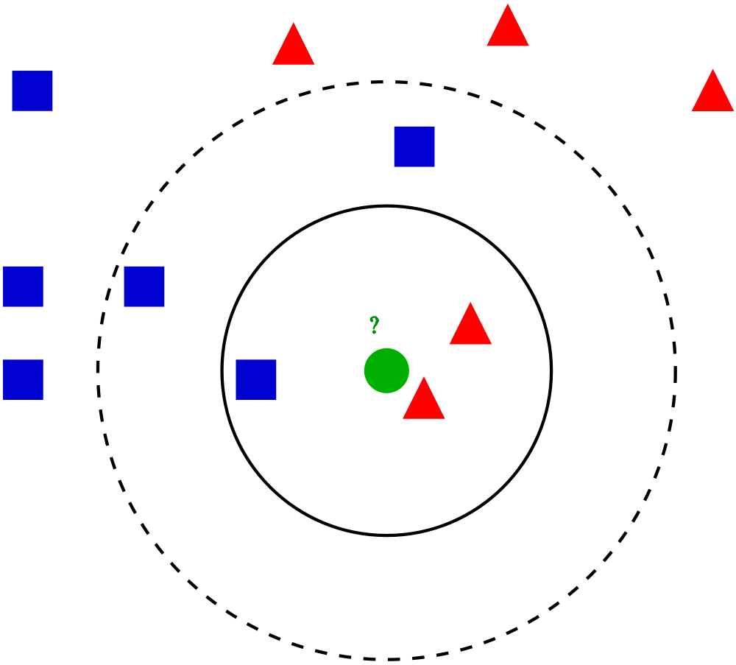
k-nearest neighbor rule
Choose k odd to help avoid ties (parameter!).
Given a query point x_{q}, find the sphere around x_{q} enclosing k points.
Classify x_{q} according to the majority of the k neighbors.
Notes:
At least k points in sphere.
Legend:
Green circle = test case.
Solid circle: k = 3
Dashed circle: k = 5.

Slide 6
Events in Asia and Middle East between 1982 and 1990
k too small ➔ overfitting. Why?
k too large ➔ underfitting. Why?
x1 = surface wave magnitude
x2 = body wave magnitude
white = earthquake
black = nuclear explosion
k = 1
k = 5
Notes:
What is overfitting and underfitting?
Overfitting: k too small, fits neighborhood too much.
Underfitting: k too large, doesn’t generalize enough. In extreme case, k = N -> prior class label.
black region: classified as nuclear explosion by nearest neighbor method.
Overfits outlier at x2 = 6.
Events in Asia and Middle East between 1982 and 1990.
white = earthquake, black = nuclear explosion

Slide 7
Example: Oil Data Set
Notes:
what is meaning of oil data set? look this up.

Slide 8
Implementation Issues
Learning very cheap compared to model estimation.
But prediction expensive: need to retrieve k nearest neighbors from large set of N points, for every prediction.
Nice data structure work: k-d trees, locality-sensitive hashing.
Notes:
k-d trees: generalized binary trees.
Locality-sensitive hashing: like hashing, but similar points have similar hash values.

Slide 9
Distance Metric
Key for making the generalization work.
Needs to be supplied by user.
With Boolean attributes: Hamming distance = number of different bits.
With continuous attributes: Use L2 norm, L1 norm, or Mahalanobis distance.
Also: kernels, see later.
For less sensitivity to choice of units, usually a good idea to normalize to mean 0, standard deviation 1.
Notes:
Mahalanobis distance looks at covariance between dimensions.
Basically, it’s the term in the exponent of the Gaussian distribution (see Bishop).

Slide 10
Curse of Dimensionality
Low dimension ➔ good performance for nearest neighbor.
  As dataset grows, the nearest neighbors are near and carry similar labels.
Curse of dimensionality: in high dimensions, almost all points are far away from each other.
Notes:
number of grid cells of fixed side lengths grows exponentially with dimension

Slide 11
Point Distribution in High Dimensions
How many points fall within the 1% outer edge of a unit hypercube?
In one dimension, 2% (x < 1%, x> 99%).
In 200 dimensions? Guess...
Answer: 94%.
Similar question: to find 10 nearest neighbors, what is the length of the average neighbourhood cube?

Slide 12
Kernel Methods
The Support Vector Machine Classification Formula

Slide 13
Weighted Nearest Neighbour?
5-nearest neighbour classifies green point as blue
But the red triangles are much closer
Could consider a weighted average vote where closer data points count for more

Slide 14
Issues for Weighted Vote
Support Vector Machine provide a form of weighted average vote
To understand the motivation, let’s consider the challenges in developing the idea
  Measuring closeness
  Encoding class labels
  Restricting the vote to important data points

Slide 15
Measuring Closeness
How to quantify how close a data point is to the query point?
Can use a kernel to converts distances to similarity/closeness
  More on that later
For now we use the dot product (x • x_{j})
  Measures the cosine of the angle between two vectors
  For centered vectors, measures their covariance
Possible classification formula (not yet final)
  h(x) = [Σ_{j} (x • x_{j}) y_{j} ] - b
bias term
Notes:
collinear = angle = 0 = cosine = 1
N x covariance = dot product for centered vectors
bias term is subtracted for technical reasons, can be positive or negative
consistent with text

Slide 16
Encoding Class Labels
  Consider the average vote
  Σ_{j} (x • x_{j}) y_{j}
  If negative class labels are encoded as y = 0, they just disappear in the sum.
  Solution: encode the negative class as y = -1.
    (we’re just pretending these are real numbers anyway)
  positive neighbours vote for the positive class
  negative neighbours vote for the negative class

Slide 17
Global Importance
  So does h(x) = [Σ_{j} (x • x_{j}) y_{j} ] – b work?
  Not really, because it sums over all instances
  Computational problem: say I have 10K instances (e.g. movies). Need to compute dot product for all 10 K
    Slow predictions
  Statistical problem: the many distant instances dominate the few close ones
  ➔get similar predictions for every data point
  SVM solution:
    add a weight α_{j} for each data point
    enforce sparsity so that many data points get 0 weights
Big Idea!
Notes:
tell kinect story

Slide 18
SVM Classification Formula
Compute weighted thresholded vote =
[Σ_{j} α_{j} (x • x_{j}) y_{j} ] – b
If vote > 0, label x as positive
If vote < 0, label x as negative
In symbols h(x) = sign( [Σ_{j} α_{j} (x • x_{j}) y_{j} ] – b)
Later: How can we learn the weights α_{j}?
Notice that the weights are like parameters, but more data points ➔ more weights
SVM Demo

Slide 19
Example 1
SVM with Gaussian kernel K(x,z) = exp{- dist(x,z)/2σ²}
Support vectors circled (importance weight > 0)
Nonlinear decision boundary

Slide 20
Example 2
SVM trained using cubic polynomial kernel
K(x,z) = (x • z +1)³
linearly separable
not linearly separable

