Slide 1
Neural Generative Models
Chapter 6
CMPT 983

Slide 2
Graph Variational Auto-Encoder I
Node Level Representation

Slide 3
Recall: Basic generator setup
Generate X from random input
Generate soft adjacency matrix A* from random input representing node representations

Slide 4
Graph Version
Encode Adjacency Matrix A, Decode Adjacency Matrix A
Can make encoding conditional on node features X
We have already discussed decoders Dec(Z)
What is approximate posterior q(Z)?
What is prior p(Z)?

Slide 5
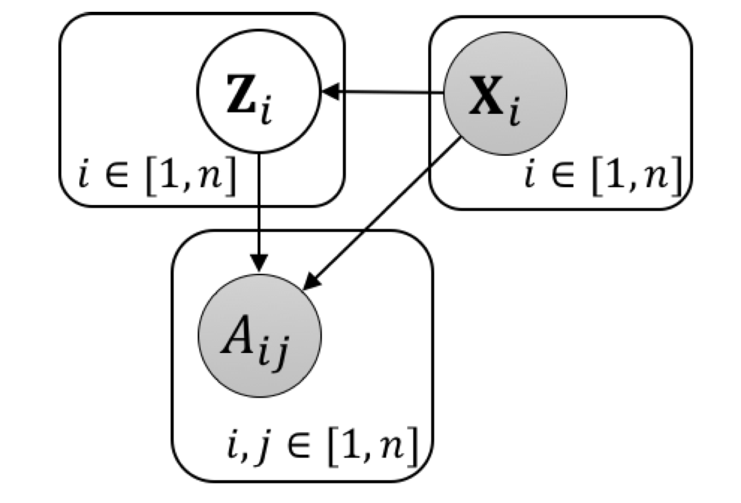
Probabilistic Encoders
Node representations are independent in the prior p
Also assumed independent in posterior
Features X are usually treated as input (conditioned)
  Can also generate features (Jaeger and Schulte IJCAI 2020)
Typically X initializes embeddings
  Prior “bias” for impact of attributes over link structure

Slide 6
Put it all together
See Kipf and Welling original vae paper
See their post

Slide 7
Graph Variational Auto-Encoder II
Graph Level Latent

Slide 8
Graph-Level Latents
Instead of encoding the adjacency matrix into a node representation matrix, can encode it into a graph embedding.
Encoder: can use graph embedding methods from previous chapter
μ_{zG}(Pool_{μ}(GNN_{μ} (X,A))) and standard deviation

Slide 9
Graph Level Decoding
Could use fully connected neural network
Problems: permutation equi-variance, need to know max
Interesting approach: use CNN encoder, deconvolutional decoder
Notes:
https://papers.nips.cc/paper/2018/file/1458e7509aa5f47ecfb92536e7dd1dc7-Paper.pdf

Slide 10
Graph GANs

Slide 11
GAN setup
GAN setup
  generator produces “fake” graph
  discriminator distinguishes fake graph from real graphs
Generator A* = σ(MLP(z))
Discriminator uses graph classifier
Discriminator wins if it correctly distinguishes fake from real graphs

Slide 12
Auto-Regressive Models

Slide 13
Neural Process Models
Stochastic processes generate graphs sequentially
  E.g. edge by edge in preferential attachment
Traditionally they assume a parametric generation process whose form is defined by the model
Neural approach: use flexible sequence models to learn edge generation processes

Slide 14
Graph RNN
Generate node neighbourhoods (A matrix rows) node-by-node
After generating row i, update graph-level state h_{i}
To generate next row, run node-level RNN with initial state h_{i}
Both levels generate end-of-sequence tokens
Not permutation equi-variant: assumes fixed node ordering
Can be used as VAE decoder
For examples see Figure 9.3 in text

Slide 15
Graph Recurrent Attention Networks
Key Idea: after generating a partial graph for nodes 1,..,i, run a GNN to predict the neighbourhood of node i+1.
See Figure 9.2

Slide 16
Graph Generation Evaluation

Slide 17
How to Evaluate Graph Generative Models
A few options:

