Slide 1
Traditional Generative Models
Chapter 8
CMPT 983

Slide 2
Generative Models
Model complete graphs
Alternative approaches:
  Assign probabilities to complete graphs
  Generate links sequentially (auto-regressive)

Slide 3
Overview
Erdos-Renyi: independent links
Stochastic Block Model: links are independent given communities/clusters/blocks
Preferential Attachment: nodes are more likely to be linked to high degree nodes

Slide 4
Erdos-Renyi Model
Every link is independent of all the others, with a single uniform link probability P(A[u,v]=1) = r.
One of the simplest graph models
Very well understood mathematically
Can be a useful null model for more complex hypotheses
Easy to sample graphs: just go through all pairs of nodes, flip a coin with outcome probability r to decide on links

Slide 5
Stochastic Blocks Model
Very well developed
Works well for many types of graph data
We already discussed this
  Similar to Rescal parametrization in multi-relational data
Generative Mechanism:
  Assign each node to one of k clusters (blocks) according to probability p₁,…,p_{k}
  Go through all pairs of nodes u,v
    If u,v are in the same block i, use an intra-block probability C[i,i]
    If u is in block i and v in block j with i≠j use an inter-block probability C[i,j]
Key Assumption: Links are independent of each other given the block assignments

Slide 6
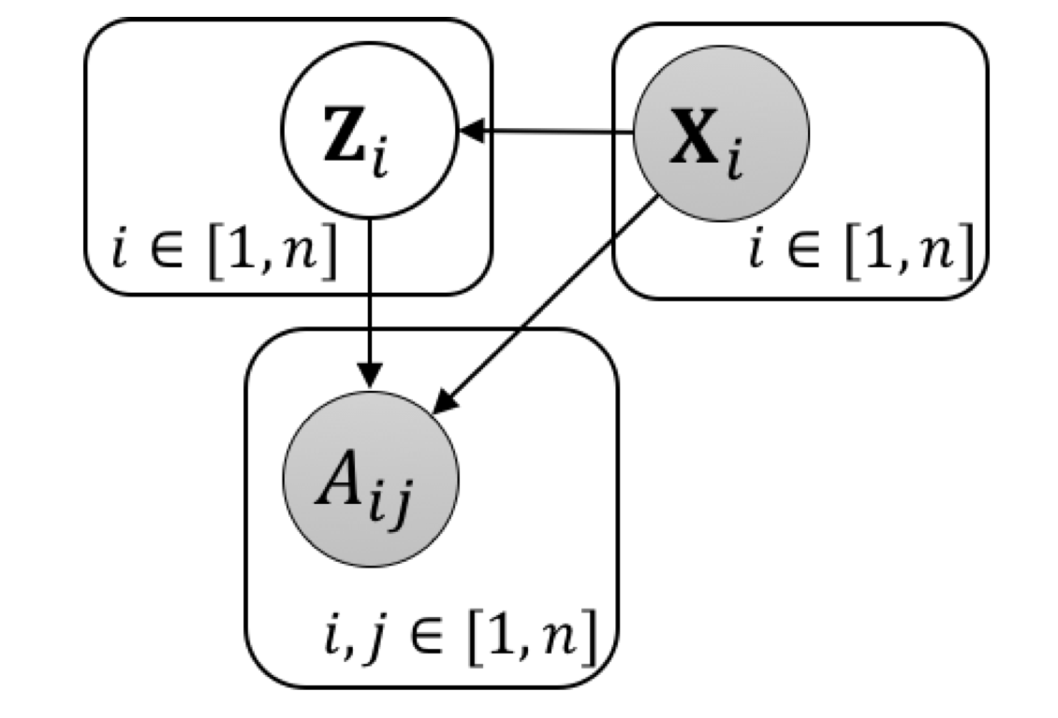
Generative Plate Diagram for SBM
Z_{i} = k is cluster assignment
X_{i} is node feature vector

Slide 7
Preferential Attachment
Basic intuition: a new node is more likely to link to an existing node that already has many links.
PA process for generating a graph with n nodes:
Start with complete graph over m₀<<n nodes := G₀
Select a new node u to be added to G_{t}.
To form G_{t+1} :Connect u to m< m₀ existing nodes with probability
P(u,v) ∝ degree(v,G_{t}) = degree of v in current graph
Illustrations
Video superlinear PA
Video sublinear PA
Notes:
https://www.researchgate.net/publication/263745870_The_Matthew_effect_in_empirical_data/figures?lo=1
https://www.youtube.com/watch?v=XcGn2KYEmVM

Slide 8
Stochastic Process Models
PA is an example of a stochastic process for generating graphs sequentially.
A stochastic process can also be defined for more complex models, e.g. Stochastic Block Model.
  Can learn number of blocks
Well-known examples include
  Chinese Restaurant Process
  Indian Buffet Process
  Polanyi Urn Model
  Yule process
In deep learning auto-regressive process

Slide 9
Power Laws
Preferential Attachment generates a “rich get richer” dynamic
Also called “cumulative advantage”
Few high-degree nodes, many low-degree nodes power law distribution
Mathematical Formula: P(node u has degree k) ∝ k^{-⍺}
where ⍺ > 1 is the power law coefficient P(x)
See Stanford slides
Theorem. Preferential Attachment Processes generate graphs with power law degree distributions
For the process described before ⍺ = 3
Notes:
http://snap.stanford.edu/class/cs224w-2015/slides/04-powerlaws.pdf

Slide 10
PA and Power Laws
Explains highly unequal distributions
Citations
Wealth. “The world’s 2,153 billionaires have more wealth than the 4.6 billion people who make up 60 percent of the planet’s population”
Black Swans: Low-frequency events with high impact
  E.g. black days on the stock market
Cannot be explained with standard statistical (exponential) models of degree distributions

Slide 11
Applications of Traditional Models
Generate synthetic graphs for evaluating deep generation models
Null models as a baseline

Slide 12
Conclusion
Generative Models define distributions over complete graphs and/or processes for generating them
Erdos-Renyi aka random graphs: Links are identically and independently distributed
Stochastic Blocks Model: Links are conditionally independent given node clusters (blocks)
Preferential Attachment: New nodes are more likely to attach to existing nodes with higher links
Power Laws: describe highly skewed degree distributions
  Few high degree nodes, many low degree nodes
Preferential Attachment is a stochastic process that generates power law distributions

