Slide 1

Unsupervised Feature Learning
Introduction
Oliver Schulte
School of Computing Science
Simon Fraser University
Notes:
plan: start with assumptions.
A1: common cause
A2: small number. dimensionality reduction.
A3: form of causation: pca.
group learning, similar assumptions

Slide 2
Overview
Assumptions for Learning Latent Features
Assumption 1: the common cause principle.
  Statistical consequence: conditional independence of observed features.
  Computational consequence: given latent feature values, relatively easy to estimate model.
Assumption 2: small number of latent features.
  Consequence: dimensionality reduction.
Assumption 3: linear relationship between latent and observed features.
  Consequence: tractable learning (principal component analysis).
Similar Assumptions for Learning Latent Groupings (Clusters)

Slide 3
Learning the Unobserved
Many tasks in machine learning involve specifying values for quantities that are not observed.
  Impute missing values.
  Clustering.
  Weights for hidden layers in neural network.

Slide 4
Latent Feature Learning: Motivation
  Dimensionality reduction.
  Eliminate redundancies among features.
Data exploration: find clusters/groupings.
Can help with missing data, either features or labels.

Slide 5
Cognitive Science
The brain infers latent structure all the time.
Example: from retina activation (rods and cones), infer 3-D scene in front of me.
Notes:
seems to be hierarchical model. people in deep learning think about this.

Slide 6
From Observed to Unobserved
Skeptical Question:
  How can we learn about what is unobserved from what is observed?
  Identifiability?
Answer: We need assumptions about the relationship between observed and unobserved features.
Observed Features
X1
X 2
X 3
Assumptions
Z1
Z2
Unobserved/Latent Features
Notes:
Psychology: from manifest to latent
Duda and Hart discuss identifiability.

Slide 7
Data Model

Slide 8
The Data Matrix
I.i.d. data can be represented in a data matrix.
A list of features/columns/variables/attributes
X=(X₁,X₂,...,X_{m}).
Data matrix D_{n x m} lists n cases. Each case lists a value for each feature.
Generative model for the joint distribution P(X).

Slide 9
Discriminative Learning
A distinguished target/class variable Y (continuous/discrete).
Data matrix D_{n x m} lists n cases. Each case lists a value for each feature.
Discriminative Model for the conditional distribution P(Y|X).

Slide 10
Example
Day | Outlook | Temperature | Humidity | Wind | PlayTennis
1 | sunny | hot | high | weak | no
2 | sunny | hot | high | strong | no
3 | overcast | hot | high | weak | yes
4 | rain | mild | high | weak | yes
5 | rain | cool | normal | weak | yes
6 | rain | cool | normal | strong | no
7 | overcast | cool | normal | strong | yes
8 | sunny | mild | high | weak | no
9 | sunny | cool | normal | weak | yes
10 | rain | mild | normal | weak | yes
11 | sunny | mild | normal | strong | yes
12 | overcast | mild | high | strong | yes
13 | overcast | hot | normal | weak | yes
14 | rain | mild | high | strong | no

Slide 11
Assumptions for Learning Latent Structure

Slide 12
Assumption 1: The Common Cause Principle

Slide 13
Reichenbach’s Common Cause Principle (1956)
“Every correlation can be explained by a direct causal connection or a common cause.”
Stanford Encyclopaedia
Notes:
The brain seems to do this too, we don’t believe in consequences.
look up Reichenbach date

Slide 14
Graphical Models Version
Assumption: If we see a correlation between two variables X,Y, then the world works like this:
X
Y
or like this
Z
or maybe like this
Z
X
Y
X
Y
Terminology: Z is a cause, component, factor.

Slide 15
Graphical Models Version
Assumption: If we see a correlation between two variables X,Y, then the world workds like this:
Observation 1
Observation 2
or
Common Cause
or
Common Cause
Observation 1
Observation 2
Observation 1
Observation 2

Slide 16
Intuitive Examples
Sun rose at 6 am each day this week.
Position of Sun, Earth, Earth Rotation
Sunrise 1
Sunrise 2
Sunrise 3
Student’s marks are explained by their knowledge.
Knowledge
Mark 1
Mark 2
Mark 3
Mark 4
Mark 5
Mark 6
Notes:
notice the flow of inference: from sunrise 1, infer the hidden parameters, then can predict sunrise 2.
The brain does this all the time. E.g.: run into same person at party 3 times.

Slide 17
Learning a Generative Model With Latent Features
Write down a model of how the observed features are generated given latent features.
Train the model on a subset of observed features.
Test on another.
Knowledge
Mark 1
Mark 2
Mark 3
Mark 4
Mark 5
Mark 6
Notes:
Check convention for latent variable nodes, e.g., in Bishop or winbugs

Slide 18
Statistical Consequences
Question: What independence relations are entailed by the Bayes net below?
Z
X1
X 2
X 3
Answer: Conditional on latent feature, observed features are independent.
Informally, Z explains the correlations among X1,X2, X3.
Notes:
this defines the type of graphical model you look for. This is the key picture: given k unobserved causes, the data lie on a k-dimensional manifold. The brain seems to assume that the world has somethign like this structure. Plus it adds a set of priors on the exact form of the conditional dependence. PCA can also be modelled this way.

Slide 19
Computational Consequences
P(X,Z) = P(X|Z) x P(Z)
= Π_{i} P(X_{i}|Z) x P(Z)
joint distribution
conditional probability for each observed variable
easy to estimate
regularize latent values
for a given guess of the latent quantities, easy to estimate and evaluate data likelihood P(X|Z).
Notes:
prior can still be hard to evaluate.
finding optimal Z values can also be hard to do even if you can evaluate Z easily (NP-hardness).

Slide 20
Multiple Common Causes
Knowledge
Effort
Mark 1
Mark 2
Mark 3
Mark 4
notice the similarity to the topology of a feedforward neural net
Notes:
in the extreme case, as many components as observed variables -> not interesting.

Slide 21
Hierarchical Version
Z
Knowledge
Effort
Mark 1
Mark 2
Mark 3
Mark 4
Latent variables at layer 1 explain correlations among observed variables.
Latent variables at layer 2 explain correlations among latent variables at layer 1.
This is the basic idea of a deep belief network.

Slide 22
Assumption 2: Low-Dimensionality

Slide 23
Latent Feature Dimensionality
Assumption: The number of unobserved causes k is much less than the number m of observed variables.
The number of latent dimensions k can be specified by the user, or learned (non-parametrics).
Knowledge
Effort
Mark 1
Mark 2
Mark 3
Mark 4
Notes:
Two in this example.

Slide 24
More Examples
Video Game Screen: 4000 pixels (say) determined by two variables (joystick position, button pressed).
position
button
Pixed 1
Pixel 2
…
Pixel 1999
Pixel 2000
The Big 5 in Psychology. Personality Types can be explained by 5 basic traits.
Openness
conscientiousness
extraversion
agreeableness
neuroticism
Answer 1
Answer 2
…
Answer 99
Answer 100
Notes:
Answers on personality questionnaire.

Slide 25
Consequence: Dimensionality Reduction
If a tuple of m observed feature values is well predicted by k latent features, we can represent the m-tuple instead by a k-tuple, without (much) loss of information.
  The data lie on a k-dimensional manifold.
Video Game example: instead of specifying all 2000 pixels, specify (position of joystick, button pressed).
  From 2 numbers we can reconstruct 2000.
Notes:
Explain manifold concept.
But in manifold, we have a 1-1 bicontinuous mapping between observed states and latent states. Can we get the same for statistical models?

Slide 26
Generative Modelling
A general framework for thinking about latent feature learning.
Model how the feature distribution is generated.
E.g., Gaussian mixture model for clustering.
From the chain rule, we have
P(Y,X) = P(Y|X) x P(X).
Discriminative model
Generative model of features

Slide 27
Discussion Question: Discriminative vs. Generative Modelling
Suppose we want to predict a student’s GPA using their marks in a course.
Might it help to model correlations among the course components?
How?
See file examples.xlsx/generative modelling.

Slide 28
The curse of dimensionality
Scaling standard ML methods to high-dimensional feature spaces is hard, both computationally and statistically.
  Statistics: data do not cover space.
  Computation: local minima for parameter optimization.
Latent feature learning can be used to reduce the data dimensionality.
Other approach: directly map the m observed features to k features with minimum loss of information.

Slide 29
Dimensionality Reduction Techniques
Day | Outlook | Temperature | Humidity | Wind | PlayTennis
1 | sunny | hot | high | weak | no
2 | sunny | hot | high | strong | no
3 | overcast | hot | high | weak | yes
4 | rain | mild | high | weak | yes
5 | rain | cool | normal | weak | yes
6 | rain | cool | normal | strong | no
7 | overcast | cool | normal | strong | yes
8 | sunny | mild | high | weak | no
Can often by visualized as merging columns.
Discrete features: use Boolean combinations.
  E.g. merge Temperature and Humidity into one feature.
PCA (continuous) use linear combinations to merge features.
Factor analysis: merge highly correlated features.
Deep learning: non-linear combinations of features.
Notes:
Self-organizing maps: directly try to map m-D data points to k-D data points such that closeness is preserved.

Slide 30
Assumption 3: Linearity

Slide 31
Principal Component Assumption
Observed Features are linear combinations of latent features.
  Plus some noise.
Z
a
b
c
X1
X 2
X 3
X1 = a Z + ε
X2 = b Z +ε
X3 = c Z +ε

Slide 32
Consequences
Given number k of principal components, relatively easy to find optimal latent features.
Columns are linear combinations of each other (neglecting noise), e.g.
  X1 = a Z and X2 = b Z implies X2 = b/a X1.

Slide 33
Feature Tuning
Usual approach: use domain knowledge to
  select relevant features
  transform basic features.
Unsupervised learning: use program to discover new features from basic ones.
  Typically the learned features are fewer than the basic features
  Dimensionality reduction.

Slide 34
Hierarchical Models
Hierarchical Clustering: group rows into level-1 clusters. Group level-1 clusters into level-2 clusters etc.
Hierarchical Feature Learning: group columns into level-1 features. Group level-1 features into level-2 features etc.
  Together with non-linearity, the key idea behind deep learning.
  Deep = many hierarchy levels.

Slide 35
Learning Latent Groups = Clusters

Slide 36
Clusters as Latent Features
Suppose we want to cluster n items.
Define Z(Item) = cluster(Item): specifies the cluster of a given item_{i}.
domain(Z) = {1,..,k}.
Single latent feature with bounded range.
Reduces model dimensionality in the sense of keeping parameter space small.
Notes:
Functional notation works very well, see tutorial.
Also tutorial: link-based classification in general.

Slide 37
Clustering merges rows
Day | Outlook | Temperature | Humidity | Wind | PlayTennis | Z
1 | sunny | hot | high | weak | no | 1
2 | sunny | hot | high | strong | no | 1
3 | overcast | hot | high | weak | yes | 1
4 | rain | mild | high | weak | yes | 2
5 | rain | cool | normal | weak | yes | 2
6 | rain | cool | normal | strong | no | 2
7 | overcast | cool | normal | strong | yes | 1
8 | sunny | mild | high | weak | no | 1
9 | sunny | cool | normal | weak | yes | 1
10 | rain | mild | normal | weak | yes | 2
11 | sunny | mild | normal | strong | yes | 2
12 | overcast | mild | high | strong | yes | 3
13 | overcast | hot | normal | weak | yes | 3
14 | rain | mild | high | strong | no | 3
Notes:
3 different clusters corresponding to different colours.
Can use cluster membership as feature.

Slide 38
Mixture Model for Clustering
Let X denote a random feature vector.
  I.e., the domain of X is the set of m-dimensional feature vectors.
Parameters of the Model are conditional probabilities
P(X=x|Z=i) for i = 1, ..k.
Z
X
Notes:
Called mixture model because the unconditional distribution over X is a mixture over Z.

Slide 39
Assumptions for Learning Latent Groups
Similar assumptions as with latent feature learning.
Similarities can be explained by a common feature: membership in the same group.
Dissimilarities can be explained by membership in different groups.
A small number of k groups suffices.
Versions of linearity also (ANOVA).
Notes:
Maybe add graphical model.

Slide 40
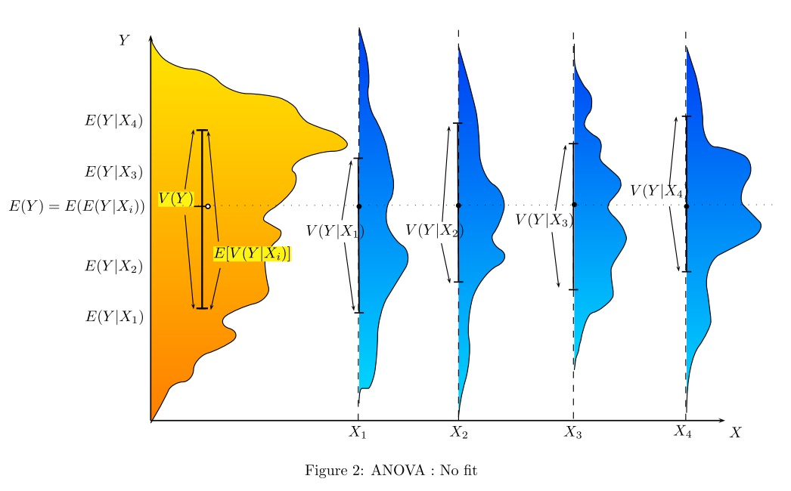
Example: Dog Weights @ Dog Show
Y = weights. X = (young, old) x (short-hair, long-hair).
Why is this a bad grouping?
Notes:
Answer: similar means, large variances between groups.
This involves observed features, could also group using latent features.

Slide 41
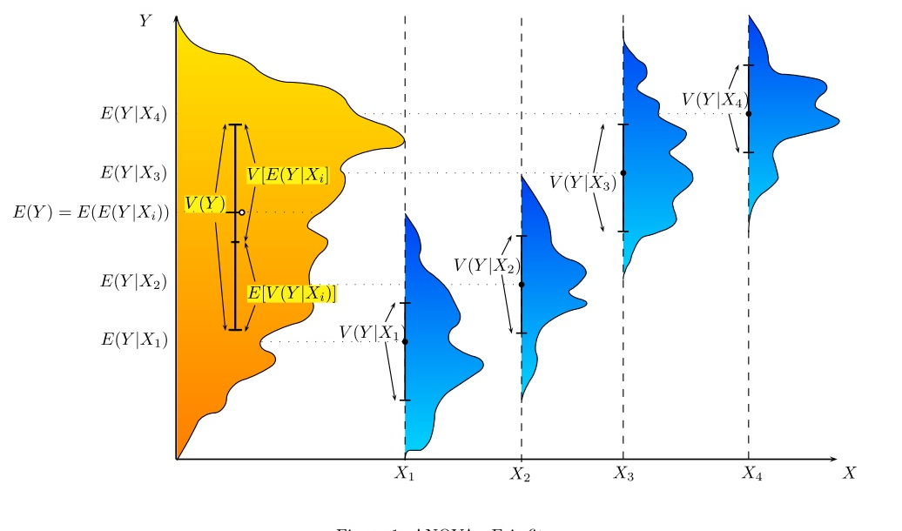
Better Fit
Y = weights. X = (pet, working breed) x (less athletic, more athletic).
Why is this a better grouping?

Slide 42
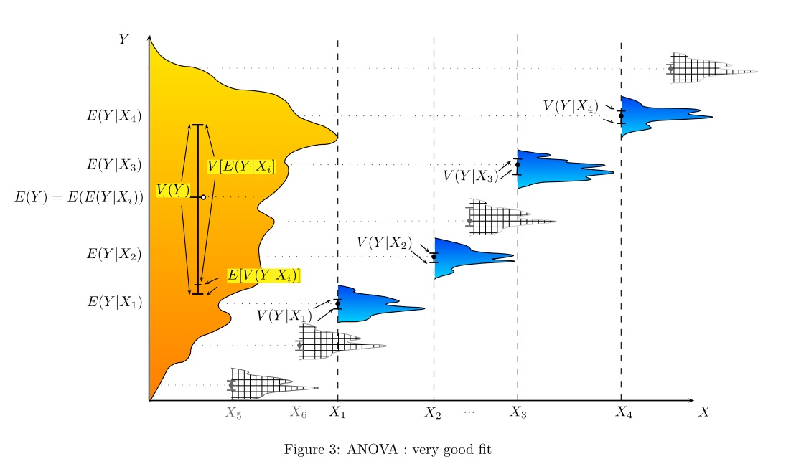
Best Fit
Y = weights. X = breed + merging
Why is this the best grouping?

Slide 43
Learning Latent Features for Latent Groups
The dog show example defined clusters in terms of observed features.
Can also learn unobserved features to define clusters. (How?).
Emphasized by deep learning researchers: latent features provided factored representations of clusters.
Breed
Z
Weight
Weight
Notes:
look at the humps in the yellow part of the picture.

Slide 44
Conclusion
General intuition for latent feature learning: A small set of unobserved features explains correlations among observed features.
Can often think of unobserved features as unobserved causes.
Finding a small set of explanatory features -> dimensionality reduction.
Explanatory = conditional on latent features, observed features are (nearly) independent.
Can visualize as merging feature columns.
Similar ideas for latent group learning (clustering): A small number of groups explains similarities among objects.
Can visualize as merging rows.
Notes:
cognitive science conjecture: the brain has more sophisticated strategies.

