Slide 1
A Crash Course in Reinforcement Learning
Oliver Schulte
Simon Fraser University
CMPT 980
Introduction to Deep Learning
Notes:
emphasis on connections with neural net learning

Slide 2
Outline
What is Reinforcement Learning?
Key Definitions
Key Learning Tasks
Reinforcement Learning Techniques

Slide 3
Overview

Slide 4
Learning To Act
So far: learning to predict
Now: learn to act
  In engineering: control theory
  Economics, operations research: decision and game theory

Slide 5
Examples
Fly stunt manoeuvres in a helicopter
Defeat the world champion at Backgammon, Go
Manage an investment portfolio
Control a power station
Make a humanoid robot walk
Play Starcraft, Atari games better than humans
Drive a car
Play hockey
Notes:
https://deepmind.com/blog/announcements/deepmind-and-blizzard-open-starcraft-ii-ai-research-environment
https://www.newscientist.com/article/2221840-deepminds-starcraft-playing-ai-beats-99-8-per-cent-of-human-gamers/

Slide 6
Differences to classification/regression
There is no supervisor, only a reward signal
  No labels “wrong choice, right choice”
Feedback is delayed, not instantaneous
Sequential, non i.i.d data
Agent’s actions affect the subsequent data it receives

Slide 7
Rl framework
At each step t the agent:
  Executes action A_{t}
  Receives observation O_{t}
  Receives scalar reward R_{t}
The environment:
  Receives action A_{t}
  Emits observation O_{t+1}
  Emits scalar reward R_{t+1}

Slide 8
Acting in Action
Autonomous Helicopter
  An example of imitation learning: start by observing human actions
Learning to play video games
  “Deep Q works best when it lives in the moment”
Learn to flip pancakes
Notes:
https://www.youtube.com/watch?v=VCdxqn0fcnE helicopter
https://www.wired.com/2015/02/google-ai-plays-atari-like-pros/
http://www.youtube.com/watch?v=W_gxLKSsSIE

Slide 9
MARKOV DECISION PROCESSES

Slide 10
Markov Process
Aka Markov Chains
A Markov process moves from one state to another with a certain probability
Transition probability: P(s_{t+1} = s’|s_{t} = s)
RNNs are like (continuous) Markov Processes with hidden States
Demo
Notes:
http://setosa.io/blog/2014/07/26/markov-chains/index.html

Slide 11
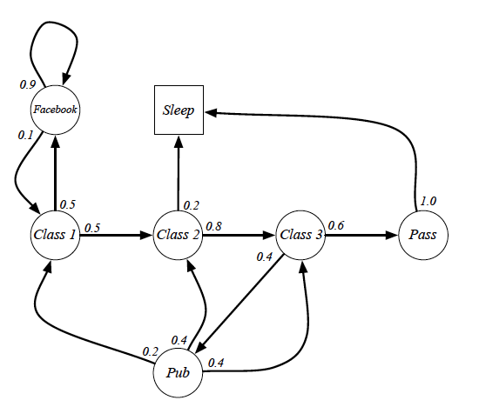
Student Example
Notes:
See file

Slide 12
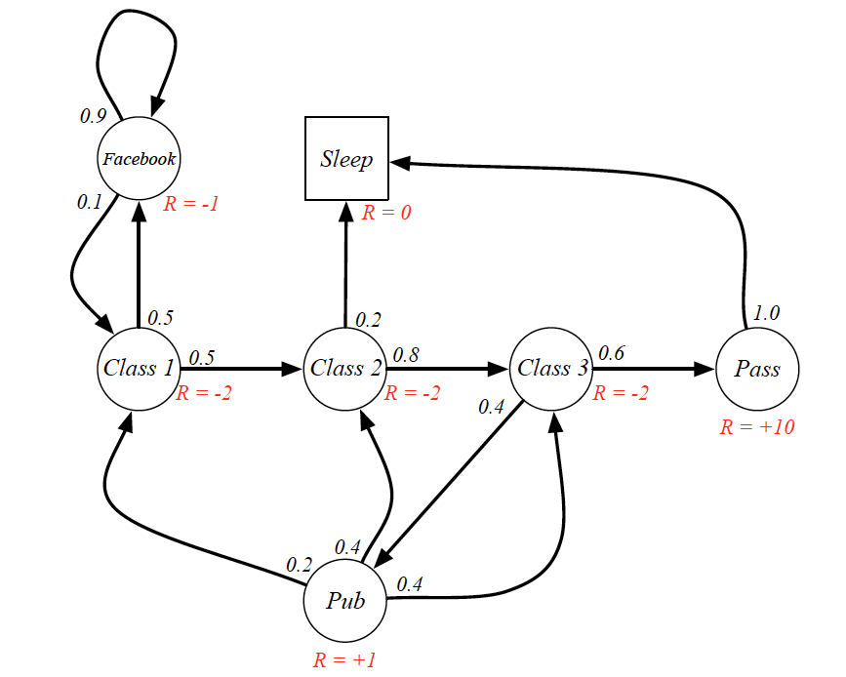
Markov reward process
Markov Process + Reward R_{s} associated with state
Notes:
Can interpret state reward as expected reward from transition

Slide 13
Returns and discounting
A trajectory is a (possibly infinite) sequence
s₀,r₀,s₁,r₁,...,s_{n},r_{n},...
The return is the total sum of rewards.
But: if the trajectory is infinite, we have an infinite sum!
Solution: Weight rewards by discount factor γ between 0 and 1.
Return = r₀+γr₁+γ²r_{n}+...
  Getting rewards sooner is better than later
Notes:
can also interpret as probability of process eding

Slide 14
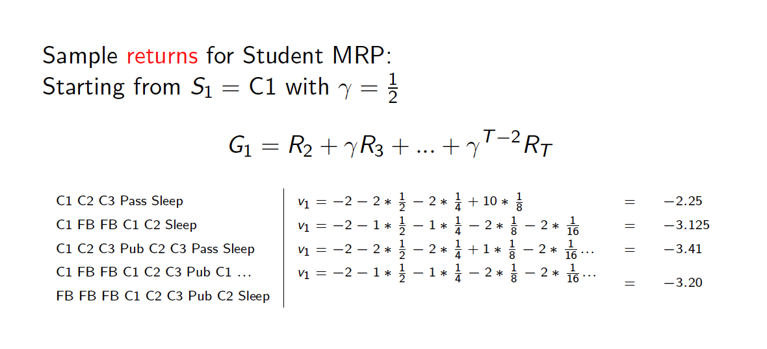
Discounting example

Slide 15
Markov Decision Processes
Markov decision process (MDP) = Markov reward process + actions
Transition probabilities depend on actions
P(s’|s,a)
Rewards depend on actions
R(s,a)
Markov game = MDP with actions, rewards for > 1 agent

Slide 16
example: Student Markov decision Process
Notes:
silver-mpd.pdf
see slide 11 student MRP for interpretation of states

Slide 17
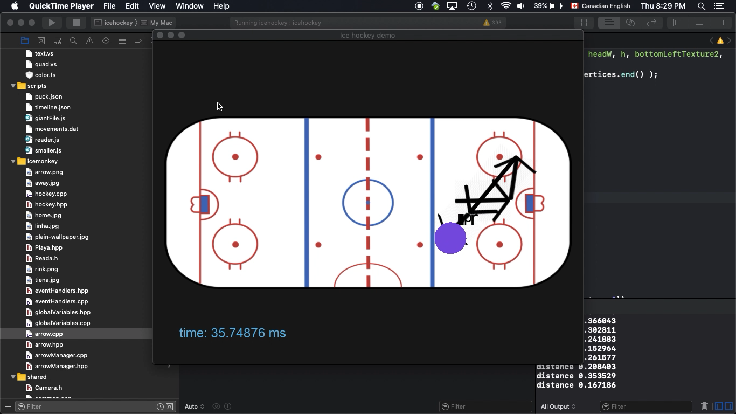
Hockey example
What are the states?
What are the rewards?
Notes:
⁨sfuvault⁩ ▸ ⁨Tien⁩/v03_with_arrow.mov

Slide 18
Factored states
In practice, RL uses a factored representation (see Russell and Norvig).
The state is defined by a list of values for a set of variables.
  E.g. in hockey, can include score, game time, locations of players, location of puck
If we have only 2 integer variables x and y, we can visualize states in a grid world
Notes:
https://cs.stanford.edu/people/karpathy/reinforcejs/gridworld_dp.html

Slide 19
Reinforcement learning algorithms
State Table Representation

Slide 20
RL framework
learning
dynamic programming
Data
Transition Probabilities
Value Function
We will start with model-based approaches.
Define your Markov Decision process model (states, rewards, actions).
Use data to learn state transitions ⇒ fully defined MDP
Use algorithms to solve the MDP
Solving MDP = determine optimal action in every state

Slide 21
Policies
A deterministic policy π is a function that maps states to actions.
  i.e. tells us how to act.
Can also be probabilistic: π(a|s)
Can be implemented using neural nets.
grid world demo

Slide 22
The Value function
Given a policy and an MDP, we have the expected return, over all infinite trajectories, from using the policy at a state.
Notation: V^{π}(s)
Important: this is a powerful look-ahead concept.
  Like searching through an entire search tree for expected success
Game example: chance of winning, expected total score.
Dr. Strange looks ahead
Can also be computed by a neural network
Notes:
https://www.youtube.com/watch?v=eGKPfZTXHsc

Slide 23
Optimal Policies
A policy π* is optimal if for any other policy and for all states s
V^{π*}(s) ≥ V^{π}(s)
The value of the optimal policy is written as V*(s).

Slide 24
The action value function
Given a policy, the expected reward at a state given an action is denoted as Q^{π}(s,a).
Similarly Q*(s,a) for the value of an action given the optimal policy.
grid example
Notes:
Show Mitchell example
http://www.cs.ubc.ca/~poole/demos/mdp/vi.html

Slide 25
RL Concepts
These 3 functions can be computed by neural networks

Slide 26
computing value functions
Bellman Equations

Slide 27
Learning Value functions
learning
dynamic programming
Data
Transition Probabilities
Value Function
Bellmann equation for computing the value function with deterministic transitions
$V^{π}\left(s\right)=R\left(s,π(s)\right)+γ{V^{π}\left(s′\right)}_{}$
grid example
Notes:
make sure this equation displays correctly
Explain: s’ = next state given current action

Slide 28
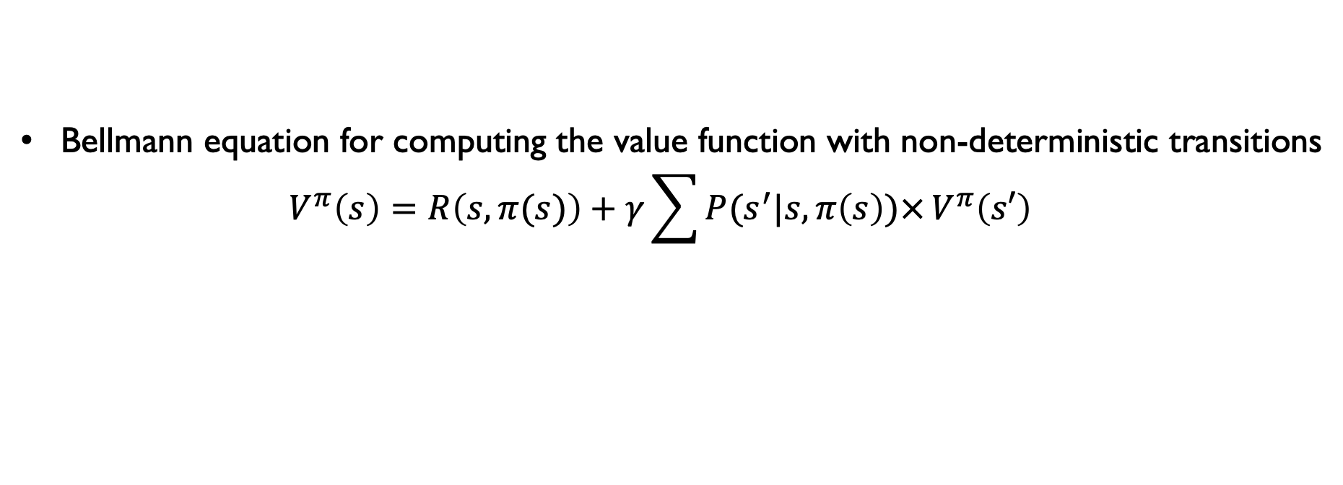
General Bellman Equation
Bellmann equation for computing the value function with non-deterministic transitions
$V^{π}\left(s\right)=R\left(s,π(s)\right)+{γ\sum{P(s^{′}|s,π\left(s\right))×}V^{π}\left(s′\right)}_{}$
How about a general equation for the Q-function?
Developed for transition probabilities that are “nice”
discrete, Gaussian, Poisson,...
Notes:
Solution: Q(s,a) = R(s,a) + \gamma x \sum_{s’} P(s’|s) x V(s’)

Slide 29
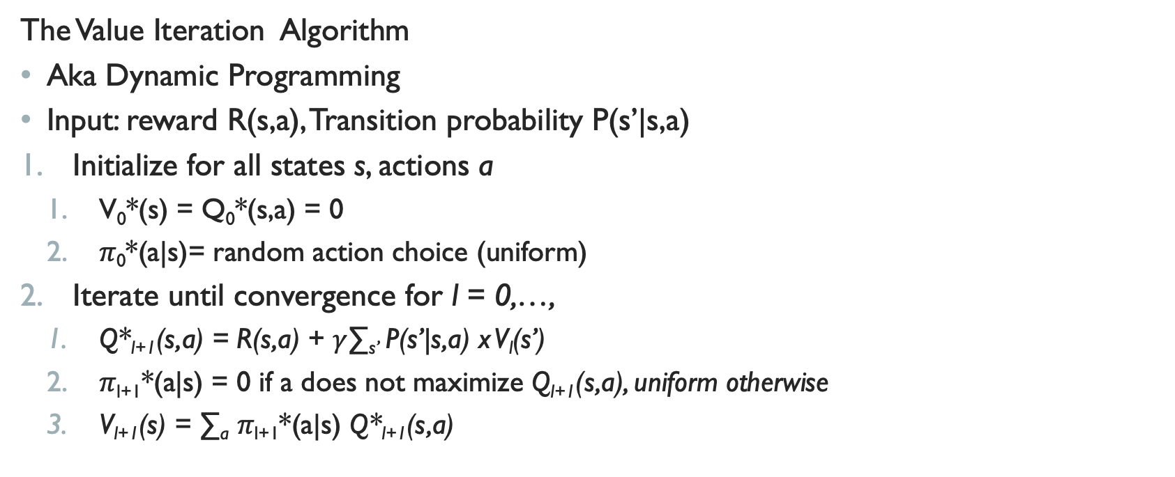
Computing Optimal values and policies
The Value Iteration Algorithm
Aka Dynamic Programming
Input: reward R(s,a), Transition probability P(s’|s,a)
Initialize for all states s, actions a
  V₀*(s) = Q₀*(s,a) = 0
  𝜋₀*(a|s)= random action choice (uniform)
Iterate until convergence for l = 0,…,
  Q*_{l+1}(s,a) = R(s,a) + $γ$∑_{s’} P(s’|s,a) x V_{l}(s’)
  𝜋_{l+1}*(a|s) = 0 if a does not maximize Q_{l+1}(s,a), uniform otherwise
  V_{l+1}(s) = ∑_{a} 𝜋_{l+1}*(a|s) Q*_{l+1}(s,a)
Notes:
Known in business schools
Can choose optimal actions with any probability, even deterministic

Slide 30
Hockey example

Slide 31
Markov Decision Process Model for the National hockey league
7 seasons (2007-2014)
Typical sequence

Slide 32
State space
List of context features +
Events leading up to current state
Ignore locations
Curse of dimensionality: state space grows exponentially with each feature
In NHL model, over 1.3M states
Value iteration can handle this
Notes:
Tough trade-off: features give context and information but blow up state space

Slide 33
Impact Values
Impact(s,a) = Q(s,a) – V(s)
How much does an action improve a teams’ change of scoring?
Correlates with player salary, other metrics

Slide 34
Summary
Reinforcement Learning: learning to act
Adds actions and rewards to a temporal Markov model
Key problems:
  Value Function: Estimate expected future cumulative reward from a given state
  Policy optimization: Find an optimal policy
Discrete MDP:
  Learn transition probabilities
  Compute value functions and optimal policies using value iteration (Bellman equation)

