Slide 1
The Bias-Variance Trade-Off
Oliver Schulte
Notes:
If you use “insert slide number” under “Footer”, that text box only displays the slide number, not the total number of slides. So I use a new textbox for the slide number in the master.
This is a version of “Equity”.

Slide 2
Estimating Generalization Error
The basic problem: Once I’ve built a classifier, how accurate will it be on future test data?
Problem of Induction: It’s hard to make predictions, especially about the future (Yogi Berra).
Cross-validation: clever computation on the training data to predict test performance.
Other variants: jackknife, bootstrapping.
Today: Theoretical insights into generalization performance.
Notes:
building a classifier may involve setting parameters

Slide 3
The Bias-Variance Trade-off
The Short Story:
generalization error = bias² + variance + noise.
Bias and variance typically trade off in relation to model complexity.
Model complexity
-
+
Bias²
Variance
+
+
Error

Slide 4
Dart Example

Slide 5
Analysis Set-up
Learned Model y(x;D)
Random Training Data
Average Squared Difference {y(x;D)-h(x)}²
for fixed input features x.
True Model h
Notes:
show Bayes net analysis from Yuke
Fix input to keep things simple for now.

Slide 6
Notes:
insert Duda and Hart Figure 9.4. maybe try tiff.
see also ParametLearningStat.xls
Legend: red g(x): learned. black F(x) = truth.
poor model, fixed, high bias, low variance.
better model, also fixed.
cubic model, trained. Lower bias, higher variance. Other extreme.
linear model, trained. Intermedate bias, intermediate variance.

Slide 7
Formal Definitions
E[{y(x;D)-h(x)}²] = average squared error (over random training sets).
E[y(x;D)] = average prediction
E[y(x;D)] - h(x) = bias = average prediction vs. true value =
E[{y(x;D) - E[y(x;D)]}²] = variance= average squared diff between average prediction and true value.
Theorem
average squared error = bias² + variance
For set of input features x₁,..,x_{n}, take average squared error for each x_{i}.
Notes:
Go back to example from Duda and Hart.

Slide 8
Bias-Variance Decomposition for Observed Target Values
Observed Target Value t(x) = h(x) + noise.
Can do the same analysis for t(x) rather than h(x).
Result: average squared prediction error =
bias² + variance+ average noise
Notes:
insert Bishop’s figure
As we increase the trade-off parameter, we overfit less, so bias goes up and variance goes down.
make sure the figure works on the notebook.

Slide 9
Training Error and Cross-Validation
Suppose we use the training error to estimate the difference between the true model prediction and the learned model prediction.
The training error is downward biased: on average it underestimates the generalization error.
Cross-validation is nearly unbiased; it slightly overestimates the generalization error.
Notes:
the average difference over datasets, between training error and average generalization error.

Slide 10
Classification
Can do bias-variance analysis for classifiers as well.
General principle: variance dominates bias.
Very roughly, this is because we only need to make a discrete decision rather than get an exact value.
Notes:
(not in Bishop; see Duda and Hart)

Slide 11
Classification
Notes:
Legend. a) full Gaussian model, trained. High variance in decision boundaries and in errors.
b) intermediate Gaussian model with diagonal covariance. Lower variance in boundaries and errors.
c) Unit covariance (linear model), decision boundaries do not change much. Higher bias.

Slide 12
Variance and Big Parameters
NNs are models with many parameters
Generally many parameters means
  Low bias
  High variance
Big data reduces variance. Why?
Consider model trained until 0 training error.
  0 bias
  Prediction error entirely due to variance in data
  i.e. is the training data representative of the true model?

Slide 13
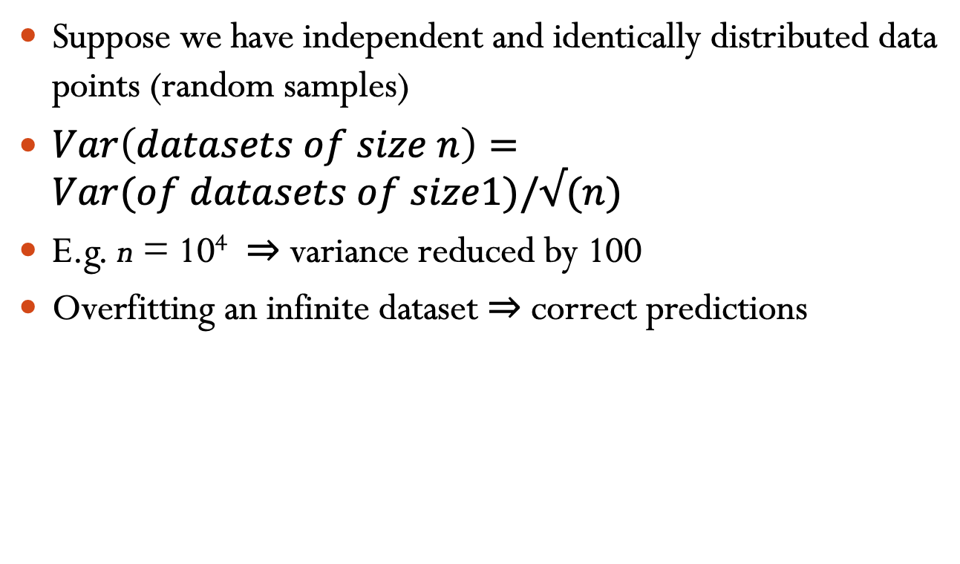
Variance and Big Data
Suppose we have independent and identically distributed data points (random samples)
$Var\left(datasets of size n\right)=Var(of datasets of size1)/√(n)$
E.g. n = 10⁴ ⇒ variance reduced by 100
Overfitting an infinite dataset ⇒ correct predictions

