Slide 1
Learning
CMPT 310
Simon Fraser University
Oliver Schulte
Notes:
If you use “insert slide number” under “Footer”, that text box only displays the slide number, not the total number of slides. So I use a new textbox for the slide number in the master.

Slide 2
The Big Picture: AI for Model-Based Agents
Planning
Decision Theory
Game Theory
Action
Reinforcement Learning
Knowledge
Learning
Logic
Probability
Heuristics
Inference
Machine Learning
Statistics

Slide 3
Motivation
We have seen how to convert knowledge into intelligent action.
Where does the knowledge come from?
Option 1: query experts.
  high quality and useful knowledge
  Significant investment of time and resources.
  Prone to error, needs debugging.
Alternative approach: Learn from examples.
Unifying Vision: Start with “seed rules” from expert, use examples to expand and refine.
Nature and nurture

Slide 4
Overview
Many learning models exist.
Will consider three representative ones that are widely used in AI.
  Learning a decision tree classifier.
  Learning neural networks
  Later: Learning Bayesian networks.

Slide 5
Example: Program By Example
Excel Flash Fill
In AI, it’s often much easier to generate examples of a behaviour than to write a program that generates the behaviour

Slide 6
Decision Tree Classifiers
Notes:
If you use “insert slide number” under “Footer”, that text box only displays the slide number, not the total number of slides. So I use a new textbox for the slide number in the master.

Slide 7
Classification
Predict a single target or class label for an object, given a vector of features.
Conditional probability P(label|features).
Example: predict PlayTennis given 4 other features.
Day | Outlook | Temperature | Humidity | Wind | PlayTennis
1 | sunny | hot | high | weak | no
2 | sunny | hot | high | strong | no
3 | overcast | hot | high | weak | yes
4 | rain | mild | high | weak | yes
5 | rain | cool | normal | weak | yes
6 | rain | cool | normal | strong | no
7 | overcast | cool | normal | strong | yes
8 | sunny | mild | high | weak | no
9 | sunny | cool | normal | weak | yes
10 | rain | mild | normal | weak | yes
11 | sunny | mild | normal | strong | yes
12 | overcast | mild | high | strong | yes
13 | overcast | hot | normal | weak | yes
14 | rain | mild | high | strong | no

Slide 8
Decision Tree
Popular type of classifier. Easy to visualize.
Especially for discrete values, but also for continuous.
Learning: Information Theory.
Notes:
aka classification tree
Use demos to explain DT learning.

Slide 9
Decision Tree Example
Notes:
try aispace demo. Load ‘LikesTV’. Use test new example button.

Slide 10
Exercise
Find a decision tree to represent
A OR B
A AND B
(A AND B) OR (C AND notD AND E).
Bonus: A XOR B.
  A XOR B is true if and only if one of A or B is true, but not both.

Slide 11
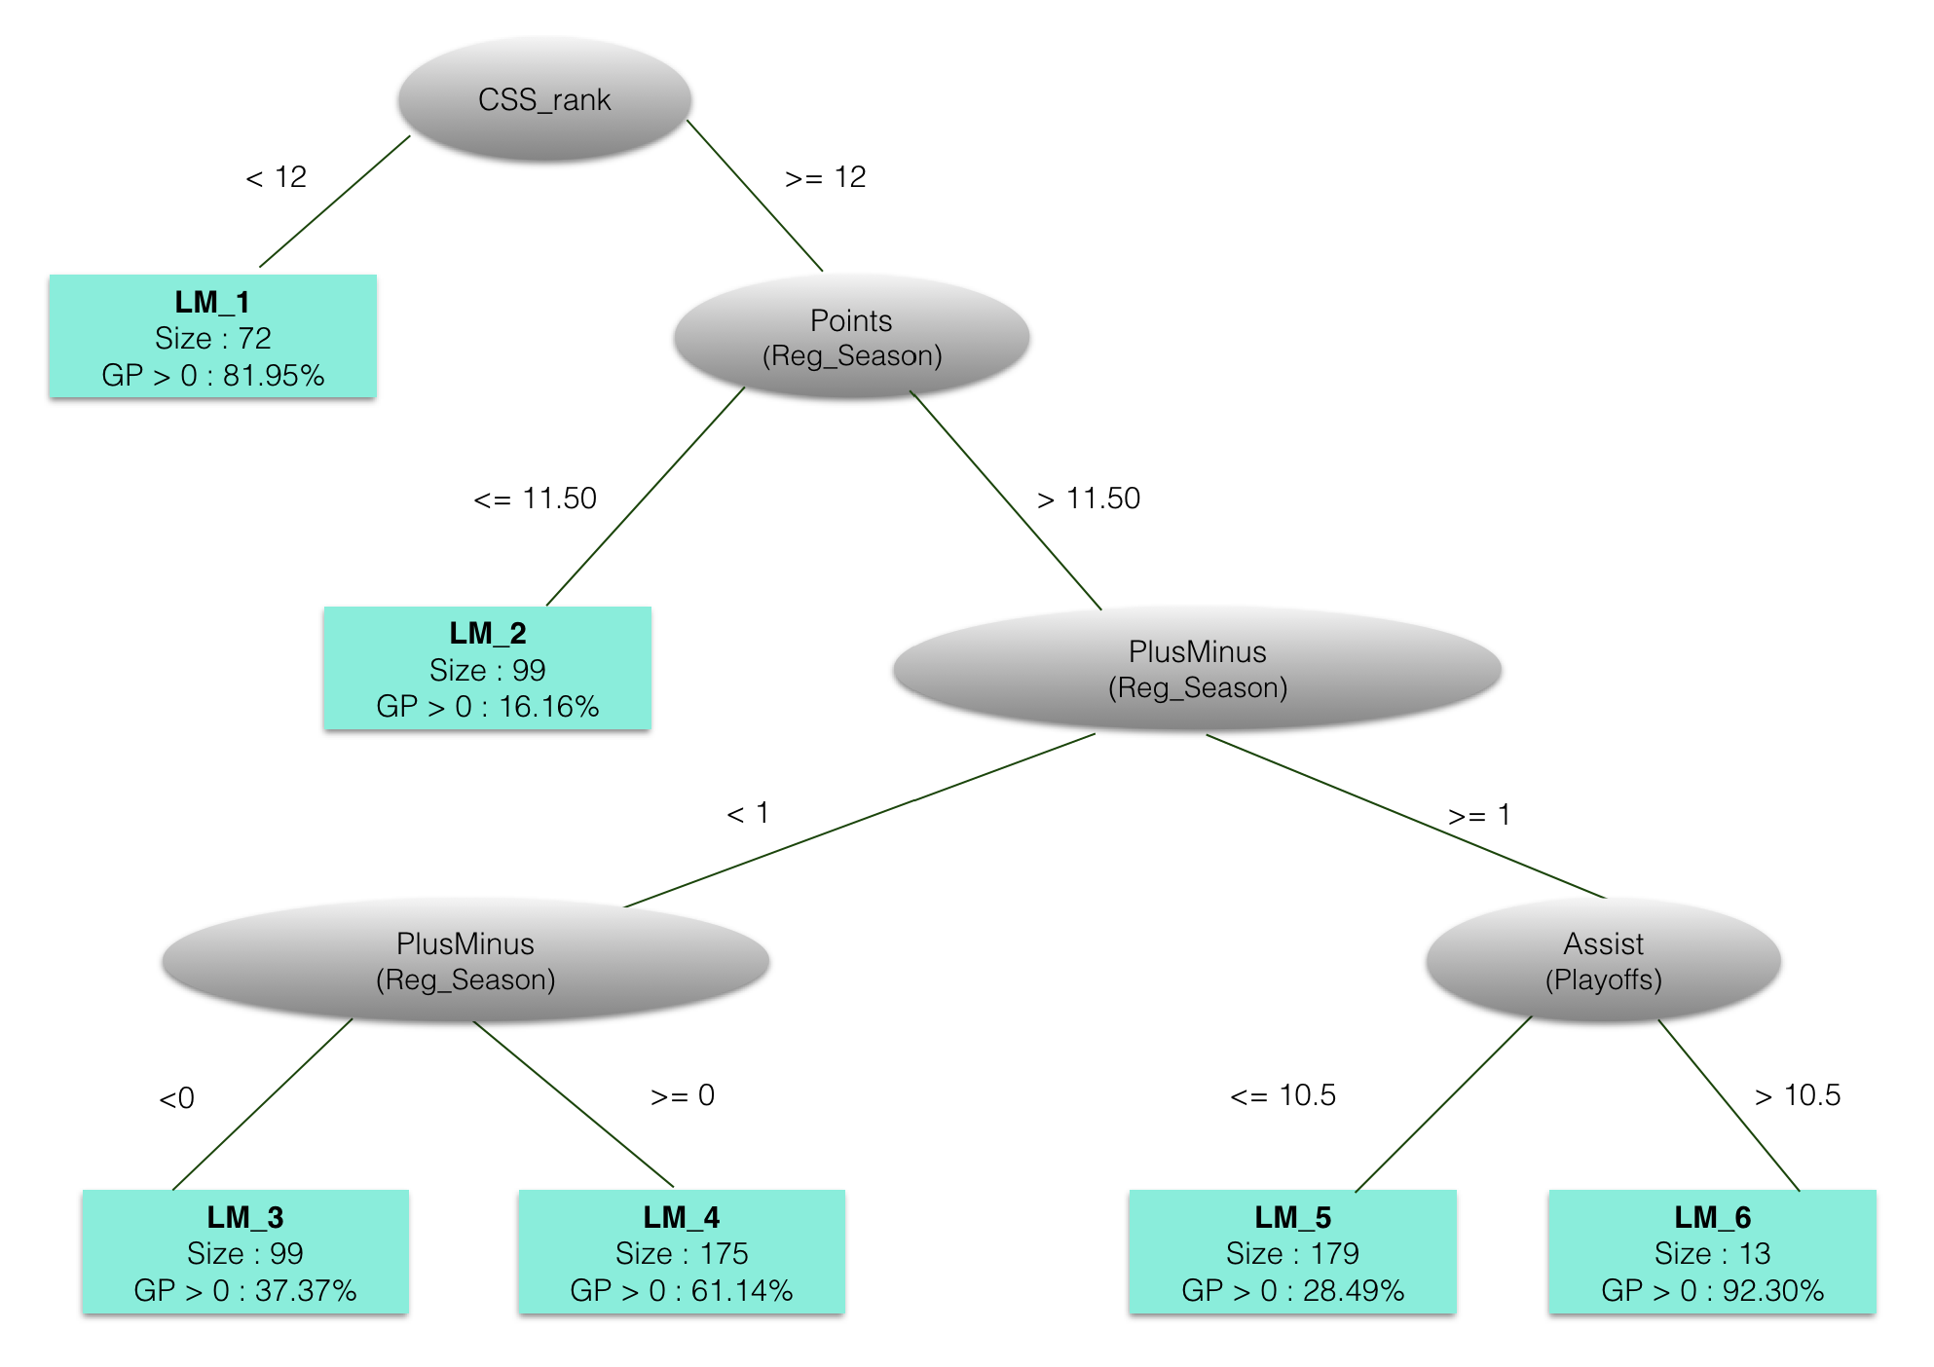
Example: Will a player play in the NHL?
Notes:
see if I can run Weka live

Slide 12
Regression Tree Example: Rate of Reboot Failure
Notes:
Estimates rate lambda of hardware failure at time t.

Slide 13
Decision Tree Learning
Basic Loop:
A := the “best” decision attribute for next node (stump)
For each value of A, create new descendant of node
Assign training examples to leaf nodes
If training examples perfect classified, then STOP.
Else iterate over new leaf nodes.

Slide 14
Entropy

Slide 15
Uncertainty and Probability
The more “balanced” a probability distribution, the less information it conveys (e.g., about class label).
How to quantify?
Information Theory: Entropy = Balance.
S is sample, p₊ is proportion positive, p₋ negative.
Entropy(S) =
-p₊log2(p₊) - p₋log2(p₋)

Slide 16
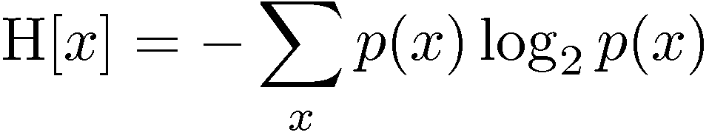
Entropy: General Definition
Important quantity in
  coding theory
  statistical physics
  machine learning

Slide 17
Intuition

Slide 18
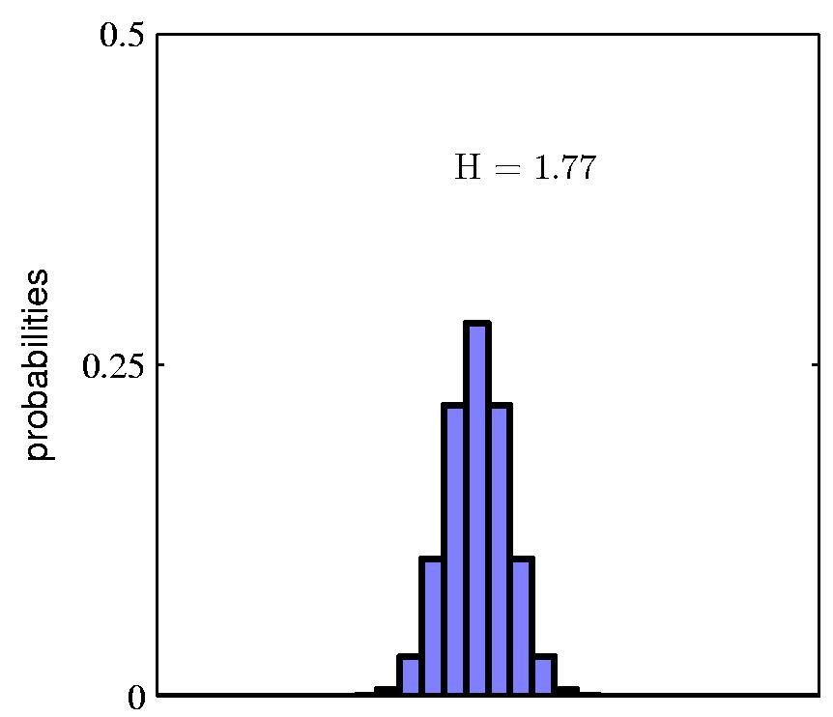
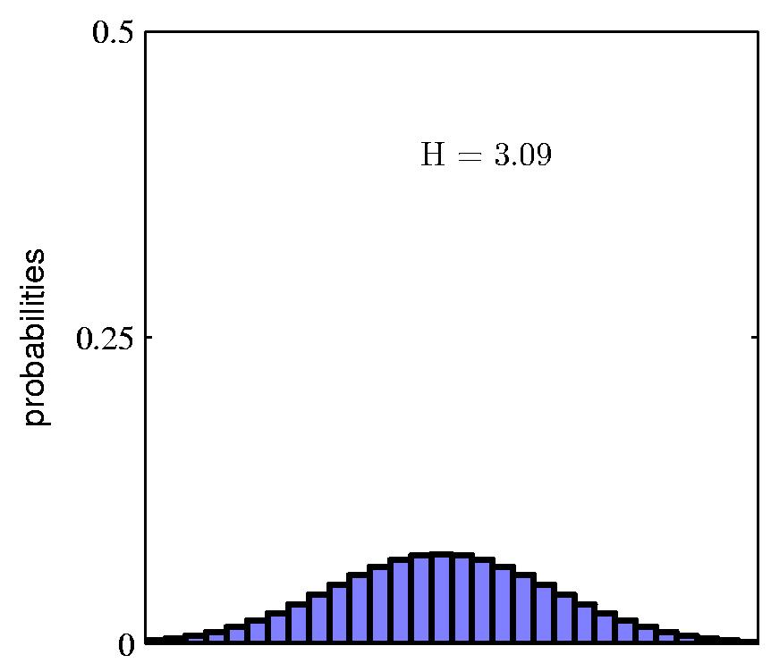
Entropy

Slide 19
Coding Theory
Coding theory: X discrete with 8 possible states (“messages”); how many bits to transmit the state of X?
Shannon information theorem: optimal code length assigns –log₂ p(x) to each “message” X = x.
(But can’t have continuous code lengths, so this is actually a lower bound on achievable expected message length)
If all states equally likely, the best code is:
Assign -log₂(1/8) =3 bits to each state
Entropy H = expected message length =
-8 x 1/8 -log₂(1/8) = 3 bits

Slide 20
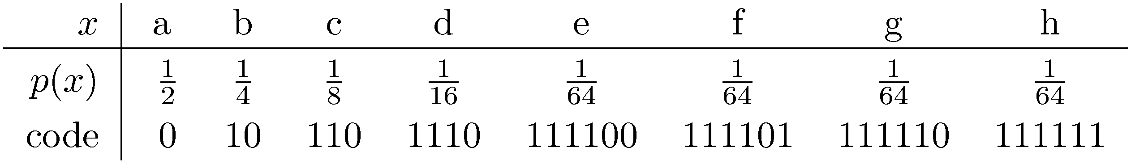
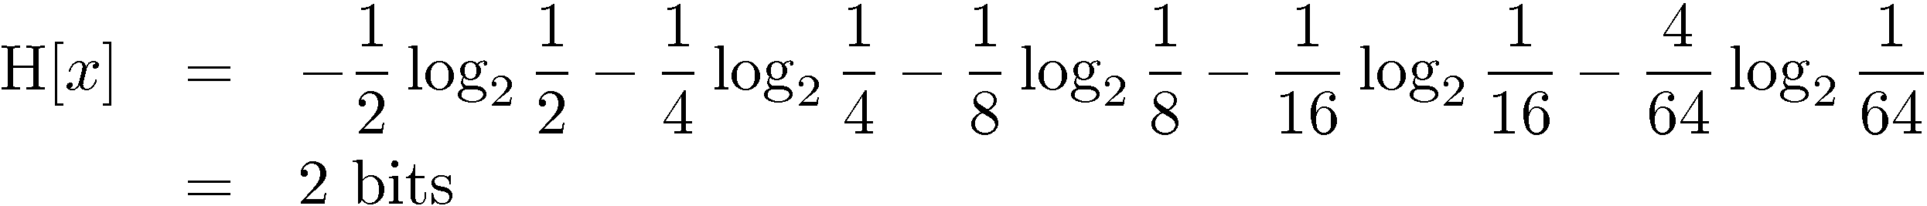
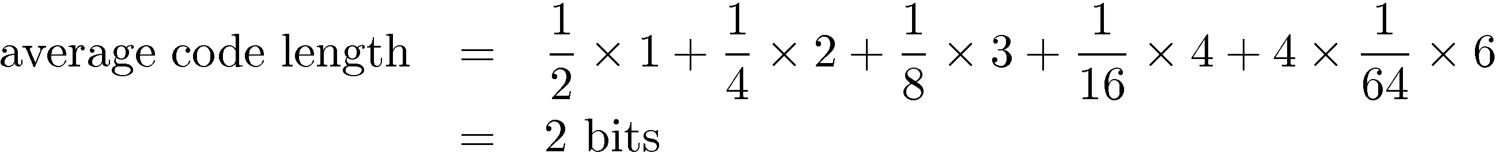
Another Coding Example
Notes:
Assumes no “stop” character between messages, like Huffmann encoding tree.

Slide 21
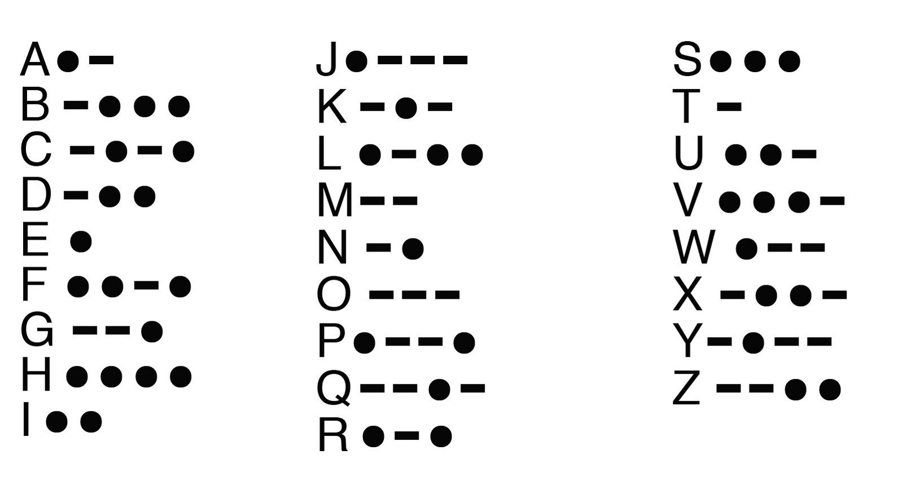
Zipf’s Law
General principle: frequent messages get shorter codes.
  e.g., abbreviations, Morse Code
  Information Compression.
Notes:
Morse Code example. Morse Code has “stop” character.

Slide 22
Information Gain

Slide 23
Splitting Criterion
A new attribute value changes the entropy.
Want to split on attribute that has the greatest reduction in entropy, averaged over its attribute values.
Gain(S,A) = expected reduction in entropy due to splitting on A.

Slide 24
Example
Notes:
gain of humidity is greater

Slide 25
Playtennis Example
Notes:
try id3 in weka, recovers original tree.
do example in LikesTV problem.
select test examples using tool. Show how test error is different from training error.
maybe add final decisoin tree

Slide 26
Decision Tree Learning Options
J48

Slide 27
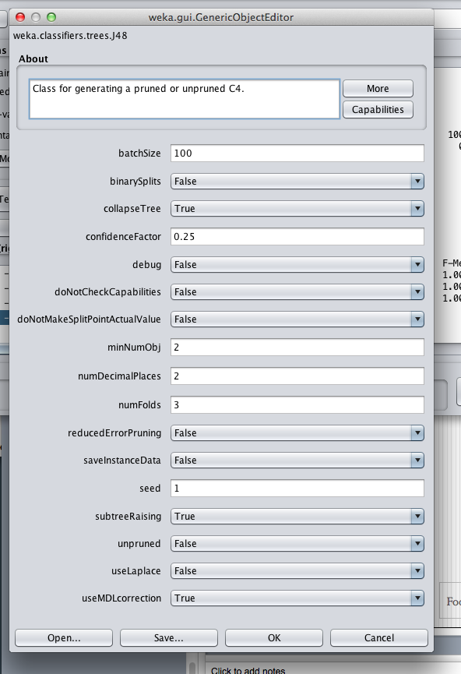
Decision Tree Options in Weka
Notes:
Next: deep learning. pdf is based on svn-projects/My Classes/deep-learning/slides/neural-nets-short.tex

