Slide 1
Making Neural Networks Work
Chapter 6
CMPT 983

Slide 2
Node Classification
General Idea: Train classifier/decoder to predict the class of a node u given its representation z_{u}.
Differentiable classification loss can be backpropagated through decoder to train encoder.

Slide 3
Training/Target Information
An important question is what class information is available about which nodes.
All training nodes are labelled -> standard supervised classification training
Some training nodes are labelled -> semi-supervised transductive learning
  Unlabelled nodes observed during training are called transductive nodes.
Test or inductive nodes can be
  Disjoint from all training nodes
  Connected to labelled training nodes and/or transductive training nodes
  Connected to unobserved unlabelled transductive nodes
  Connected to unobserved labelled nodes
Notes:
Transductive nodes “transfer” information

Slide 4
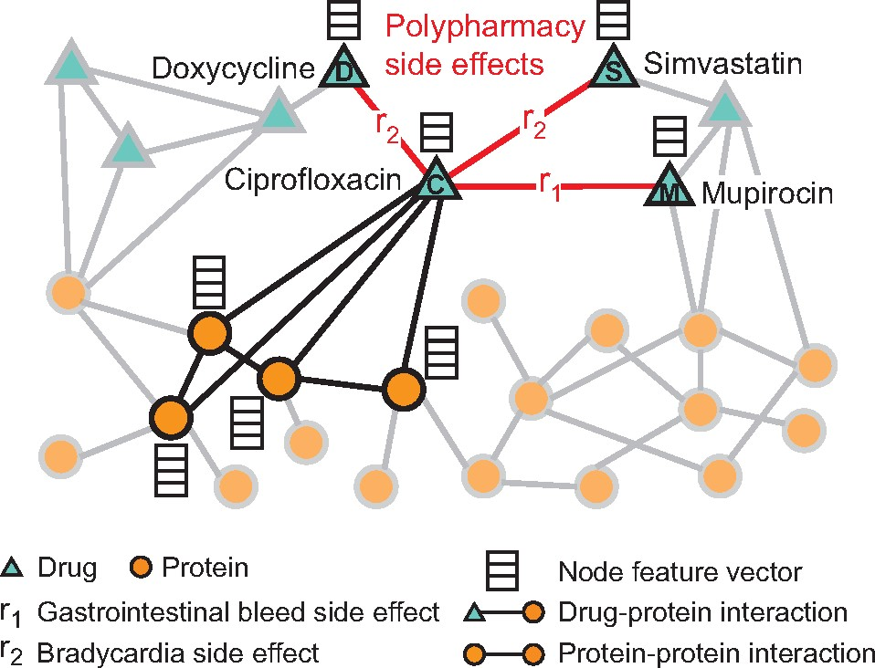
Example of Inductive/Transductive Nodes

Slide 5
Graph Classification and Link Prediction
Given a graph embedding z_{G}, we can use any classifier based on the graph embeddings.
For link prediction we can use the (multi-)relational decoders we studied in Chapter 5.

Slide 6
Mini-Batching and Subsampling
For i.i.d. (non-relational data), minibatching is very helpful to scale gradient descent.
Why is this not easy for GNNs?
Nodes are not independent of each other.
Removing nodes from a node batch also means removing neighbours from the batches in the node.
Possible Approach:
Choose target nodes for computing representations
Include neighbours of target nodes in minibatch
Subsample fixed number of neighbours
Many network sampling schemes exists (subgraph sampling, snowball sampling) could be tried)

Slide 7
Dealing with Many Parameters
Regularization (L2 penalty, dropout)
Parameter sharing: use same parameters for
  each layer
  Gated updates
Edge dropout: randomly remove edges during training

