Slide 1
Embeddings and Encodings
Oliver Schulte
Introduction to Deep Learning 980
Notes:
If you use “insert slide number” under “Footer”, that text box only displays the slide number, not the total number of slides. So I use a new textbox for the slide number in the master.

Slide 2
Outline
Discrete inputs for continuous functions → embeddings
Embeddings can be viewed as learning a kernel – similarity measure among inputs
Map discrete sequence to discrete sequence → encode, decode architecture
How to encode an input sequence

Slide 3
Embeddings

Slide 4
Discrete Values
How can we feed discrete values to a continuous computation?
For Boolean/binary values, can use 1.0 and 0.0
Age
Gender
Votes
Convervative
Variable | Value | number
Gender | female | 1.0
Gender | Male | 0.0
Votes | Yes | 1.0
Votes | No | 0.0
Notes:
Maybe show neural net .jar

Slide 5
Problems With Binary Coding
Within variable: numeric distances are not meaningful
  E.g. the distance between “female” and “male” is not 1
Across variables: numbers look comparable but are not really
  E.g. “Yes” is not as big as “female”
What if we have 3 possible values for a variable?
Variable | Value | number
Gender | female | 1.0
Gender | Male | 0.0
Votes | Yes | 1.0
Votes | No | 0.0

Slide 6
Categorical Variables with > 2 categories
What to do?
Can use binary/one-hot coding for each category
Variable | Value | number
Female | Yes | 1.0
Male | Yes | 1.0
Trans | Yes | 1.0
Female
Male
Votes
Trans
Problems with this approach?
Age
Convervative

Slide 7
Problems with One-Hot Coding
Curse of dimensionality: Number of variables = Number of values
Misses dependencies among new variables
  E.g. Male = 1.0 excludes Female = 1.0
Inherits problems of Boolean coding

Slide 8
Embeddings
An embedding maps an m-dimensional vector to a d-dimensional vector of real numbers
E: R^{m} → R^{d}
Male | Female | Votes | Age
1.0 | 0.0 | 1.0 | 42
original data
embedding
-2 | 4
embedding
Embeddings can keep/increase/decrease original dimensionality

Slide 9
Kernels
A kernel is a similarity metric that takes as input two vectors and returns their similarity measure.
A kernel is “reasonable” if it satisfies a set of straightforward axioms (e.g. symmetry, not covered).

Slide 10
Mercer’s Theorem (1909)
For any reasonable kernel K, there is an embedding E such that K(x,z) = E(x) •E(z).
In words, the embedding maps the kernel to Euclidean dot product (co-sine similarity).
1 | 2 | 3
4 | 5 | 5
1 | 2 | 3
4 | 5 | 5
2 | 0
2 | 2
k = 4
•=4

Slide 11
Neural Nets Learn Embeddings
Neural Nets learn embeddings almost automatically
We can think of neural nets as performing linear classification in embedding space
Convervative
Female
Male
Trans
Age
Votes
Notes:
Maybe show neural.jar

Slide 12
Advantages of Neural Net Embeddings
Can be learned using backpropagation
Learns task-specific similarity tuned to prediction task
  E.g. for unsupervised learning, how to make 2 clusters out of a family with father, mother, son, daughter?
Sometimes the embedding can be used in other tasks
An important example are word embeddings

Slide 13
Word Embeddings
And Other Discrete Entities

Slide 14
Embedding Discrete Entities
A common problem is to make predictions about discrete entities
  Words
  Characters
  Users
  Teams
Approach: construct one-hot vectors, then embed
Notes:
Show website http://mccormickml.com/2016/04/19/word2vec-tutorial-the-skip-gram-model/ to give idea of one-hot vectors

Slide 15
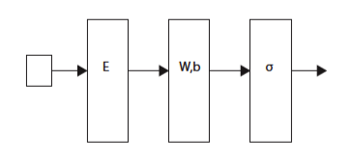
Word Embedding Model
How do we expect embeddings to behave?
Input word
(one-hot)
Embedding
Layer
Process
embedding
Next word (one-hot)

Slide 16
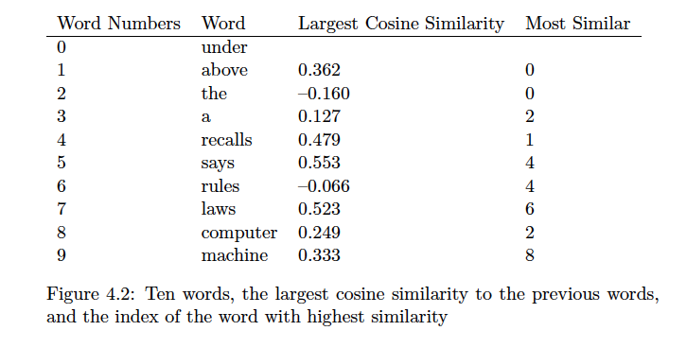
Embeddings and Meanings
Words that co-occur with similar words are mapped to similar embeddings. Demo
  “You shall know a word by the company it keeps”
Why?
Notes:
http://bionlp-www.utu.fi/wv_demo/

Slide 17
Skip-Gram Model
Google built a huge embedding for a news corpus containing over 1 billion words drawn from
Vocabulary size 3M
  So one-hot vectors have dimension 3M.
  Reduce to embedding space dimension 300.
Skip-gram model:
  Input: current word
  Predict members of a neighbourhood around the current word
    Instead of predicting next word as with RNN model
For details see here.
Notes:
https://code.google.com/archive/p/word2vec/
http://mccormickml.com/2016/04/19/word2vec-tutorial-the-skip-gram-model/
Show diagram from tutorial especially “source text”

Slide 18
Embedding Items
The recommendation problem is to predict which item a user will choose/rate highly.
The data is a sequence of item choices by the user
item₁, item₂, …, item_{n}
We can use the skip-gram model to embed items to a common space.
Improves click-through rates:
  9% Yahoo search
  21% Airbnb “similar listings”
See illustration
Notes:
See skip-gram tutorial for details and examples
http://mccormickml.com/2018/06/15/applying-word2vec-to-recommenders-and-advertising/ see music example

Slide 19
Embedding Teams
The data are a sequence of match scores
(team A, team B, 1-0), (team A, team C, 0-2), (team B, team C, 3-0)
The problem: predict the winner of a match (team X, team Y)
A rating is an embedding of teams to the real numbers.
Can generalize to a vector (“rock-paper-scissor” model).
Most sophisticated version is the blade-chest model
Notes:
Give example of Joachims’ paper

Slide 20
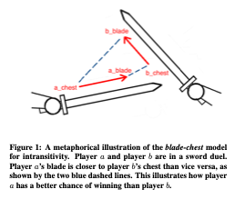
Blade-Chest Model: Illustration

Slide 21
Blade-Chest Model
blade_{X} is a d-dimensional vector measuring the offensive capability of team X
chest_{X} is a d-dimensional vector measuring the defensive capability of team X
Given a match-up of X vs. Y
  Compute (blade_{X} – chest_{Y}).
  Use as feature vector to predict #goals(by X against Y)
  Compute (blade_{Y} – chest_{X})
  Use as feature vector to predict #goals(by Y against X)
  Predict that X wins if and only if
  #goals(by X against Y) > #goals(by Y against X)
Notes:
Maybe make flow diagram

Slide 22
Encoders and Decoders

Slide 23
Sequence-To-Sequence Problems
Recall: An RNN generates an output prediction for each point in the input sequence.
Maps input sequence to output sequence pointwise
But some problems require mapping the entire input sequence to a complete output sequence
Pointwise
prediction
Sequence-to-sequence
Finish processing input

Slide 24
Example: Translation
French | Hansards | Revisé | Numero | 1
English | Revised | Hansards | Number | 1
Need to see “revisé” before translating “Revised”

Slide 25
Encoder/Decoder Architecture
Basic idea:
Summarize or encode input sequence in a vector c
Give c to an RNN that generates the output sequence-the decoder.
A few examples follow

Slide 26
Example: Caption Generation with
CNN Encoding
Demo in pdf
Notes:
Slide 55 in Stanford-rnn-copy

Slide 27
Example: Encoding = Final RNN State
Decoder RNN
Encoder RNN

Slide 28
Example: Encoding = Average RNN state

Slide 29
Example: Pointwise Decoding
Code is input for each generated item

Slide 30
Attention Weights

Slide 31
Attention as Position Weights
Consider again pointwise decoding
For each output position j, input Σ_{i} code(i) where i ranges over input positions
Every input position has equal influence on every output position
But typically earlier inputs are more important for earlier outputs, later inputs for later outputs etc.
Solution: Introduce a weight matrix W[i,j] that measures how important input position i is to output position j

Slide 32
Toy Example
hansards
revise
numero
Matching positions have higher weights
Requires fixed windows to fix positions
1/6
1/6
1/2
hansards
revisé
numero
1
Input/Output | 1 | 2 | 3
1 | 1/2 | 1/6 | 1/6
2 | 1/6 | 1/3 | 1/6
3 | 1/6 | 1/6 | 1/3
4 | 1/6 | 1/6 | 1/3
Notes:
Note that matching positions get the most weight

Slide 33
Example with Learned Weights
French-to-English with a 13*13 window
Note that positive weights are largest for matching positions
Notes:
But what’s up with the large negative weights for prior positions?
Also the -33 must be a typo

Slide 34
Conclusion
Embeddings map discrete values/entities to a real-valued vector
  Can be processed by neural networks
  Dot product represents similarity (kernel) in original space
Encoder: maps a sequence to a real-valued vector
Decoder: maps a real-valued vector to a sequence
The encoder/decoder architecture can perform a sequence-to-sequence mapping
  Often combines embeddings with recurrent neural networks

