Slide 1
A Crash Course in Deep Reinforcement Learning
Oliver Schulte
Simon Fraser University
CMPT 980
Introduction to Deep Learning
Notes:
emphasis on connections with neural net learning

Slide 2
Outline
Reinforcement Learning as Function Learning
Deep RL using Episodes
Monte Carlo Learning
Temporal Difference Learning
Policy Gradient
Actor-Critic

Slide 3
Reinforcement learning as function learning

Slide 4
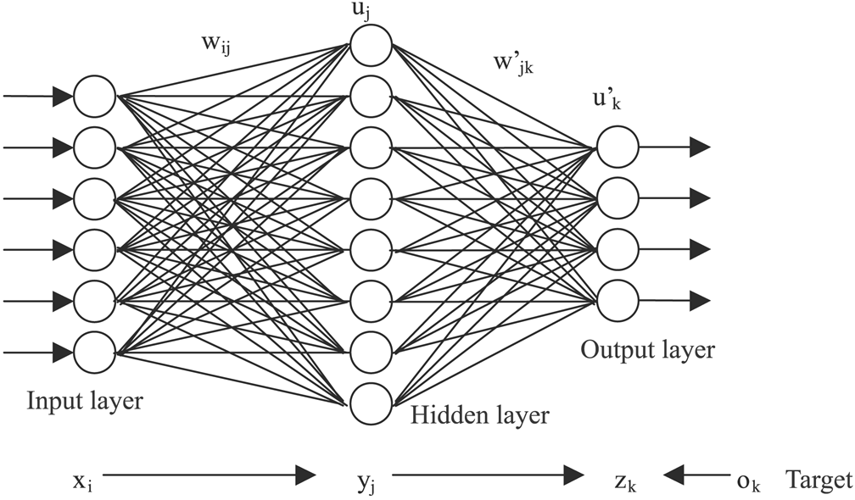
State-based functions
RL goal is to learn functions that map states to outputs
Tabular/grid representation: 1 row per state
Factored representation: state = list of features
Neural net: #of features = #input nodes
State | Action | V(s) | Q(s, a)
S1 | A1 | 0.345 | 0.012
V(S1)
S1
Q(S1, A1)

Slide 5
Review: RL Concepts
These 3 functions can be computed by neural networks

Slide 6
When to use function approximators?
State space is too large to handle by tabular representation
E.g. #possible chess positions > #atoms in the universe
Curse of dimensionality: linearly more features→ exponentially more states
States/actions are continuous
E.g. location, time in sports
Choose location, speed in puckworld

Slide 7
Examples

Slide 8
Games
Board Games: input position of pieces
TD-Gammon for backgammon
Also chess, checkers
Video Games: input (sequence of) video frames
Use CNN, maybe combined with LSTM
Starcraft

Slide 9
Example: Alpha* games
data generated by self-play
Neural net outputs 2 quantities
V(s), the win rate from a position
P(a|s): vector of move probabilities
more promising moves should have higher probability
Like node ordering in tree search
To play, performs a (Monte Carlo) tree search using the neural net output
Watch the alphago movie

Slide 10
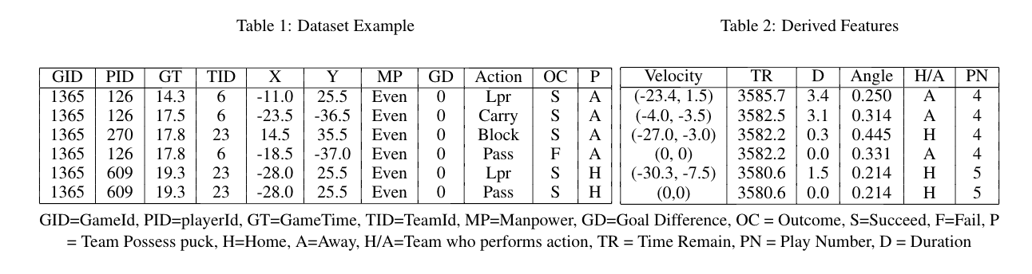
Ice Hockey examples
I’ve done quite a lot of work applying RL to ice hockey
Using millions of events from NHL games

Slide 11
Pipeline
Computer Vision Techniques:
Video tracking
Play-by-play Dataset
Large-scale Machine Learning
Notes:
With the advanced of computer vision techniques,
We can extract feature from professional as video
Lots of sport league, NBA, NHL…
A massive play-by-play data
Increasingly opportunity apply large scale machine learning to analyze game or player
Guide the team to draft or trade the player, with the large player market

Slide 12
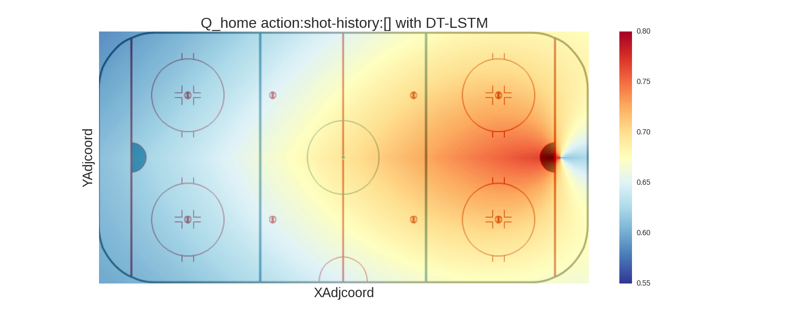
Spatial Projection
Q-value for the action “shot” action over the rink.

Slide 13
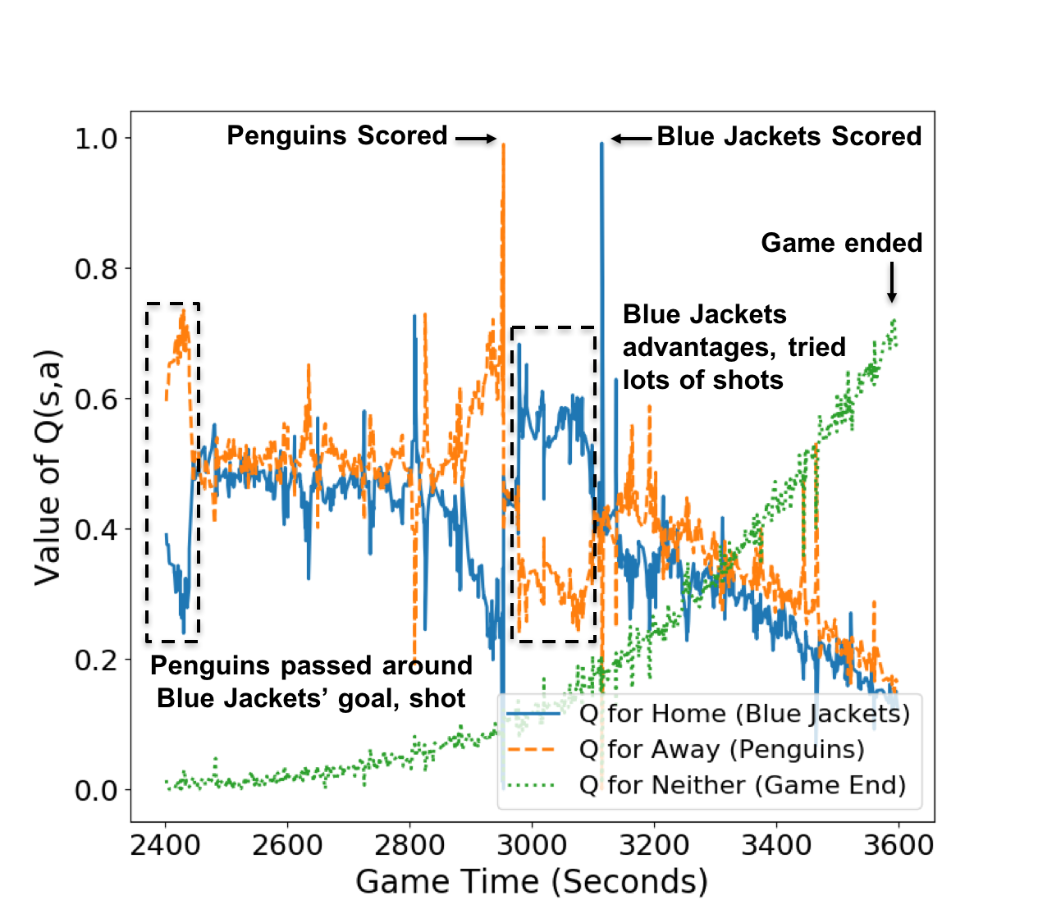
Value Ticker: Temporal Projection
Q(s, a)
Game Time
Notes:
Temporal projection of third period of a random game, X-axis: game time, Y-axis: Q values, mark the important events
(1) Spike means score, game end, (2) Q neither increase while the other two decreases

Slide 14
Model-Free Learning

Slide 15
The problem with transition probabilities
Value iteration computes value functions, policy given transition probabilities
In continuous/massive state spaces, working with transition probabilities is hard. Why?
Each transition occurs only once in data → cannot estimate probability
Cannot represent in matrix
Cannot sum over all states, actions (recall Bellman equation)

Slide 16
Learning without transition probabilities
”model-free” learning = no transition probabilities
Unfortunate term, because we use a NN model to do “model-free” RL
Learn target function directly from episodes
People who know Markov decision processes but not reinforcement learning don’t know about this
The main problem: what is the loss function?
No supervision signal
Notes:
(e.g. business school faculty)

Slide 17
episodes
A transition is a 5-item sequence s,a,r,s’,a’
An episode is a sequence of transitions s₀,a₀,r₁,s₁,a₁…,s_{n-1},a_{n-1},r_{n}
At every time t, we denote the episode return or (discounted) sum of future rewards as v_{t}.
Examples:
Sports: each game is an episode. At each time t in the game, the return v_{t} specifies whether the team won or lost.
Tennis: each match is broken into set episodes which are broken into point episodes
Degree: each course is broken into components.
The return v_{t} specifies learning outcomes/grade at the end of course.

Slide 18
Driving home example
State | Elapsed Minutes | v_{t}: future time | Elapsed Minutes | v_{t}: future time
leaving office | 0 | 43 | 0 | 44
reach car, raining | 5 | 38 | 5 | 39
exit highway | 20 | 23 | 22 | 22
behind truck | 30 | 13 | 31 | 13
home street | 40 | 3 | 41 | 3
arrive home | 43 | 0 | 44 | 0
Could have different states/actions in different episodes
E.g. some days no rain

Slide 19
Monte carlo learning
Regression approach

Slide 20
Regression approach
Start with a dataset of episodes
For every observed state s_{t}, make the return v_{t} the target.
Train a model to predict (the expected value of) v_{t} given s_{t} as input.

Slide 21
Regression Approach: Example
State = X | v_{t} = Y
leaving office | 43
reach car, raining | 38
exit highway | 23
behind truck | 13
home street | 3
arrive home | 0
leaving office | 44
reach car, raining | 39
exit highway | 22
behind truck | 13
home street | 3
arrive home | 0
Regression: Predict Y given X
People who know machine learning but not reinforcement learning use this approach
Sports examples:
How to serve in volleyball
Valuing Actions by Estimating Probabilities in soccer
Main Problem: regression methods assume i.i.d data
But subsequent states have highly correlated return values
Slow learning

Slide 22
Temporal difference learning

Slide 23
TD Learning
A key idea in CS RL, used in almost all RL AI systems
Key intuition: compare 2 estimates
Current return estimate V(s_{t})
Return estimate from look ahead 1 time step: r_{t+1} + γV(s_{t+1})
TD-error for NN gradient = [r_{t+1} + γV(s_{t+1}) - V(s_{t})]²
Can be generalized to look-ahead multiple time steps

Slide 24
example
State | Elapsed Minutes total | Current Elapsed Minutes | Predicted Time to Go | TD-target | TD-error
leaving office | 0 | 0 | 30 | 5+35 = 40 | (40-30)²=100
reach car, raining | 5 | 5 | 35 | 15+15 = 30 | (30-35)² = 25
exit highway | 20 | 15 | 15 | 10+10 = 20 | (20-15)²=25
behind truck | 30 | 10 | 10 | 10+3 = 13 | (13-10)²=9
home street | 40 | 10 | 3 | 3+0 = 3 | (3-3)²=0
arrive home | 43 | 3 | 0

Slide 25
example
State | Elapsed Minutes | Predicted Time to Go | Predicted Total Time | TD-target | TD-error
leaving office | 0 | 30 | 30 | 40 | (40-30)²=100
reach car, raining | 5 | 35 | 40 | 35 | (35-40)² = 25
exit highway | 20 | 15 | 35 | 40 | (40-35)²=25
behind truck | 30 | 10 | 40 | 43 | (43-40)²=9
home street | 40 | 3 | 43 | 43 | (43-43)²=0
arrive home | 43 | 0 | 43

Slide 26
TD vs. MC (regression)
TD Pros
Exploits temporal dependencies rather than ignoring them
Can start learning before end of episode
Deep versions converge faster than MC
Technically: TD has lower variance, higher bias
Notes:
- Important for on-line learning

Slide 27
Policy Learning

Slide 28
Policy learning
A policy maps a state to a distribution over a finite set of actions
Like multi-class learning
Can be represented in a NN
What is the objective function?

Slide 29
Policy gradient
Policy gradient uses an objective function with tractable gradient
Based on expected value 𝜋(a|s) x v_{t}(s_{t},a_{t}) where v_{t}(s_{t},a_{t}) is the observed episode return as in Monte Carlo learning

Slide 30
Actor-Critic
Policy gradient based on expected value 𝜋(a|s) x Q_{t}(s_{t},a_{t})
Q_{t}(s_{t},a_{t}) is a value function estimated by the critic
Typically using TD-learning
Advantage Actor-Critic
replace Q_{t}(s_{t},a_{t}) by Q_{t}(s_{t},a_{t}) – V_{t}(s_{t}) = ”advantage”/impact
Advantage values have lower variance than Q values →easier to learn
Current state of the art
Notes:
Intuition: actor cannot influence V(st).

Slide 31
Summary
Reinforcement learning aims to learn various key functions
Value function, policy
Can be naturally implemented as neural networks
In large/infinite state spaces, need model-free learning
Learning techniques for value functions
Monte-Carlo: reduce to regression
Temporal difference: make different value estimates at different times consistent with each other

