Slide 1

Unsupervised Learning
Oliver Schulte
School of Computing Science
Simon Fraser University
Introduction to Deep Learning

Slide 2
Overview
Unsupervised Learning: No label is given
Tasks:
Generate Data
Component Analysis
Learning Latent Features (Basis Functions)
Reduce Dimensionality: merge correlated columns
Methods
Auto-Encoder Neural Networks
Principal component analysis
Convolutional Auto-Encoder
Variational Auto-Encoder

Slide 3
Unsupervised Learning and Embeddings
In many settings we are not given labels for observed data
E.g. text and videos on-line
It is still possible and useful to learn embeddings = latent features
Dimensionality reduction
Eliminate redundancies among features.
Can help with missing data.
Generate instances
E.g. generate text, generate images
Support downstream supervised learning

Slide 4
Unsupervised Latent Feature Learning: Motivation
Discover new features/basis functions
Dimensionality reduction.

Slide 5
Component Analysis

Slide 6

Intuition
Many high-dimensional data are generated from a few unobserved settings
Example: Digit Rotation
Take a single 3 in a 28x28 = 784 pixel image.
Make new 3s by
Rotating through an angle c1
Shifting up or down c2
Every new 3 can be represented by two numbers (c1,c2).
Much less than 784!
Notes:
Illustrates general idea: if we find the right basis, data can be represented as k numbers using the basis vectors.

Slide 7
Intuitive Examples
Sun rose at 6 am each day this week.
Position of Sun, Earth, Earth Rotation
Sunrise 1
Sunrise 2
Sunrise 3
Student’s marks are explained by their knowledge.
Knowledge
Mark 1
Mark 2
Mark 3
Mark 4
Mark 5
Mark 6
Notes:
notice the flow of inference: from sunrise 1, infer the hidden parameters, then can predict sunrise 2.
The brain does this all the time. E.g.: run into same person at party 3 times.

Slide 8
Source Separation
Source Separation Demo
In a noisy room, two microphones produce a combined signal.
Can you reconstruct the component signals from the combined signal?
Netflix ratings: Mum, Dad, Adriana and Marina all rate movies on one account. Can Netflix tell which ratings came from which person?
Notes:
https://www.youtube.com/watch?v=Qr74sM7oqQc&feature=related

Slide 9
Hierarchical Version
Z
Knowledge
Effort
Mark 1
Mark 2
Mark 3
Mark 4
Latent variables at layer 1 explain correlations among observed variables.
Latent variables at layer 2 explain correlations among latent variables at layer 1.
This is the basic idea of a deep belief network.
Also convolutional neural network

Slide 10
Cognitive Science
The brain infers latent structure all the time.
Example: from retina activation (rods and cones), infer 3-D scene in front of me.
Notes:
seems to be hierarchical model. people in deep learning think about this.

Slide 11
From Observed to Unobserved
Skeptical Question:
How can we learn about what is unobserved from what is observed?
Identifiability?
Answer: We need assumptions about the relationship between observed and unobserved features.
Observed Features
X1
X 2
X 3
Assumptions
Z1
Z2
Unobserved/Latent Features
Notes:
Psychology: from manifest to latent
Duda and Hart discuss identifiability.

Slide 12
Assumptions for Learning Latent Structure

Slide 13
Assumption 1: The Common Cause Principle

Slide 14
Reichenbach’s Common Cause Principle (1956)
“Every correlation can be explained by a direct causal connection or a common cause.”
Stanford Encyclopaedia
Notes:
The brain seems to do this too, we don’t believe in consequences.
The common cause may be unobserved.

Slide 15
Graphical Models Version
Assumption: If we see a correlation between two variables X,Y, then the world works like this:
X
Y
or like this
Z
or maybe like this
Z
X
Y
X
Y
Terminology: Z is a cause, component, factor.

Slide 16
Statistical Consequences
Question: What independence relations are entailed by the Bayes net below?
Z
X1
X 2
X 3
Answer: Conditional on latent feature, observed features are independent.
Informally, Z explains the correlations among X1,X2, X3.
Notes:
this defines the type of graphical model you look for. This is the key picture: given k unobserved causes, the data lie on a k-dimensional manifold. The brain seems to assume that the world has somethign like this structure. Plus it adds a set of priors on the exact form of the conditional dependence. PCA can also be modelled this way.

Slide 17
Multiple Common Causes
Knowledge
Effort
Mark 1
Mark 2
Mark 3
Mark 4
note the similarity to the topology of a feedforward neural net
Notes:
in the extreme case, as many components as observed variables -> not interesting.

Slide 18
Assumption 2: Low-Dimensionality

Slide 19
Latent Feature Dimensionality
Assumption: The number of unobserved components m is much less than the number n of observed variables.
The number of latent dimensions m can be specified by the user, or learned.
Knowledge
Effort
Mark 1
Mark 2
Mark 3
Mark 4
Notes:
Two in this example.

Slide 20
More Examples
Video Game Screen: 4000 pixels (say) determined by two variables (joystick position, button pressed).
position
button
Pixed 1
Pixel 2
…
Pixel 1999
Pixel 2000
The Big 5 in Psychology. Personality Types can be explained by 5 basic traits.
Openness
conscientiousness
extraversion
agreeableness
neuroticism
Answer 1
Answer 2
…
Answer 99
Answer 100
Notes:
Answers on personality questionnaire.

Slide 21
Consequence: Dimensionality Reduction
If a tuple of n observed feature values is well predicted by m latent features, we can represent the n-tuple instead by a m-tuple, without (much) loss of information.
The data lie on a m-dimensional manifold.
Latent feature learning can be used to reduce the data dimensionality.
Video Game example: instead of specifying all 2000 pixels, specify (position of joystick, button pressed).
From 2 numbers we can reconstruct 2000.
Notes:
Explain manifold concept.
But in manifold, we have a 1-1 bicontinuous mapping between observed states and latent states. Can we get the same for statistical models?

Slide 23
Learning Methods

Slide 24
Dimensionality Reduction

Slide 25
The curse of dimensionality
Scaling standard ML methods to high-dimensional feature spaces is hard, both computationally and statistically.
Statistics: data do not cover space.
Computation: local minima for parameter optimization.
Latent feature learning can be used to reduce the data dimensionality.
Alternative: learn to directly map the n observed features to m features with minimum loss of information.
Dimensionality reduction merges columns.
Clustering merges rows.

Slide 26
Dimensionality Reduction Techniques
Day | Outlook | Temperature | Humidity | Wind | PlayTennis
1 | sunny | hot | high | weak | no
2 | sunny | hot | high | strong | no
3 | overcast | hot | high | weak | yes
4 | rain | mild | high | weak | yes
5 | rain | cool | normal | weak | yes
6 | rain | cool | normal | strong | no
7 | overcast | cool | normal | strong | yes
8 | sunny | mild | high | weak | no
Can often by visualized as merging columns.
Discrete features: use Boolean combinations.
E.g. merge Temperature and Humidity into one feature.
PCA (continuous) use linear combinations to merge features.
Factor analysis: merge highly correlated features.
Deep learning: non-linear combinations of features.
Notes:
Self-organizing maps: directly try to map m-D data points to k-D data points such that closeness is preserved.

Slide 27
Assumption 3: Linearity

Slide 28
Neural net Auto-Encoders

Slide 29
Auto-Association
An auto-associative neural net has just as many input units as output units.
The error is the squared difference between input unit x_{i} and output unit o_{i}.
Backpropagation trains the network to recreate the input.
The hidden layer maps n input values to m hidden node output values.
If n<m➔ dimensionality reduction!
output = 2.5 error = 0.5 x 0.5
input = 2.0
n
n
input = 1.0
output = 1.0 error = 0
bottleneck

Slide 30
Deep Auto-Encoders
With more than one hidden layer, auto-encoders perform non-linear dimensionality reduction.
n
bottleneck
n

Slide 31
Principal Component Analysis
Linear Algebra View

Slide 32
Principal Component Assumption
Observed Features are linear combinations of latent features.
Plus some noise.
Z
a
b
c
X1
X 2
X 3
X1 = a Z + ε
X2 = b Z +ε
X3 = c Z +ε

Slide 33
Principal Component Analysis
Given number m of principal components, relatively easy to find optimal latent features.
Columns are linear combinations of each other (neglecting noise), e.g.
X1 = a Z and X2 = b Z implies X2 = b/a X1.
There is a closed-form solution for finding the set of optimal components with minimal reconstruction error.
PCA notebook demo
Theorem A neural net with the architecture input-bottleneck-output computes the same components as PCA
Auto-encoders show similar behaviour to PCA

Slide 34
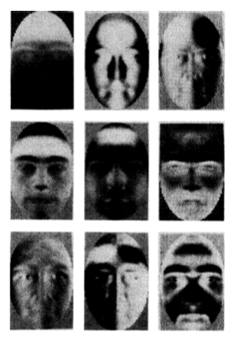
Eigenfaces
http://en.wikipedia.org/wiki/Eigenface
Regular human faces are reconstructed as linear combinations of the eigenfaces

Slide 35
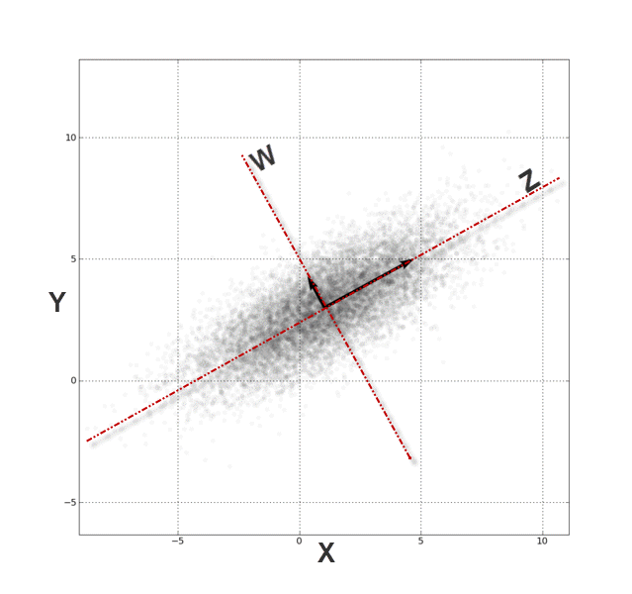
Preprocessing: Whitening
Let m= n, i.e. #principal components = number of input features.
Then PCA changes basis so that
Each column has mean 0 and standard deviation 1.
All covariances are 0.

Slide 36
Conclusion
General intuition for latent feature learning: A small set of unobserved features explains correlations among observed features.
Finding a small set of explanatory features -> dimensionality reduction.
Can visualize as merging feature columns.
Autoencoders reduce dimensionality by reconstructing input from small number of hidden units
Think of each node in the bottleneck layer as representing an unobserved component
Principal Component Analysis projects input to m-dimensional subspace
Notes:
cognitive science conjecture: the brain has more sophisticated strategies.

