Slide 1

Deep Generative Architectures
Oliver Schulte
School of Computing Science
Simon Fraser University
Introduction to Deep Learning

Slide 2
Generative Probabilistic Models
Supervised learning models P(y|x): the probability of one or more target variables y given input variables x
Generative model P(x): just model the distribution of the inputs

Slide 3
Example: synthetic outputs
See tutorial
And on-line demo
And face generator
Notes:
https://jaan.io/what-is-variational-autoencoder-vae-tutorial/
http://vdumoulin.github.io/morphing_faces/online_demo.html

Slide 4
General Neural Network Approach
Input random vector z to neural net
  Typically from a Gaussian bell curve distribution
Network maps z to output vector x
Intuitively, the output should be like the observations x

Slide 5
Simple Example Mappings
Latent distribution | +1 distribution
Uniform over [0,1] | Uniform over [1,2]
Gaussian with mean 0 and standard deviation 1 | Gaussian with mean 1 and standard deviation 1
Notes:
Solution:
Uniform over [1,2]
Gaussian with mean 1 and standard deviation 1

Slide 6
Generate Ring from Gaussian
f(z) = z/10+z/||z||
Samples from
Gaussian distribution of 2D Z
Samples from output distribution

Slide 7
How to Train Deep Generative Models?
What training objective?
2 main ideas
  Variational Auto-Encoder
  Generative Adversarial Network

Slide 8
Variational Auto-Encoder

Slide 9
VAE Objective Approximates Log-Likelihood
Loss function for input x =
- ln(P(x))
  The negative log-likelihood is the standard loss for generative models
In the decoder architecture
P(x) = ∫_{z} 1(f(z) = x) d p(z)
  1(f(z) = x) returns 1 if the decoder maps random z to x, 0 o.w.
Integral is intractable
VAE architecture is designed so that training loss approximates integral negative log-likelihood

Slide 10
Variational Auto-Encoder (VAE)
Combines Auto-Encoding with
Generative Modeling
High-level idea
Design a non-deterministic version of an auto-encoder
  Can produce multiple outputs x-out for the same input x-in
Generate random input z, produce
(non-deterministic) output

Slide 11
Example: Non-deterministic output
original
reconstruction

Slide 12
VAE Training Architecture
Regularizer for Mu, Sigma
Variance: noise around reconstruction
reconstruction/
encoding

Slide 13
VAE Test Architecture
Random input

Slide 14
Example Application
Embeddings for Hockey Players

Slide 15
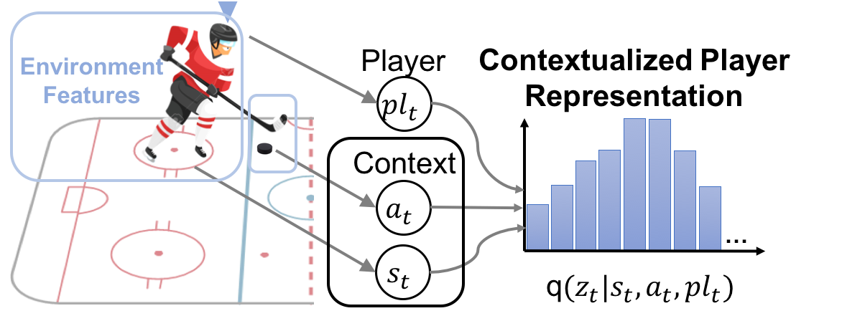
Contextualized Player Embedding
The set-up: we see a hockey game sequence.
Using a VAE, compute a contextualized player embedding as a function of the game sequence.
The VAE generates a distribution P(player_{t} = i| sequence up to time t)
Notes:
Show golden goal video https://www.youtube.com/watch?v=G7DeQbTzPE8
To alleviate the partial observability in the dataset, A game state $s_{t}$is applied to include the game history: $s_{t}=$ $x_{t},{{pl}_{t−1},a}_{t−1},x_{t−1},{pl}_{t−1},a_{t−2}……$ $x_{0}$(${pl}_{t}$ records the current acting player).

Slide 16
Combining LSTM with VAE
Sequence is processed using LSTM
VAE generates probability distribution over players

Slide 17
Accuracy in Player Recognition
Given a match sequence, can you predict which player is likely to have the puck now?
Method | Accuracy | Log-likelihood
LSTM | 12.41% | -3.131
LSTM + VAE | 48% | -2.228
The player embeddings help with predicting
  Whether a shot will lead to a goal
  The final game outcome

Slide 18
Generative Adversarial Models
GANs

Slide 19
GAN Architecture
Recall the basic generative NN architecture
How to train?
VAE: approximate log-likelihood of the observations
GAN: train the generator so that synthetic generated examples cannot be distinguished from actual observations

Slide 20
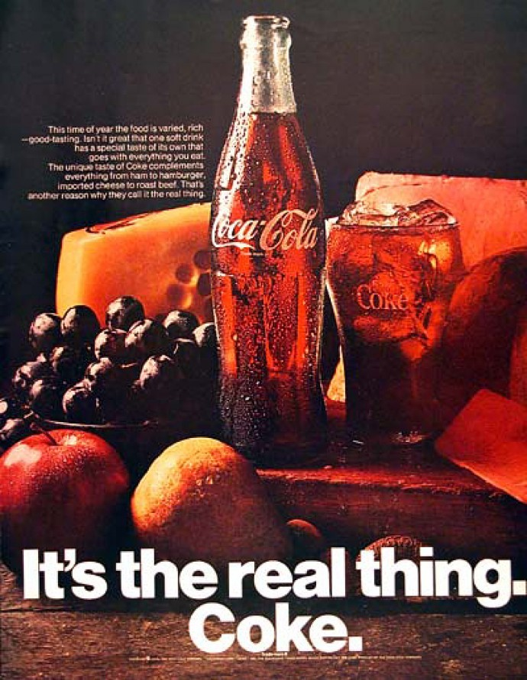
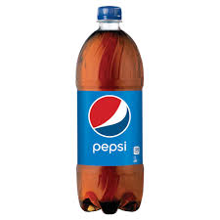
Intuition: Taste Test
Coke is the real thing
Pepsi wants to imitate coke
How does Pepsi know they have succeeded?
When a blind taste test cannot tell the difference!

Slide 21
Chatbots and the Turing Test
Alan Turing (1950) “Computing Machines and Intelligence”
How can we know if a machine is intelligent?
Test if it can fool a human!
Loebner Prize
Chatbots
Notes:
http://www.loebner.net/Prizef/loebner-prize.html
http://www.cleverbot.com/

Slide 22
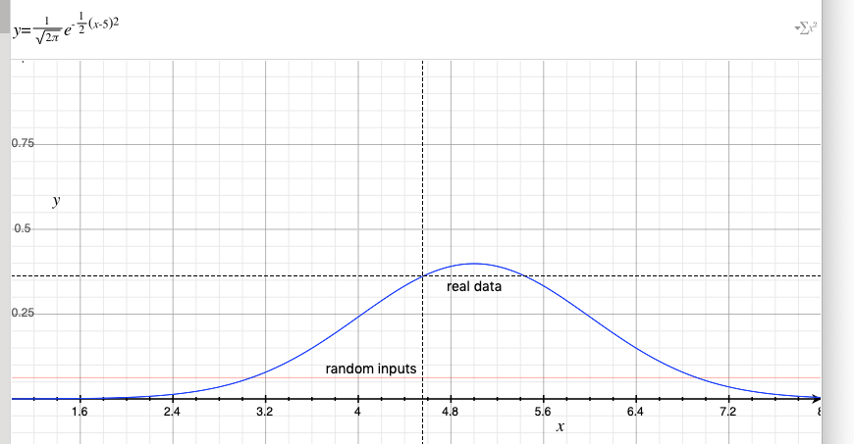
Distinguishing Uniform and Gaussians
Fake data: uniform [-8,8]
Real data: Gaussian with mean 5, standard deviation 1

Slide 23
The Tester
How can we test whether a network generates realistic outputs?
Train another classifier network to distinguish synthetic from real examples!
Discriminator D outputs o_{D}(x)=P(x is real example)
Why can we not just backpropagate to train the generator?

Slide 24
The Loss Functions
Discriminator objective function given real examples R and fake examples F [note: the book seems to have a mistake on this]
V(D,G) = mean_{r} ln(o_{D}(r)) + mean_{f} ln(1-o_{D}(f))
The discriminator wants to maximize V, the generator to minimize V
Minmax problem: GANs are relatively tricky to train
 | Discriminator |  |  | Generator
x | Output | Objective | Loss | Objective | Loss
Real r | o_{D}(r) | ln(o_{D}(r)) | -ln(o_{D}(r)) | -ln(o_{D}(r)) | ln(o_{D}(r))
Fake f | o_{D}(f) | ln(1-o_{D}(f)) | -ln(1-o_{D}(f)) | -ln(1-o_{D}(f)) | ln(1-o_{D}(f))
Notes:
Maybe make survey question on-line

Slide 25
Examples and Demos
Style GAN
Deep Fakes

Slide 26
Conclusion
Generative models generate outputs without an input
Basic idea: map a random input to an output
Without a target output, what is the training objective?
Variational AE: approximate the log-likelihood of the observed data x
  Also produces an embedding of the input x
Generative Adversarial Network: generate synthetic outpus that cannot be distinguished from actual observations by an adversarial classifier network

