Slide 1
HJ Reachability Analysis II
CMPT 882
Mar. 4

Slide 2
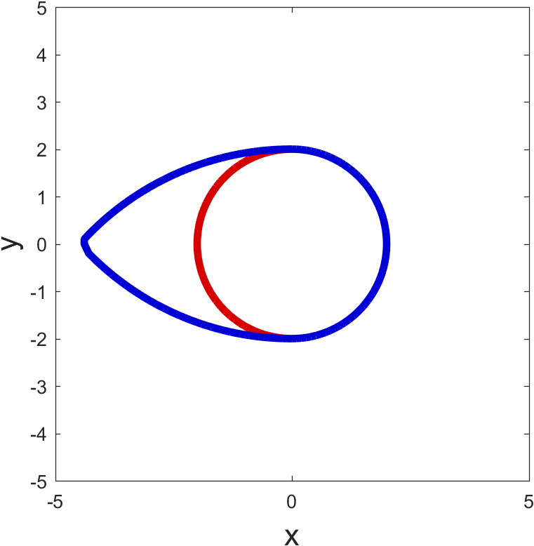
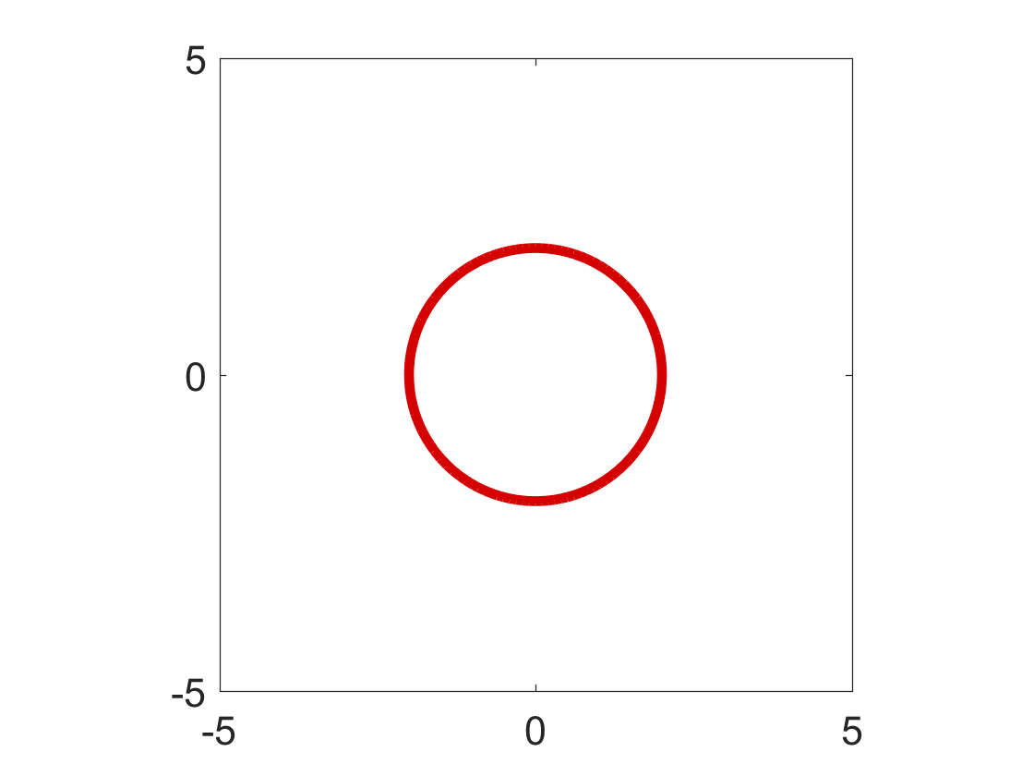
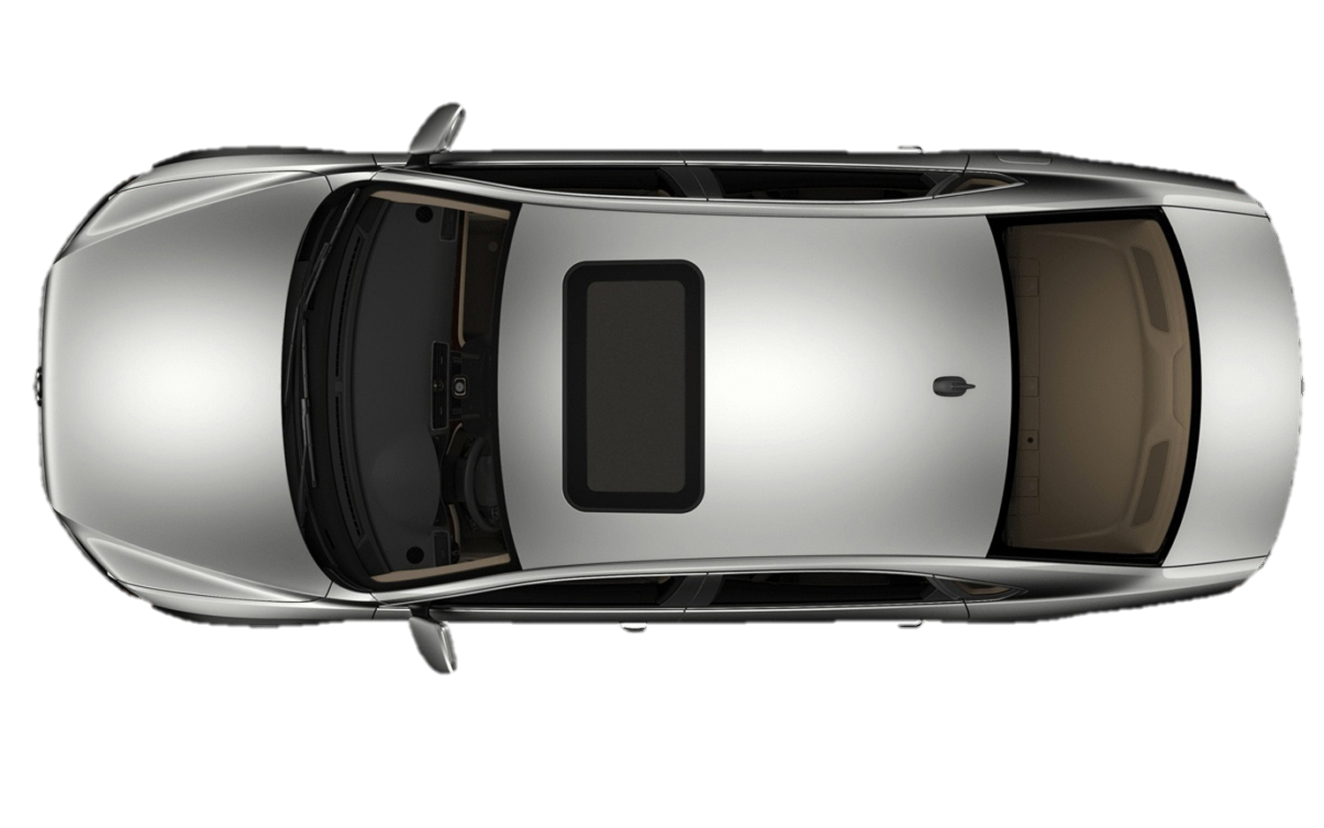
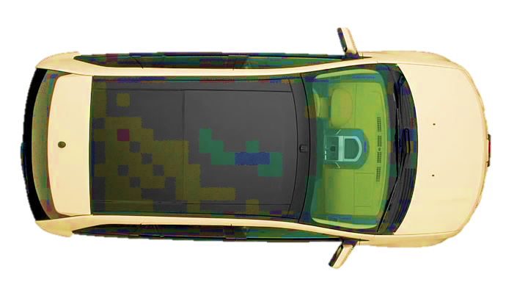
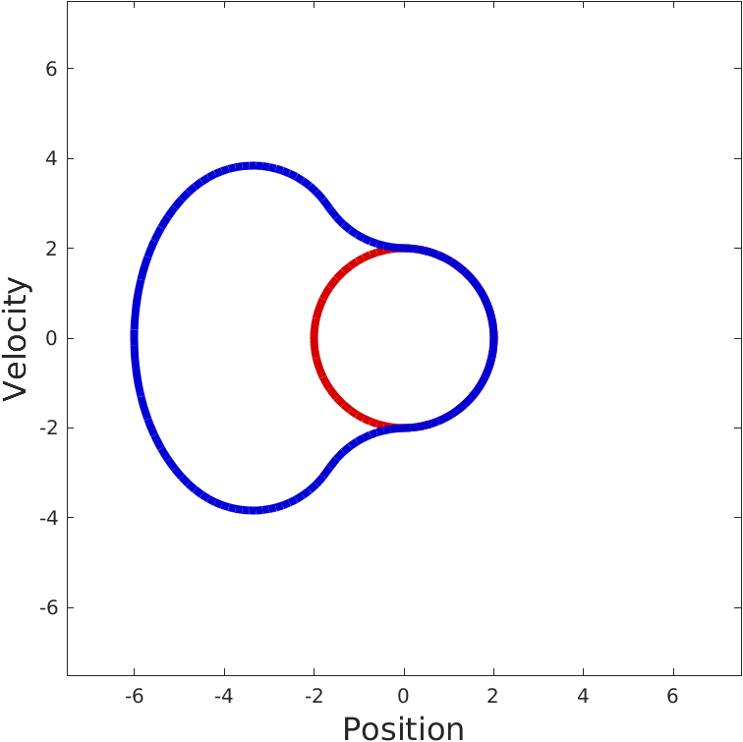
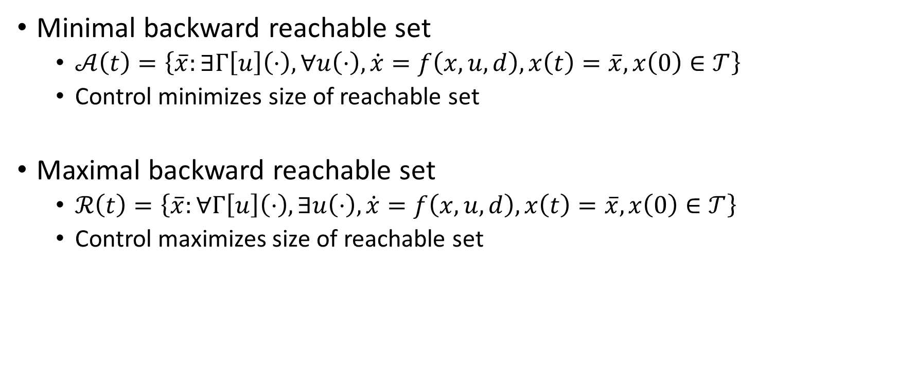
Terminology
Minimal backward reachable set
$𝒜\left(t\right)=\left\{\overline{x}:∃Γ\left[u\right]\left(⋅\right), ∀u\left(⋅\right), \dot{x}=f\left(x,u,d\right),x\left(t\right)=\overline{x},x\left(0\right)∈𝒯\right\}$
Control minimizes size of reachable set
Maximal backward reachable set
$ℛ\left(t\right)=\left\{\overline{x}:∀Γ\left[u\right]\left(⋅\right), ∃u\left(⋅\right), \dot{x}=f\left(x,u,d\right),x\left(t\right)=\overline{x},x\left(0\right)∈𝒯\right\}$
Control maximizes size of reachable set

Slide 3
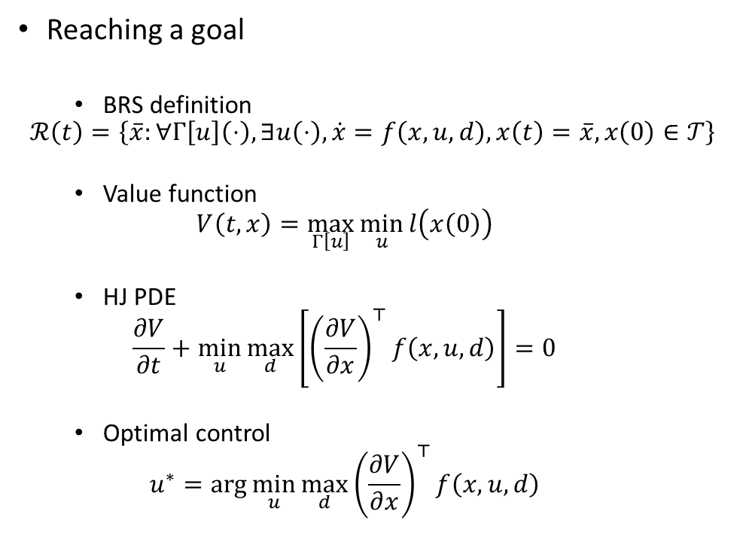
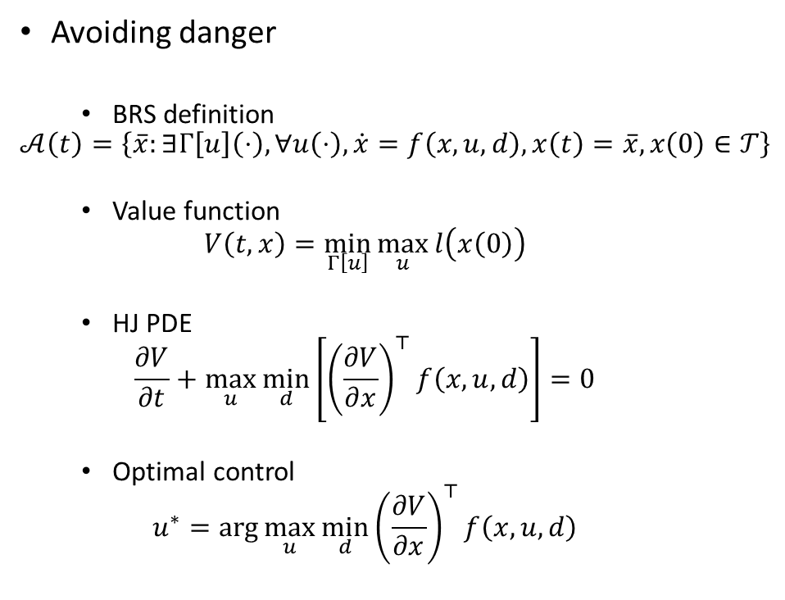
Reaching vs. Avoiding
Avoiding danger
BRS definition
$$𝒜\left(t\right)=\left\{\overline{x}:∃Γ\left[u\right]\left(⋅\right), ∀u\left(⋅\right), \dot{x}=f\left(x,u,d\right),x\left(t\right)=\overline{x},x\left(0\right)∈𝒯\right\}$$
Value function
$$V\left(t,x\right)=\min_{Γ\left[u\right]}{\max_{u}{l\left(x\left(0\right)\right)}}$$
HJ PDE
$$\frac{∂V}{∂t}+\max_{u}\min_{d}\left[{\left(\frac{∂V}{∂x}\right)}^{⊤}f\left(x,u,d\right)\right]=0$$
Optimal control
$$u^{∗}=\arg{\max_{u}{\min_{d}{{\left(\frac{∂V}{∂x}\right)}^{⊤}f\left(x,u,d\right)}}}$$
Reaching a goal
BRS definition
$$ℛ\left(t\right)=\left\{\overline{x}:∀Γ\left[u\right]\left(⋅\right), ∃u\left(⋅\right), \dot{x}=f\left(x,u,d\right),x\left(t\right)=\overline{x},x\left(0\right)∈𝒯\right\}$$
Value function
$$V\left(t,x\right)=\max_{Γ\left[u\right]}{\min_{u}{l\left(x\left(0\right)\right)}}$$
HJ PDE
$$\frac{∂V}{∂t}+\min_{u}\max_{d}\left[{\left(\frac{∂V}{∂x}\right)}^{⊤}f\left(x,u,d\right)\right]=0$$
Optimal control
$$u^{∗}=\arg{\min_{u}{\max_{d}{{\left(\frac{∂V}{∂x}\right)}^{⊤}f\left(x,u,d\right)}}}$$

Slide 4









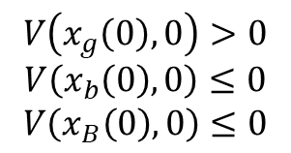
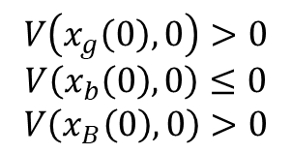

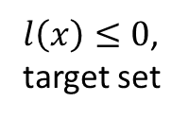
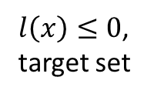


“Sets” vs. “Tubes”
Backward reachable set (BRS)
Only final time matters
Initial states that passing through target are not necessarily in BRS
Not ideal for safety
Backward reachable tube (BRT)
Keep track of entire time duration
Initial states that pass thorugh target are in BRT
Used to make safety guarantees
$$x_{g}\left(0\right)$$
$$x_{g}\left(0\right)$$
$$x_{b}\left(0\right)$$
$$x_{b}\left(0\right)$$
$$x_{B}\left(0\right)$$
$$x_{B}\left(0\right)$$
$$x_{g}\left(t\right)$$
$$x_{g}\left(t\right)$$
$l\left(x\right)≤0$,
target set
$l\left(x\right)≤0$,
target set
$$x_{B}\left(t\right)$$
$$x_{B}\left(t\right)$$
$$V\left(x_{g}\left(0\right),0\right)>0$$
$$V\left(x_{b}\left(0\right),0\right)≤0$$
$$V\left(x_{B}\left(0\right),0\right)>0$$
$$V\left(x_{g}\left(0\right),0\right)>0$$
$$V\left(x_{b}\left(0\right),0\right)≤0$$
$$V\left(x_{B}\left(0\right),0\right)≤0$$
$$x_{b}\left(t\right)$$
$$x_{b}\left(t\right)$$

Slide 5
Terminology
Minimal backward reachable set
$𝒜\left(t\right)=\left\{\overline{x}:∃Γ\left[u\right]\left(⋅\right), ∀u\left(⋅\right), \dot{x}=f\left(x,u,d\right),x\left(t\right)=\overline{x},x\left(0\right)∈𝒯\right\}$
Control minimizes size of reachable set
Maximal backward reachable set
$ℛ\left(t\right)=\left\{\overline{x}:∀Γ\left[u\right]\left(⋅\right), ∃u\left(⋅\right), \dot{x}=f\left(x,u,d\right),x\left(t\right)=\overline{x},x\left(0\right)∈𝒯\right\}$
Control maximizes size of reachable set
Minimal and maximal backward reachable tube
$\overline{𝒜}\left(t\right)=\left\{\overline{x}:∃Γ\left[u\right]\left(⋅\right), ∀u\left(⋅\right), \dot{x}=f\left(x,u,d\right),x\left(t\right)=\overline{x},∃s∈\left[t,0\right],x\left(s\right)∈𝒯\right\}$
$\overline{ℛ}\left(t\right)=\left\{\overline{x}:∀Γ\left[u\right]\left(⋅\right), ∃u\left(⋅\right), \dot{x}=f\left(x,u,d\right),x\left(t\right)=\overline{x},∃s∈\left[t,0\right],x\left(s\right)∈𝒯\right\}$

Slide 6
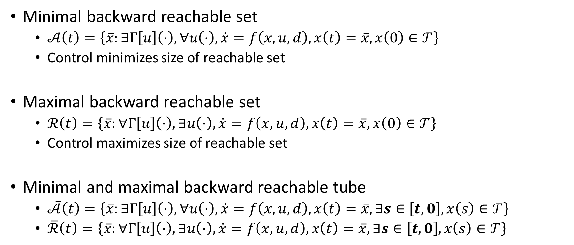
Terminology
Minimal backward reachable set
$𝒜\left(t\right)=\left\{\overline{x}:∃Γ\left[u\right]\left(⋅\right), ∀u\left(⋅\right), \dot{x}=f\left(x,u,d\right),x\left(t\right)=\overline{x},x\left(0\right)∈𝒯\right\}$
Control minimizes size of reachable set
Maximal backward reachable set
$ℛ\left(t\right)=\left\{\overline{x}:∀Γ\left[u\right]\left(⋅\right), ∃u\left(⋅\right), \dot{x}=f\left(x,u,d\right),x\left(t\right)=\overline{x},x\left(0\right)∈𝒯\right\}$
Control maximizes size of reachable set
Minimal and maximal backward reachable tube
$\overline{𝒜}\left(t\right)=\left\{\overline{x}:∃Γ\left[u\right]\left(⋅\right), ∀u\left(⋅\right), \dot{x}=f\left(x,u,d\right),x\left(t\right)=\overline{x},∃s∈\left[t,0\right],x\left(s\right)∈𝒯\right\}$
$\overline{ℛ}\left(t\right)=\left\{\overline{x}:∀Γ\left[u\right]\left(⋅\right), ∃u\left(⋅\right), \dot{x}=f\left(x,u,d\right),x\left(t\right)=\overline{x},∃s∈\left[t,0\right],x\left(s\right)∈𝒯\right\}$

Slide 7









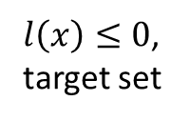







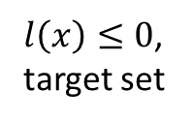
“Sets” vs. “Tubes”
Backward reachable set (BRS)
Value function definition
$V\left(t,x\right)=\min_{Γ\left[u\right]}{\max_{u}{l\left(x\left(0\right)\right)}}$
Value function obtained from
$$\frac{∂V}{∂t}+\max_{u}\min_{d}\left[{\left(\frac{∂V}{∂x}\right)}^{⊤}f\left(x,u,d\right)\right]=0$$
Backward reachable tube (BRT)
Value function definition
$V\left(t,x\right)=\min_{Γ\left[u\right]}{\max_{u}{\min_{s∈\left[t,0\right]}{l\left(x\left(s\right)\right)}}}$
Value function obtained from
$$\min\left\{\frac{∂V}{∂t}+\max_{u}\min_{d}\left[{\left(\frac{∂V}{∂x}\right)}^{⊤}f\left(x,u,d\right)\right],l\left(x\right)−V\left(t,x\right)\right\}=0$$
$$x_{g}\left(0\right)$$
$$x_{g}\left(0\right)$$
$$x_{b}\left(0\right)$$
$$x_{b}\left(0\right)$$
$$x_{B}\left(0\right)$$
$$x_{B}\left(0\right)$$
$$x_{g}\left(t\right)$$
$$x_{g}\left(t\right)$$
$l\left(x\right)≤0$,
target set
$l\left(x\right)≤0$,
target set
$$x_{B}\left(t\right)$$
$$x_{B}\left(t\right)$$
$$V\left(x_{g}\left(0\right),0\right)>0$$
$$V\left(x_{b}\left(0\right),0\right)≤0$$
$$V\left(x_{B}\left(0\right),0\right)>0$$
$$x_{b}\left(t\right)$$
$$V\left(x_{g}\left(0\right),0\right)>0$$
$$V\left(x_{b}\left(0\right),0\right)≤0$$
$$V\left(x_{B}\left(0\right),0\right)≤0$$
$$x_{b}\left(t\right)$$

Slide 8
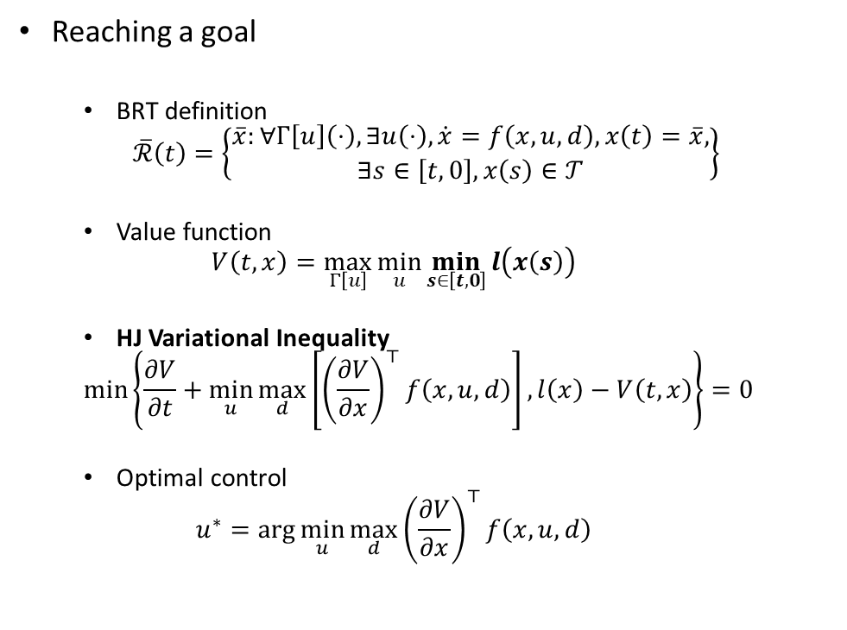
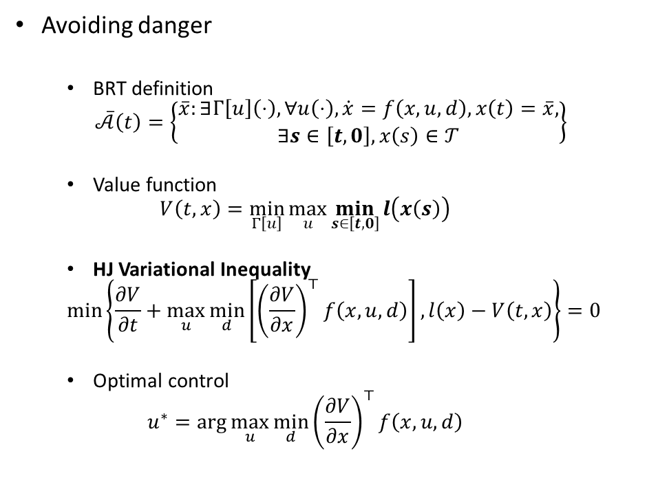
Reaching vs. Avoiding: Backward Reachable Tubes
Avoiding danger
BRT definition
$$\overline{𝒜}\left(t\right)=\left\{\begin{aligned}\overline{x}:∃Γ\left[u\right]\left(⋅\right), ∀u\left(⋅\right), \dot{x}=f\left(x,u,d\right),x\left(t\right)=\overline{x}, \\ ∃s∈\left[t,0\right],x\left(s\right)∈𝒯\end{aligned}\right\}$$
Value function
$$V\left(t,x\right)=\min_{Γ\left[u\right]}{\max_{u}{\min_{s∈\left[t,0\right]}{l\left(x\left(s\right)\right)}}}$$
HJ Variational Inequality
$$\min\left\{\frac{∂V}{∂t}+\max_{u}\min_{d}\left[{\left(\frac{∂V}{∂x}\right)}^{⊤}f\left(x,u,d\right)\right],l\left(x\right)−V\left(t,x\right)\right\}=0$$
Optimal control
$$u^{∗}=\arg{\max_{u}{\min_{d}{{\left(\frac{∂V}{∂x}\right)}^{⊤}f\left(x,u,d\right)}}}$$
Reaching a goal
BRT definition
$$\overline{ℛ}\left(t\right)=\left\{\begin{aligned}\overline{x}:∀Γ\left[u\right]\left(⋅\right), ∃u\left(⋅\right), \dot{x}=f\left(x,u,d\right),x\left(t\right)=\overline{x}, \\ ∃s∈\left[t,0\right],x\left(s\right)∈𝒯\end{aligned}\right\}$$
Value function
$$V\left(t,x\right)=\max_{Γ\left[u\right]}{\min_{u}{\min_{s∈\left[t,0\right]}{l\left(x\left(s\right)\right)}}}$$
HJ Variational Inequality
$$\min\left\{\frac{∂V}{∂t}+\min_{u}\max_{d}\left[{\left(\frac{∂V}{∂x}\right)}^{⊤}f\left(x,u,d\right)\right],l\left(x\right)−V\left(t,x\right)\right\}=0$$
Optimal control
$$u^{∗}=\arg{\min_{u}{\max_{d}{{\left(\frac{∂V}{∂x}\right)}^{⊤}f\left(x,u,d\right)}}}$$

Slide 9
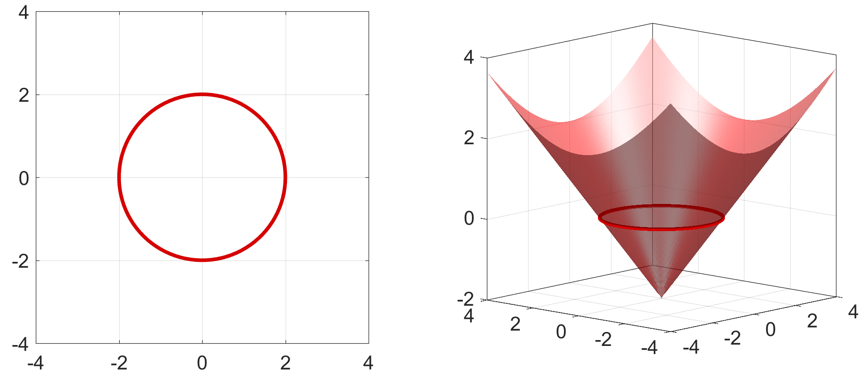







Hamilton-Jacobi (HJ) Reachability Theory
Target set: $𝒯=\left\{x:l\left(x\right)<0\right\}$
Value function: $V\left(t,x\right)$
$$V\left(t,x\left(t\right)\right)=\min_{Γ\left[u\right]\left(⋅\right)}{\max_{u\left(⋅\right)}{\min_{s∈\left[t,0\right]}{l\left(x\left(s\right)\right)}}}$$
subject to $\dot{x}=f\left(x,u,d\right),t≤0$
$$y$$
$$l\left(x,y\right)$$
$$y$$
$$x$$
$$x$$
Notes:
Let’s look at the toy example of the bike in more detail. Starting with a target set representing the set of dangerous states, we define what’s called an implicit surface function l, such that l is negative inside, and non-negative outside
The way we will compute the reachable set is through this optimization V(z,t) = max over the function u of l(z(T)), the value of the implicit surface function at the state at the final time
0.5 min

Slide 10
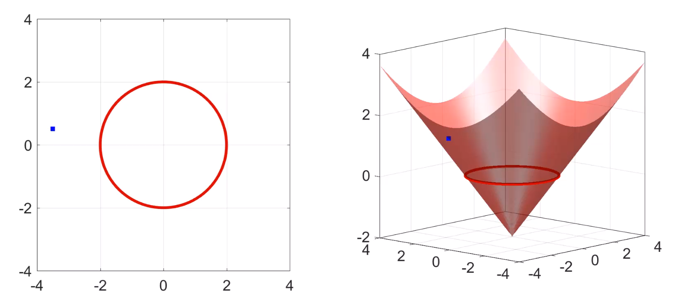


Hamilton-Jacobi (HJ) Reachability Theory
Target set: $𝒯=\left\{x:l\left(x\right)<0\right\}$
Value function: $V\left(t,x\right)$
$$V\left(t,x\left(t\right)\right)=\min_{Γ\left[u\right]\left(⋅\right)}{\max_{u\left(⋅\right)}{\min_{s∈\left[t,0\right]}{l\left(x\left(s\right)\right)}}}$$
subject to $\dot{x}=f\left(x,u,d\right),t≤0$
$$x_{1}(t)$$
$$y$$
$$l\left(x,y\right)$$
$$x_{1}(0)$$
$$y$$
$$x$$
$$x$$
Notes:
For example, suppose the initial state of the system is here, at z1(0). If we apply some control function u, the system may take the following trajectory until it arrives at some z1(T). In this case, this end point is inside the target set, and so l at the end point is negative, as shown in the right subplot
Note that here on the left, we keep track of system trajectories, and on the right, we keep track of the value of l along the trajectory.

Slide 11
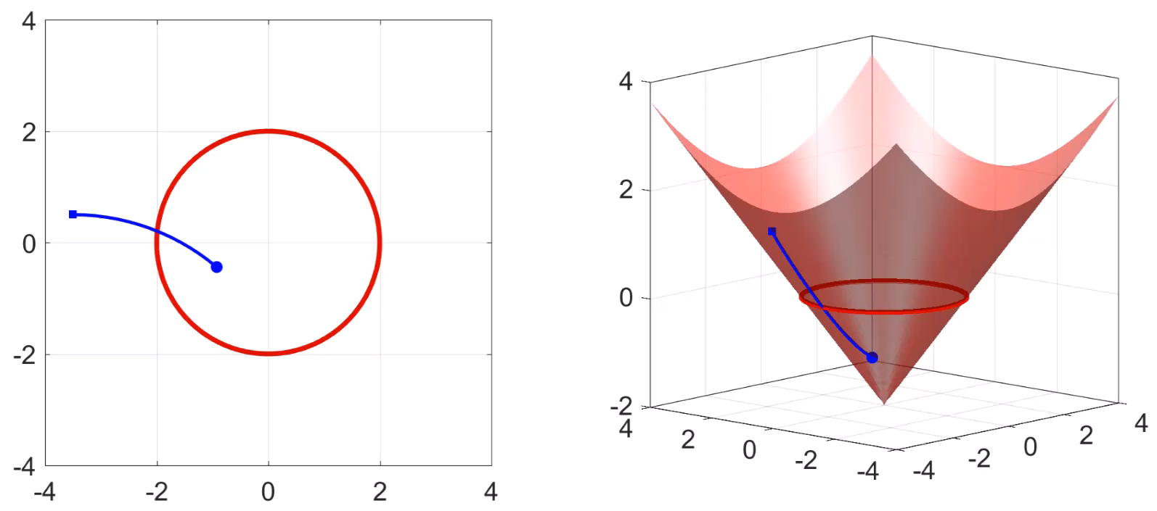

Hamilton-Jacobi (HJ) Reachability Theory
Target set: $𝒯=\left\{x:l\left(x\right)<0\right\}$
Value function: $V\left(t,x\right)$
$$V\left(t,x\left(t\right)\right)=\min_{Γ\left[u\right]\left(⋅\right)}{\max_{u\left(⋅\right)}{\min_{s∈\left[t,0\right]}{l\left(x\left(s\right)\right)}}}$$
subject to $\dot{x}=f\left(x,u,d\right),t≤0$
$$x_{1}(t)$$
$$x_{1}(0)$$
$$y$$
$$l\left(x,y\right)$$
$$y$$
$$x$$
$$x$$
Notes:
Applying a different control u would take the system on a trajectory with a different end point. As we can see this end point also has a negative l value

Slide 12

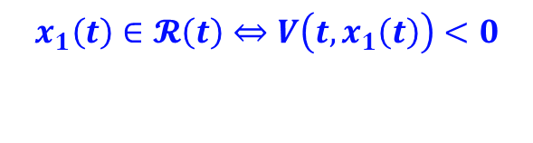

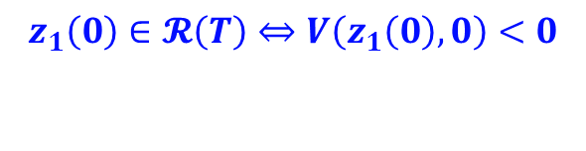
Hamilton-Jacobi (HJ) Reachability Theory
Target set: $𝒯=\left\{x:l\left(x\right)<0\right\}$
Value function: $V\left(t,x\right)$
$$V\left(t,x\left(t\right)\right)=\min_{Γ\left[u\right]\left(⋅\right)}{\max_{u\left(⋅\right)}{\min_{s∈\left[t,0\right]}{l\left(x\left(s\right)\right)}}}$$
subject to $\dot{x}=f\left(x,u,d\right),t≤0$
$$x_{1}(0)$$
$$x_{1}\left(t\right)∈𝓡\left(t\right)⇔V\left(t,x_{1}\left(t\right)\right)<0$$
$$z_{2}\left(0\right)∉ℛ\left(T\right)⇔V\left(z_{2}\left(0\right),0\right)≥0$$
$$x_{1}(t)$$
$$y$$
$$l\left(x,y\right)$$
$$y$$
$$x$$
$$x$$
Notes:
In this particular example, even if we apply the optimal control, the one that maximizes the value of l at the end point, the system still ends up in the target set. In this case, we say that z1(0) is in the reachable set, or equivalent, V at z1(0) is negative.

Slide 13
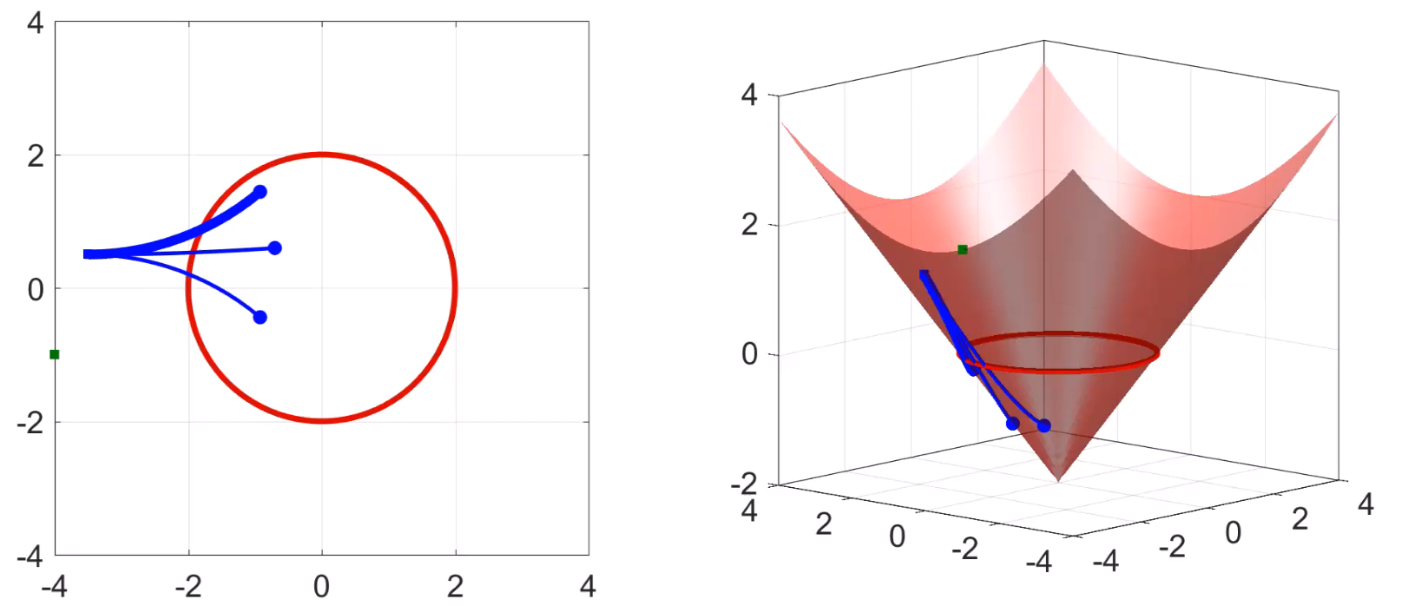



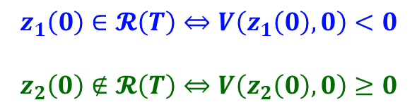

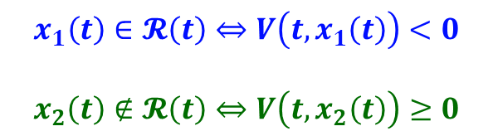
Hamilton-Jacobi (HJ) Reachability Theory
Target set: $𝒯=\left\{x:l\left(x\right)<0\right\}$
Value function: $V\left(t,x\right)$
$$V\left(t,x\left(t\right)\right)=\min_{Γ\left[u\right]\left(⋅\right)}{\max_{u\left(⋅\right)}{\min_{s∈\left[t,0\right]}{l\left(x\left(s\right)\right)}}}$$
subject to $\dot{x}=f\left(x,u,d\right),t≤0$
$$x_{1}(T)$$
$$x_{1}\left(t\right)∈𝓡\left(t\right)⇔V\left(t,x_{1}\left(t\right)\right)<0$$
$$x_{2}\left(t\right)∉𝓡\left(t\right)⇔V\left(t,x_{2}\left(t\right)\right)≥0$$
$$x_{1}(0)$$
$$y$$
$$l\left(x,y\right)$$
$$x_{2}(0)$$
$$x_{2}(T)$$
$$y$$
$$x$$
$$x$$
Notes:
Now, consider a different initial state, z2(0). In this case, the optimal trajectory takes the system outside of the target set, and the end point is has a positive value of l. In this case, z2(0) is not in the reachable set, and equivalently, V at z2(0) is non-negative.
Now that we have formulated the optimization problem, how can the solution, the value function V, can be found?
0.5 min

Slide 14
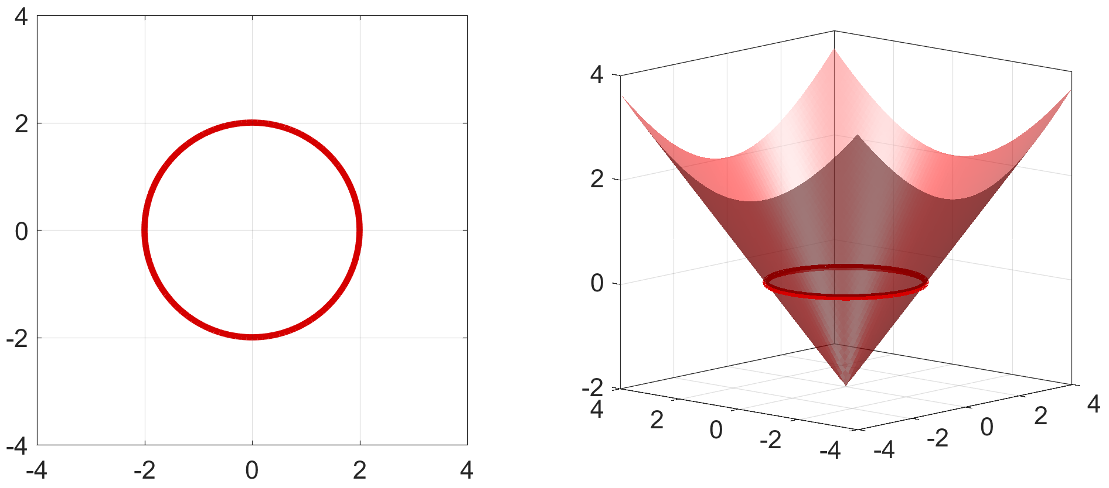
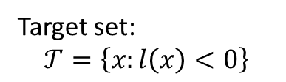


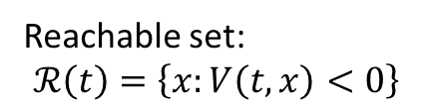
Hamilton-Jacobi (HJ) Reachability Theory
Hamilton-Jacobi Variational Inequality:
$$\frac{dV}{dt}+\min\left\{0,\max_{u}{\min_{d}{{\left(\frac{∂V}{∂x}\right)}^{⊤}f(x,u,d) }}\right\}=0,t≤0$$
$$V\left(t,x\right)=l(x)$$
Target set:
$$𝒯=\left\{x:l\left(x\right)<0\right\}$$
Reachable set:
$$ℛ\left(t\right)=\left\{x:V\left(t,x\right)<0\right\}$$
$$y$$
$$V\left(t,x,y\right)$$
$$y$$
$$x$$
$$x$$
Notes:
The answer is by solving the Hamilton-Jacobi partial differential equation. This equation can be derived based on the dynamic programming principle. If anyone is interested, I’d be happy to talk about this in more detail.
For now, at a high level, we first set the reachable set at the final time to be the target set. This is done by setting the final condition of the PDE. As we solve this PDE, the negative region of the solution V gives us the reachable set. Next, we look at all nearby states, and see which of these are guaranteed to enter the current reachable set.
1 min

Slide 15
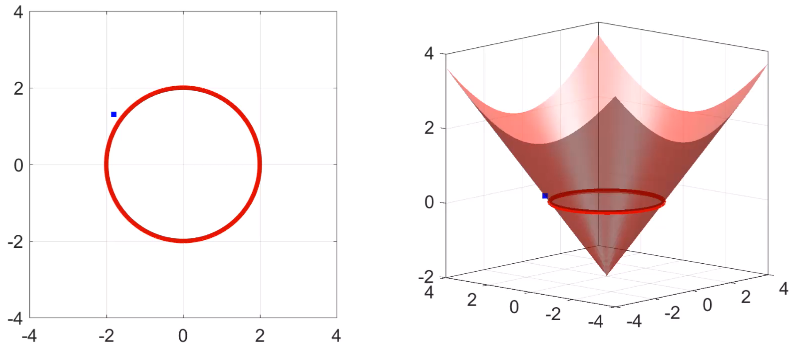
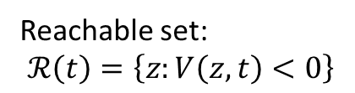

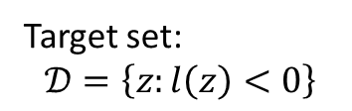

Hamilton-Jacobi (HJ) Reachability Theory
Hamilton-Jacobi PDE: based on the dynamic programming principle
$$\frac{dV}{dt}+\min\left\{0,\max_{u}{\min_{d}{∇V⋅f(z,u,d) }}\right\}=0,t∈\left[0,T\right]$$
$$V\left(z,T\right)=l(z)$$
Target set:
$$𝒟=\left\{z:l\left(z\right)<0\right\}$$
Reachable set:
$$ℛ\left(t\right)=\left\{z:V\left(z,t\right)<0\right\}$$
$$y$$
$$V\left(x,y,T\right)$$
$$y$$
$$x$$
$$x$$
Notes:
In this short time horizon, the blue ones end up in the target set, and the green ones don’t. This is basically the continuous analogue of the bellman backup used in for example reinforcement learning or any dynamic programming-based algorithm. So, the reachable set gets updated as follows. Of course some green trajectories may later hit the obstacle, but that is taken care of at later iterations.
These are just a few example trajectories.

Slide 16
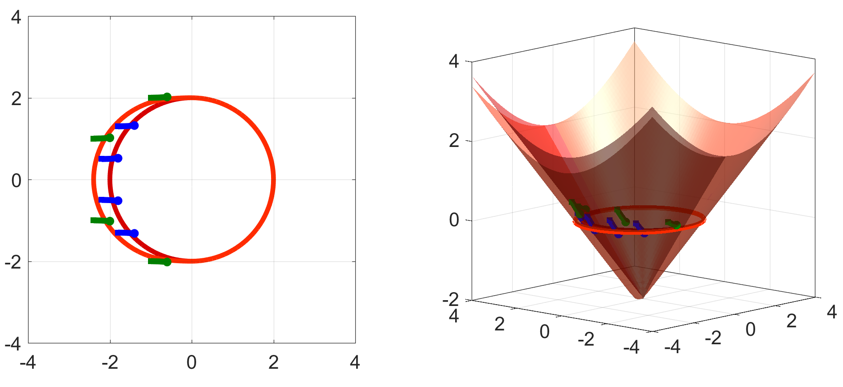
Hamilton-Jacobi (HJ) Reachability Theory
Hamilton-Jacobi PDE: based on the dynamic programming principle
$$\frac{dV}{dt}+\min\left\{0,\max_{u}{\min_{d}{∇V⋅f(z,u,d) }}\right\}=0,t∈\left[0,T\right]$$
$$V\left(z,T\right)=l(z)$$
Target set:
$$𝒟=\left\{z:l\left(z\right)<0\right\}$$
Reachable set:
$$ℛ\left(t\right)=\left\{z:V\left(z,t\right)<0\right\}$$
$$y$$
$$V\left(x,y,T\right)$$
$$y$$
$$x$$
$$x$$
Notes:
When the PDE is solved, all possible trajectories are taken into account.

Slide 17
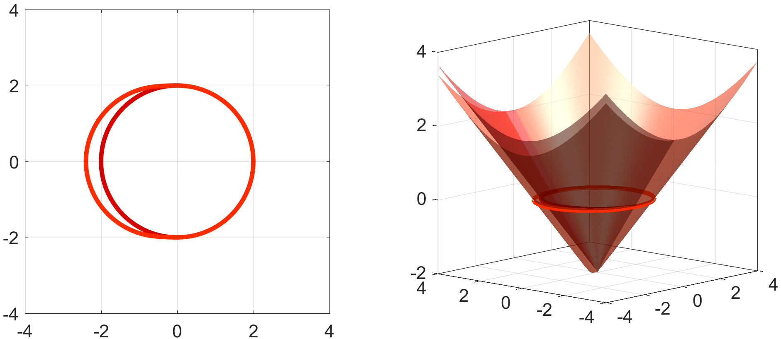

Hamilton-Jacobi (HJ) Reachability Theory
Hamilton-Jacobi PDE: based on the dynamic programming principle
$$\frac{dV}{dt}+\min\left\{0,\max_{u}{\min_{d}{∇V⋅f(z,u,d) }}\right\}=0,t∈\left[0,T\right]$$
$$V\left(z,T\right)=l(z)$$
Reachable set:
$$ℛ\left(t\right)=\left\{z:V\left(z,t\right)<0\right\}$$
Notes:
Equivalently, we update V so that V is negative at these new states. We can do this recursively to obtain the reachable set over time.

Slide 18
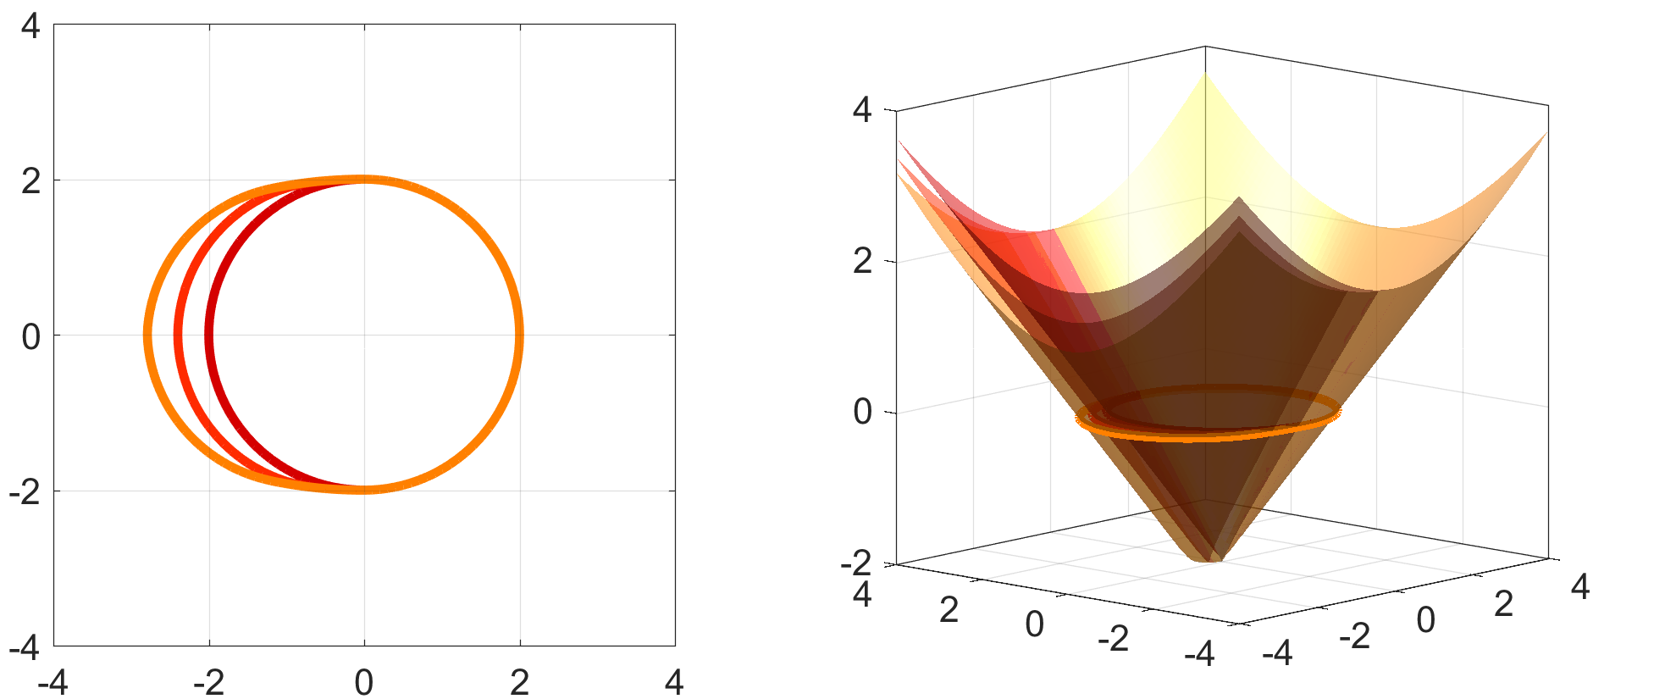
Hamilton-Jacobi (HJ) Reachability Theory
Hamilton-Jacobi PDE: based on the dynamic programming principle
$$\frac{dV}{dt}+\min\left\{0,\max_{u}{\min_{d}{∇V⋅f(z,u,d) }}\right\}=0,t∈\left[0,T\right]$$
$$V\left(z,T\right)=l(z)$$
Reachable set:
$$ℛ\left(t\right)=\left\{z:V\left(z,t\right)<0\right\}$$

Slide 19
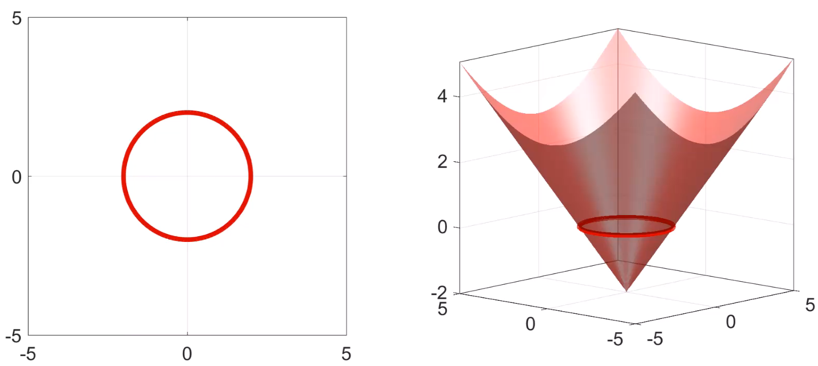

Hamilton-Jacobi (HJ) Reachability Theory
Hamilton-Jacobi PDE: based on the dynamic programming principle
$$\min\left\{\frac{∂V}{∂t}+\max_{u}\min_{d}\left[{\left(\frac{∂V}{∂x}\right)}^{⊤}f\left(x,u,d\right)\right],l\left(x\right)−V\left(t,x\right)\right\}=0$$
$$V\left(z,T\right)=l(z)$$
Reachable set:
$$ℛ\left(t\right)=\left\{z:V\left(z,t\right)<0\right\}$$
Notes:
This video show how the reachable set and the solution to the PDE evolves over time. The PDE effectively turns a trajectory-based perspective into a set-based perspective to account for all possible system trajectories at once

Slide 20
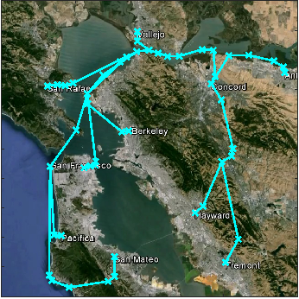
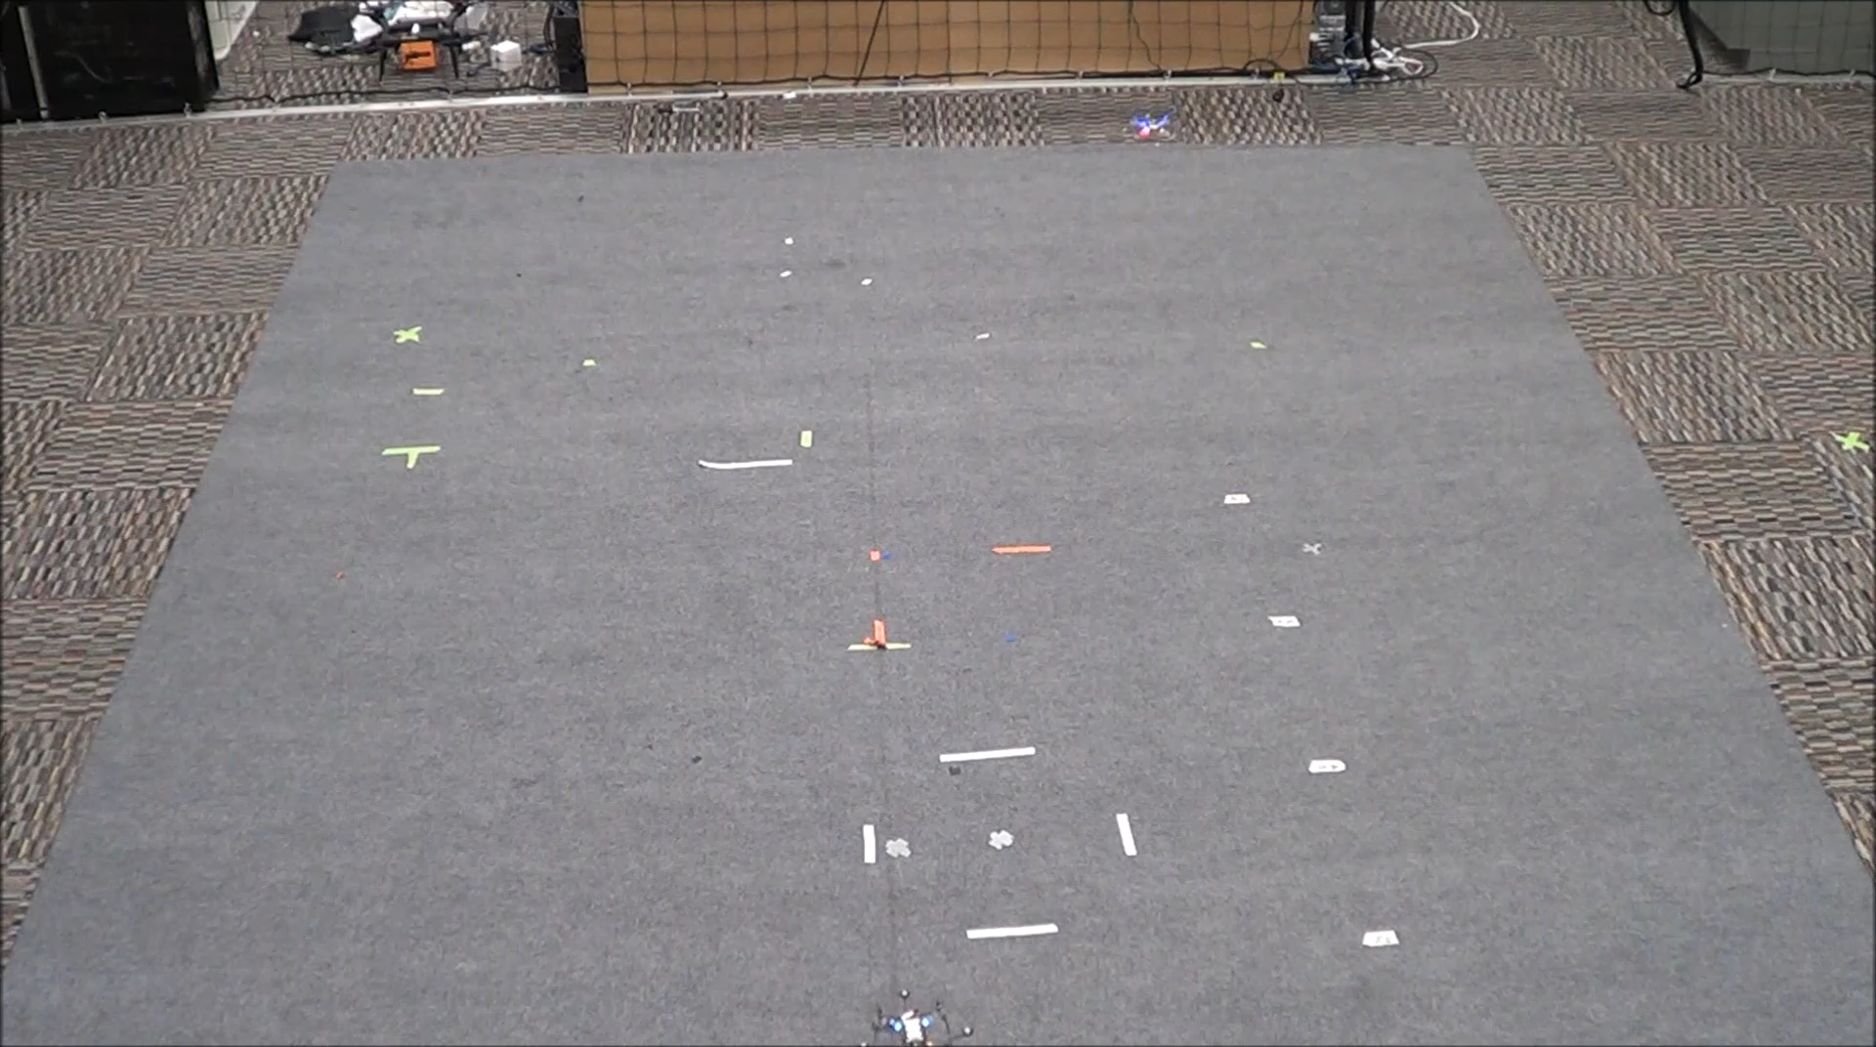
Intruder Avoidance
Platoon leader
(autonomous)
Intruder
(human controlled)
Notes:
2 min

Slide 21
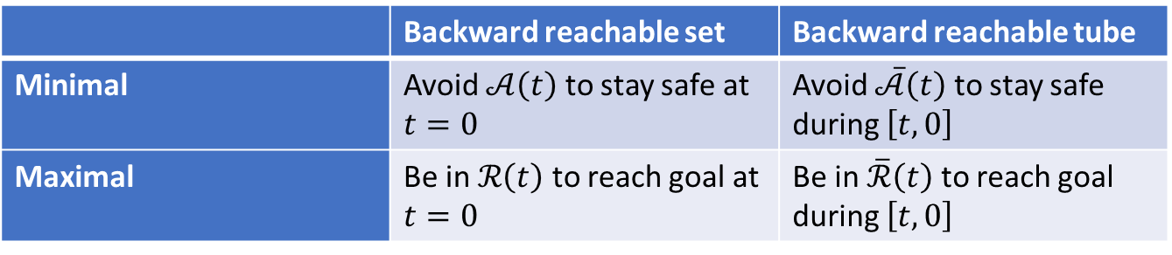
“Flavours” of Reachability
So far:
Other variations:
Forward reachable sets and tubes
Reach-avoid sets and tubes
States from which goal can be reached while avoiding obstacles
 | Backward reachable set | Backward reachable tube
Minimal | Avoid $𝒜\left(t\right)$ to stay safe at $t=0$ | Avoid $\overline{𝒜}\left(t\right)$ to stay safe during $\left[t,0\right]$
Maximal | Be in $ℛ\left(t\right)$ to reach goal at $t=0$ | Be in $\overline{ℛ}\left(t\right)$ to reach goal during $\left[t,0\right]$

Slide 22
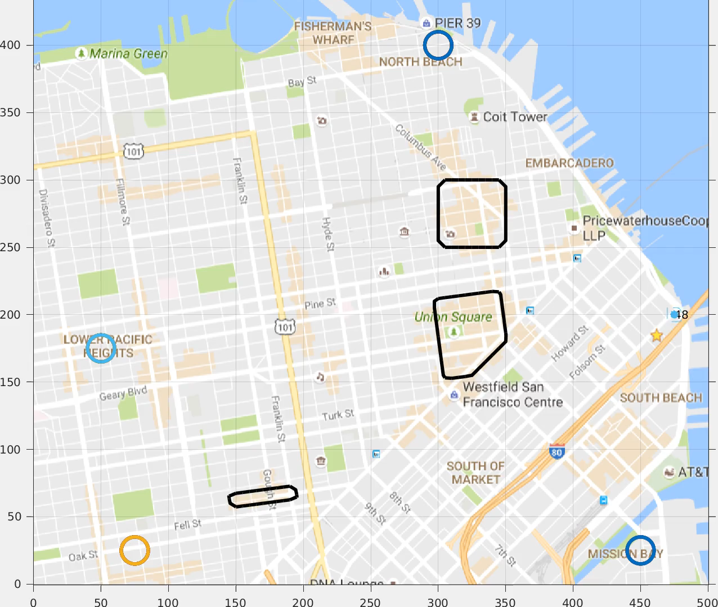
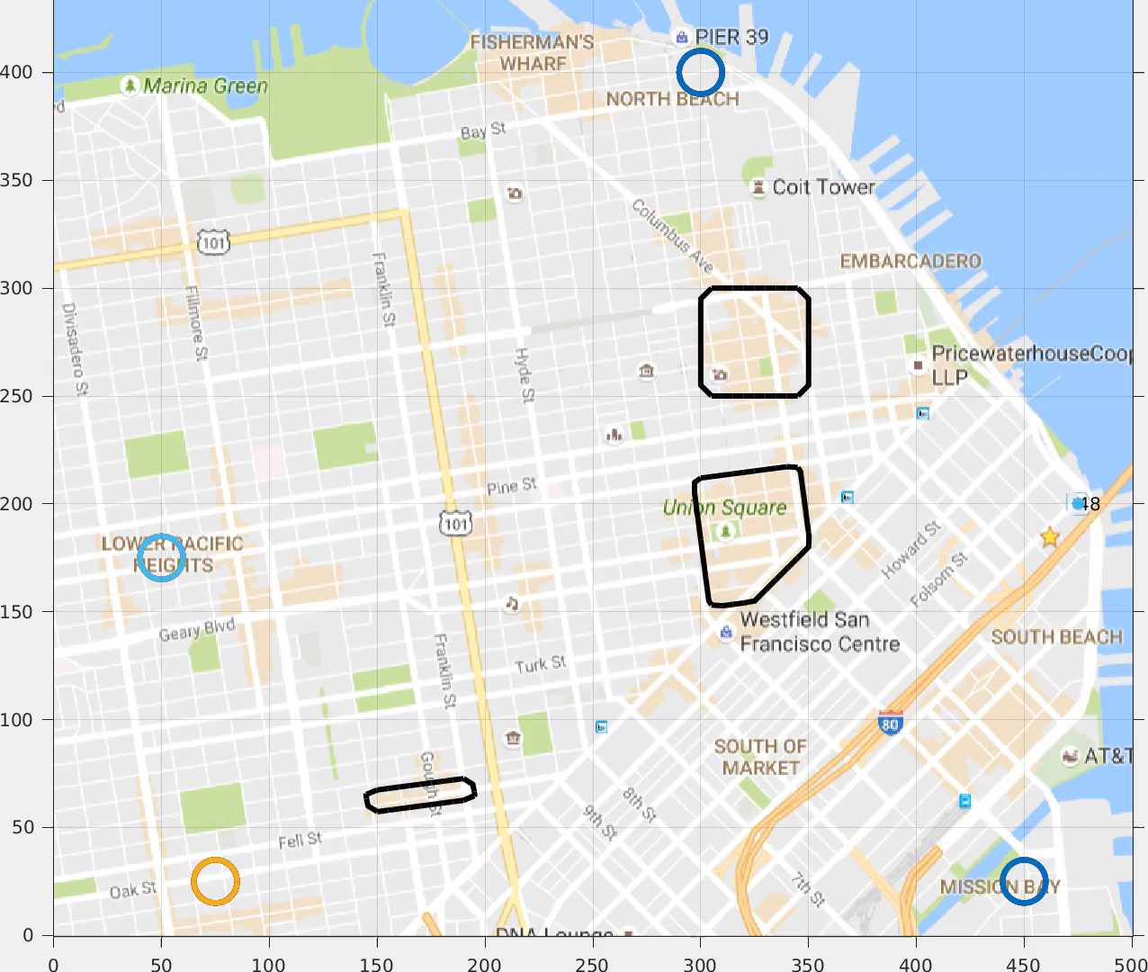



Wind speed:
11 m/s
Unmanned Aerial Systems Traffic Management
6 m/s
Scheduled arrival time separation: 0 s
5 s
10 s
Notes:
[COULD GO QUICKLY HERE]
Other multi-agent analysis methods such as sequential path planning can be used off the highway, where the number of vehicles may be smaller.
In sequential path planning, vehicles are assigned priorities, and lower-priority vehicles treat higher-priority vehicles as moving obstacles.
Effectively, this structure allows us to reserve “space-time” in the airspace for one vehicle at a time. Using a time-varying formulation of reachability, space-time reservations are guaranteed to be dynamically feasible, robust to disturbances, and robust to a single intruder in the airspace.
1 min

Slide 23



Comments
6D:
intractable!
Computational complexity
$V\left(t,x\right)$ is computed on an $\left(n+1\right)$-dimensional grid
Currently, $n≤5$. GPU acceleration under-way
Dimensionality reduction methods sometimes help
Alternative approaches
Sacrifice global optimality
Give up guarantees
Sampling-based methods
Reinforcement learning
5D:
days
gigabytes
$O\left(N^{d}\right)$ time and space complexity!
Computation time and RAM usage
4D:
hours
hundreds of megabytes
3D:
minutes
tens of megabytes
2D:
seconds
negligible RAM
1D:
< 0.1s
negligible RAM
number of system dimensions

Slide 24
Numerical Toolboxes
helperOC Matlab toolbox
https://github.com/HJReachability/helperOC.git
Reachability wrapper around the level set toolbox
Requires level set toolbox
Hamilton-Jacobi PDE solver by Ian Mitchell, UBC
https://bitbucket.org/ian_mitchell/toolboxls
C++ and CUDA version in development, beta also available
C++: 5+ times faster than Matlab
CUDA: Up to 100 times faster than Matlab
https://github.com/HJReachability/beacls

Slide 25

Tutorial Code Overview

Slide 26


Tutorial Code Overview
Computation domain
Make sure domain is large enough
Make sure grid resolution captures smallest features
Remember periodic state space dimensions (angles)
Target set
Built-in functions available to create simple shapes
Arbitrary functions can be defined using the grid
g.xs{i} in this context represents i^{th} state
Time horizon
dt and tau determine what $t$ is stored for $V\left(t,x\right)$
Time discretization for computation is determined automatically to ensure numerical stability
Vehicle parameters (Dubins car’s speed and max turn rate)
Reach or avoid? (min for reach, max for avoid)

Slide 27



Tutorial Code Overview
ODE model of system
Implemented as classes, found in the DynSys folder
Implementing extra models is relatively simple
Pack parameters and solve PDE
minWith parameter determines whether reachable sets or tubes are computed
Solution is stored in data, which is a $\left(n+1\right)$-dimensional array

