Slide 1
A Crash Course in Reinforcement Learning
Oliver Schulte
Simon Fraser University
Notes:
emphasis on connections with neural net learning

Slide 2
Outline
What is Reinforcement Learning?
Key Definitions
Key Learning Tasks
Reinforcement Learning Techniques
Reinforcement Learning with Neural Nets

Slide 3
Overview

Slide 4
Learning To Act
So far: learning to predict
Now: learn to act
  In engineering: control theory
  Economics, operations research: decision and game theory

Slide 5
Examples
Fly stunt manoeuvres in a helicopter
Defeat the world champion at Backgammon, Go
Manage an investment portfolio
Control a power station
Make a humanoid robot walk
Play Starcraft, Atari games better than humans
Drive a car
Play hockey
Notes:
https://deepmind.com/blog/announcements/deepmind-and-blizzard-open-starcraft-ii-ai-research-environment
https://www.newscientist.com/article/2221840-deepminds-starcraft-playing-ai-beats-99-8-per-cent-of-human-gamers/

Slide 6
A new kind of learning
There is no supervisor, only a reward signal
  No labels “wrong choice, right choice”
Feedback is delayed, not instantaneous
Time really matters (sequential, non i.i.d data)
Agent’s actions affect the subsequent data it receives

Slide 7
Rl framework
At each step t the agent:
  Executes action A_{t}
  Receives observation O_{t}
  Receives scalar reward R_{t}
The environment:
  Receives action A_{t}
  Emits observation O_{t+1}
  Emits scalar reward R_{t+1}

Slide 8
Acting in Action
Autonomous Helicopter
  An example of imitation learning: start by observing human actions
Learning to play video games
  “Deep Q works best when it lives in the moment”
Learn to flip pancakes
Notes:
https://www.youtube.com/watch?v=VCdxqn0fcnE helicopter
https://www.wired.com/2015/02/google-ai-plays-atari-like-pros/
http://www.youtube.com/watch?v=W_gxLKSsSIE

Slide 9
Remember your peas
Performance, Environment, Actuators, Sensors
Learning to play video games
  Exercise: What are the PEAS?
Learn to flip pancakes
  Exercise: What are the PEAS?
Autonomous Helicopter
  An example of imitation learning: start by observing human actions
  Exercise: What are the PEAS?
Notes:
https://www.youtube.com/watch?v=VCdxqn0fcnE helicopter
https://www.wired.com/2015/02/google-ai-plays-atari-like-pros/
http://www.youtube.com/watch?v=W_gxLKSsSIE

Slide 10
MARKOV DECISION PROCESSES

Slide 11
Markov Process
Aka Markov Chains
Think about atomic representation of environment state (Russell and Norvig)
Like state space in problem search
A Markov process moves from one state to another with a certain probability
Transition probability: P(s_{t+1} = s’|s_{t} = s)
Demo
Notes:
http://setosa.io/blog/2014/07/26/markov-chains/index.html

Slide 12
Example
Student Markov Chain
Notes:
See file

Slide 13
Markov reward process
Markov Process + Reward R_{s} associated with state
Example: Student Markov Reward Process
  See file
Notes:
Can interpret state reward as expected reward from transition

Slide 14
Markov Decision Processes
Markov decision process (MDP) = Markov reward process + actions
Transition probabilities depend on actions
Markov game = MDP with actions, rewards for > 1 agent

Slide 15
example: Student Markov decision Process
Notes:
silver-mpd.pdf
see slide 11 student MRP for interpretation of states

Slide 16
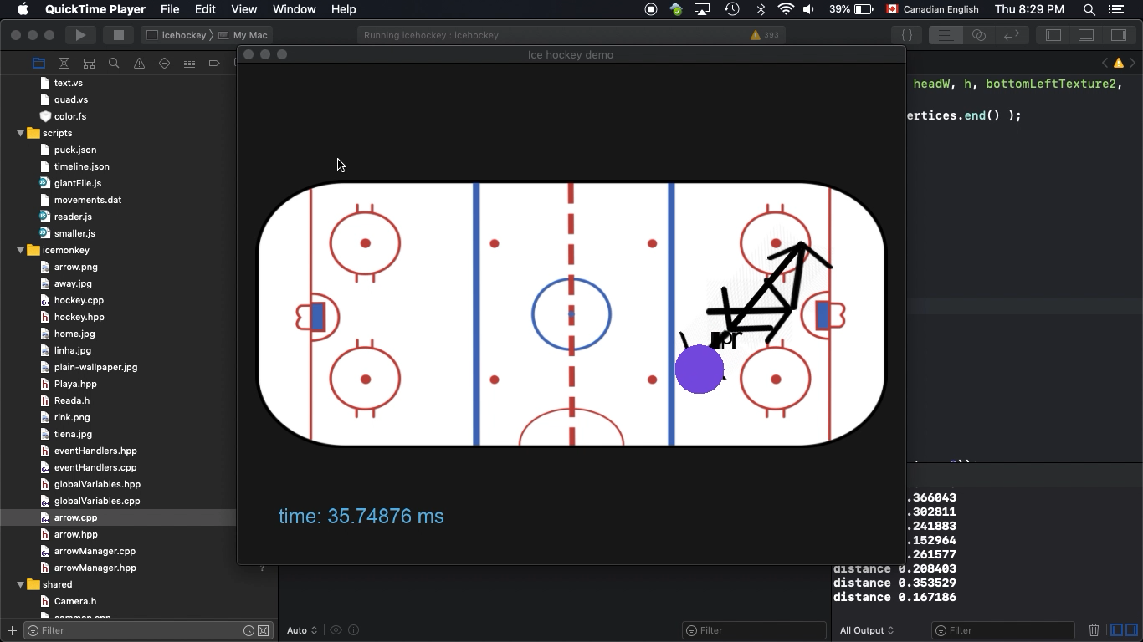
Hockey example
What are the states?
What are the rewards?
Notes:
⁨sfuvault⁩ ▸ ⁨Tien⁩/v03_with_arrow.mov

Slide 17
Factored states
In practice, RL uses a factored representation (see Russell and Norvig).
The state is defined by a list of values for a set of variables.
  E.g. in hockey, can include score, game time, locations of players, location of puck
If we have only 2 integer variables x and y, we can visualize states in a grid world
Notes:
https://cs.stanford.edu/people/karpathy/reinforcejs/gridworld_dp.html

Slide 18
Reinforcement learning algorithms

Slide 19
RL framework
learning
dynamic programming
Data
Transition Probabilities
Value Function
We will discuss model-based approaches.
  There are also model-free approaches, advanced topic.
Define your Markov Decision process model (states, rewards, actions).
  Like building a PEAS model
Use data to learn state transitions ⇒ fully defined MDP
Use algorithms to solve the MDP
Solving MDP = determine optimal action in every state

Slide 20
Returns and discounting
A trajectory is a (possibly infinite) sequence
s₀,a₀,r₀,s₁,a₁,r₁,...,s_{n},a_{n},r_{n},...
The return is the total sum of rewards.
But: if the trajectory is infinite, we have an infinite sum!
Solution: Weight rewards by discount factor γ between 0 and 1.
Return = r₀+γr₁+γ²r_{n}+...
  Getting rewards sooner is better than later
Notes:
can also interpret as probability of process eding

Slide 21
Discounting example

Slide 22
Policies
A deterministic policy π is a function that maps states to actions.
  i.e. tells us how to act.
Can also be probabilistic.
Can be implemented using neural nets.
grid world demo

Slide 23
The Value function
Given a policy and an MDP, we have the expected return, over all infinite trajectories, from using the policy at a state.
Notation: V^{π}(s)
Important: this is a powerful look-ahead concept.
  Like searching through an entire search tree for expected success
Game example: chance of winning, expected total score.
Dr. Strange looks ahead
Can also be computed by a neural network
Notes:
https://www.youtube.com/watch?v=eGKPfZTXHsc

Slide 24
Optimal Policies
A policy π* is optimal if for any other policy and for all states s
V^{π*}(s) ≥ V^{π}(s)
The value of the optimal policy is written as V*(s).

Slide 25
The action value function
Given a policy, the expected reward at a state given an action is denoted as
Q^{π}(s,a).
Similarly Q*(s,a) for the value of an action given the optimal policy.
grid example
Notes:
Show Mitchell example
http://www.cs.ubc.ca/~poole/demos/mdp/vi.html

Slide 26
RL Concepts
These 3 functions can be computed by neural networks

Slide 27
Learning Value functions
learning
dynamic programming
Data
Transition Probabilities
Value Function
Bellmann equation for computing the value function with deterministic transitions
$$V^{π}\left(s\right)=R\left(s\right)+γ{V^{π}\left(s′\right)}_{}$$
grid example
Notes:
make sure this equation displays correctly
Explain: s’ = next state given current action

Slide 28
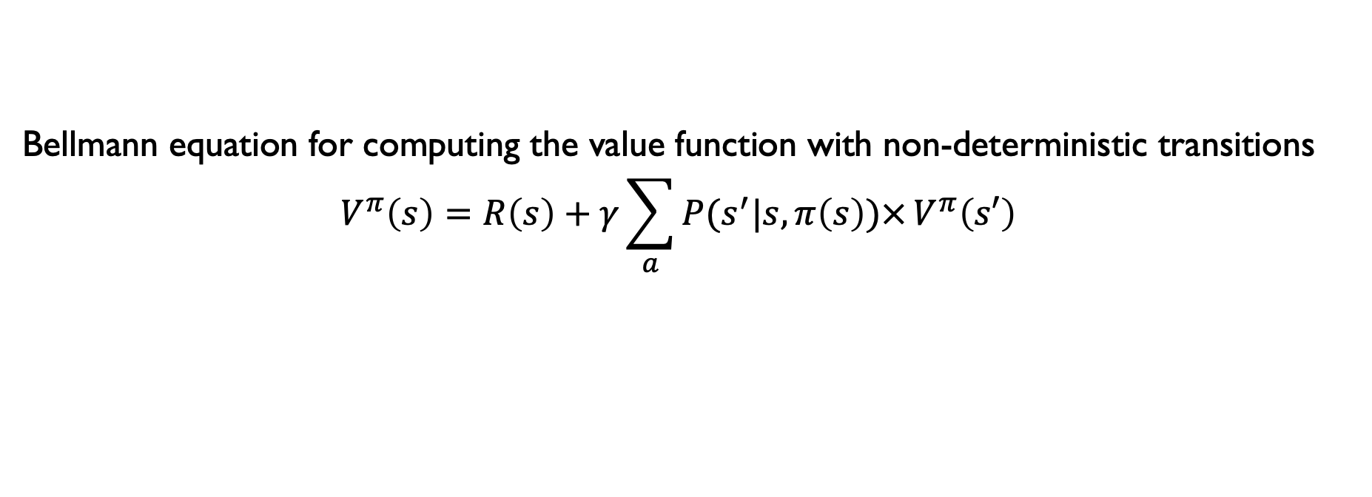
General Bellman Equation
Bellmann equation for computing the value function with non-deterministic transitions
$$V^{π}\left(s\right)=R\left(s\right)+{γ\sum_{a}{P(s^{′}|s,π\left(s\right))×}V^{π}\left(s′\right)}_{}$$
Developed for transition probabilities that are “nice”
discrete, Gaussian, Poisson,...
Notes:
make sure this equation displays correctly
Label elements to explain meaning
Would be nice to have example

Slide 29
Examples

Slide 30
Example: Alpha* games
data generated by self-play
Neural net outputs 2 quantities
  V(s), the win rate from a position
  P(a|s): vector of move probabilities
    more promising moves should have higher probability
    Like node ordering in tree search
To play, performs a (Monte Carlo) tree search using the neural net output
Watch the alphago movie

Slide 31
Ice Hockey examples
I’ve done quite a lot of work applying RL to ice hockey
Using millions of events from NHL games

Slide 32
Pipeline
Computer Vision Techniques:
Video tracking
Play-by-play Dataset
Large-scale Machine Learning
Notes:
With the advanced of computer vision techniques,
We can extract feature from professional as video
Lots of sport league, NBA, NHL…
A massive play-by-play data
Increasingly opportunity apply large scale machine learning to analyze game or player
Guide the team to draft or trade the player, with the large player market

Slide 33
Example State Trajectory on Rink
Notes:
Q-value ticker

Slide 34
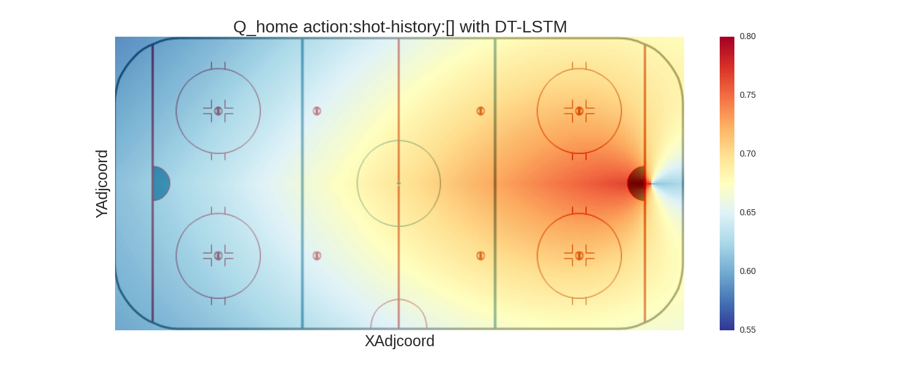
Spatial Projection
Q-value for the action “shot” action over the rink.

Slide 35
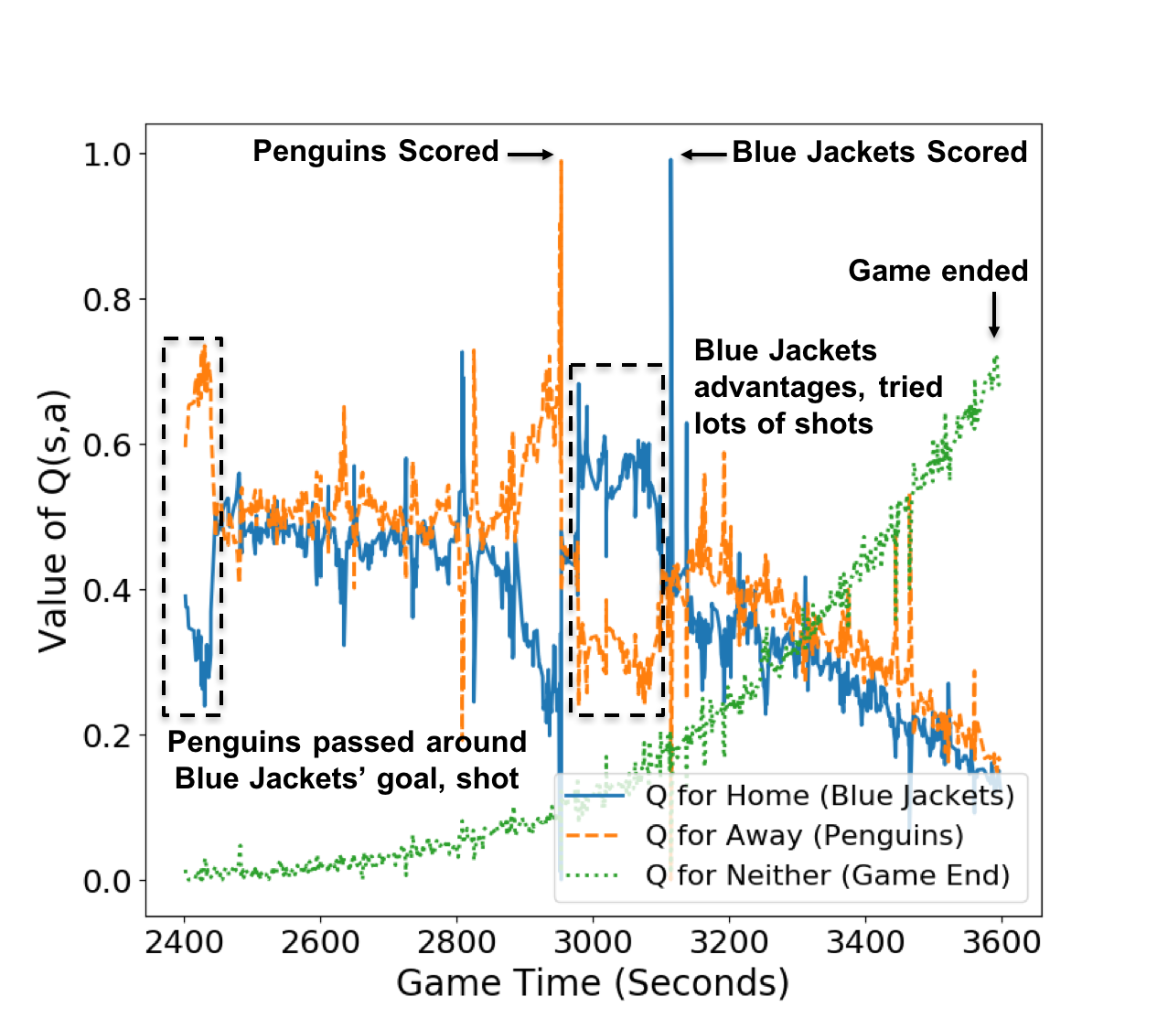
Value Ticker: Temporal Projection
Q(s, a)
Game Time
Notes:
Temporal projection of third period of a random game, X-axis: game time, Y-axis: Q values, mark the important events
(1) Spike means score, game end, (2) Q neither increase while the other two decreases

Slide 36
The Impact of an Action
expected reward
after action
expected reward
before action
Q(s, a)
Game Time
Notes:
- is like difference in Q-values
- we have also used V(s)

Slide 37
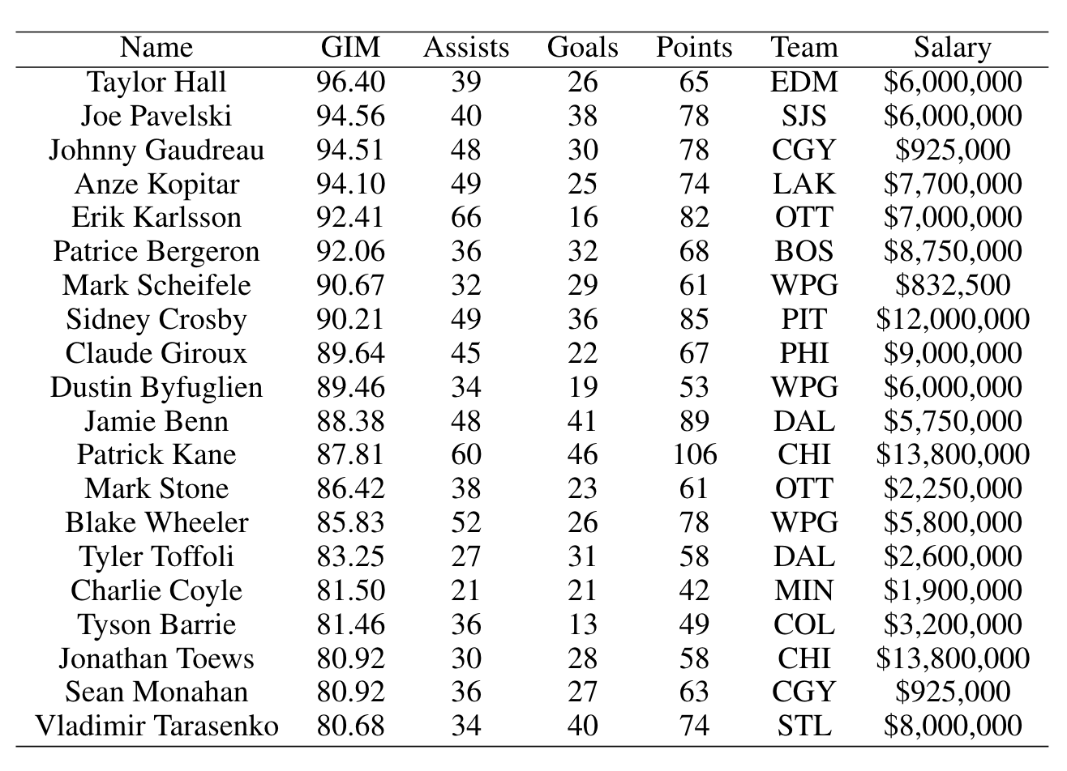
PLAYER RANKING
Rank players by the total impact of all their actions
Mark Scheifele drew salaries below what his GIM rank would suggest.
Later he received a $5M+ contract in 2016-17 season
Notes:
The top 20 players ranked by GIM
Application of ranking, find the undervalued players:
For example Mark Scheifele, who is the top 10 player suggested by our GIM, drew significant less salaries than others,
But in the next season, his potential is and he received a $5M+ contract

Slide 38
Summary
Reinforcement Learning: learning to act
Adds actions and rewards to a temporal Markov model
Learning problems:
  Value function: Compute the expected cumulative reward given a state for a given policy/ an optimal policy
  Policy optimization: Find an optimal policy
Value functions and policies can be represented in a neural net⇒ Deep RL

