Slide 1
Intelligent Agents
CHAPTER 2
Oliver Schulte

Slide 2
Outline
Agents and environments
Rationality
PEAS (Performance measure, Environment, Actuators, Sensors)
Environment types
Agent types

Slide 3
The PEAS Model

Slide 4
Agents
An agent is anything that can be viewed as perceiving its environment through sensors and acting upon that environment through actuators
Human agent:
  eyes, ears, and other organs for sensors;
  hands, legs, mouth, and other body parts for actuators
Robotic agent:
  cameras and infrared range finders for sensors
  various motors for actuators

Slide 5
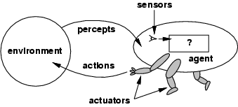
Agents and environments
The agent function maps from percept histories to actions:
[f: P* → A]
The agent program runs on the physical architecture to produce f
agent = architecture + program
Notes:
show how the same behaviour can be generated in different ways, e.g. self-driving car demo

Slide 6
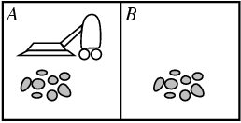
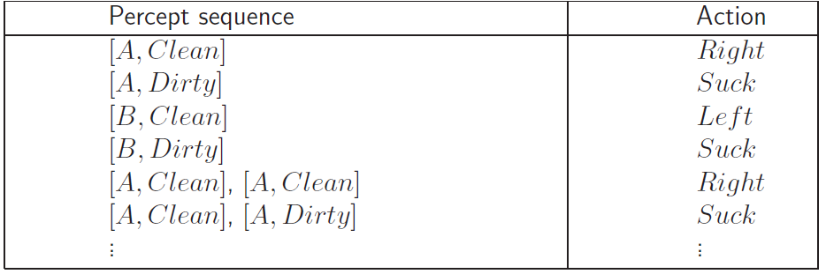
Vacuum-cleaner world
Open Source Demo
Percepts: location and contents, e.g., [A,Dirty]
Actions: Left, Right, Suck, NoOp
Agent’s function → look-up table
  For many agents this is a very large table
Notes:
Only 2 locations
aima-java.googlecode.com%5Csvn%5Ctrunk%5Caima-all%5Crelease%5Caima-gui-VacuumApp.jnlp
file name = aima-gui-VacuumApp.jpnlp
Maybe do UBC demo on reinforcement learning
Need to set 4 parameters. We can see solution immediately. But how can a computer?
Can input the problem and analyse it. But What does it mean to “input a problem” (bascially, specify PEAS)
Can learn from behaviour

Slide 7
Rational agents
Rationality
  Performance measuring success
  Agents prior knowledge of environment
  Actions that agent can perform
  Agent’s percept sequence to date
Rational Agent: For each possible percept sequence, a rational agent should select an action that is expected to maximize its performance measure, given
the evidence provided by the percept sequence, and
whatever built-in knowledge the agent has.
Notes:
See File: intro-choice.doc

Slide 8
Rationality
Rational is different from omniscience
  Percepts may not supply all relevant information
  E.g., in card game, don’t know cards of others.
Rational is different from being perfect
  Rationality maximizes expected outcome while perfection maximizes actual outcome.

Slide 9
Autonomy in Agents
The autonomy of an agent is the extent to which its
behaviour is determined by its own experience,
rather than knowledge of designer.
Extremes
  No autonomy – ignores environment/data
  Complete autonomy – must act randomly/no program
Example: baby learning to crawl
Ideal: design agents to have some autonomy
  Possibly become more autonomous with experience

Slide 10
The PEAS Framework
Performance measure, Environment, Actuators, Sensors.

Slide 11
PEAS
PEAS: Performance measure, Environment, Actuators, Sensors
Specifies the setting for designing an intelligent agent

Slide 12
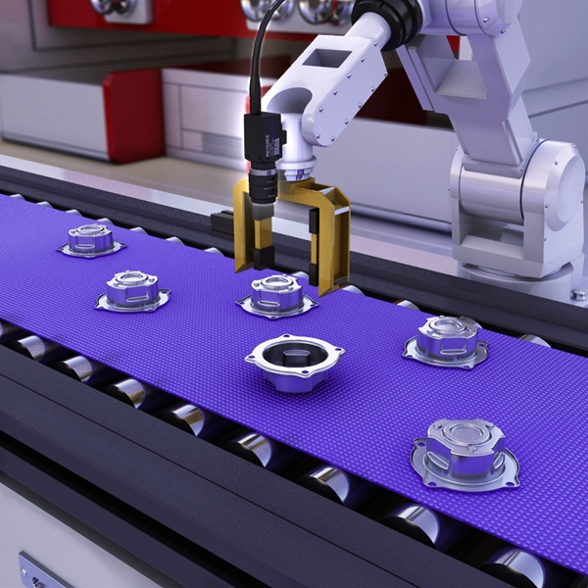
PEAS: Part-Picking Robot
Agent: Part-picking robot
Performance measure: Percentage of parts in correct bins
Environment: Conveyor belt with parts, bins
Actuators: Jointed arm and hand
Sensors: Camera, joint angle sensors

Slide 13
PEAS
Agent: Interactive Spanish tutor
Performance measure: Maximize student's score on test
Environment: Set of students
Actuators: Screen display (exercises, suggestions, corrections)
Sensors: Keyboard

Slide 14
Discussion: Self-Driving Car
Performance measure:
Environment:
Actuators:
Sensors:
Notes:
Consider, e.g., the task of designing a self-driving car.
Performance measure: Safe, fast, legal, comfortable trip, maximize profits, minimize accidents.
Environment: Roads, other traffic, pedestrians, customers.
Actuators: Steering wheel, accelerator, brake, signal, horn.
Sensors: Cameras, sonar, speedometer, GPS, odometer, engine sensors, keyboard

Slide 15
Environments

Slide 16
Environment types
Fully observable (vs. partially observable)
Deterministic (vs. stochastic)
Episodic (vs. sequential)
Static (vs. dynamic)
Discrete (vs. continuous)
Single agent (vs. multiagent).

Slide 17
Fully observable (vs. partially observable)
Is everything an agent requires to choose its actions available to it via its sensors?
  If so, the environment is fully observable
If not, parts of the environment are unobservable.
  Agent must make informed guesses about world.
Cross Word
Poker
Backgammon
Taxi driver
Part picking robot
Image analysis
Fully
Partially
Fully
Partially
Partially
Fully
Notes:
Satellite image analysis. Some categories depend on definition of task.
In decision theory: perfect information vs. imperfect information.
robot: guess which part it is dealing with because of vision problem.

Slide 18
Deterministic (vs. stochastic)
Does the change in world state depend only on current state and agent’s action?
Non-deterministic environments
  Have aspects beyond the control of the agent
  Utility functions have to guess at changes in world
Cross Word
Cross Word
Poker
Poker
Backgammon
Backgammon
Taxi driver
Taxi driver
Part picking robot
Part
Image analysis
Image analysis
Deterministic
Stochastic
Stochastic
Stochastic
Stochastic
Deterministic

Slide 19
Episodic (vs. sequential):
Is the choice of current action
  Dependent on previous actions?
  If not, then the environment is episodic
In sequential environments:
  Agent has to plan ahead:
    Current choice will affect future actions
Cross Word
Poker
Backgammon
Taxi driver
Part picking robot
Image analysis
Sequential
Sequential
Sequential
Sequential
Episodic
Episodic

Slide 20
Static (vs. dynamic):
Static environments don’t change
  While the agent is deliberating over what to do
Dynamic environments do change
  So agent should/could consult the world when choosing actions
Semidynamic: If the environment itself does not change with the passage of time but the agent's performance score does.
Cross Word
Poker
Backgammon
Taxi driver
Part picking robot
Image analysis
Static
Static
Static
Dynamic
Dynamic
Semi
Another example: off-line route planning vs. on-board navigation system
Notes:
Alternatively: anticipate the change during deliberation OR make decision very fast.
image analysis is semidynamic because time is ticking away
maybe they’re missing stationary

Slide 21
Discrete (vs. continuous)
A limited number of distinct, clearly defined percepts and actions vs. a range of values (continuous)
Cross Word
Poker
Backgammon
Taxi driver
Part picking robot
Image analysis
Discrete
Discrete
Discrete
Conti
Conti
Conti

Slide 22
Single agent (vs. multiagent):
An agent operating by itself in an environment vs.
there are many agents working together
Cross Word
Poker
Backgammon
Taxi driver
Part picking robot
Image analysis
Single
Multi
Multi
Multi
Single
Single

Slide 23
Discussion: Self-Driving Car
 | Observable | Deterministic | Episodic | Static | Discrete | Agents
Self-Driving Car | partially | non-deterministic | sequential | dynamic | continuous | multi-agent
Apple self-driving car was rear-ended by Nissan Leaf
Notes:
https://www.reuters.com/article/us-apple-autos/apples-self-driving-car-involved-in-accident-california-dmv-idUSKCN1LG2X1
should be similar to taxi driver

Slide 24
Summary.
 | Observable | Deterministic | Episodic | Static | Discrete | Agents
Cross Word | Fully | Deterministic | Sequential | Static | Discrete | Single
Poker | Partially | Stochastic | Sequential | Static | Discrete | Multi
Backgammon | Fully | Stochastic | Sequential | Static | Discrete | Multi
Taxi driver | Partially | Stochastic | Sequential | Dynamic | Conti | Multi
Part picking robot | Partially | Stochastic | Episodic | Dynamic | Conti | Single
Image analysis | Fully | Deterministic | Episodic | Semi | Conti | Single
Notes:
How many environment types are there in total?

Slide 25
Environments and Rational Choice
Fully Observable
yes
no
Deterministic
no
yes
Certainty: Search
Uncertainty
Notes:
Comparison to game theory. How can you have full observability with nondeterminism? E.g. GPS system: knows its state, but doesn’t know whether driver will follow its instructions. Can argue philosophically that nondeterminism involves partial observability because there must be hidden factors that determine outcome.

Slide 26
Agents
Agent Types
learning

Slide 27
Agent types
Four basic types in order of increasing generality:
  Simple reflex agents
  Reflex agents with state/model
  Goal-based agents
  Utility-based agents
  All these can be turned into learning agents
Notes:
http://www.ai.sri.com/~oreilly/aima3ejava/aima3ejavademos.html

Slide 28
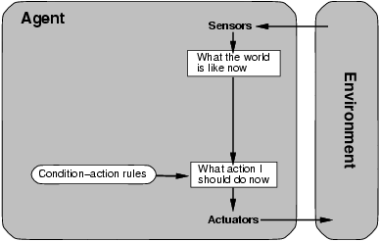
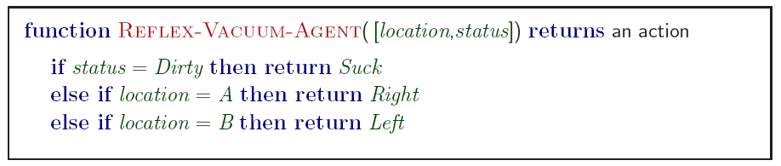
Simple reflex agents
Notes:
Based on sensors

Slide 29
Vacuum Cleaner Reflex Agent
Robot forgets past, knows only current square
History | State | Action
[A,Clean] | [A,Clean] | Right
[A,Clean,Right; B, Dirty] | [B,Dirty] | Suck
[A,Clean,Right; B, Dirty, Suck; B, Clean] | [B, Clean] | Left
[A,Clean,Right; B, Dirty, Suck; B, Clean, Left; A, Clean] | [A, Clean]

Slide 30
Simple reflex agents
Simple but very limited intelligence.
Action does not depend on percept history, only on current percept.
  Thermostat.
Therefore no memory requirements.
Infinite loops
  Suppose vacuum cleaner does not observe location. What do you do given location = clean? Left on A or right on B -> infinite loop.
  Fly buzzing around window or light.
  Possible Solution: Randomize action.
Notes:
Chess – openings, endings
Lookup table (not a good idea in general)
35¹⁰⁰ entries required for the entire game
Think of html protocol, fire and forget.

Slide 31
States: Beyond Reflexes
Recall the agent function that maps from percept histories to actions:
[f: P* → A]
An agent program can implement an agent function by maintaining an internal state.
  e.g. cell phone knows its battery usage
The internal state can contain information about the state of the external environment.
The state depends on the history of percepts and on the history of actions taken:
[f: P*, A*→ S →A] where S is the set of states.
Notes:
If each internal state includes all information relevant to information making, the state space is Markovian.

Slide 32
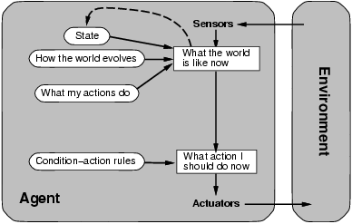
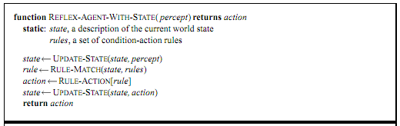
State-based reflex agents
Update state = remember history
Many (most?) state-of-the-art systems for open-world problems follow this architecture
  (e.g. translation)
No thinking

Slide 33
Model-based reflex agents
Know how world evolves
  Overtaking car gets closer from behind
Predict how agents actions affect the world
  Wheel turned clockwise takes you right
Model-based agents predict consequences of their actions

Slide 34
Goal-based agents
knowing state and environment? Enough?
  Car can go left, right, straight
Has a goal
  A destination to get to
Uses knowledge about a goal to guide its actions
  E.g., Search, planning

Slide 35
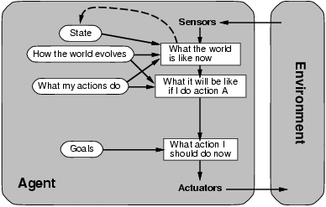
Goal-based agents
Reflex agent brakes when it sees brake lights. Goal based agent reasons
  Brake light -> car in front is stopping -> I should stop -> I should use brake
Notes:
see self-driving car demo

Slide 36
Example
The Monkey and Banana Problem
Monkeys can use a stick to grasp a hanging banana
Notes:
https://en.wikipedia.org/wiki/Monkey_and_banana_problem

Slide 37
Utility-based agents
Goals are not always enough
  Many action sequences get car to destination
  Consider other things. How fast, how safe…..
A utility function maps a state onto a real number which describes the associated degree of “happiness”, “goodness”, “success”.
Where does the utility measure come from?
  Economics: money.
  Biology: number of offspring.
  Your life?
Notes:
Example: why is it important to get a good grade in this course?

Slide 38
Utility for Self-Driving Cars
What is the performance metric?
Safety - No accidents
Time to destination
What if accident is unavoidable? E.g.
  is it better to crash into an old person than into a child?
  How about 2 old people vs. 1 child?

Slide 39
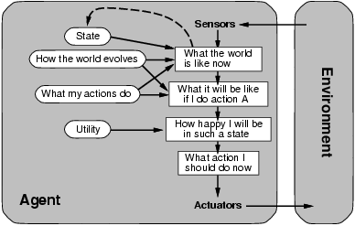
Utility-based agents

Slide 40
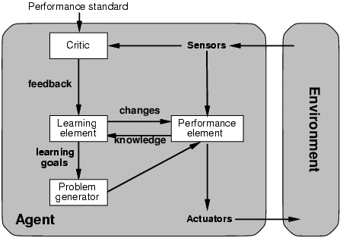
Learning agents
Performance element is what was previously the whole agent
  Input sensor
  Output action
Learning element
  Modifies performance element.
Notes:
Problem generator: acts in new ways, explores.

Slide 41
Learning agents
Critic: how the agent is doing
  Input: checkmate?
  Fixed
Problem generator
  Tries to solve the problem differently instead of optimizing.
  Suggests exploring new actions -> new problems.

Slide 42
Learning agents (Self-Driving Car)
  Performance element
    How it currently drives
  Actuator (steering): Makes quick lane change
  Sensors observe
    Honking
    Sudden Proximity to other cars in the same lane
  Learning element tries to modify performance elements for future
    Problem generator suggests experiment: try out something called Signal Light
  Exploration vs. Exploitation
    Exploration: try something new
    Improved Performance in the long run
    Cost in the short run
Notes:
build in knowledge: e.g. use signal light? Nature vs. nuture
give example of apple car being re-ended

Slide 43
The Big Picture: AI for Model-Based Agents
Planning
Decision Theory
Game Theory
Action
Reinforcement Learning
Knowledge
Learning
Logic
Probability
Heuristics
Inference
Machine Learning
Statistics

Slide 44
The Picture for Reflex-Based Agents
Action
Reinforcement Learning
Learning
Studied in AI, Cybernetics, Control Theory, Biology, Psychology.
Skinner box

Slide 45
Discussion Question
Model-based reasoning has a large overhead.
Our large brains are very expensive from an evolutionary point of view.
Why would it be worthwhile to base behaviour on a model rather than “hard-code” it?
For what types of organisms in what type of environments?
  The dodo is an example of an inflexible animal
Notes:
Bill Bryson: “Millions of years of peaceful isolation had not prepared it for the erratic and deeply unnerving behavior of human beings...If you wished to find all the dodos in a vicinity you had only to catch one and set it to squawking, and all the others would waddle along to see what was up.”

Slide 46
Summary
Agents can be described by their PEAS.
Environments can be described by several key properties: 64 Environment Types.
A rational agent maximizes the performance measure for their PEAS.
The performance measure depends on the agent function.
The agent program implements the agent function.
4 main architectures for agent programs.
In this course we will look at some of the common and useful combinations of environment/agent architecture.
Notes:
AI is about finding the right agent architecture for the PEAS.

