Slide 1
Introduction to
Artificial Intelligence
CMPT 310
Oliver Schulte

Slide 2
Topics
Intelligent Agents.
Multi-agent decision making, game theory.
Search
Probability
Reasoning under uncertainty
Bayesian networks
Learning
Logic (time permitting)

Slide 3
Course Aims
Two aims:
  Give you an understanding of what AI is
    Aims, abilities, methodologies, applications, …
  Equip you with techniques for solving problems
    By writing/building intelligent software/machines

Slide 4
Computers and Intelligence
Why use computers for intelligent behaviour at all?
  They can do some things better than us.
    Big calculations quickly and reliably
    Search through many options.
    Avoid common mistakes.
  Cognitive Science: building intelligent machines helps us understand the nature of intelligence.
Informal Definition of AI: “Things that humans are good at, but computers are not (yet).”
Notes:
maybe show emails from AAAI

Slide 5
Intelligent Behavior: Examples (?)
Siri, Google Voice Search
Soccer Goalie Robot
Object Tracking
roboclean talk
roboclean action
Watson Game Show
Watson U.S. cities
Learn to flip pancakes
Asimo human like
Self-Driving Car. No Hands Across America
Notes:
What do we learn from these examples?
Pancake flipping: teaching is easier than programming. Sensory input is key.
Watson: also uses reinforcement learning, markov decision processes.
Uncertainty has to do with intelligence (knowing what you don’t know). Contrast with dung beetle.
When was no hands across america done?

Slide 6
AI Research

Slide 7
AI Research at SFU
Various opportunities for funding:
  NSERC Undergraduate Research Award. Full-time research in the summer.
  Work-study SFU.
  RAships from professors.
AI researchers
  Richard Vaughan. Robotics.
  Anoop Sarkar. Fred Popowich.Linguistics, Machine Translation.
  James Delgrande. Logic and AI.
  David Mitchell. Eugenia Ternovska. Logic, Theorem Proving, Constraint Satisfaction.
  Greg Mori. Vision, Tracking.
  Oliver Schulte. Machine Learning, Network Analysis.

Slide 8
What is AI?
Views of AI fall into four categories:
Thinking humanly | Thinking rationally
Acting humanly | Acting rationally
Modern view (ie. Since 1990s): Acting rationally.
In economics and statistics, since the 1920s or earlier.

Slide 9
Thinking
Humanly and Rationally

Slide 10
Thinking humanly: cognitive modeling
Validate by comparing with thinking in humans
Cognitive science brings together
  computer models from AI
  experimental techniques from psychology
to construct the working of the human mind.

Slide 11
Thinking rationally
Aristotle: what are correct arguments/thought processes?
Several Greek schools developed various forms of logic:
  notation and rules of derivation for thoughts;
Direct line through mathematics and philosophy to modern AI.

Slide 12
Acting
Humanly and rationally
The TurinG Test
The Chinese Room

Slide 13
Acting Humanly
Turing (1950) "Computing machinery and intelligence":
"Can machines think?" → "Can machines behave intelligently?”
The Imitation Game
Turing's article
Skills required:
  Natural language processing
  Knowledge representation
  Automated reasoning
  Machine learning
Predicted that by 2000, a machine might have a 30% chance of fooling a lay person for 5 minutes
  Mitsuku
  Eliza
  Loebner Prize

Slide 14
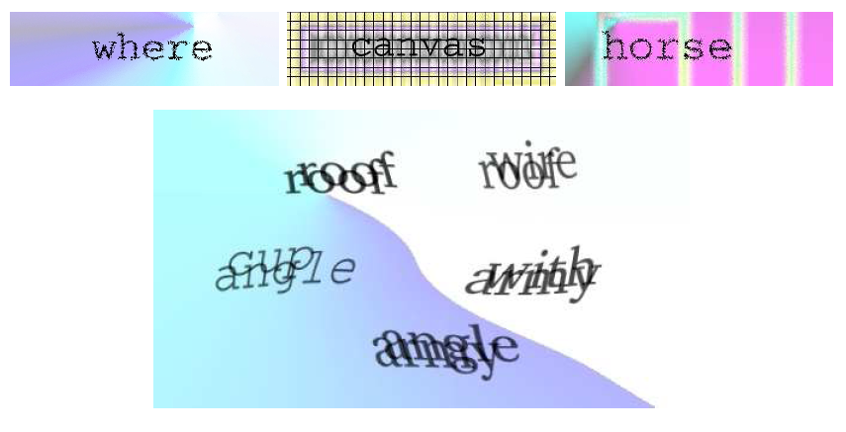
Captcha
Completely Automated Public Turing test to tell Computers and Humans Apart

Slide 15
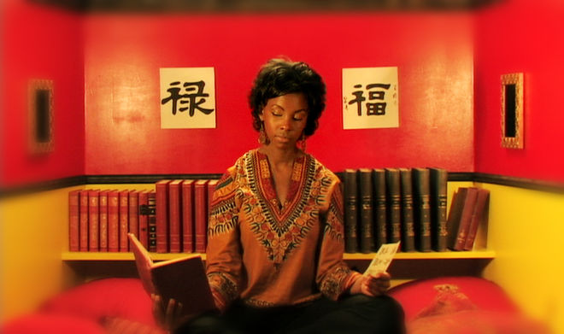
Searle’s Chinese Room
Person sits in Chinese room
The room has a book with rules for mapping Chinese input sentences to output sentences.
This allows the person in the room to carry on a conversation with a Chinese speaker.

Slide 16

The Translation Room
German | Spanish
Schach | ajedrez
königliche | real
das | el
Spiel | juego
ist | es
Jane is given a translation table like the one shown
We ask her to translate “Schach ist das königliche Spiel” into Spanish
Her answer “ajedrez es el juego real”
Correct!
Does this mean that she speaks German and Spanish?
Notes:
show also in google translate

Slide 17
Chinese Room Conclusion
Modest conclusion: it is possible for a program to engage in speech recognition, conversation, translation without understanding language.
Stronger conclusion (controversial): it is possible for a program to pass the Turing test without understanding language.
Strongest conclusion (very controversial): computer programs can only apply rules, not understand the meaning of language.
Infinite AI Loop

Slide 18
Rational Action
Rational behavior: doing the right thing
The right thing: that which is expected to maximize goal achievement, given the available information

Slide 19
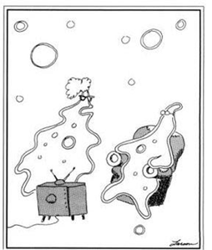
Acting vs. Thinking
Does acting require thinking?
Not always.
  Iroboclean? Dyson cleaner?
  blinking reflex.
  Insects. Do dung beetles think?
  Siri? Watson?
What are the advantages of thinking? Why would a thinking animal have evolved?
Thinking seems to lead to
  flexibility and
  robustness.
Stimulus, response! Stimulus, response! Don't you ever THINK?"

Slide 20
History and Related Fields

Slide 21
AI prehistory
Philosophy
  Can formal rules be used to draw valid conclusions?
  Where does knowledge come from?
  How does knowledge lead to action?
Mathematics/Statistics
  What are the formal rules to draw valid conclusion?
  How do we reason with uncertain information?
  How do intelligent agents learn?
Economics
  How should we make decisions to maximize payoff?
  How should we do this when others are making decisions too?
Psychology
  How do humans and animals think?
Computer Science
  How can we build efficient computers?
Linguistics
  How does language relate to thoughts?
  knowledge representation, grammar
Notes:
Statistics is missing

Slide 22
Abridged history of AI
1943 McCulloch & Pitts: Boolean circuit model of brain
1950 Turing's "Computing Machinery and Intelligence“
1950s Early AI programs, including Samuel's checkers
1965 Robinson's complete algorithm for logical reasoning
1966—73 AI discovers computational complexity
Neural network research almost disappears
1969—79 Early development of knowledge-based systems
1980-- AI becomes an industry
1987-1993 AI winter; industry collapses
1986--1995 Neural networks return to popularity, wane again.
1995-- The emergence of intelligent agents
2012—2017 Deep neural nets become popular

Slide 23
State-of-the-art
Autonomous planning and scheduling
  NASA's Mars Rover on-board program controlled the operations for a spacecraft a hundred million miles from Earth
Game playing:
  Deep Blue defeated the world chess champion Garry Kasparov in 1997
  Alphago defeated top player in 2016
Autonomous control
  Tesla Autopilot https://www.youtube.com/watch?v=tP7VdxVY6UQ
Language understanding and problem solving
  solves crossword puzzles better than most humans
  automated speech assistant (Siri)
Notes:
https://www.youtube.com/watch?v=tP7VdxVY6UQ
Problems around 3 min

Slide 24
Inspirations for AI
Major question:
  “How are we going to get a machine to
  act intelligently to perform complex tasks?”

Slide 25
Inspirations for AI
1. Logic
  Studied intensively within mathematics
  Gives a handle on how to reason intelligently
Example: automated reasoning
  Proving theorems using deduction
  http://www.youtube.com/watch?v=3NOS63-4hTQ
Advantage of logic:
  We can be very precise (formal) about our programs
Disadvantage of logic:
  Not designed for uncertainty.

Slide 26
Inspirations for AI
2. Introspection
  Humans are intelligent, aren’t they?
Expert systems
  Implement the ways (rules) of the experts
Example: MYCIN (blood disease diagnosis)
  Performed better than junior doctors

Slide 27
Inspirations for AI
3. Brains
  Our brains and senses are what give us intelligence
Neurologist tell us about:
  Networks of billions of neurons
Build artificial neural networks
  In hardware and software (mostly software now)
Build neural structures
  Interactions of layers of neural networks
    http://www.youtube.com/watch?v=r7180npAU9Y&NR=1
    Neurons Firing

Slide 28
Inspirations for AI
4. Evolution
  Our brains evolved through natural selection
So, simulate the evolutionary process
  Simulate genes, mutation, inheritance, fitness, etc.
Genetic algorithms and genetic programming
  Used in machine learning
  Used in Artificial Life simulation

Slide 29
1.2 Inspirations for AI
5. Society
  Humans interact to achieve tasks requiring intelligence
  Can draw on group/crowd psychology
Software should therefore
  Cooperate and compete to achieve tasks
Multi-agent systems
  Split tasks into sub-tasks
  Autonomous agents interact to achieve their subtask
    http://www.youtube.com/watch?v=1Fn3Mz6f5xA&feature=related
    http://www.youtube.com/watch?v=Vbt-vHaIbYw&feature=related
    Used in movies too.

Slide 30
Decision Theory and Rational Agents
For any given class of environments and task, we seek the agent (or class of agents) with the best performance.
The primary goal is performance, not
  thinking
  consciousness
  intelligence
  autonomy
  These may be means to achieve performance.
Performance measure is usually given by the user or engineer. Economics: rationality = maximize utility (performance).
computational limitations make perfect performance unachievable
  design best program for given machine resources
Notes:
= best performance = maximization

