Slide 1

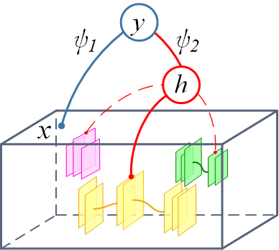
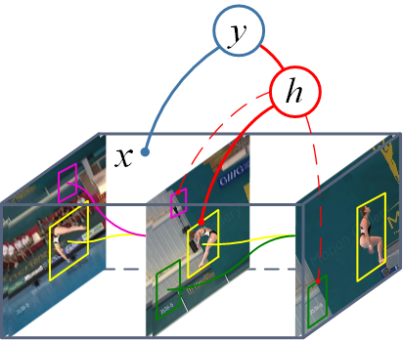
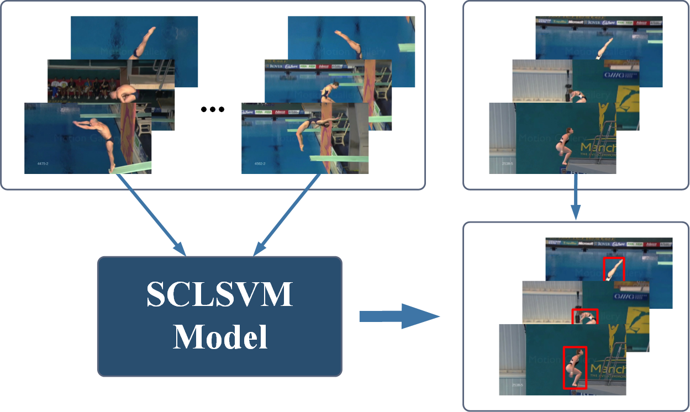
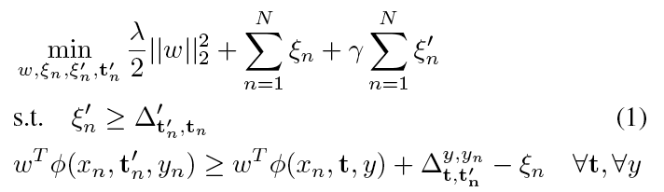
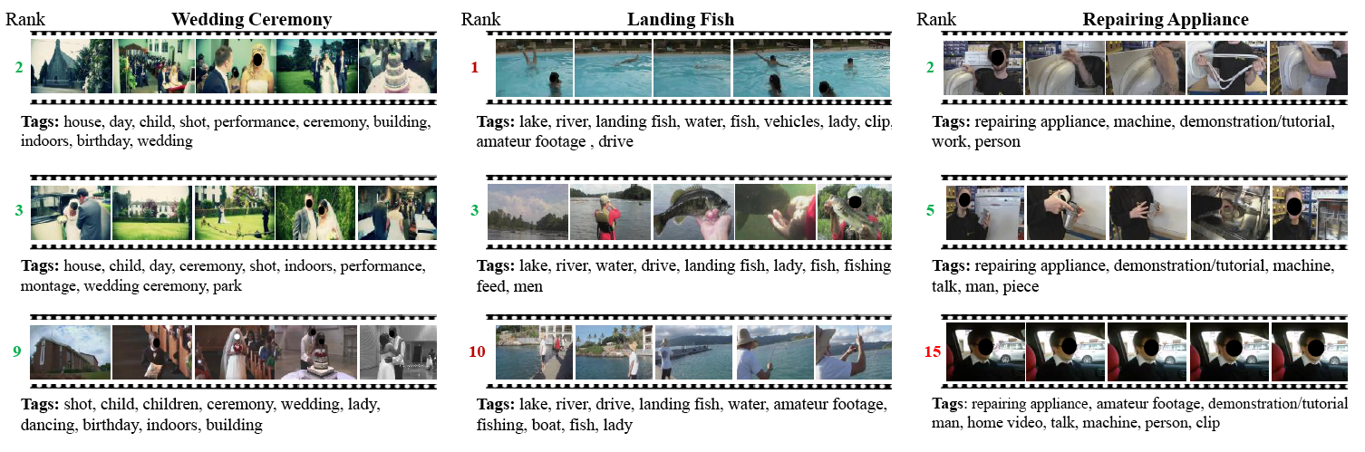
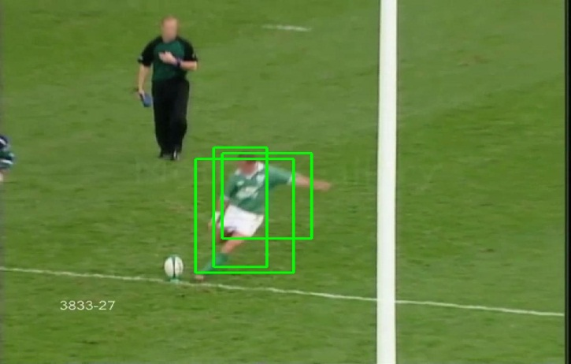
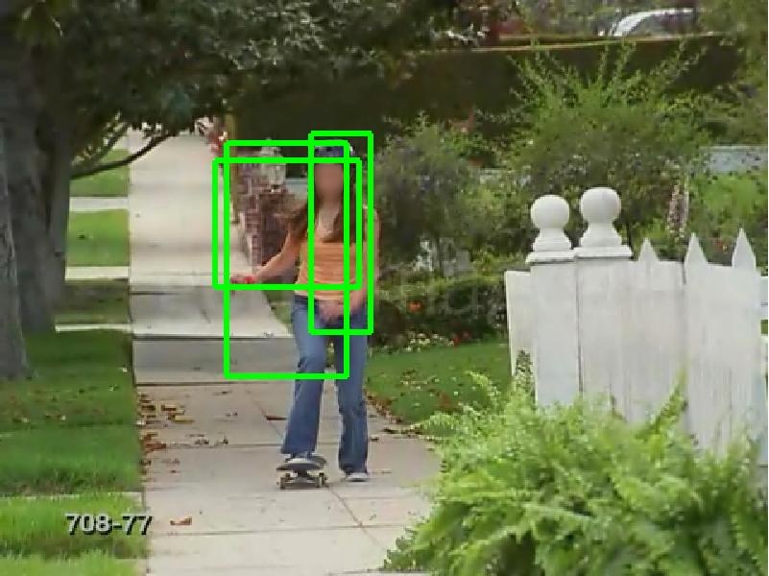
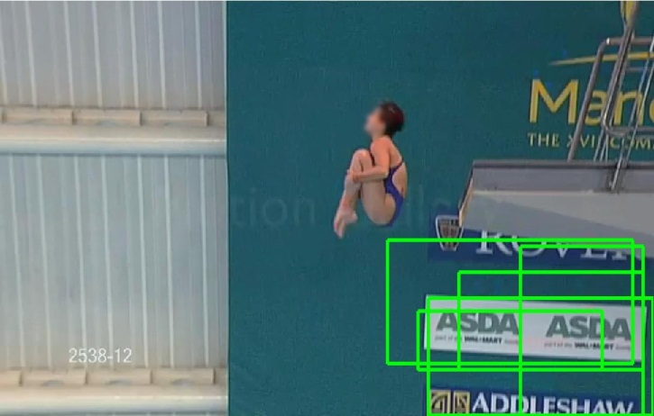
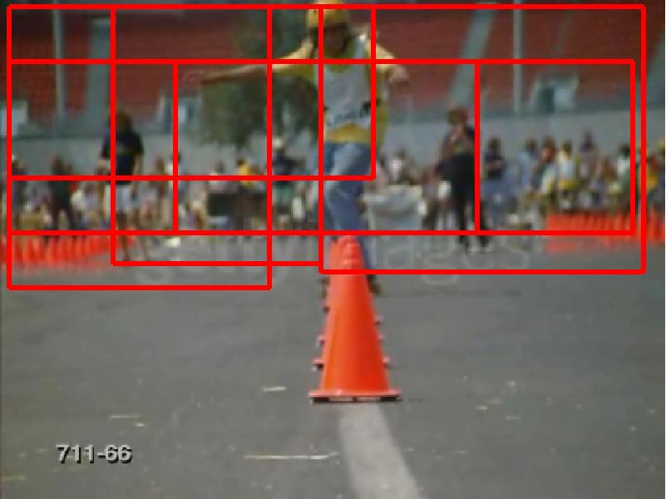
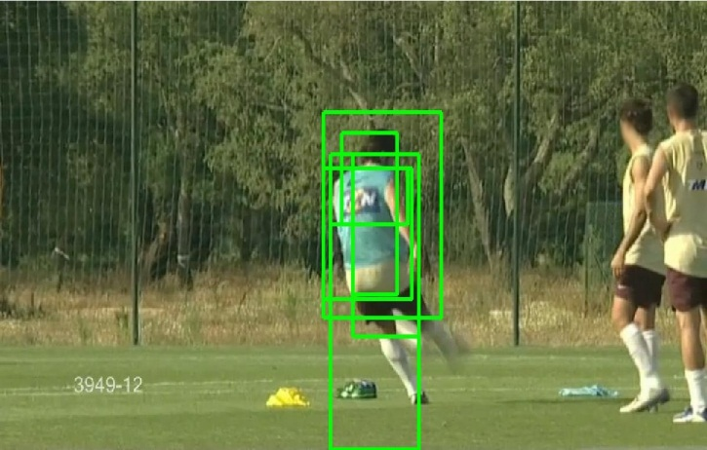
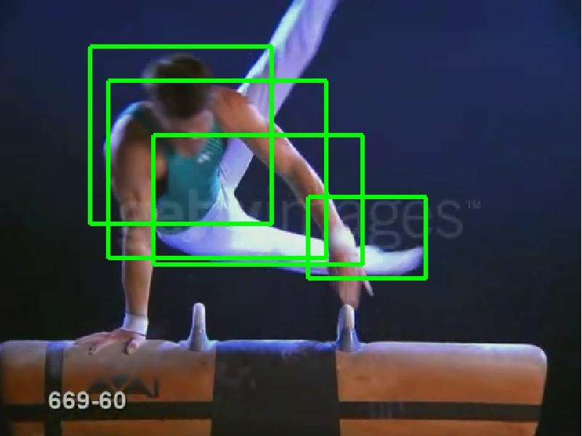
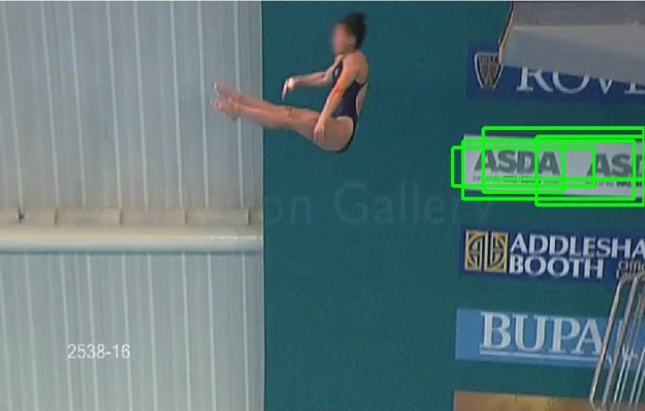
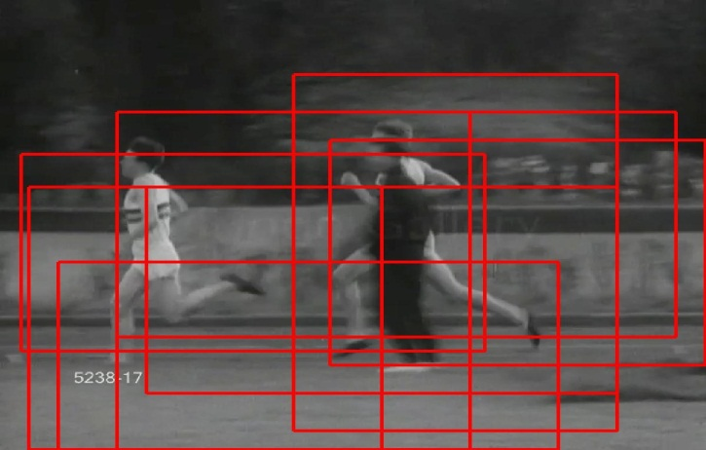
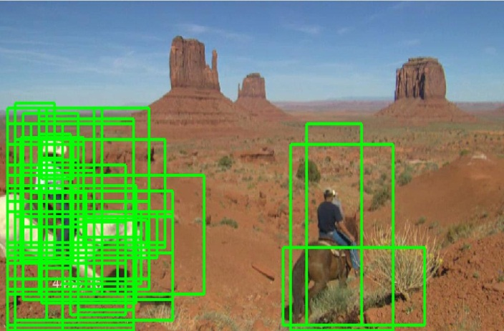
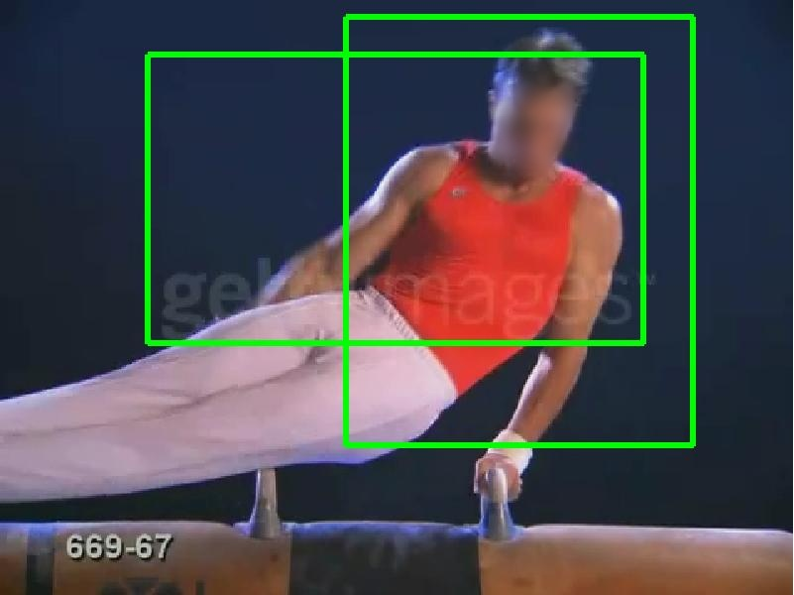
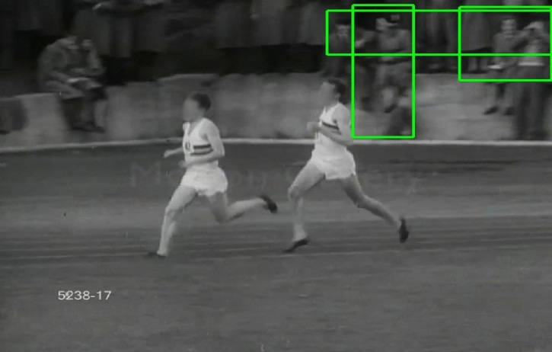
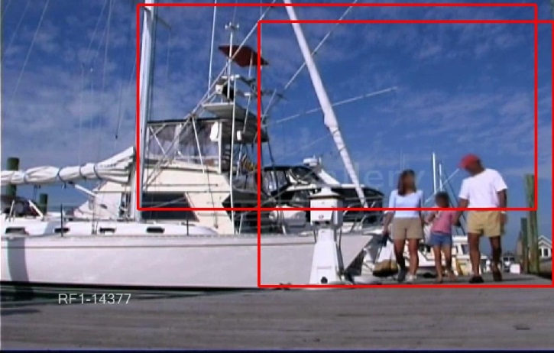
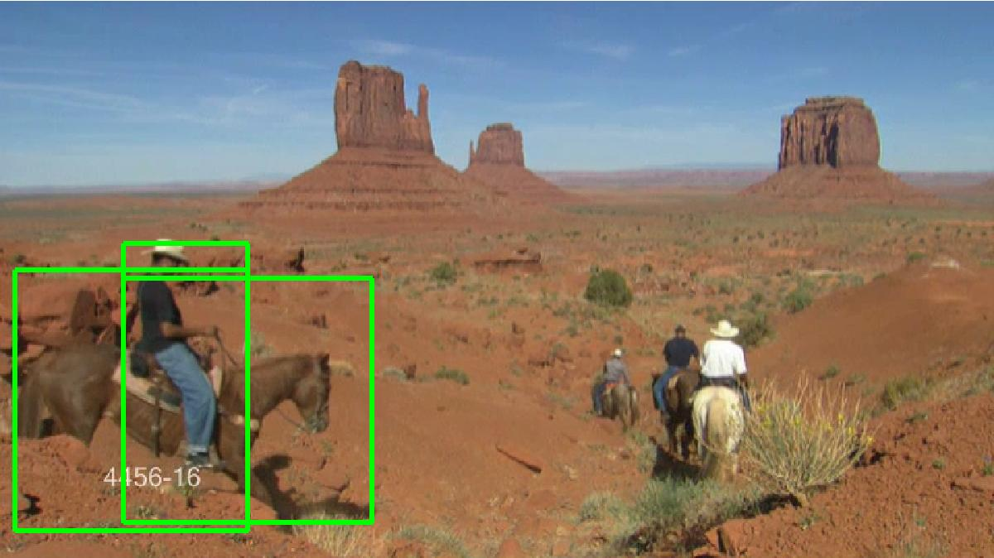
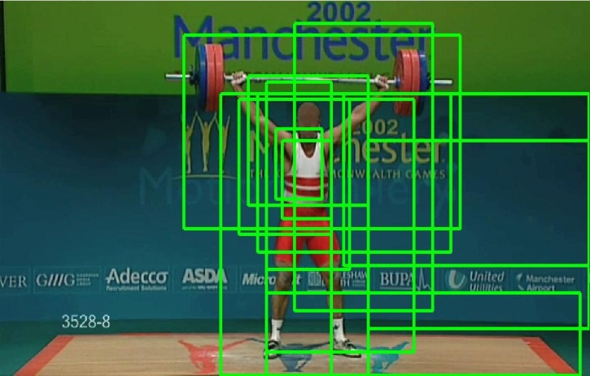
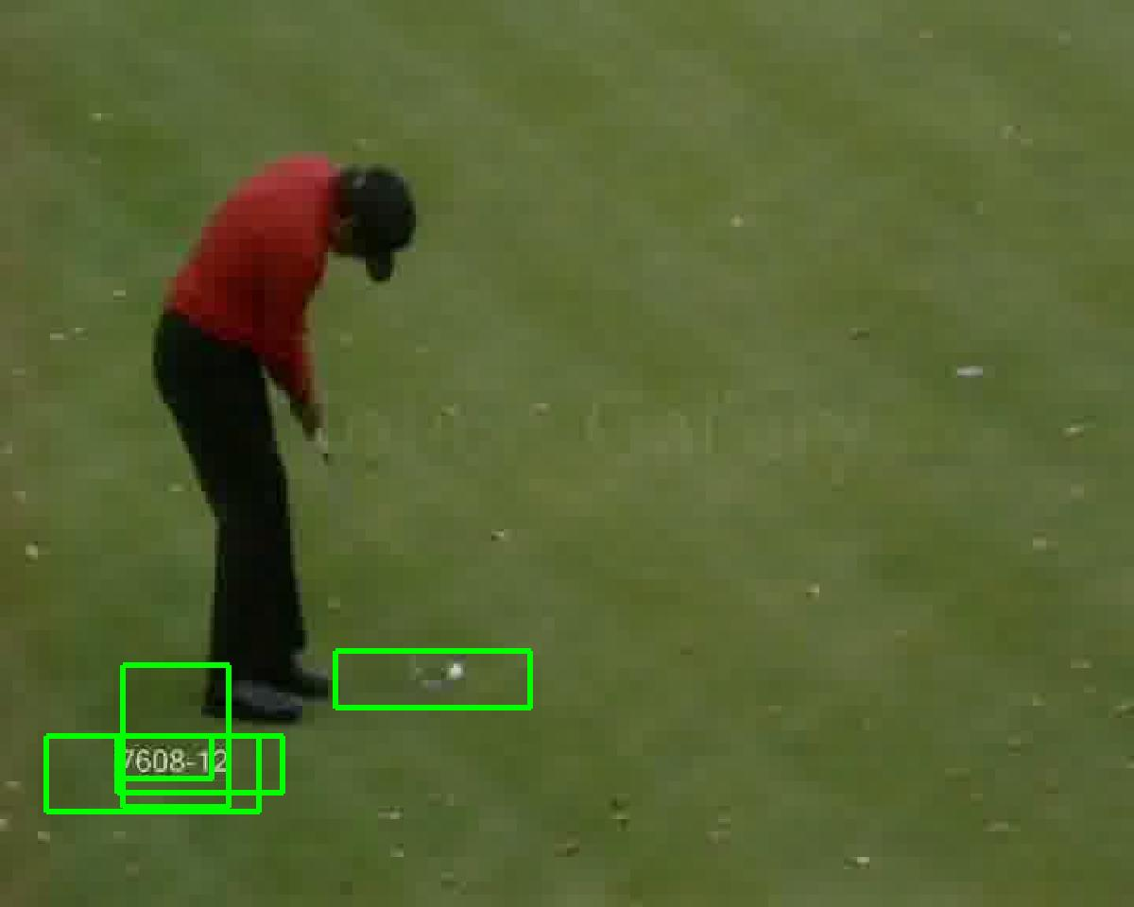
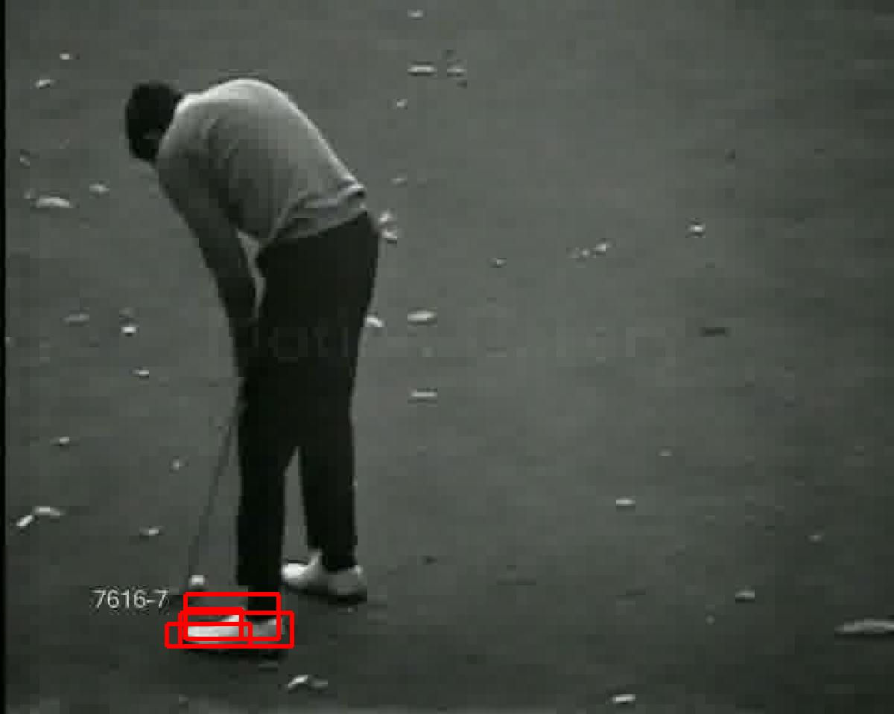
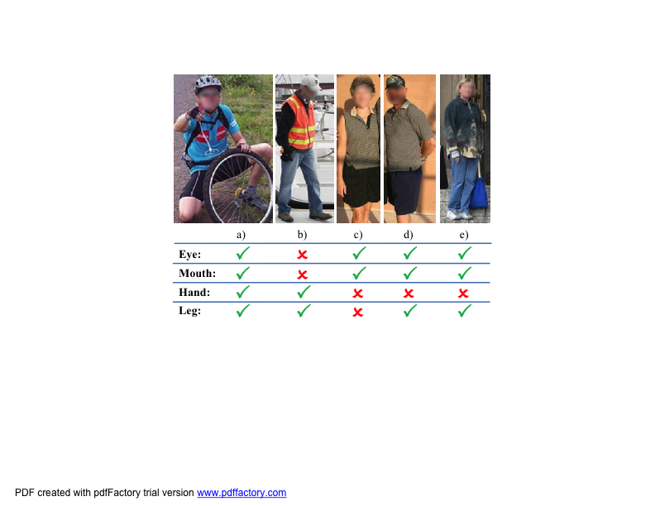
Weakly Supervised Action Recognition
Nataliya Shapovalova, Arash Vahdat, Kevin Cannons, Tian Lan, and Greg Mori
Simon Fraser University
Vision and Media Lab
PROBLEM
Perform action classification while:
– localizing the evidence from the video that
led to the classification decision
– encouraging consistency of latent variables
across all the training data
Contribution: A novel Similarity Constrained Latent SVM that considers pairwise similarity of latent variables across all the training data
MODEL FORMULATION
The scoring function for image feature x, latent region h and action label y is defined as:
Latent variable h is a collection of similar regions across all the frames of the video
PROBLEM
Perform video retrieval and detect semantic tags. Training these models is difficult:
– noisy training data for tags either due to visual ambiguity or missing labels on training data
Contribution: A novel learning algorithm FlipSVM that models label noise by flipping labels on training data
FLIP SVM
Training with images x, tags t and video label y.
Tags automatically obtained, either from human labeling (aPASCAL, aYahoo attributes datasets) or automatic text analysis of captions (Topia)
Both result in noisy tags
Choose model parameters, modifying SVMstruct framework to permit label flips, penalizing for too many flips
Action label
Video
Training videos Test video
Diving
Output
video-action potential
latent region-action potential
EXPERIMENTS
TRECVID MED11 DEV-T/O.
Extract 100 tags from training data.
Predict event category and tags on
test data.
Retrieved video rank and tags shown.
SIMILARITY CONSTRAINED LSVM
Extends the Latent SVM, adding one more slack variable:
SCLSVM learning requires inference of h, which is challenging due to the added constraint that links all the latent variables for all videos in the training set.
EXPERIMENTS Dataset: UCF-sports
Quantitative results of classification accuracy and regions similarity:
Qualitative examples of classification and evidence localization:
new term, penalty for dissimilarity of latent variables
 | BoW | LSVM | SCLSVM | Lan et al. ICCV11
Accuracy | 65.4 | 70.4 | 75.3 | 73.3
Regions Similarity | – | 0.1928 | 0.2322 | –
Examples of correctly classified testing videos Misclassified videos
constraint on similarity; linking all the latent variables together
pairwise dissimilarity between selected latent region of video i and latent region of video j

