Slide 1
Nonparametric Methods: Support Vector Machines
Oliver Schulte
CMPT 726 Machine Learning
Notes:
If you use “insert slide number” under “Footer”, that text box only displays the slide number, not the total number of slides. So I use a new textbox for the slide number in the master.

Slide 2
The Support Vector Machine Classification Formula

Slide 3
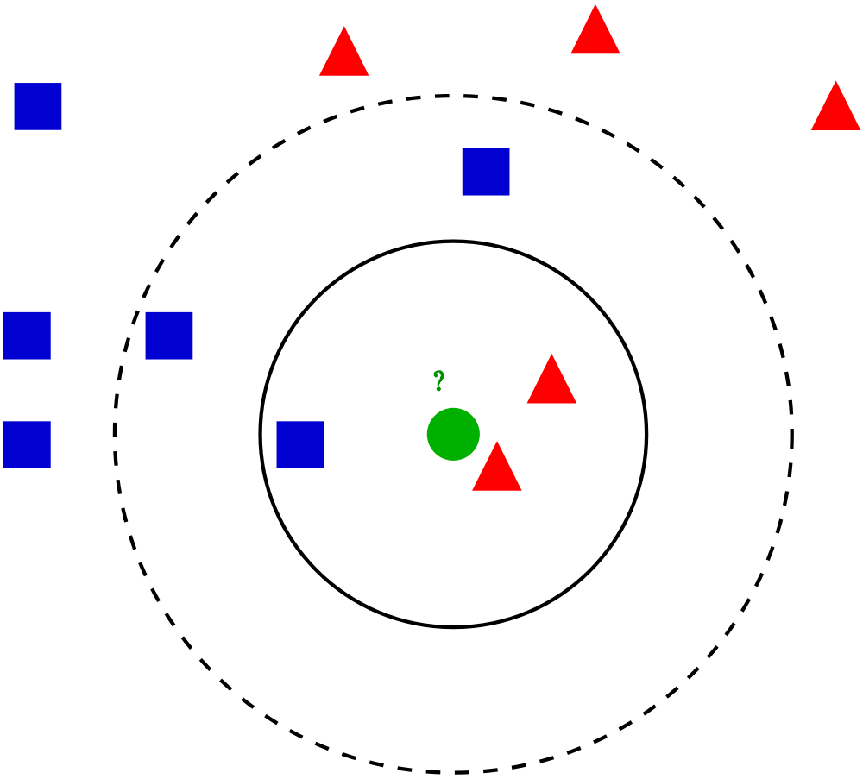
Weighted Nearest Neighbour?
5-nearest neighbour classifies green point as blue
But the red triangles are much closer
Could consider a weighted average vote where closer data points count for more

Slide 4
Issues for Weighted Vote
Support Vector Machine provide a form of weighted average vote
To understand the motivation, let’s consider the challenges in developing the idea
  Measuring closeness
  Encoding class labels
  Restricting the vote to important data points

Slide 5
Measuring Closeness
How to quantify how close a data point is to the query point?
Can use a kernel to converts distances to similarity/closeness
  More on that later
For now we use the dot product (x • x_{j})
  Measures the cosine of the angle between two vectors
  For centered vectors, measures their covariance
Possible classification formula (not yet final)
  h(x) = [Σ_{j} (x • x_{j}) y_{j} ] - b
bias term
Notes:
collinear = angle = 0 = cosine = 1
N x covariance = dot product for centered vectors
bias term is subtracted for technical reasons, can be positive or negative
consistent with text

Slide 6
Encoding Class Labels
  Consider the average vote
  Σ_{j} (x • x_{j}) y_{j}
  If negative class labels are encoded as y = 0, they just disappear in the sum.
  Solution: encode the negative class as y = -1.
    (we’re just pretending these are real numbers anyway)
  positive neighbours vote for the positive class
  negative neighbours vote for the negative class

Slide 7
Global Importance
  So does h(x) = [Σ_{j} (x • x_{j}) y_{j} ] – b work?
  Not really, because it sums over all instances
  Computational problem: say I have 10K instances (e.g. movies). Need to compute dot product for all 10 K
    Slow predictions
  Statistical problem: the many distant instances dominate the few close ones
  ➔get similar predictions for every data point
  SVM solution:
    add a weight α_{j} for each data point
    enforce sparsity so that many data points get 0 weights
Big Idea!
Notes:
tell kinect story

Slide 8
SVM Classification Formula
Compute weighted thresholded vote =
[Σ_{j} α_{j} (x • x_{j}) y_{j} ] – b
If vote > 0, label x as positive
If vote < 0, label x as negative
In symbols h(x) = sign( [Σ_{j} α_{j} (x • x_{j}) y_{j} ] – b)
How can we learn the weights α_{j}?
Notice that the weights are like parameters, but more data points ➔ more weights

Slide 9
Learning Importance Weights

Slide 10
SVMs Are Linear Classifiers
linear combination of data points
Assuming dot product, that is.
Dot product is linear in its arguments
Σ_{j} α_{j} y_{j} (x_{j} • x) = Σ_{j} (α_{j} y_{j} x_{j} • x) = (Σ_{j} α_{j} y_{j} x_{j}) • x
Defining w := (Σ_{j} α_{j} y_{j} x_{j}), the SVM discriminant function is
w• x-b – linear classifier!
Notes:
At least k points in sphere.
Legend:
Green circle = test case.
Solid circle: k = 3
Dashed circle: k = 5.

Slide 11
Important Points for Linear Classifiers
Assume linear separability
What points matter for determining the line?
The borderline points!
These are called support vectors
Notes:
Can also show in 1 D
+ + + -----

Slide 12
Line Drawing
The second big idea of SVMs
Where should we try the line between the classes?
Right in the middle!

Slide 13
The Maximum Margin Classifier
Distance from positive/negative class to decision boundary =
distance of closest positive/negative class to boundary
Margin = minimum distance of either class to boundary
Line in the middle = both classes at same distance = max margin
Maximum Margin
Smaller Margin
-1
Notes:
circles are support vectors

Slide 14
Objective Function
How to find the weights?
After a lot of math, maximizing the following function does it
argmax{α_{j}: Σ_{j}α_{j} - 1/2Σ_{j,k} (α_{j}α_{k} y_{j}y_{k}( x_{j} • x) }
where α_{j}≥0 and Σ_{j}α_{j}y_{j}=0
Quadratic problem: convex, tractable
α_{j}>0 ➔support vector. For most j, we have α_{j}=0.
Can replace ( x_{j} • x) by other similarity metrics

Slide 15
The Kernel Trick

Slide 16
Linear Non-Separability
What if the data are not linearly separable?
recall: Can transform the data with basis functions so that they are linearly separable

Slide 17
Linear Classification With Gaussian Basis Function
φ₂: measures closeness to red centre
3D version
φ₁: measures closeness to blue centre
Notes:
Legend:
left: datapoints in 2D. Red and blue are class labels (ignore). – 2 Gaussian basis functions, we see the centers shown as crosses and the countours shown by green circles.
Right: Each point is now mapped to another pair of numbers phi 1 = (1-distance to blue centre)/2. phi 2: (1-distance to red centre)/2
On right, classes are linearly separable, see black line. The black line on right corresponds to the black circle on left.
Intuitive example: think of Gaussian centers as indicating parts of a picture, or parts of a body.
svm video at https://www.youtube.com/watch?v=3liCbRZPrZA

Slide 18
Transformation
(x₁)²+(x₂)²=0 is boundary
Linearly Non-separable
Linearly Separable

Slide 19
The Kernel Trick
Naive Option
compute basis functions
compute dot product for basis functions
Kernel Trick
Compute dot product for basis functions directly using similarity metric on original feature vectors

Slide 20
Example
f1 | f2 | f3
(x₁)² | (x₂)² | √2x₁x₂
g1 | g2 | g3
(z₁)² | (z₂)² | √2z₁z₂
Exercise: show that
(f1,f2,f3) •(g1, g2,g3) = [(x1,x2) • (z1,z2)]²

Slide 21
Kernels
A kernel converts distance to similarity
E.g. K(d) = max{0,1-(2|x|/10)²
Can also define kernels directly as similarity metrics: K(x,z)
Many kernels exist, e.g. for vectors, matrices, strings, graphs, images....

Slide 22
Mercer’s Theorem (1909)
For any reasonable kernel K, there is a set of basis functions F such that K(x,z) = F(x) •F(z).
In words, the kernel computes the dot product in basis function space without actually computing the basis functions!
For SMVS, this means that we can find the support vectors for non-separable problems without having to compute basis functions.
Set of basis functions can be very large, even infinite.

Slide 23
Example 1
SVM with Gaussian kernel K(x,z) = exp{- dist(x,z)/2σ²}
Support vectors circled
Linear decision boundary in basis function space ➔
non-linear in original feature space

Slide 24
Example 2
SVM trained using cubic polynomial kernel
K(x,z) = (x • z +1)³
linearly separable
not linearly separable

