Slide 1
Linear Regression
Oliver Schulte
Machine Learning 726
Notes:
R+ N: y is always the true value, h_x(x) is the predicted value

Slide 2
Parameter Learning Scenarios
The general problem: predict the value of a continuous variable from one or more continuous features.
Parent Node/ Child Node | Discrete | Continuous
Discrete | Maximum Likelihood Decision Trees | logit distribution (logistic regression)
Continuous | conditional Gaussian | linear Gaussian (linear regression)

Slide 3
Single Node Case
Examples of Continuous Random Variables
NHL: Sum of Games Played After 7 Years
House Prices
Term Marks in Course
How to define probability distribution?
Can no longer use a table
Term Marks
Notes:
show example from 310 grades

Slide 4
Discretization
Simplest Idea: Assign continuous data to discrete groups (bins).
E.g. A,B,C,D,E,F
Equal width: set bins according to variable values.
E.g. 100-90,90-80,70-60,50-40
Equal frequency: set bins so that each bin has same number of students.
E.g. choose cut-offs so that 10% of students get an A, 10% a B, 10% a C
Curving: set bins to match a prior distribution
e.g. match grade distribution in other CS 3rd-year courses
See actual cut-offs in 310
Notes:
for equal width, show google spreadsheet example

Slide 5
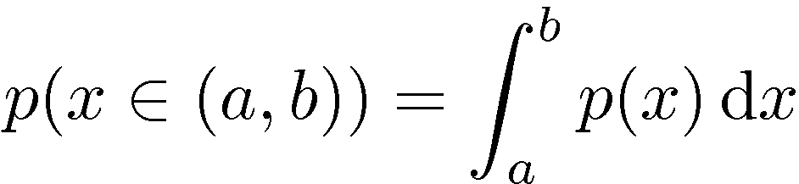
Density Function
Define a function p(X=x)
Behaves like a probability for X=x but not quite.
The density function defines a probability for intervals via integration.
P(T) = 1 becomes
Exercise: Find the p.d.f. of the uniform distribution over a closed interval [a,b].

Slide 6
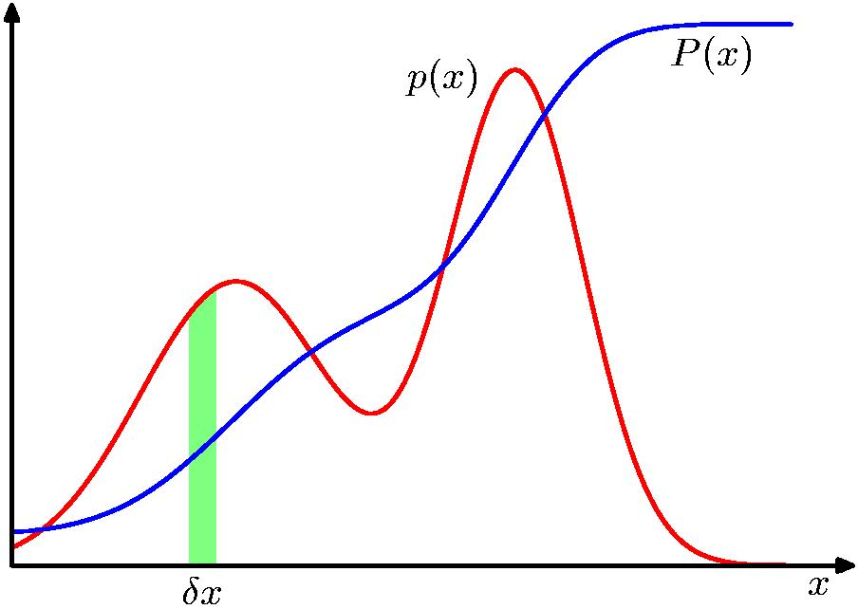
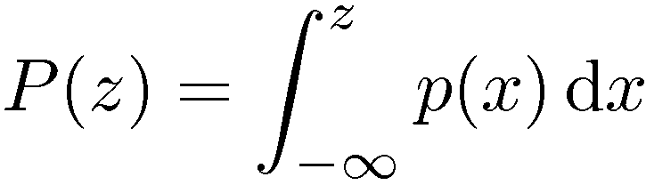
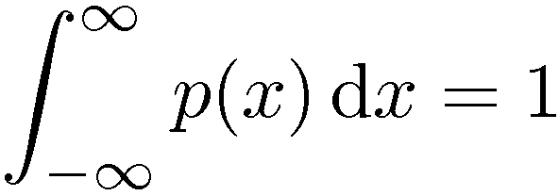

Probability Densities
Notes:
x can be anything

Slide 7
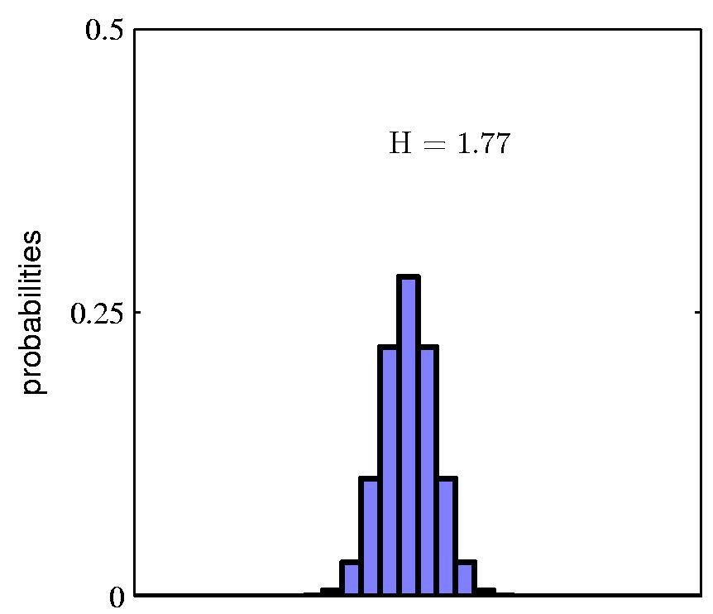
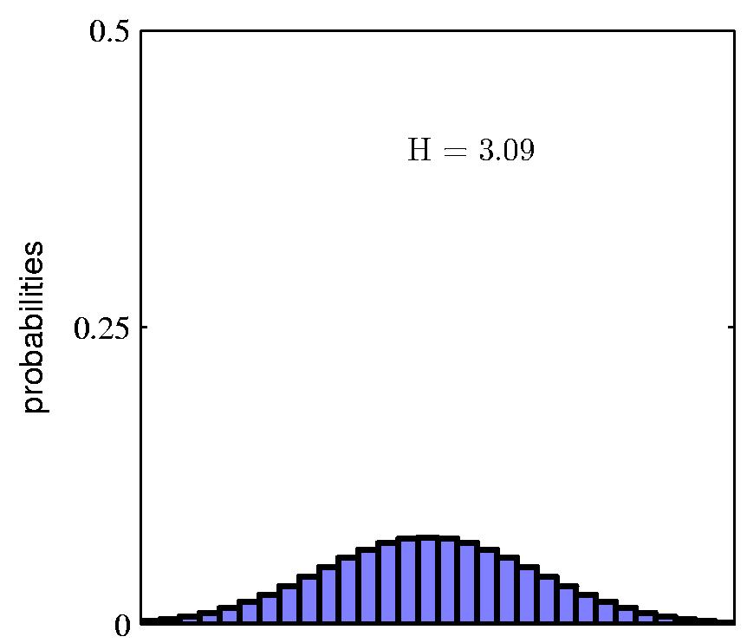
Histograms approximate densities
A density function is like a smoothed histogram (for infinitely many bins and infinitely many data points)
probability = count/# objects
Notes:
See also 310-grades sheets in google drive and https://www.benlcollins.com/spreadsheets/histograms-normal-distribution/ and histogram-gaussian figure

Slide 8
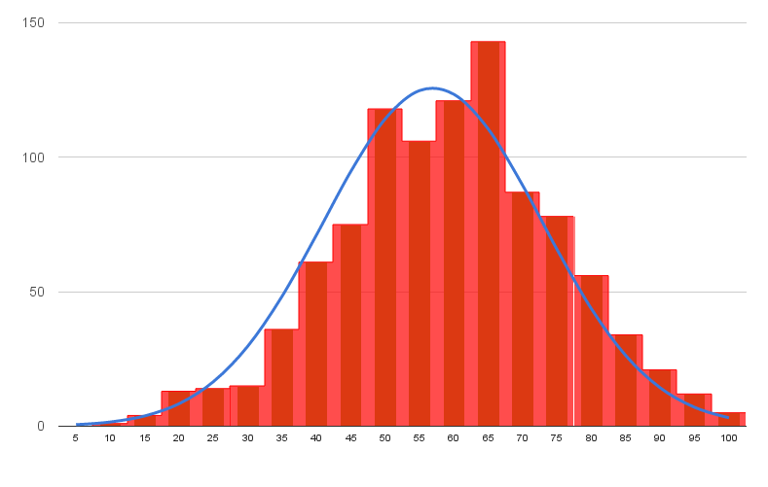
Densities as limit histograms
let B be a bin in a histogram
height(B) = count(B) by definition
area(B) = height(B) x width(B) = count(B) x width(B)
therefore count(B) = height(B) = area(B)/width(B)
p(x in B) = area(B) as width(B) ➔0
p(x) = count(B) x width(B) as width(B) ➔0
Can think of p(x) as proportional to counts around x
Notes:
show google spreadsheet xample

Slide 9
Mean
Aka average, expectation, or mean of P.
Notation: E, µ.
How to define for a density function?
Example Excel
Notes:
Give example of grades.

Slide 10
Variance
Variance of a distribution:
Find mean of distribution.
For each point, find distance to mean. Square it. (Why?)
Take expected value of squared distance.
Measures the spread of continuous values.
Example Excel

Slide 11
The Gaussian Density Function

Slide 12
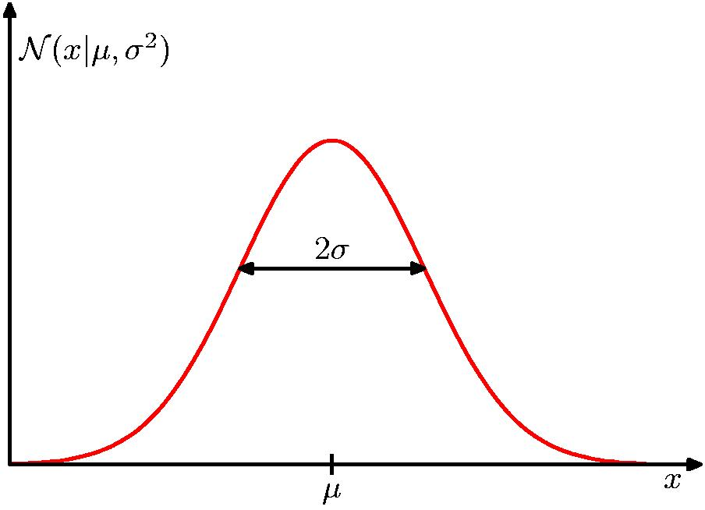
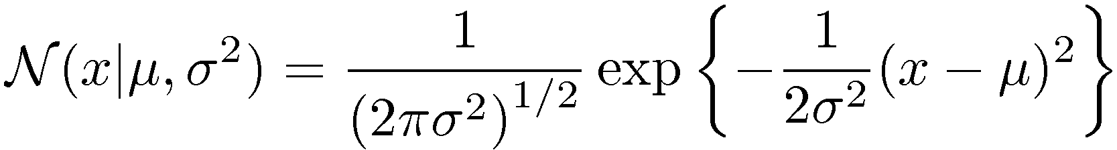
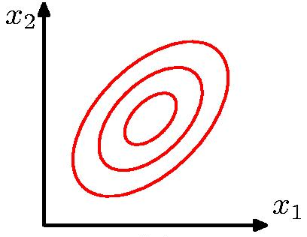
The Gaussian Distribution

Slide 13
Meet the exponential family
A common way to define a probability density p(x) is as an exponential function of x.
Simple mathematical motivation: multiplying numbers between 0 and 1 yields a number between 0 and 1.
E.g. (1/2)^{n}, (1/e)^{x}.
Deeper mathematical motivation: exponential pdfs have good statistical properties for learning.
E.g., conjugate prior, maximum likelihood, sufficient statistics.
Notes:
In fact, the exponential family is the only class with these properties.
To see this for conjugate prior, note that the likelihood is typically a product (i.i.d. data). So the posterior is proportional to prior x product. If the prior is also a product (exponential), then the posterior is a product like the prior. If the prior is something else, then something else x product is usually not something else.

Slide 14
Reading exponential prob formulas
Suppose there is a relevant feature f(x) and I want to express that “the greater f(x) is, the less probable x is”.
f(x)⬆, p(x)⬇
Use p(x) = α exp(-f(x)).

Slide 15
Example: exponential form sample size
Fair Coin: The longer the sample size, the less likely it is.
p(n) = 2^{-n}.
ln[p(n)]
Sample size n
Notes:
Try to do matlab plot. Slope goes down because of minus sign.

Slide 16
Location Parameter
The further x is from the center μ, the less likely it is.
ln[p(x)]
(x-μ)²

Slide 17
Spread/Precision parameter
The greater the spread σ², the more likely x is (away from the mean).
The greater the precision β, the less likely x is.
ln[p(x)]
1/σ² = β

Slide 18
Normalization
Let p*(x) be an unnormalized density function.
To make a probability density function, need to find normalization constant α s.t.
Therefore
For the Gaussian (Laplace 1782)
Notes:
So all I have to do is solve the integral!

Slide 19
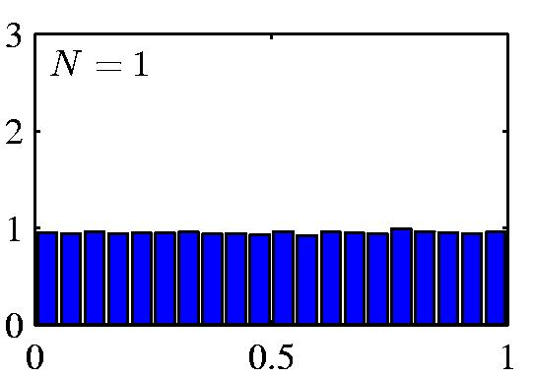
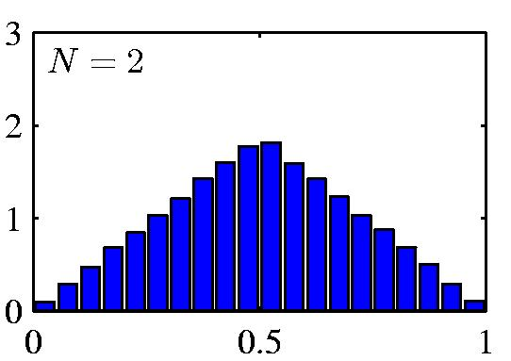
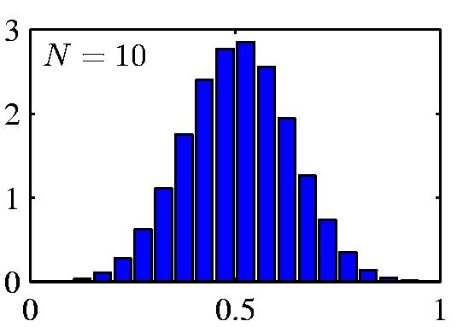
Central Limit Theorem
The distribution of the sum/mean of N i.i.d. random variables becomes increasingly Gaussian as N grows.
Laplace (1810).
Example: N uniform [0,1] random variables.

Slide 20
Log-linear Models
Many probability distributions used in machine learning follow this exponential pattern for assigning a probability or density to an object x.
Define a set of aggregate functions T₁(x),..,T_{m}(x) known as sufficient statistics
The log-probability is proportional to a weighted sum of the sufficient statistics
Works for anything: documents, videos, term marks, data sets,
e.g. discrete BN estimation: where w_{ijk} = ln(θ_{ijk})
Notes:
Division of labour: define statistics vs. learn the weights

Slide 21
Maximum Likelihood Learning
Same fundamental idea as with discrete variables: maximize data likelihood given parameters.
The likelihood function for Gausssian distribution:
Log-likelihood function
Find derivatives of L, set to 0.
For details see text and assignment.
Results:
For mean, the MLE estimate is the sample mean
For standard deviation the MLE estimate is the sample sd
MLE estimates track the data

Slide 22
Parameter Learning: Discrete Parents

Slide 23
Conditional Gaussian Models
If all parents are discrete, simply make conditional probability table where entries are (mean, variance) rather than probabilities.
GP>0 | mean(age) | variance(age)
yes | 19.25 | 3.91
no | 19.13 | 3.12

Slide 24
Regression Trees
As with discrete variables, can replace conditional probability tables by regression trees.
Leaf contains (mean, variance).
GP>7
yes
no
age μ=19.25
σ²= 3.91
age μ= 19.13
σ²= 3.12

Slide 25
Covariance and Correlation
Single continuous parent

Slide 26
Probabilistic Dependence for Continuous Variables
For discrete parents, observing parent value changes probability of child value: P(child|parent) ≠ P(child)
But with continuous parents, cannot condition on single value. What to do?
Answer: consider changes in parent values
E.g. if parent value increases, so does child value
Exam1
Term Mark
Notes:
see excel spreadsheet under correlation tab

Slide 27
Covariance
“if parent value goes up” – compared to what?
Statistical Answer: the expected value or mean
Quantify strength of connection: look at the difference to the mean
Covariance(X,Y) = E[(X-μ_{X}) (Y-μ_{Y})]

Slide 28
Comparing Covariances
How can we compare strength of association across different variables?
e.g. what is more important for term mark: quiz mark of exam mark?
Problem: covariance conflates scale and strength of association
e.g. quiz mark has small covariance because scale = 0-10 whereas exam scale = 0-100
Solution: Standardize variables to same scale

Slide 29
Standardizing Variables
How to standardize variables?
Possible answer: divide by max-min range
Statistical answer: divide by standard deviation
Subtract mean from all variables
Divide by standard deviation
Compute covariance
In symbols: ρ(X,Y) = covariance([X-μ_{X}]/σ_{X},Y-μ_{Y}/σ_{Y}) is called the correlation coefficient

Slide 30
Correlation Range
Theorem: For any two random variables, their correlation coefficient lies between -1 and 1.
The extreme values -1 and 1 are attained for deterministic relationships.

Slide 31
Predictive Modelling

Slide 32
Predictive Relationship
Correlation tells us that the probability of the child node varies with the parent nodes.
But that does not define a conditional probability P(child node value|parent node value).
Strategy:
Build model to predict a child node value given parent node values.
Incorporate (Gaussian) uncertainty to turn prediction into probability.

Slide 33
Linear Regression

Slide 34
Example 1: Predict House prices
Price vs. floor space of houses for sale in Berkeley, CA, July 2009.
Size
Price
Notes:
Line shows best fit.
Univariate Example.

Slide 35
Grading Example
Predict: final percentage mark for student.
Features: assignment grades, midterm exam, final exam.
Questions for linear regression:
I forgot the weights of components. Can you recover them from a spreadsheet of the final grades?
How important is each component, actually? Could I guess well someone’s final mark given their assignments? Given their exams?
Notes:
see examples/regression

Slide 36
Multiple Parents
Suppose we have multiple parents as in the grading example
Then predict the child value using a weighted sum
Quiz
Exam1
Exam2
Term Mark

Slide 37
Line Fitting
Input:
a data table X_{NxD}.
a target vector y_{Nx1}.
Output: a weight vector w_{Dx1}.
Prediction model: predicted value = weighted linear combination of input features.
Notation Trick: add constant 1 column to all data to allow for bias weight ŷ_{n}=h_{w}(x_{n})=x_{n}•w ŷ=X•w
Book notation
Notes:
What is N? What is D? See spreadsheet for dummay variable trick

Slide 38
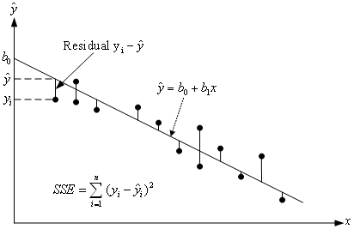
Least Squares Error
We seek the closest fit of the predicted line to the data points.
Error = the sum of squared errors. (= “Loss” in book)
Sensitive to outliers.
Notes:
sorry about the notation change, but it’s good for you.
Demonstrate in spreadsheet.

Slide 39
Squared Error on House Price Example
Minimum occurs at w₀ = 246, w₁ = 0.232
Notes:
Legend:
left: Given values for w_0, w_1, Plot of the squared diff loss for the data shown on the right (as before).
Note that the loss function is convex, so there is a single minimum.
where is the minimum?

Slide 40
Intuition
Suppose that there is an exact solution and that the input matrix is invertible. Then we can find the solution by simple matrix inversion:
Alas, X is hardly ever square let alone invertible. But X^{T}X is square, and usually invertible. So multiply both sides of equation by X^{T}, then use inversion.
Notes:
If X^{T}X is not invertible, can perturb with identity matrix: X^{T}X+epsilon I.
Let’s now prove that this is the least-squares solution.

Slide 41
General Solution
If there is no exact fit, we can still minimize the squared error.
Solution: The squared error is minimized by
For details see text and assignment

Slide 42
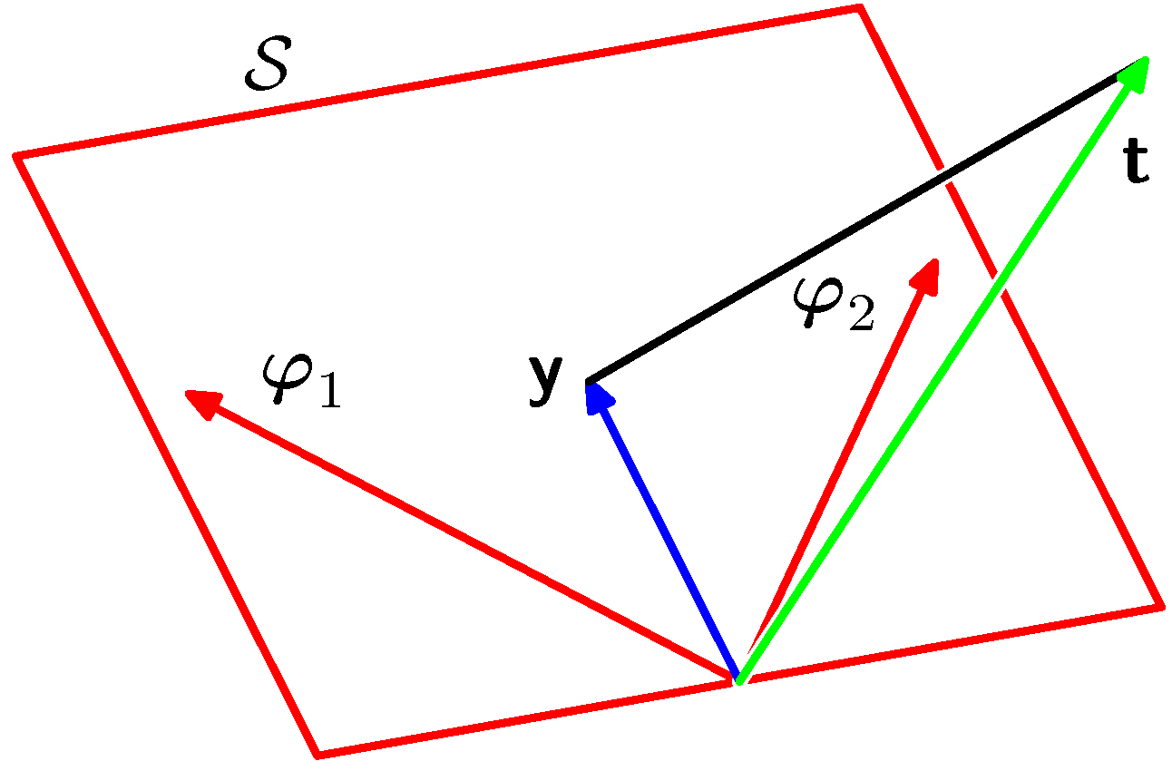
Geometric Interpretation
Any vector of the form ŷ = Xw is a linear combination of the columns (variables) of X.
If ŷ is the least squares approximation, then ŷ is the orthogonal projection of y onto this subspace
y
x²
ŷ
x¹
x^{i} = column vector i
Notes:
The orthogonal projection is the closest vector to y in the subspace.

Slide 43
Probabilistic Model
Prediction + Uncertainty = Probability

Slide 44
Noise Model
A linear function predicts a deterministic value ŷ=h_{w}(x)=x•w for each input vector.
We can turn this into a probabilistic prediction via a model true value = predicted value + random noise:
Linear regression assumes a Gaussian noise model
Notes:
Same noise model for all inputs.

Slide 45
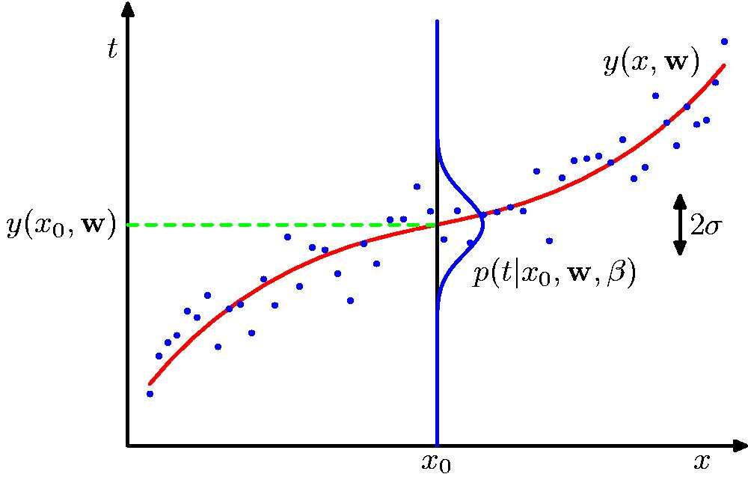
Curve Fitting With Noise
prediction for x₀
Gaussian centered on prediction
Notes:
don’t worry about the beta for now.
Gives a measure of uncertainty.
Remember turning functions into probabilites. Also for recommendation systems.

Slide 46
Synthetic Example
Linear Model with Gaussian Noise y = w₀ + w₁ x + ε

Slide 47
Gaussian Likelihood Function
Class Exercise: Assume a Gaussian noise model, so the likelihood function becomes (see text)
Show that the maximum likelihood solution for w minimizes the sum of squares error:
Home exercise: Show that the maximum likelihood solution for σis the average squared difference between the target y_{n} and the predicted value x_{n}•w.
Notes:
proof: take logs of the Gaussian.

Slide 48
Mixed/Hybrid Parents
The General Case

Slide 49
Hybrid Parents
Parents could contain both continuous and discrete data
One option: use regression tree
Another option: treat discrete variables as if they were continuous.
turn all discrete variables into binary (Boolean variables) (dummy variables, one-of-k coding, one-hot vector)
Use the fact that 1 and 0 behave like T and F (kind of).
Notes:
Regression tree in Weka see file preprocessed_datasets

Slide 50
Overfitting

Slide 51
Overfitting
Maximum likelihood treats data sample as if it represents complete information.
For both discrete BNs and regression models
For small samples, this leads to extreme results.
For regression models, we get overfitting: test set performance is much worse than training set.
A deeper perspective on overfitting is the bias-variance trade-off to be discussed later.

Slide 52
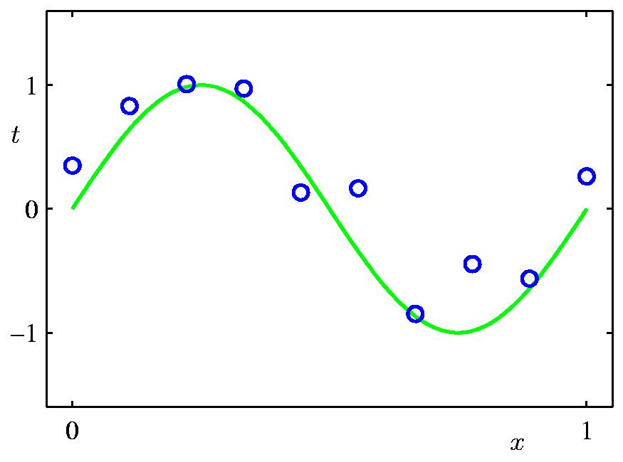
Polynomial Curve Fitting
True Curve is sine curve + Gaussian noise

Slide 53
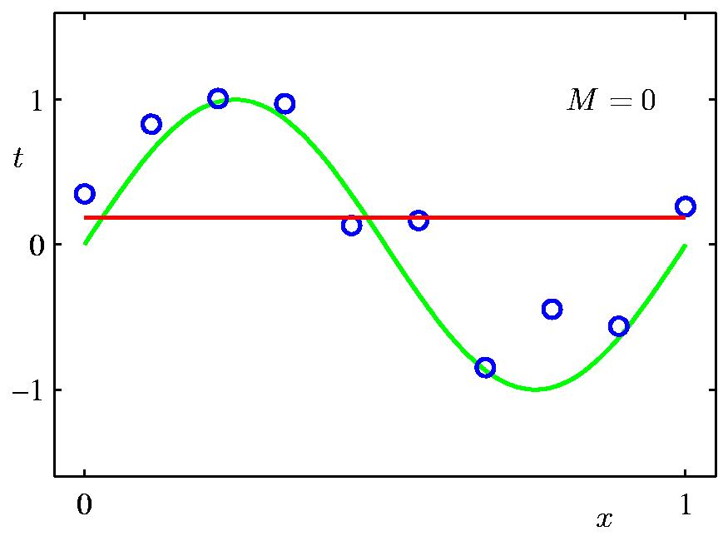
0th Order Polynomial
0-th order polynomial with minimum squared error

Slide 54
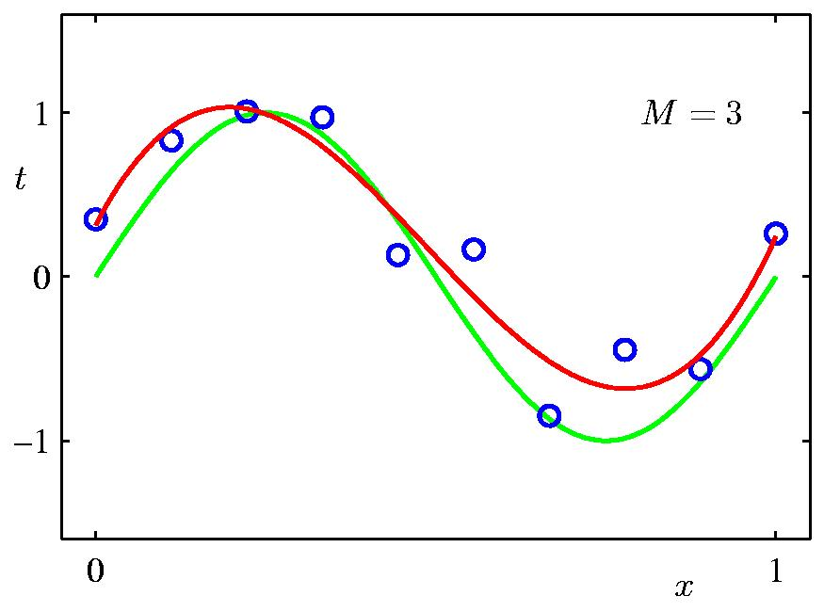
3rd Order Polynomial
3rd-order polynomial with minimum squared error

Slide 55
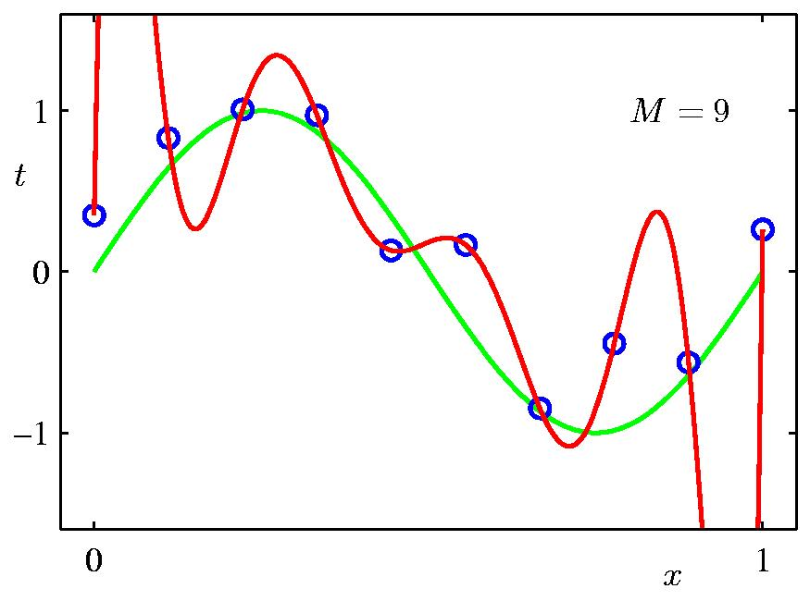
9th Order Polynomial
9th-order polynomial with minimum squared error

Slide 56
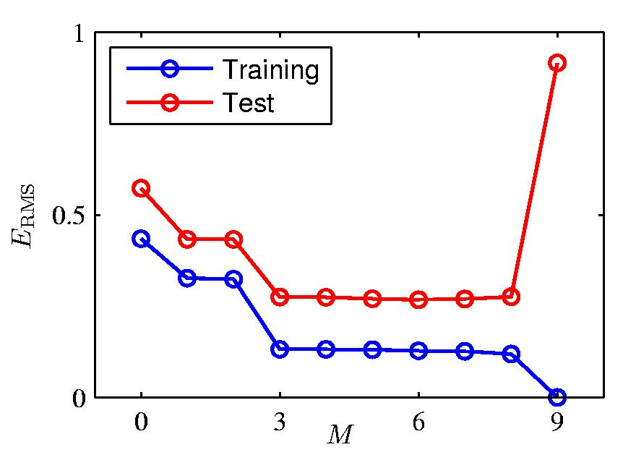
Over-fitting
Root-Mean-Square (RMS) Error: average root of squared error
for degree M, find best data fit coefficients w*
compute RMS over observed training data points and 100 data points in test set

Slide 57
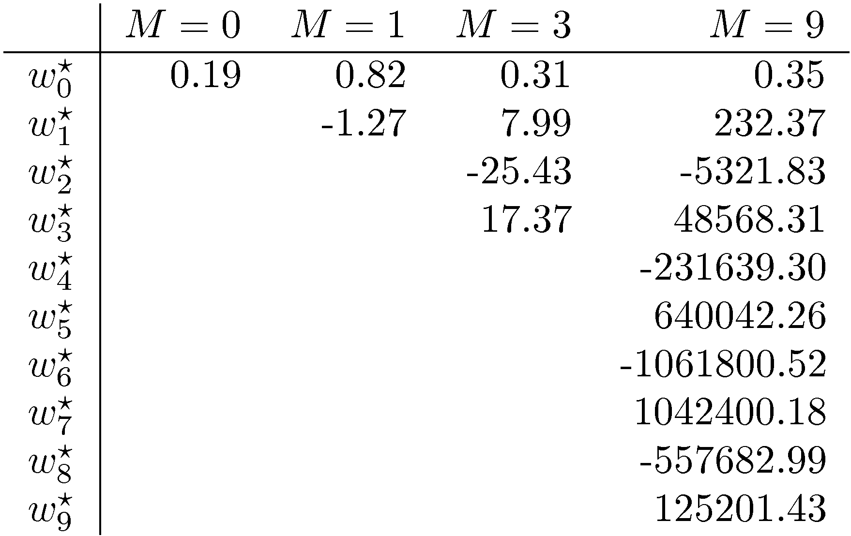
Polynomial Coefficients
Notes:
Large weights are a clue to overfitting.

Slide 58

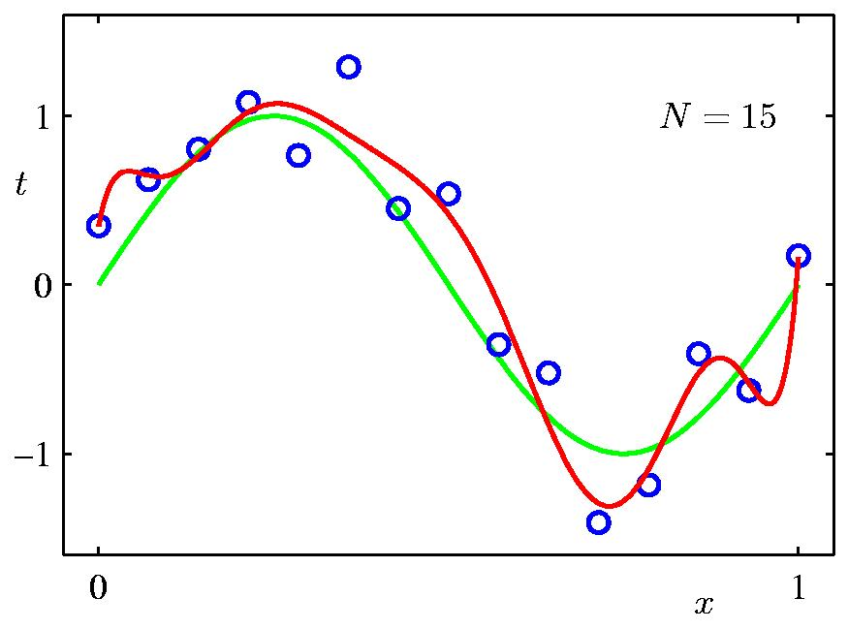
Data Set Size:
9th Order Polynomial
Notes:
Overfitting depends on data set size.

Slide 59
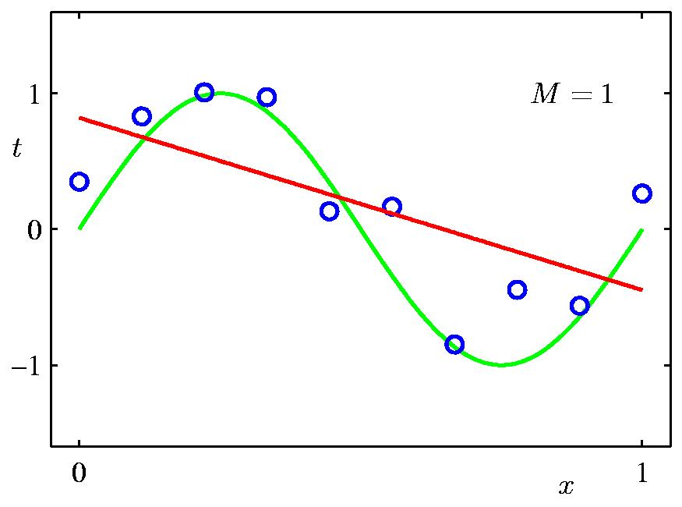
1st Order Polynomial

Slide 60

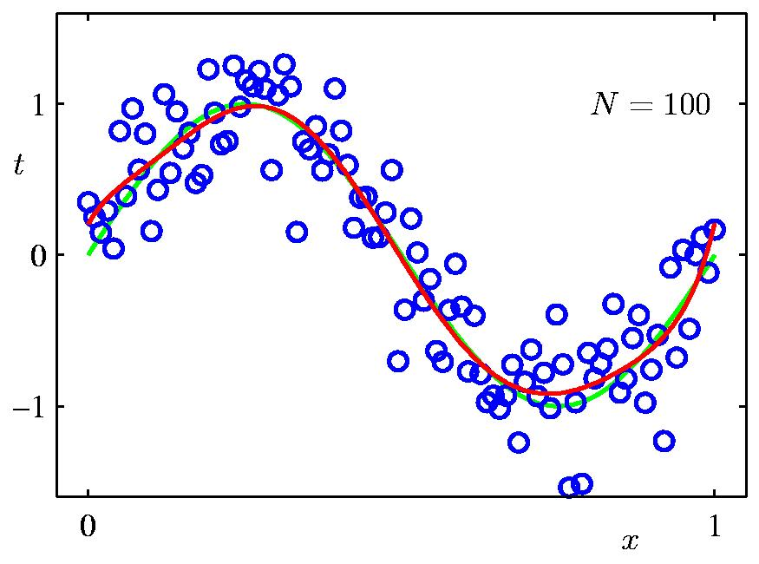
Data Set Size:
9th Order Polynomial

Slide 61
Regularization

Slide 62
Solution to Overfitting
Recall for discrete data: smooth towards the uniform distribution (Laplace correction).
Bayesian perspective: maximize the posterior P(θ|D), which includes a (uniform) prior, not just the likelihood.
For linear regression: smooth or regularize towards w= 0 weight.
Bayesian perspective: maximize the posterior P(θ|D), which includes a shrinkage prior that assigns highest probability to 0.
Interpretation: assume irrelevance until the data prove otherwise.

Slide 63
Example: Quadratic Regularization
Penalize large coefficient values
¸ is called the regularization coefficient.
Observed value
Predicted Value
Parameter Term

Slide 64
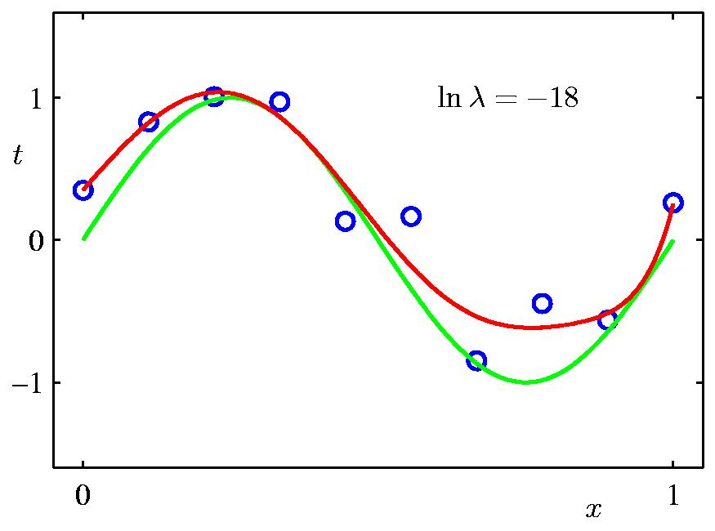
Regularization
Fix λ≈ 0.0000000152
Find polynomial curve that minimizes regularized squared error
Third-order polynomial

Slide 65
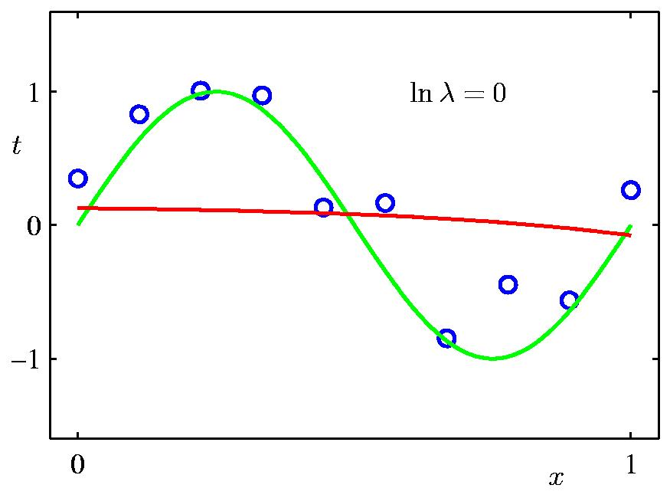
Regularization
Fix λ=1
Find polynomial curve that minimizes regularized squared error
0-order polynomial

Slide 66


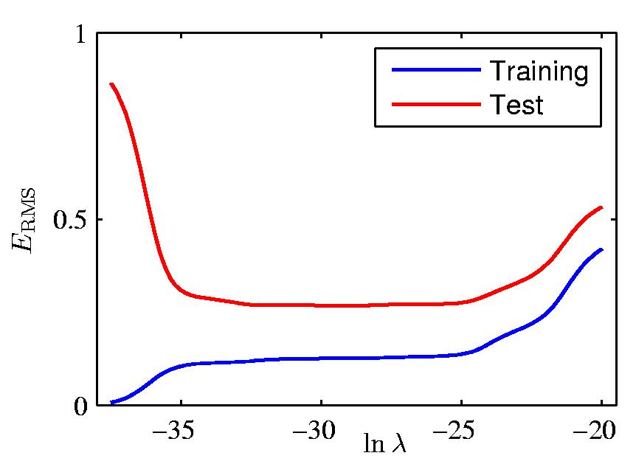
Regularization: vs.
Notes:
Bias vs. variance analysis of error: two components to error.

Slide 67
Regularized Least Squares Learning
With the sum-of-squares error function and a quadratic regularizer, we get
which is minimized by (Assignment 2)
Notes:
Problem in assignment. This inverse always exists.

Slide 68
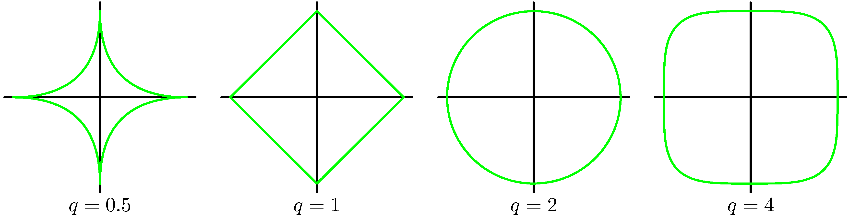
Regularized Least Squares (2)
There are many complexity penalties, e.g.
AIC = aka L0 norm simply penalizes the number of non-zero parameters
Polynomial regularizers are of the form:
Lasso
Quadratic

Slide 69
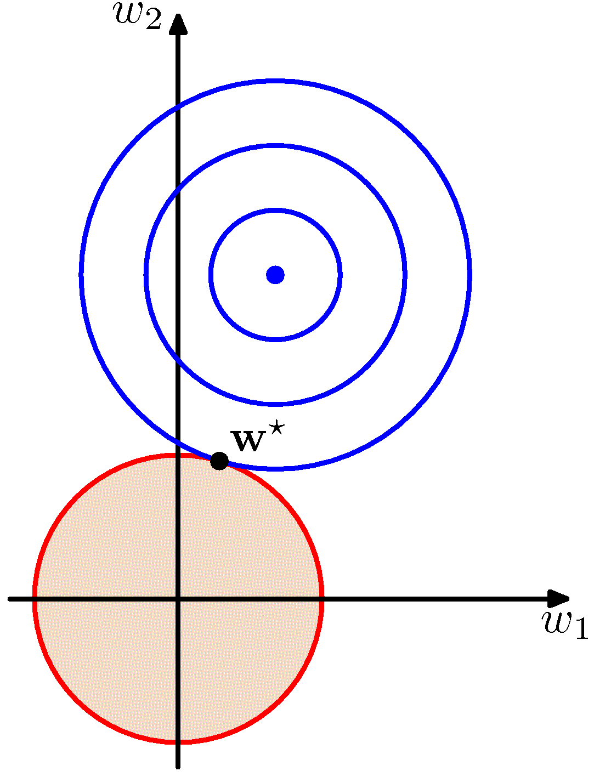
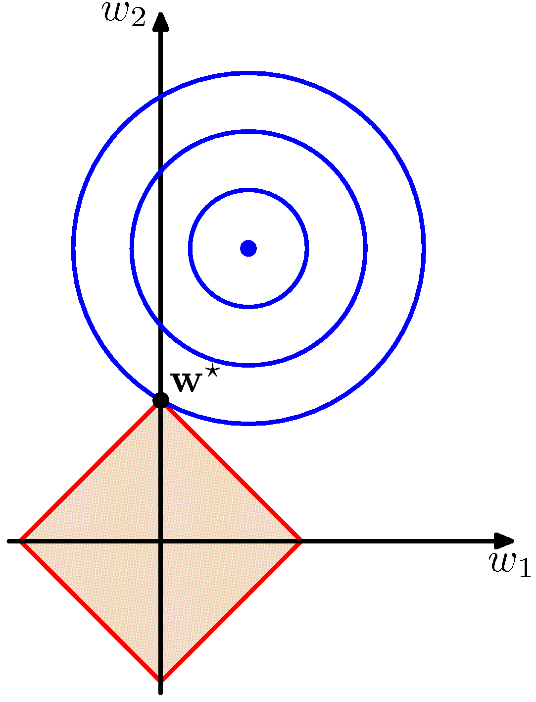
Regularized Least Squares (3)
minimum squared error
possible weights with L1 regularizer
possible weights with L2 regularizer
L1 tends to generate sparser solutions than a quadratic regularizer.
L2 is preferred if predictive features are correlated.
Notes:
But is not rotation invariant.
Lagrangian: minimizing squared error + lambda L^q is equivalent to minimize squared error with constraing that L^q <= c. For L2, we have circle with radius less than c.

Slide 70
Standardization
If the predictive features are on different scales, a single regularization coefficient λ is not adequate.
e.g.
Solution: Standardize variables before choosing λ.

Slide 71
Evaluating Models and Parameters By Cross-Validation

Slide 72
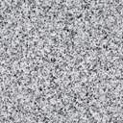
Evaluating Learners on Validation Set
Training Data
Learner
Validation Set
Model
Notes:
Also called testing set, hold-out set

Slide 73
What if there is no validation set?
What does training error tell me about the generalization performance on a hypothetical validation set?
Scenario 1: You run a big pharmaceutical company. Your new drug looks pretty good on the trials you’ve done so far. The government tells you to test it on another 10,000 patients.
Scenario 2: Your friendly machine learning instructor provides you with another validation set.
What if you can’t get more validation data?

Slide 74
Examples from Andrew Moore
Andrew Moore's slides
Notes:
Also demo on Naive Bayes vs. DT tree on playtennis data set.

Slide 75
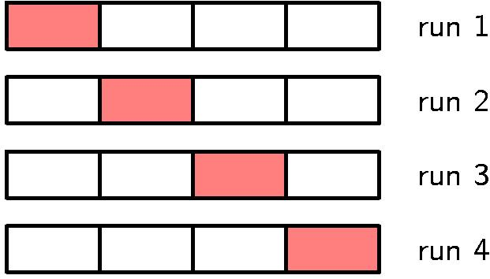
Cross-Validation for Evaluating Learners
Cross-validation to estimate the performance of a learner on future unseen data
Learn on 3 folds, test on 1
Learn on 3 folds, test on 1
Learn on 3 folds, test on 1
Learn on 3 folds, test on 1
Notes:
Show Weka demo.
4-fold cross validation. Common default = 10. Use to evaluate lambda, stop at first minimum of error function. Jackknife: leave out one data point only, do for all data points. Think about doing this for the Bernoulli distribution.

Slide 76
Cross-Validation for Hyperparameters
Training Data
Training Data
Learner(λ)
If the learner requires setting a parameter, we can evaluate different parameter settings against the data using training error or cross validation.
Then cross-validation is part of learning.
Model(λ)

Slide 77
Cross-Validation for evaluating a parameter value
Cross-validation for λset (e.g. λ = 1)
Learn withλ on 3 folds, test on 1
Learn withλ on 3 folds, test on 1
Learn withλ on 3 folds, test on 1
Learn withλ on 3 folds, test on 1
Average error over all 4 runs is the cross-validation estimated error for the λ value
Notes:
4-fold cross validation. Common default = 10. Use to evaluate lambda, stop at first minimum of error function. Jackknife: leave out one data point only, do for all data points. Think about doing this for the Bernoulli distribution.

Slide 78
Stopping Criterion
for any type of validation (hold-out set validation, cross-validation)

Slide 79
Regression With Basis Functions
Details in Assignment

Slide 80
Nonlinear Features
We can increase the power of linear regression by using functions of the input features instead of the input features.
Like sufficient statistics, but called basis functions in the context of regression
Linear regression can then be used to assign weights to the basis functions.
We will see several examples (Assignment 2)
Neural nets are a way to learn powerful basis functions
Notes:
show example of quadratic

Slide 81
Conclusion
Density functions define probabilities for continuous random variables
The Gaussian density function is the most prominent.
There is a typical value called the mean
probability(x) decreases with distance from x
Linear regression predicts a continuous value given a set of continuous input features using a linear model ŷ=x•w
Uncertainty in prediction is modelled as a Gaussian centered on the prediction ŷ
Can combine linear regression with nonlinear basis functions φ(x)

Slide 82
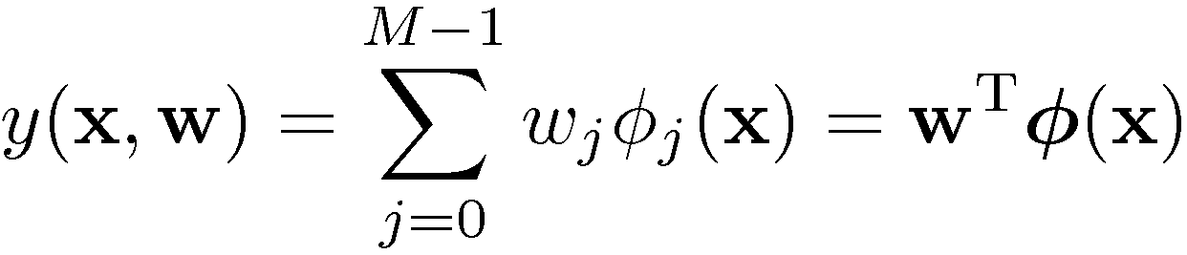
Linear Basis Function Models (1)
Generally
where ϕ_{j}(x) are known as basis functions.
Typically, ϕ₀(x) = 1, so that w₀ acts as a bias.
In the simplest case, we use linear basis functions : ϕ_{d}(x) = x_{d}.
Notes:
Can often think of basis functions as “features” computed from data vector x.

Slide 83
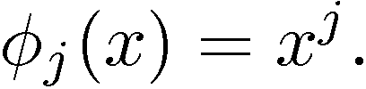
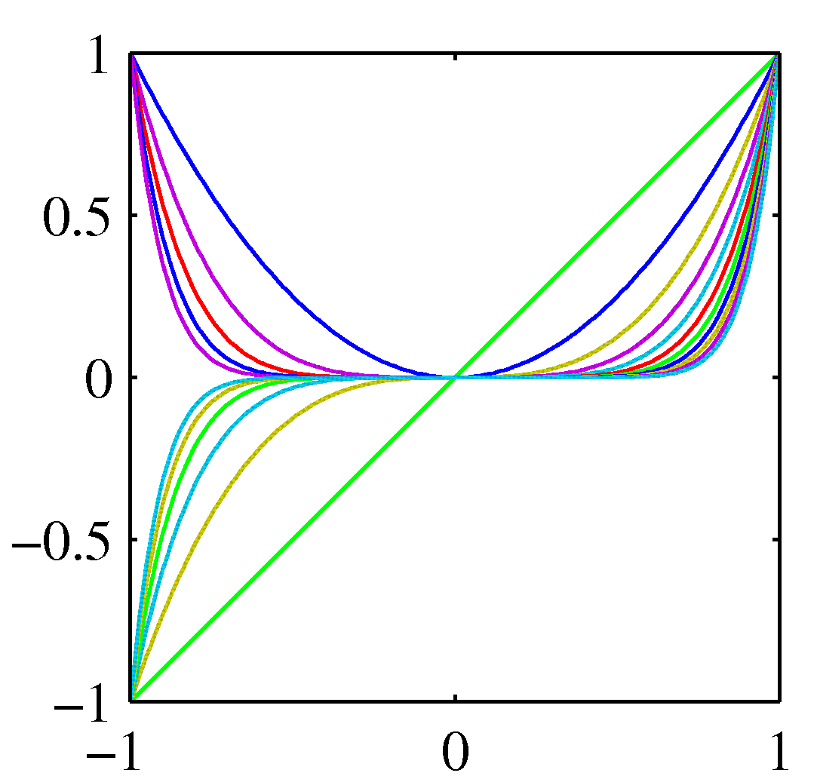
Linear Basis Function Models (2)
Polynomial basis functions:
These are global, the same for all input vectors.
Notes:
Showing functions for difference choices of exponents.

Slide 84
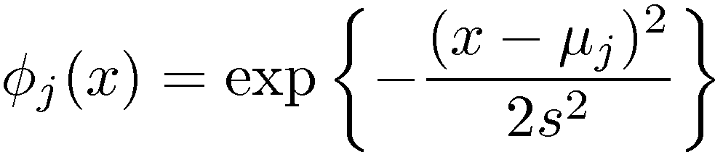
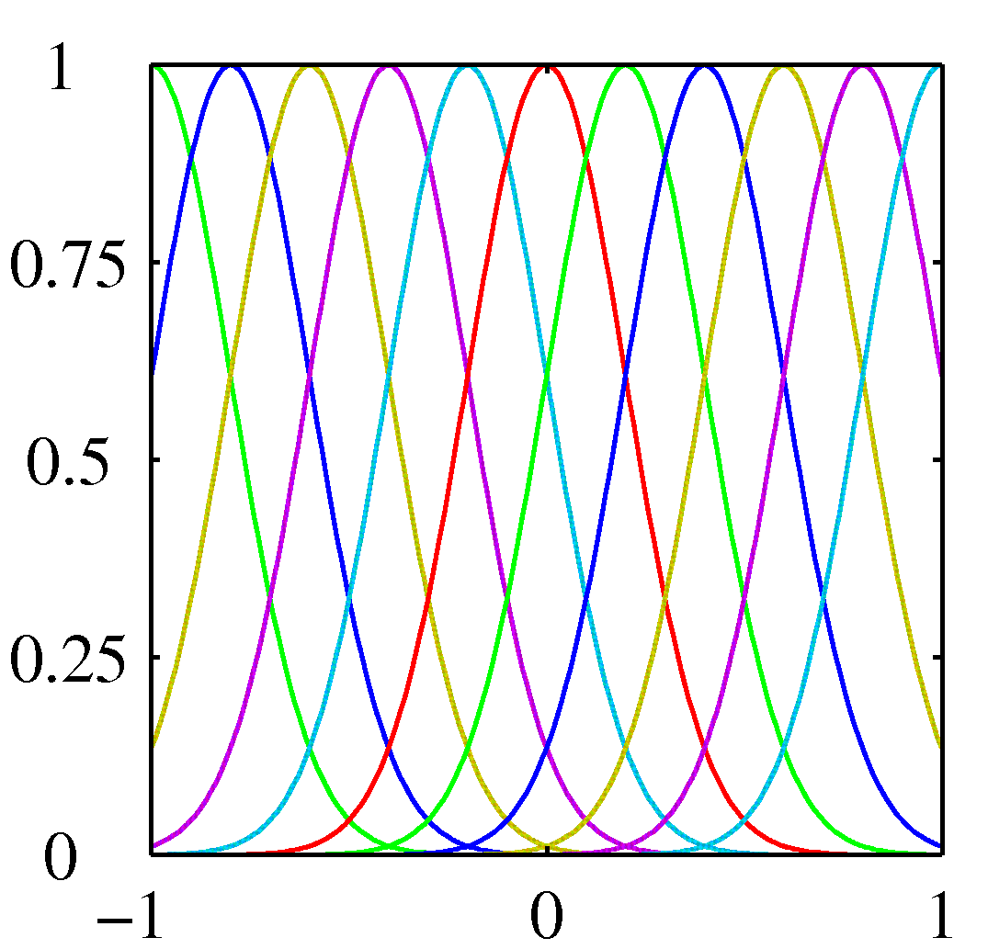
Linear Basis Function Models (3)
Gaussian basis functions:
These are local; a small change in x only affects nearby basis functions. ¹_{j} and s control location and scale (width).
Related to kernel methods.
Notes:
Intuition: use features in parts of image or body.

Slide 85
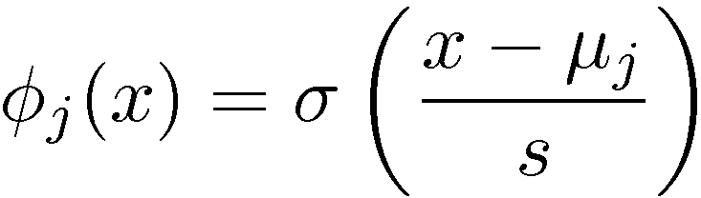
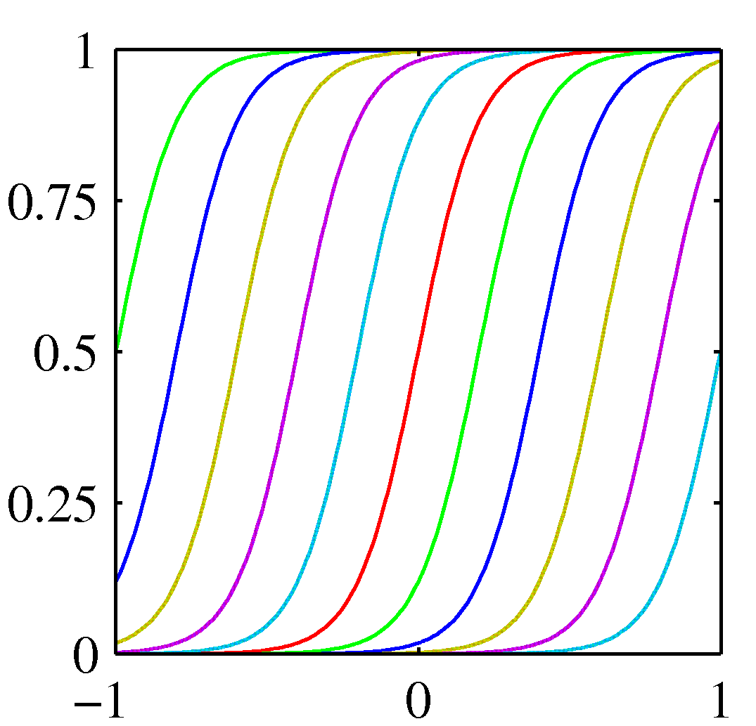
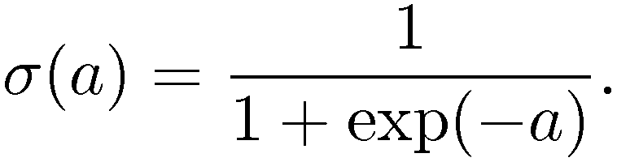
Linear Basis Function Models (4)
Sigmoidal basis functions:
where
Also these are local; a small change in x only affect nearby basis functions. μ_{j} and s control location and scale (slope).
Notes:
Maps x to 0-1 range. Like smooth treshold. Also like probability.

Slide 86
Basis Function Example Transformation
Notes:
Legend:
left: datapoints in 2D. Red and blue are class labels (ignore). – 2 Gaussian basis functions, we see the centers shown as crosses and the countours shown by green circles.
Right: Each point is now mapped to another pair of numbers (roughly, distance to phi1, distance to phi2).
Intuitive example: think of Gaussian centers as indicating parts of a picture, or parts of a body.

Slide 87
Limitations of Fixed Basis Functions
M basis functions along each dimension of a D-dimensional input space require M^{D} basis functions: the curse of dimensionality.
In later chapters, we shall see how we can get away with fewer basis functions, by choosing these using the training data.

Slide 88
Partial Derivative
Think about single weight parameter w_{j}.
Partial derivative is
Gradient changes weight to bring prediction closer to actual value.
Notes:
notice that the gradient is intuitive. Check this in spreadsheet.
the minus sign gets reversed by inner derivative.

Slide 89
Gradient
Find gradient vector for each input x, add them up.
=Linear combination of row vectors x_{n} with coefficients.x_{n}w-t_{n}.

Slide 90
Solution: The Pseudo-Inverse
Assume that X^{T}X is invertible. Then the solution is given by

Slide 91
The w₀ offset
Recall the formula for the partial derivative, and that x_{n0}=1 for all n.
Write w*=(w₁,w₂,...,w_{D}) for the weight vector without w₀, and similarly xn*=(x_{n1},x_{n2},...,x_{nD}) for the n-th feature vector without the “dummy” input. Then
Setting the partial derivative to 0, we get
average target value
average predicted value
Notes:
derivation:
1. write sum twice, once with just w0 -> N x w0.
2. Move Sum (yn – tn) over to left, puts tn postive.
3. divide both sides by N.

