Slide 1

Component Analysis
Oliver Schulte
School of Computing Science
Simon Fraser University
Notes:
plan: start with assumptions.
A1: common cause
A2: small number. dimensionality reduction.
A3: form of causation: pca.
group learning, similar assumptions

Slide 2
Overview
Goals of Component Analysis
Learning Latent Features (Basis Functions)
Learning Latent Causes (Factors)
Reduce Dimensionality: merge correlated columns
Clustering merges similar rows, component analysis merges correlated columns
Methods
Principal Component Analysis
Auto-Encoder Neural Networks

Slide 3
Component Analysis Examples
Term Mark = w1 Assignments + w2 Project + w3 Midterm
Given observed term marks, can we recover Assignments, Project, Midterm grades?
Source Separation
In a noisy room, two microphones produce a combined signal.
Can you reconstruct the component signals from the combined signal?
Netflix ratings: Mum, Dad, Adriana and Marina all rate movies on one account. Can Netflix tell which ratings came from which person?
Notes:
https://www.youtube.com/watch?v=Qr74sM7oqQc&feature=related

Slide 4
Component Analysis: Goals

Slide 5
Latent Feature Learning: Motivation
Discover new features/basis functions
Dimensionality reduction.
Eliminate redundancies among features.
Can help with missing data.

Slide 6
Cognitive Science
The brain infers latent structure all the time.
Example: from retina activation (rods and cones), infer 3-D scene in front of me.
Notes:
seems to be hierarchical model. people in deep learning think about this.

Slide 7
From Observed to Unobserved
Skeptical Question:
How can we learn about what is unobserved from what is observed?
Identifiability?
Answer: We need assumptions about the relationship between observed and unobserved features.
Observed Features
X1
X 2
X 3
Assumptions
Z1
Z2
Unobserved/Latent Features
Notes:
Psychology: from manifest to latent
Duda and Hart discuss identifiability.

Slide 8
Assumptions for Learning Latent Structure

Slide 9
Assumption 1: The Common Cause Principle

Slide 10
Reichenbach’s Common Cause Principle (1956)
“Every correlation can be explained by a direct causal connection or a common cause.”
Stanford Encyclopaedia
Notes:
The brain seems to do this too, we don’t believe in consequences.
The common cause may be unobserved.

Slide 11
Graphical Models Version
Assumption: If we see a correlation between two variables X,Y, then the world works like this:
X
Y
or like this
Z
or maybe like this
Z
X
Y
X
Y
Terminology: Z is a cause, component, factor.

Slide 12
Intuitive Examples
Sun rose at 6 am each day this week.
Position of Sun, Earth, Earth Rotation
Sunrise 1
Sunrise 2
Sunrise 3
Student’s marks are explained by their knowledge.
Knowledge
Mark 1
Mark 2
Mark 3
Mark 4
Mark 5
Mark 6
Notes:
notice the flow of inference: from sunrise 1, infer the hidden parameters, then can predict sunrise 2.
The brain does this all the time. E.g.: run into same person at party 3 times.

Slide 13
Statistical Consequences
Question: What independence relations are entailed by the Bayes net below?
Z
X1
X 2
X 3
Answer: Conditional on latent feature, observed features are independent.
Informally, Z explains the correlations among X1,X2, X3.
Notes:
this defines the type of graphical model you look for. This is the key picture: given k unobserved causes, the data lie on a k-dimensional manifold. The brain seems to assume that the world has somethign like this structure. Plus it adds a set of priors on the exact form of the conditional dependence. PCA can also be modelled this way.

Slide 14
Multiple Common Causes
Knowledge
Effort
Mark 1
Mark 2
Mark 3
Mark 4
note the similarity to the topology of a feedforward neural net
Notes:
in the extreme case, as many components as observed variables -> not interesting.

Slide 15
Hierarchical Version
Z
Knowledge
Effort
Mark 1
Mark 2
Mark 3
Mark 4
Latent variables at layer 1 explain correlations among observed variables.
Latent variables at layer 2 explain correlations among latent variables at layer 1.
This is the basic idea of a deep belief network.
Also convolutional neural network

Slide 16
Assumption 2: Low-Dimensionality

Slide 17
Latent Feature Dimensionality
Assumption: The number of unobserved causes m is much less than the number n of observed variables.
The number of latent dimensions m can be specified by the user, or learned.
Knowledge
Effort
Mark 1
Mark 2
Mark 3
Mark 4
Notes:
Two in this example.

Slide 18
More Examples
Video Game Screen: 4000 pixels (say) determined by two variables (joystick position, button pressed).
position
button
Pixed 1
Pixel 2
…
Pixel 1999
Pixel 2000
The Big 5 in Psychology. Personality Types can be explained by 5 basic traits.
Openness
conscientiousness
extraversion
agreeableness
neuroticism
Answer 1
Answer 2
…
Answer 99
Answer 100
Notes:
Answers on personality questionnaire.

Slide 19
Consequence: Dimensionality Reduction
If a tuple of n observed feature values is well predicted by m latent features, we can represent the n-tuple instead by a m-tuple, without (much) loss of information.
The data lie on a m-dimensional manifold.
Video Game example: instead of specifying all 2000 pixels, specify (position of joystick, button pressed).
From 2 numbers we can reconstruct 2000.
Notes:
Explain manifold concept.
But in manifold, we have a 1-1 bicontinuous mapping between observed states and latent states. Can we get the same for statistical models?

Slide 20
Dimensionality Reduction

Slide 21
The curse of dimensionality
Scaling standard ML methods to high-dimensional feature spaces is hard, both computationally and statistically.
Statistics: data do not cover space.
Computation: local minima for parameter optimization.
Latent feature learning can be used to reduce the data dimensionality.
Alternative: learn to directly map the n observed features to m features with minimum loss of information.
Dimensionality reduction merges columns.
Clustering merges rows.

Slide 22
Dimensionality Reduction Techniques
Day | Outlook | Temperature | Humidity | Wind | PlayTennis
1 | sunny | hot | high | weak | no
2 | sunny | hot | high | strong | no
3 | overcast | hot | high | weak | yes
4 | rain | mild | high | weak | yes
5 | rain | cool | normal | weak | yes
6 | rain | cool | normal | strong | no
7 | overcast | cool | normal | strong | yes
8 | sunny | mild | high | weak | no
Can often by visualized as merging columns.
Discrete features: use Boolean combinations.
E.g. merge Temperature and Humidity into one feature.
PCA (continuous) use linear combinations to merge features.
Factor analysis: merge highly correlated features.
Deep learning: non-linear combinations of features.
Notes:
Self-organizing maps: directly try to map m-D data points to k-D data points such that closeness is preserved.

Slide 23
Assumption 3: Linearity

Slide 24
Principal Component Assumption
Observed Features are linear combinations of latent features.
Plus some noise.
Z
a
b
c
X1
X 2
X 3
X1 = a Z + ε
X2 = b Z +ε
X3 = c Z +ε

Slide 25
Consequences
Given number m of principal components, relatively easy to find optimal latent features.
Columns are linear combinations of each other (neglecting noise), e.g.
X1 = a Z and X2 = b Z implies X2 = b/a X1.

Slide 26
Neural net Auto-Encoders

Slide 27
Auto-Association
An auto-associative neural net has just as many input units as output units.
The error is the squared difference between input unit x_{i} and output unit o_{i}.
Backpropagation trains the network to recreate the input.
The hidden layer maps n input values to m hidden node output values.
If n<m➔ dimensionality reduction!
output = 2.5 error = 0.5 x 0.5
input = 2.0
n
n
input = 1.0
output = 1.0 error = 0

Slide 28
Deep Auto-Encoders
With more than one hidden layer, auto-encoders perform non-linear dimensionality reduction.
n
n

Slide 29
Supervised Dimensionality Reduction
Consider a prediction problem with a single target node.
If #hidden nodes < #input nodes, the neural net maps input vectors to lower-dimensional vectors that keep information relevant for prediction.
See UBC neural net tool
Google’s skip-gram models: reduces 1 Billion input nodes to about 300 features

Slide 30
Adding Dimensions
Can have the same or more hidden layer nodes
Same number: change of basis
More nodes: overcomplete dictionary
Term Mark
assignments
projects
midterm
Term Mark

Slide 31
Principal Component Analysis
Linear Algebra View

Slide 32
Projecting Input Vectors
Let w_{m} be the vector of weights feeding into h_{m}.
This is an n-dimensional vector.
Assume linear activation functions.
Then a_{m}(x)=x•w_{m} – the projection of x onto w_{m}
x1
x2
x3
h1
h2
x1
x2
x3

Slide 33
Subspace Projection
Let W_{(mxn)} be the matrix where row i = w_{i}.
Then the hidden layer maps input x to vector Wx^{T}
Projection onto linear subspace spanned by row vectors.
For M =1, n=2

Slide 34
Unit Length Constraint
Many weight vectors with equivalent reconstruction error.
Impose normalization constraint: ||w_{i}||=1 for i=1,..M
No loss of generality
Closed-form solution given sample covariance matrix S
S_{ij} = Covariance(column i, column j)
Theorem Given m hidden units, the weight vectors that minimize reconstruction error are the first m eigenvectors of S.
First eigenvector Su₁ = u₁λ₁ where λ₁ is the biggest eigenvalue
Second eigenvector Su₂ = u₂λ₂ has 2nd biggest value λ₂<λ₁

Slide 35
Digit Reconstruction Example
PCA reconstruction = mean + sum of eigenvectors
performed by hidden-to-output layer
As hidden dimensions M are increased, the PCA reconstruction becomes more accurate
#of input features (pixels) = 784
with M =250 quite good reconstruction

Slide 36
Learned Eigenvectors: Digit Example
Blue = positive, yellow = negative
Notes:
left side: eigenvalues for eigenvectors
right: reconstruction error

Slide 37
Eigenfaces
http://en.wikipedia.org/wiki/Eigenface

Slide 38
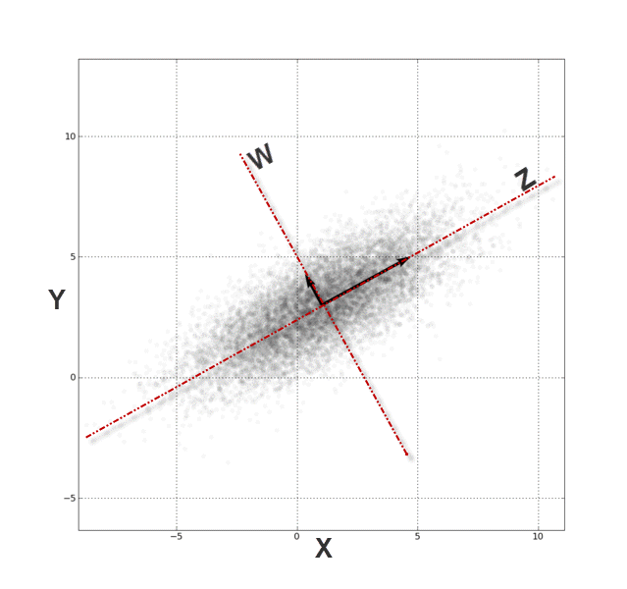
Preprocessing: Whitening
Let m= n, i.e. #principal components = number of input features.
Then PCA changes basis so that
Each column has mean 0 and standard deviation 1.
All covariances are 0.

Slide 39
Conclusion
General intuition for latent feature learning: A small set of unobserved features explains correlations among observed features.
Can often think of unobserved features as unobserved causes.
Finding a small set of explanatory features -> dimensionality reduction.
Explanatory = conditional on latent features, observed features are (nearly) independent.
Can visualize as merging feature columns.
Can visualize as merging rows.
Autoencoders reduce dimensionality by reconstructing input from small number of hidden units
Principal Component Analysis projects input to m-dimensional subspace.
Notes:
cognitive science conjecture: the brain has more sophisticated strategies.

