Slide 1
Neural Network Architectures
CMPT 726
Machine Learning
Oliver Schulte

Slide 2
Feed-Forward Networks

Slide 3
Network View of Basis Functions
Output layer: Regression model Y = w0 + w1 (x1 • x2) + w2 (x2 • x3)
Y
w0
w1
w2
Hidden layer: 2 basis functions representing one quadratic interaction each
x1 • x2
x2 • x3
x1
Input layer: observed inputs
e.g. age, weight, games played...
x2
x3

Slide 4
Trainable Basis Functions
Output layer: Regression model Y = w0 + w1 (x1 • x2) + w2 (x2 • x3)
Y
w0
w1
w2
Hidden layer: 2 basis functions with adjustable parameters
ϕ(x1,x2;w)
ϕ(x2,x3;w)
x1
Input layer: observed inputs
e.g. age, weight, games played...
x2
x3

Slide 5
Allow All Interactions
Output layer: Regression model Y = w0 + w1 (x1 • x2) + w2 (x2 • x3)
Y
w0
w1
w2
Fully connected Hidden layer: 2 basis functions with adjustable parameters
ϕ(x;w)
ϕ(x;w)
x1
Input layer: observed inputs
e.g. age, weight, games played...
x2
x3
Notes:
can learn 0 weights to break connections

Slide 6
What kind of basis function?
Y
w0
Any function that maps n numbers to 1 could be a basis function.
e.g. Gaussian basis function (RBF network).
How about linear functions?
We now how to do linear regression!
w1
w2
ϕ(x;w)
ϕ(x;w)
w11
w13
x1
w12
x3
x2
similarly we have w21,w22,w23

Slide 7
Deep Neural Networks

Slide 8
Definition
A deep neural network is a neural network with at least 2 hidden layers.
That’s it!
output layer
fully connected linear/logistic regression
Y
w0
w1
w2
ϕ(x;w)
ϕ(x;w)
hidden layer
rectified linear unit
ϕ(x;w)
ϕ(x;w)
ϕ(x;w)
x1
x2
x3

Slide 9
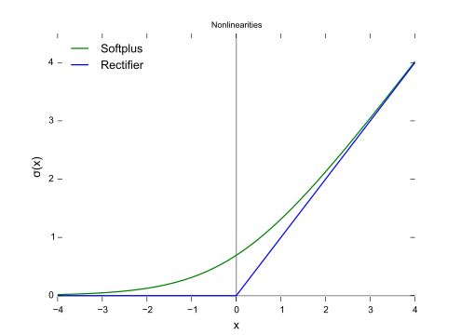
Rectified Linear Unit
f(x) = max(0,x)
Notes:
softplus is smooth version (integral of logistic function)

Slide 10
Advantages of RLUs
Gradients linear in input
avoids vanishing gradients
many units have 0 activation
avoids co-adaption

Slide 11
The Vanishing Gradient Problem
The sigmoid function becomes flat quickly away from 0
Recall that the gradient is multiplied by the derivative of the sigmoid function
In multiple layers, each layer adds a gradient multiplication
small gradient
small gradient

