Slide 1
Nonparametric Methods: Nearest Neighbors
Oliver Schulte
CMPT 726 Machine Learning
Notes:
If you use “insert slide number” under “Footer”, that text box only displays the slide number, not the total number of slides. So I use a new textbox for the slide number in the master.

Slide 2
Instance-based Methods
Model-based methods:
  estimate a fixed set of model parameters from data.
  compute prediction in closed form using parameters.
Instance-based methods:
  look up similar “nearby” instances.
  Predict that new instance will be like those seen before.
  Example: will I like this movie?

Slide 3
Nonparametric Methods
Another name for instance-based or memory-based learning.
Misnomer: they have parameters.
Number of parameters is not fixed.
Often grows with number of examples:
  More examples ➔ higher resolution.

Slide 4
k-nearest neighbor classification

Slide 5
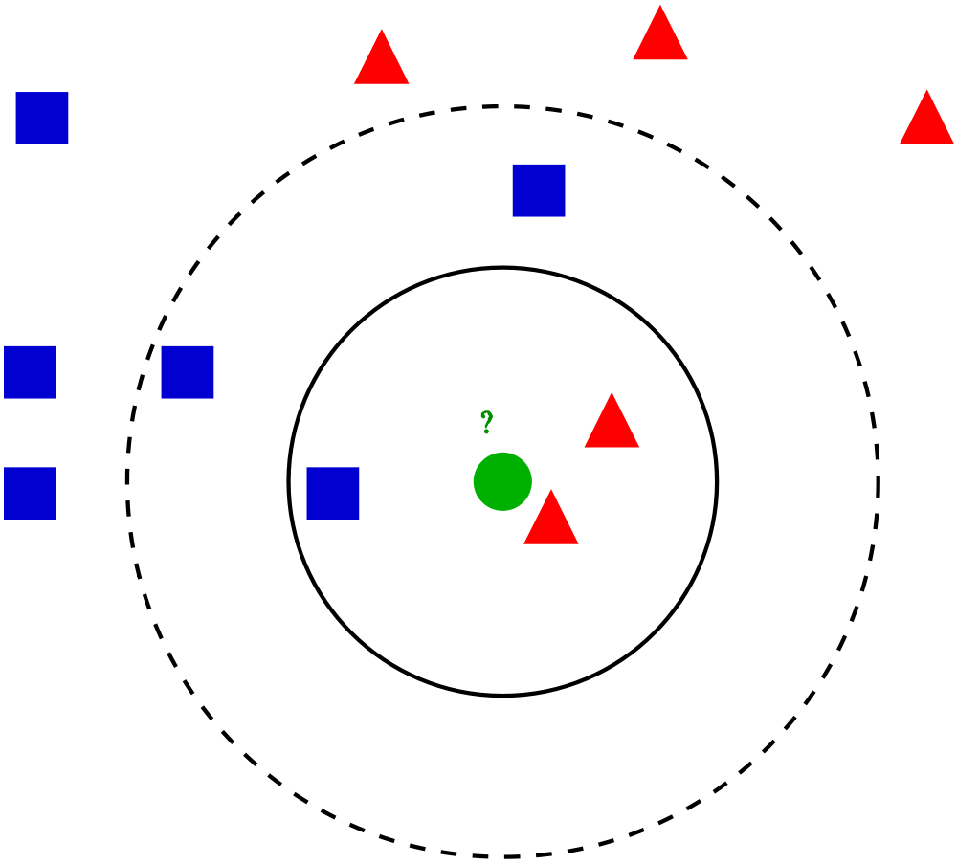
k-nearest neighbor rule
Choose k odd to help avoid ties (hyperparameter!).
Given a query point x_{q}, find the k nearest data points.
Classify x_{q} according to the majority of the k neighbors.
Good theoretical guarantees for big data!
Notes:
At least k points in sphere.
Legend:
Green circle = test case.
Solid circle: k = 3
Dashed circle: k = 5.

Slide 6
Events in Asia and Middle East between 1982 and 1990
k too small ➔ overfitting. Why?
k too large ➔ underfitting. Why?
x1 = surface wave magnitude
x2 = body wave magnitude
white = earthquake
black = nuclear explosion
k = 1
k = 5
Notes:
What is overfitting and underfitting?
Overfitting: k too small, fits neighborhood too much.
Underfitting: k too large, doesn’t generalize enough. In extreme case, k = N -> prior class label.
black region: classified as nuclear explosion by nearest neighbor method.
Overfits outlier at x2 = 6.
Events in Asia and Middle East between 1982 and 1990.
white = earthquake, black = nuclear explosion

Slide 7
Example: Oil Data Set
Notes:
what is meaning of oil data set? look this up.

Slide 8
Issues with Nearest Neighbour
Implementation, Curse of Dimensionality

Slide 9
Implementation Issues
Learning very cheap compared to model estimation.
But prediction expensive: need to retrieve k nearest neighbors from large set of N points, for every prediction.
Nice data structure work: k-d trees, locality-sensitive hashing. See text.
Notes:
k-d trees: generalized binary trees.
Locality-sensitive hashing: like hashing, but similar points have similar hash values.

Slide 10
Distance Metric
Key for making the generalization work.
Needs to be supplied by user.
With Boolean attributes: Hamming distance = number of different bits.
With continuous attributes: Use L2 norm, L1 norm, or Mahalanobis distance.
Also: kernels, see later.
For less sensitivity to choice of units, usually a good idea to normalize to mean 0, standard deviation 1.
Notes:
Mahalanobis distance looks at covariance between dimensions.
Basically, it’s the term in the exponent of the Gaussian distribution (see Bishop).

Slide 11
Curse of Dimensionality
Low dimension ➔ good performance for nearest neighbor.
  As dataset grows, the nearest neighbors are near and carry similar labels.
Curse of dimensionality: in high dimensions, almost all points are far away from each other.
Notes:
number of grid cells of fixed side lengths grows exponentially with dimension
*but it’s odd that more features should hurt
* other parts of machine learning: datapoints become sparse, hard to assess correlations

Slide 12
Point Distribution in High Dimensions
How many points fall within the 1% outer edge of a unit hypercube?
In one dimension, 2% (x < 1%, x> 99%).
In 200 dimensions? Guess...
Answer: 94%.
Similar question: to find 10 nearest neighbors, what is the length of the average neighbourhood cube?

Slide 13
Nearest Neighbour Regression

Slide 14
Nearest Neighbour Regression
Can also adapt the idea to predict a continuous label.
  take average of k-nearest neighbours
  apply linear regression to k nearest neighbours
  locally weighted: apply linear regression and weight neighbours according to their distance from the query point

Slide 15
Connect the Dots
apply regression with left and right neighbour to predict query label

Slide 16
3-nearest Neighbour Average
Notes:
map neighbourhood to constant

Slide 17
3-nearest neighbour linear regression

Slide 18
Locally Weighted Linear Regression

Slide 19
Conclusion (I)
Nonparametric methods grow add parameters to fit dataset
  no model
  no fixed prediction formula
Instance-based: predict target label based on labels for similar data points.
Nearest neighbour methods: based on closest k data points
  Classification: take majority vote in neighbourhood
  Regression:
    map neighbourhood to representative constant, e.g. average
    fit line to neighbourhood
    local weighting: assign higher weight to closer data points

Slide 20
Conclusion (II)
Advantages:
  can approximate complicated functions (like NNs)
  no need to guess functional form
  learning is simple
Disadvantages:
  sensitive to metric for distance/similarity (kernel)
  curse of dimensionality: performance deteriorates with increasing dimensions/features
  need to find k nearest neighbours
  can be slow at prediction time

