Slide 1
Linear Regression
Oliver Schulte
Machine Learning 726
Notes:
If you use “insert slide number” under “Footer”, that text box only displays the slide number, not the total number of slides. So I use a new textbox for the slide number in the master.

Slide 2
Parameter Learning Scenarios
The general problem: predict the value of a continuous variable from one or more continuous features.
Parent Node/ Child Node | Discrete | Continuous
Discrete | Maximum Likelihood Decision Trees | logit distribution (logistic regression)
Continuous | conditional Gaussian (not discussed) | linear Gaussian (linear regression)

Slide 3
Single Node Case
Examples of Continuous Random Variables
  NHL: Sum of Games Played After 7 Years
  House Prices
  Term Marks in Course
How to define probability distribution?
Can no longer use a table
Term Marks
Notes:
show example from 310 grades

Slide 4
Discretization
Simplest Idea: Assign continuous data to discrete groups (bins).
  E.g. A,B,C,D,E,F
Equal width: set bins according to variable values.
  E.g. 100-90,90-80,70-60,50-40
Equal frequency: set bins so that each bin has same number of students.
  E.g. choose cut-offs so that 10% of students get an A, 10% a B, 10% a C
Curving: set bins to match a prior distribution
  e.g. match grade distribution in other CS 3rd-year courses
  See actual cut-offs in 310

Slide 5
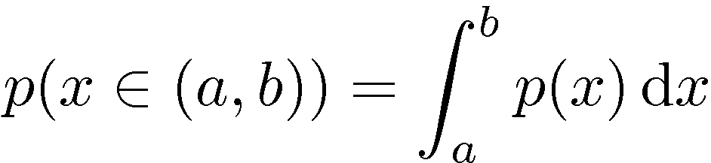
Density Function
Define a function p(X=x)
Behaves like a probability for X=x but not quite.
Better intuition: The density function defines a probability for intervals via integration.
P(T) = 1 becomes
Exercise: Find the p.d.f. of the uniform distribution over a closed interval [a,b].

Slide 6
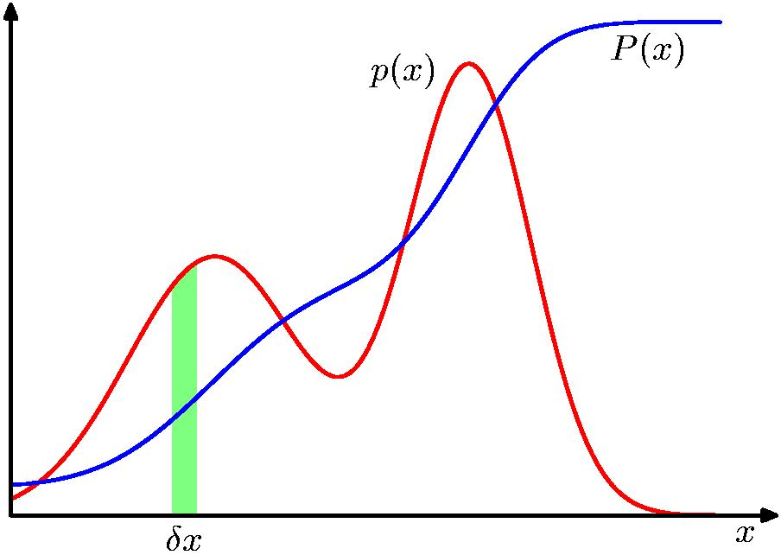
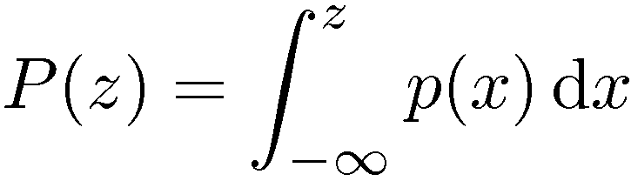
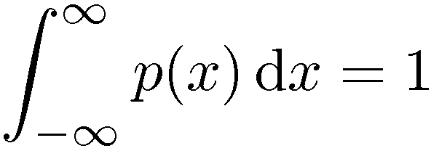

Probability Densities
Notes:
x can be anything

Slide 7
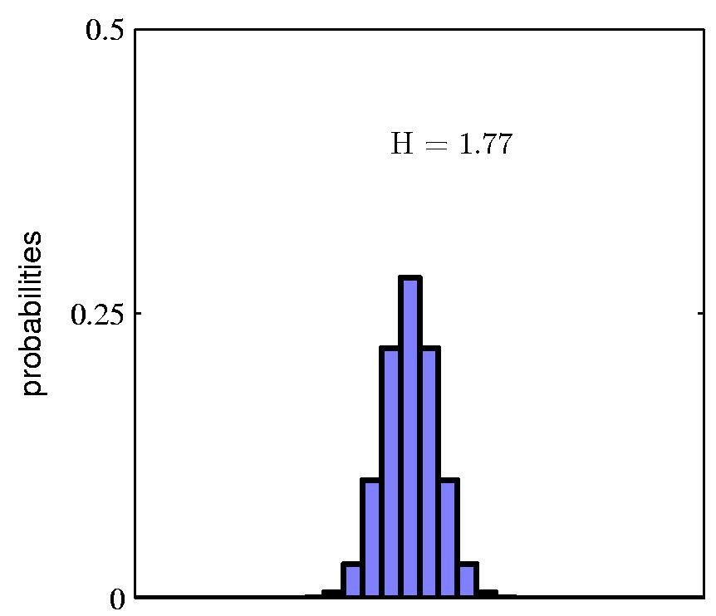
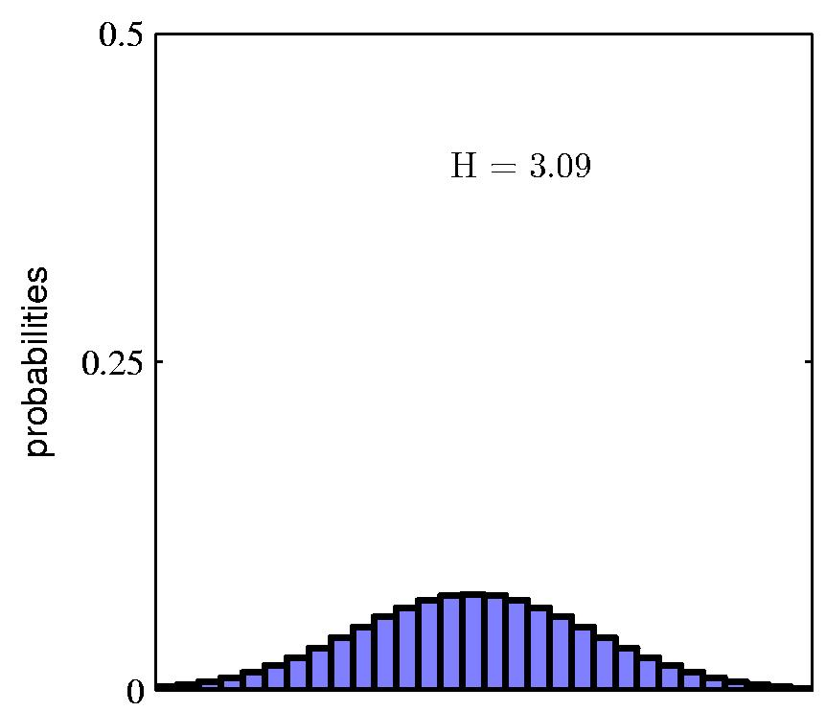
Histograms approximate densities
Notes:
See also 310-grades sheets in google drive and https://www.benlcollins.com/spreadsheets/histograms-normal-distribution/ and histogram-gaussian figure

Slide 8
Densities as limit histograms
let B be a bin in a histogram
height(B) = count(B) by definition
area(B) = height(B) x width(B) = count(B) x width(B)
p(y in B) = area(B) as width(B) ➔0
p(y) = count(B) x width(B) as width(B) ➔0
Can think of p(x) as proportional to counts around x

Slide 9
Mean
Aka average, expectation, or mean of P.
Notation: E, µ.
How to define for a density function?
Example Excel
Notes:
Give example of grades.

Slide 10
Variance
Variance of a distribution:
Find mean of distribution.
For each point, find distance to mean. Square it. (Why?)
Take expected value of squared distance.
Measures the spread of continuous values.
Example Excel

Slide 11
The Gaussian Density Function

Slide 12
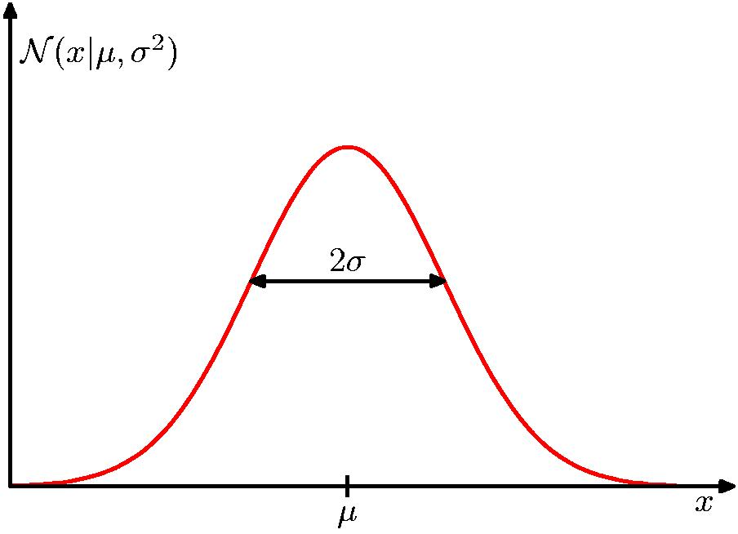
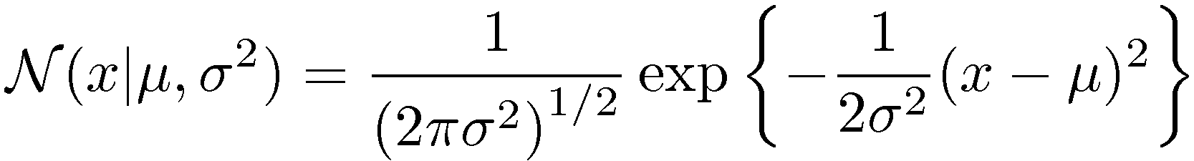
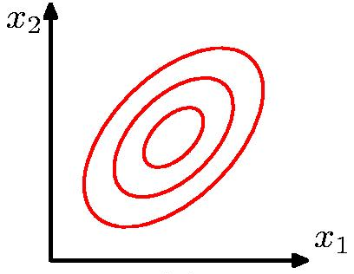
The Gaussian Distribution

Slide 13
Meet the exponential family
A common way to define a probability density p(x) is as an exponential function of x.
Simple mathematical motivation: multiplying numbers between 0 and 1 yields a number between 0 and 1.
  E.g. (1/2)^{n}, (1/e)^{x}.
Deeper mathematical motivation: exponential pdfs have good statistical properties for learning.
  E.g., conjugate prior, maximum likelihood, sufficient statistics.
Notes:
In fact, the exponential family is the only class with these properties.
To see this for conjugate prior, note that the likelihood is typically a product (i.i.d. data). So the posterior is proportional to prior x product. If the prior is also a product (exponential), then the posterior is a product like the prior. If the prior is something else, then something else x product is usually not something else.

Slide 14
Reading exponential prob formulas
Suppose there is a relevant feature f(x) and I want to express that “the greater f(x) is, the less probable x is”.
f(x)⬆, p(x)⬇
Use p(x) = α exp(-f(x)).

Slide 15
Example: exponential form sample size
Fair Coin: The longer the sample size, the less likely it is.
p(n) = 2^{-n}.
ln[p(n)]
Sample size n
Notes:
Try to do matlab plot. Slope goes down because of minus sign.

Slide 16
Location Parameter
The further x is from the center μ, the less likely it is.
ln[p(x)]
(x-μ)²

Slide 17
Spread/Precision parameter
The greater the spread σ², the more likely x is (away from the mean).
The greater the precision β, the less likely x is.
ln[p(x)]
1/σ² = β

Slide 18
Normalization
Let p*(x) be an unnormalized density function.
To make a probability density function, need to find normalization constant α s.t.
Therefore
For the Gaussian (Laplace 1782)
Notes:
So all I have to do is solve the integral!

Slide 19
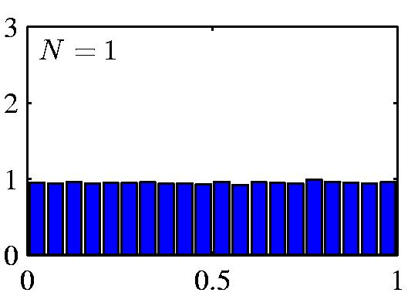
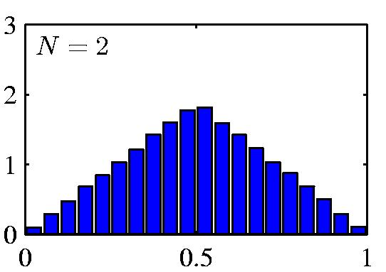
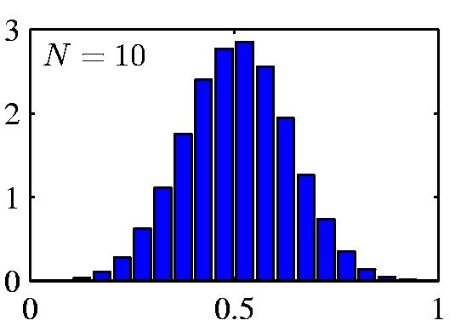
Central Limit Theorem
The distribution of the sum of N i.i.d. random variables becomes increasingly Gaussian as N grows.
Laplace (1810).
Example: N uniform [0,1] random variables.

Slide 20
Log-linear Models
Many probability distributions used in machine learning follow this exponential pattern for assigning a probability or density to an object x.
Define a set of aggregate/basis functions
T₁(x),..,T_{m}(x) known as sufficient statistics
The log-probability is proportional to a weighted sum of the sufficient statistics
Works for anything: documents, videos, term marks,...
e.g. discrete BN estimation:
Notes:
Division of labour: define statistics vs. learn the weights

Slide 21
Normal Distribution Parameter Learning

Slide 22
Maximum Likelihood Learning
Same fundamental idea as with discrete variables: maximize data likelihood given parameters.
The likelihood function for Gaussian distribution:
Find derivatives of L, set to 0.
Result: The maximum likelihood estimates are the sample mean and the sample variance.
  I.e. mean and variance computed directly from the data.
For details see text and assignment.

Slide 23
Conclusion
Density functions represent probability distributions for continuous data
  Like histograms with infinitely many bins
Most important density is the Gaussian distribution
Two parameters:
  mean μ represents typical or expected value
  probability of point depends on distance to mean
  variance σ² represents spread or flatness of curve
As with discrete parameters, MLE estimates use parameter values computed directly from data.

