Slide 1
Decision Tree Learning
CMPT 310
Simon Fraser University
Oliver Schulte
Notes:
If you use “insert slide number” under “Footer”, that text box only displays the slide number, not the total number of slides. So I use a new textbox for the slide number in the master.

Slide 2
Classification
Predict a single target or class label for an object, given a vector of features.
Conditional probability P(label|features).
Example: predict PlayTennis given 4 other features.
Day | Outlook | Temperature | Humidity | Wind | PlayTennis
1 | sunny | hot | high | weak | no
2 | sunny | hot | high | strong | no
3 | overcast | hot | high | weak | yes
4 | rain | mild | high | weak | yes
5 | rain | cool | normal | weak | yes
6 | rain | cool | normal | strong | no
7 | overcast | cool | normal | strong | yes
8 | sunny | mild | high | weak | no
9 | sunny | cool | normal | weak | yes
10 | rain | mild | normal | weak | yes
11 | sunny | mild | normal | strong | yes
12 | overcast | mild | high | strong | yes
13 | overcast | hot | normal | weak | yes
14 | rain | mild | high | strong | no

Slide 3
Classification Models
In principle Bayes nets can answer queries of the form P(class|features). But:
A Bayes net is a very general probability model.
Sometimes want to use more specific models.
  More intelligible for some users.
  Models make assumptions : if correct → better learning, fewer parameters required.

Slide 4
Decision Tree Classifiers
Notes:
If you use “insert slide number” under “Footer”, that text box only displays the slide number, not the total number of slides. So I use a new textbox for the slide number in the master.

Slide 5
Decision Tree
Popular type of classifier. Easy to visualize.
Especially for discrete values, but also for continuous.
Learning: Information Theory.
Notes:
aka classification tree
Use demos to explain DT learning.

Slide 6
Decision Tree Example
Notes:
try aispace demo. Load ‘LikesTV’. Use test new example button.

Slide 7
Exercise
Find a decision tree to represent
A OR B
A AND B
(A AND B) OR (C AND notD AND E).
Bonus: A XOR B.
  A XOR B is true if and only if one of A or B is true, but not both.

Slide 8
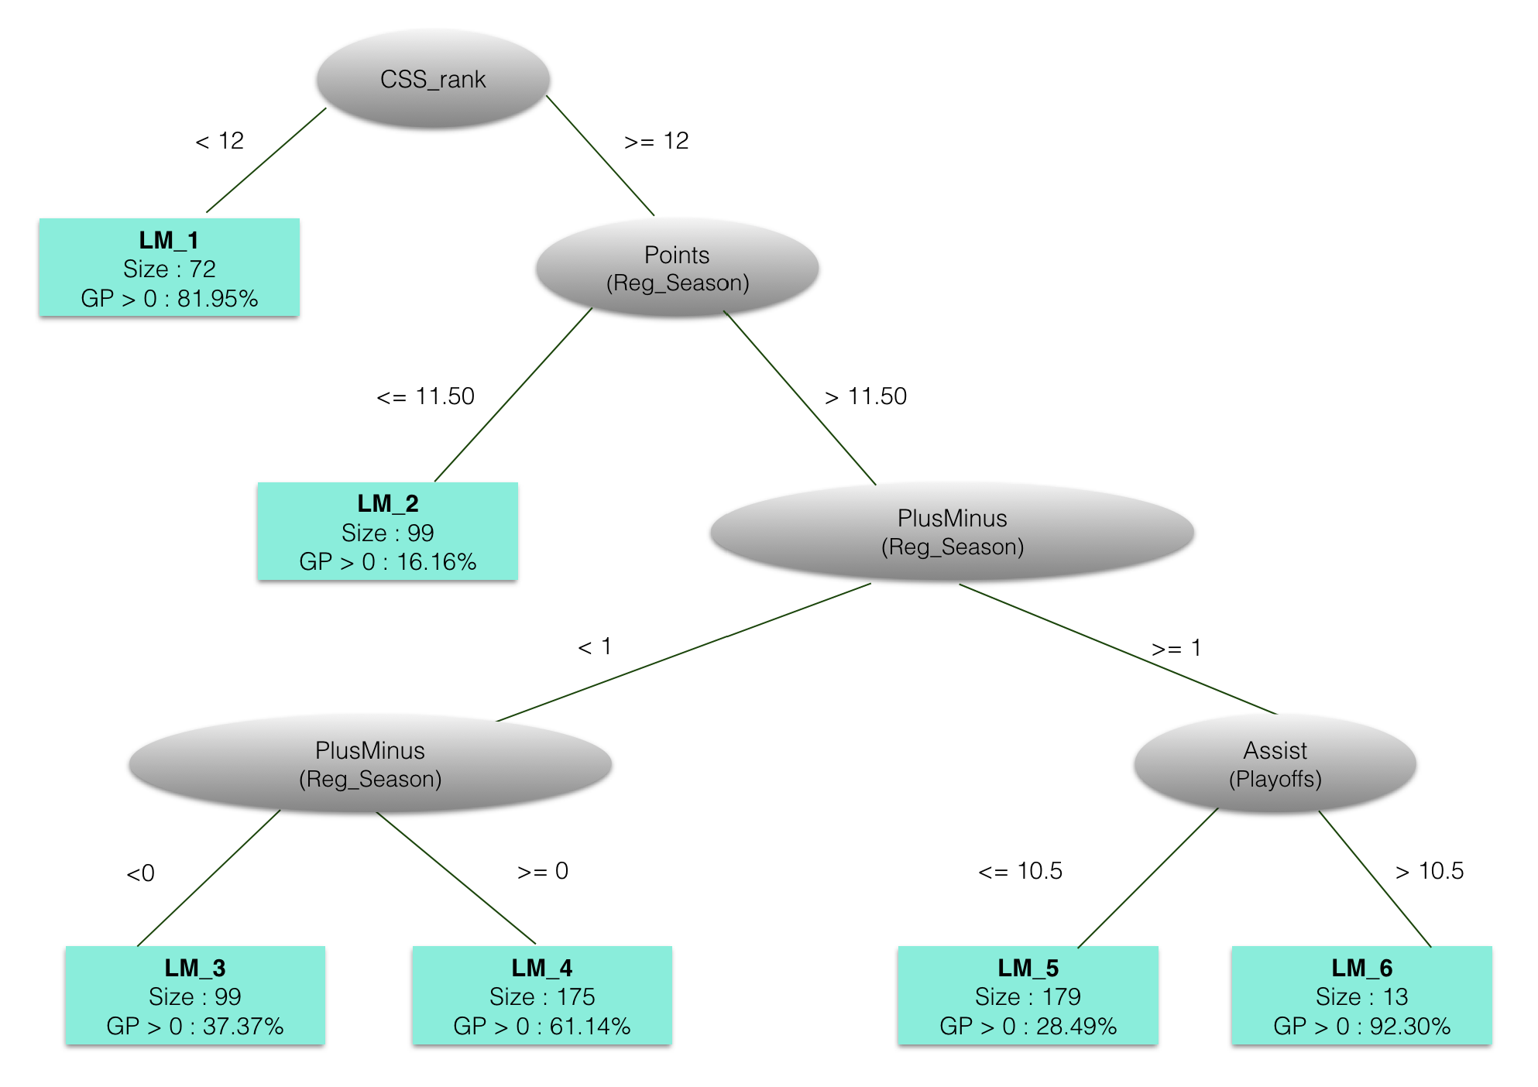
Example: Will a player play in the NHL?
Notes:
see if I can run Weka live

Slide 9
Regression Tree Example: Rate of Reboot Failure
Notes:
Estimates rate lambda of hardware failure at time t.

Slide 10
Decision Tree Learning
Basic Loop:
A := the “best” decision attribute for next node (stump)
For each value of A, create new descendant of node
Assign training examples to leaf nodes
If training examples perfect classified, then STOP.
Else iterate over new leaf nodes.

Slide 11
Entropy

Slide 12
Uncertainty and Probability
The more “balanced” a probability distribution, the less information it conveys (e.g., about class label).
How to quantify?
Information Theory: Entropy = Balance.
S is sample, p₊ is proportion positive, p₋ negative.
Entropy(S) =
-p₊log2(p₊) - p₋log2(p₋)

Slide 13
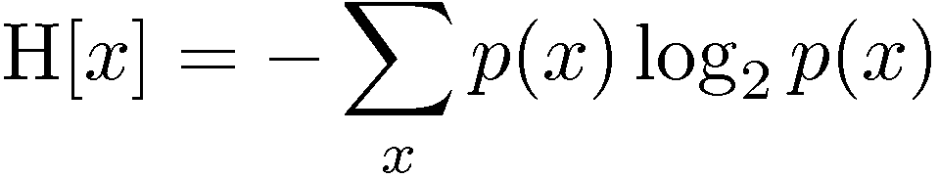
Entropy: General Definition
Important quantity in
  coding theory
  statistical physics
  machine learning

Slide 14
Intuition

Slide 15
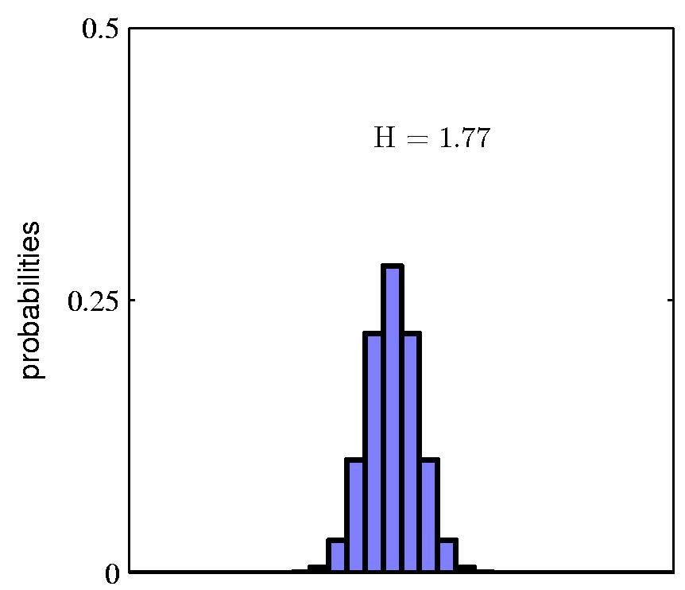
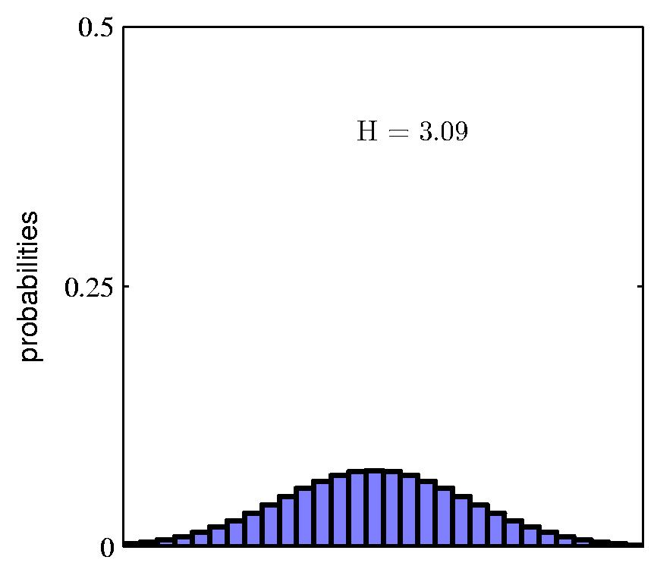
Entropy

Slide 16
Coding Theory
Coding theory: X discrete with 8 possible states (“messages”); how many bits to transmit the state of X?
Shannon information theorem: optimal code length assigns –log₂ p(x) to each “message” X = x.
If all states equally likely, the best code is:
Assign -log₂(1/8) =3 bits to each state
Entropy H = expected message length =
-8 x 1/8 -log₂(1/8) = 3 bits

Slide 17
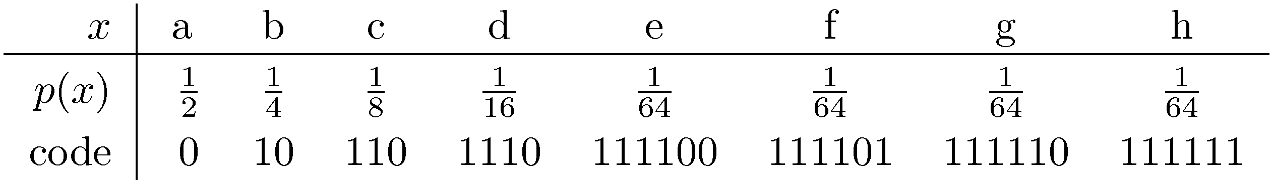
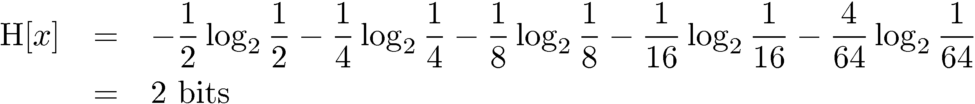
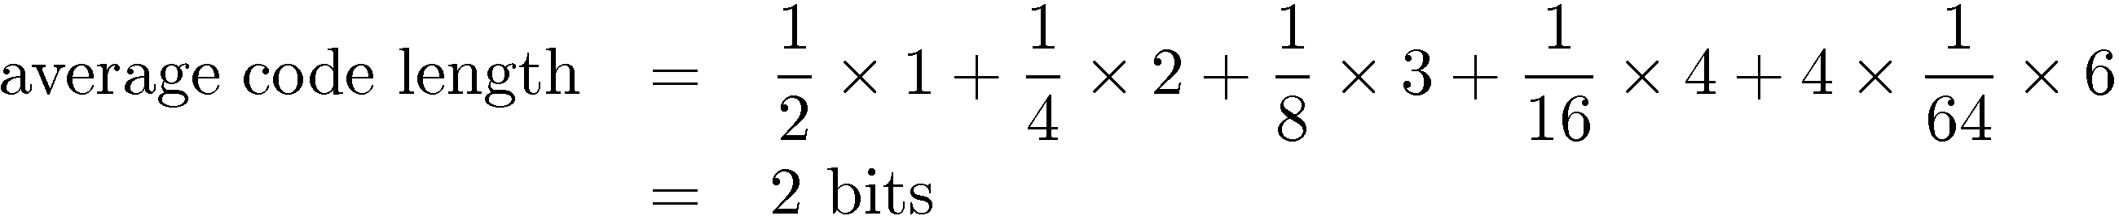
Another Coding Example
Notes:
Assumes no “stop” character between messages, like Huffmann encoding tree.

Slide 18
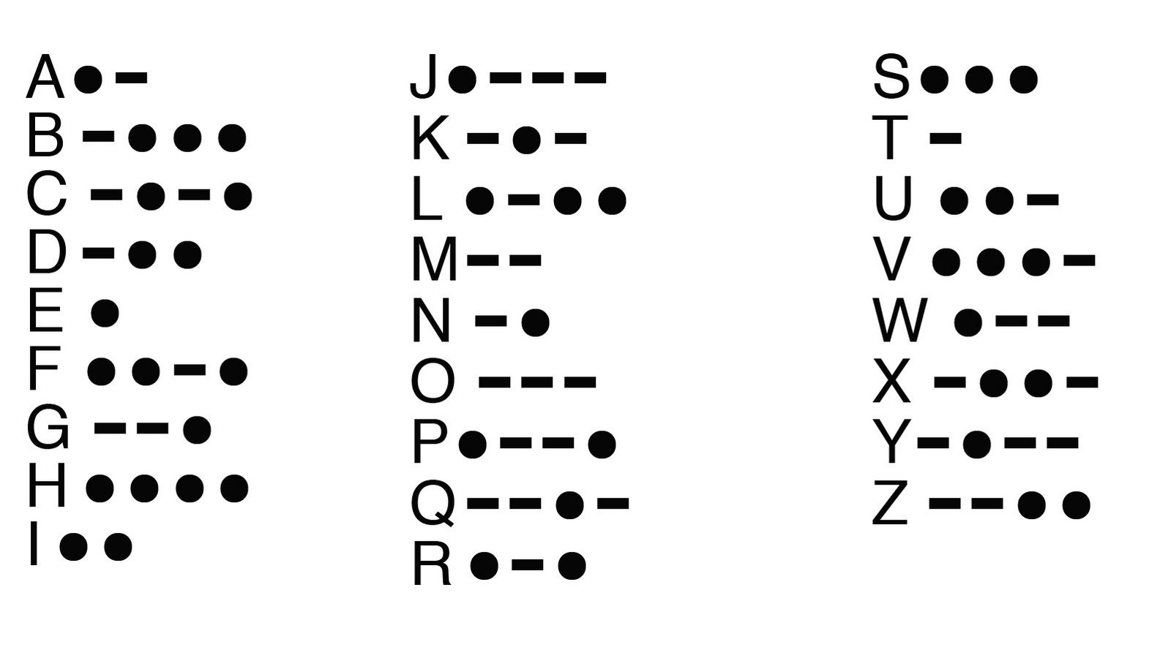
Zipf’s Law
General principle: frequent messages get shorter codes.
  e.g., abbreviations, Morse Code
  Information Compression.
Notes:
Morse Code example. Morse Code has “stop” character.

Slide 19
Information Gain

Slide 20
Splitting Criterion
A new attribute value changes the entropy.
Want to split on attribute that has the greatest reduction in entropy, averaged over its attribute values.
Gain(S,A) = expected reduction in entropy due to splitting on A.

Slide 21
Example
Notes:
gain of humidity is greater

Slide 22
Playtennis Example
Notes:
try id3 in weka, recovers original tree.
do example in LikesTV problem.
select test examples using tool. Show how test error is different from training error.
maybe add final decisoin tree

Slide 23
Decision Tree Learning Options
J48

Slide 24
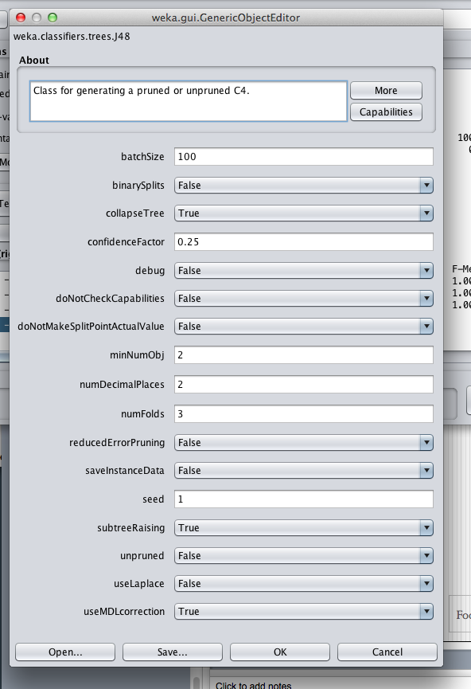
Decision Tree Options in Weka
Notes:
Next: deep learning. pdf is based on svn-projects/My Classes/deep-learning/slides/neural-nets-short.tex

