Slide 1
Bayes Net Learning:
Bayesian Approaches
Oliver Schulte
Machine Learning 726
Notes:
If you use “insert slide number” under “Footer”, that text box only displays the slide number, not the total number of slides. So I use a new textbox for the slide number in the master.

Slide 2
The Parameter Learning Problem
Input: a data table X_{NxD}.
  One column per node (random variable)
  One row per instance.
How to fill in Bayes net parameters?
Day | Outlook | Temperature | Humidity | Wind | PlayTennis
1 | sunny | hot | high | weak | no
2 | sunny | hot | high | strong | no
3 | overcast | hot | high | weak | yes
4 | rain | mild | high | weak | yes
5 | rain | cool | normal | weak | yes
6 | rain | cool | normal | strong | no
7 | overcast | cool | normal | strong | yes
8 | sunny | mild | high | weak | no
9 | sunny | cool | normal | weak | yes
10 | rain | mild | normal | weak | yes
11 | sunny | mild | normal | strong | yes
12 | overcast | mild | high | strong | yes
13 | overcast | hot | normal | weak | yes
14 | rain | mild | high | strong | no
Humidity
PlayTennis
Notes:
What is N? What is D?
PlayTennis: Do you play tennis Saturday morning?
For now complete data, incomplete data another day (EM).

Slide 3
Bayesian Parameter Learning

Slide 4
Uncertainty in Estimates
A single point estimate does not quantify uncertainty.
  Is 6/10 the same as 6000/10000?
Classical statistics: specify confidence interval for estimate.
Bayesian approach: Assign a probability to parameter values.

Slide 5
Parameter Probabilities
Intuition: Quantify uncertainty about parameter values by assigning a prior probability to parameter values.
Not based on data. Example:
Hypothesis | Chance of Heads | Prior probability of Hypothesis
1 | 100% | 10%
2 | 75% | 20%
3 | 50% | 40%
4 | 25% | 20%
5 | 0% | 10%
Notes:
Yes, these are probabilities of probabilities.

Slide 6
Bayesian Prediction/Inference
What probability does the Bayesian assign to Coin = heads?
I.e., how should we bet on Coin = heads?
Answer:
Make a prediction for each parameter value.
Average the predictions using the prior as weights:
Hypothesis | Chance of Heads | Prior probability | weighted chance
1 | 100% | 10% | 10%
2 | 75% | 20% | 15%
3 | 50% | 40% | 20%
4 | 25% | 20% | 5%
5 | 0% | 10% | 0%
 |  | Expected Chance = | 50%
Notes:
Relationship to BN parameters: assign distribution over numbers

Slide 7
Mean
In the binomial case, Bayesian prediction can be seen as the expected value of a probability distribution P.
Aka average, expectation, or mean of P.
Notation: E, µ.
Example Excel
Notes:
Give example of grades.

Slide 8
Variance
Variance of a distribution:
Find mean of distribution.
For each point, find distance to mean. Square it. (Why?)
Take expected value of squared distance.
Variance of a parameter estimate = uncertainty.
Decreases with more data.
Example Excel

Slide 9
Continuous priors
Probabilities usually range over [0,1].
Then probabilities of probabilities are probabilities of continuous variables = probability density function.
p(x) behaves like probability of discrete value, but with integrals replacing sum.
E.g. .
Exercise: Find the p.d.f. of the uniform distribution over a closed interval [a,b].

Slide 10
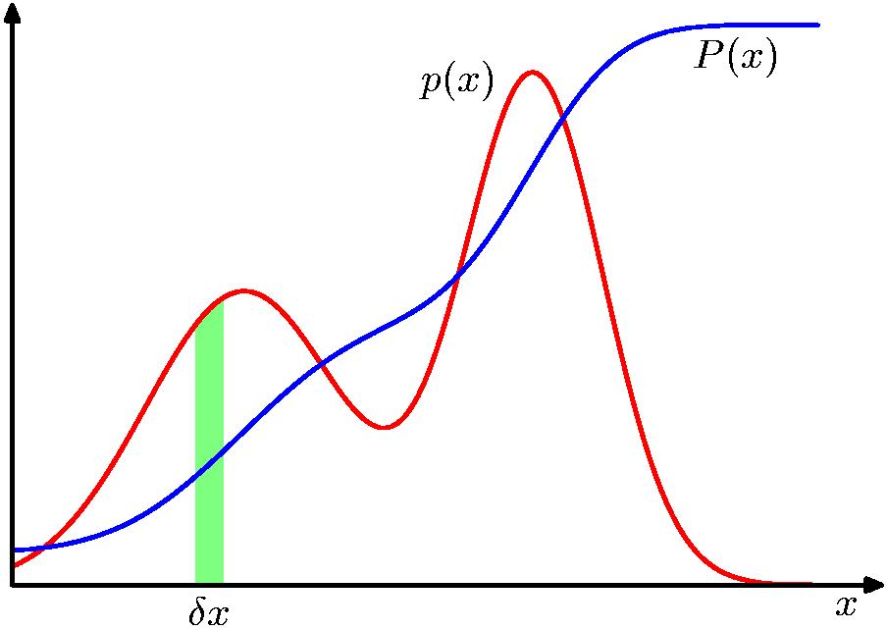
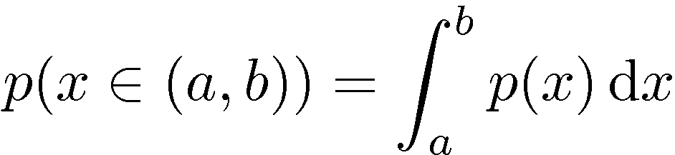
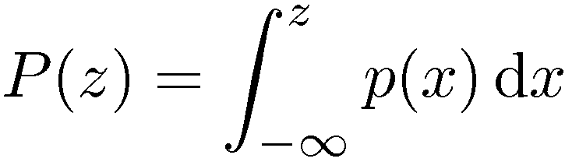
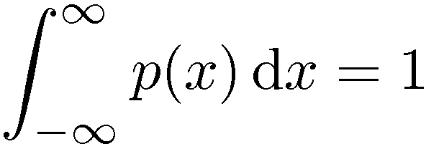

Probability Densities
Notes:
x can be anything

Slide 11
Bayesian Prediction With P.D.F.s
Suppose we want to predict
p(x|θ)
Given a distribution over the parameters, we marginalize over θ.

Slide 12
Bayesian Learning

Slide 13
Bayesian Updating
Update prior using Bayes’ theorem.
P(h|D) = αP(D|h) x P(h).
Example: Posterior after observing 10 heads
Hypothesis | Chance of Heads | Prior probability
1 | 100% | 10%
2 | 75% | 20%
3 | 50% | 40%
4 | 25% | 20%
5 | 0% | 10%
Notes:
Answer: theta^h x (1-theta)t/2^{-n}.
Notice that the posterior has a different from than the prior.

Slide 14
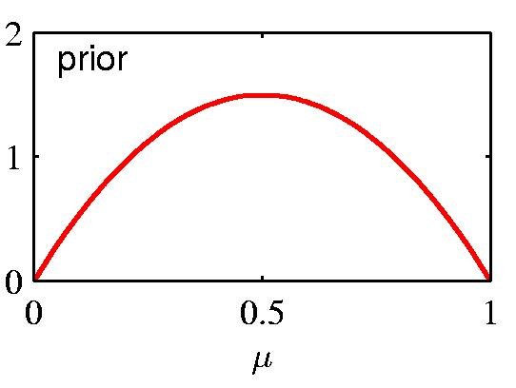
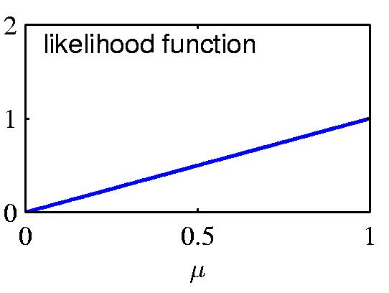
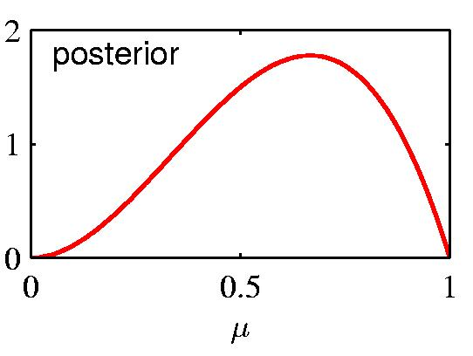
Prior ∙ Likelihood = Posterior

Slide 15
Updated Bayesian Predictions
Predicted probability that next coin is heads as we observe 10 coins.
Notes:
smooth approach to 1 compared to max likelihood
in the limit, Bayes = max likelihood. This is typical.

Slide 16
Updating: Continuous Example
Consider again the binomial case where θ= prob of heads.
Given n coin tosses and h observed heads, t observed tails, what is the posterior of a uniform distribution over θ in [0,1]?
Solved by Laplace in 1814!

Slide 17
Bayesian Prediction
How do we predict using the posterior?
We can think of this as computing the probability of the next head in the sequence
Any ideas?
Solution:
Laplace 1814!

Slide 18
The Laplace Correction Revisited
Suppose I have observed n data points with k heads.
  Find posterior distribution.
  Predict probability of heads using posterior distribution.
  Result h+1/n+2 =
  m-estimate with uniform prior, m=2.

Slide 19
Parametrized Priors
Motivation: Suppose I don’t want a uniform prior.
  Smooth with m>0.
  Express prior knowledge.
Use parameters for the prior distribution.
  Called hyperparameters.
  Chosen so that updating the prior is easy.

Slide 20
Beta Distribution: Definition
Hyperparameters a>0,b>0.
The Γ term is a normalization constant.
Notes:
note the exponential distribution.

Slide 21
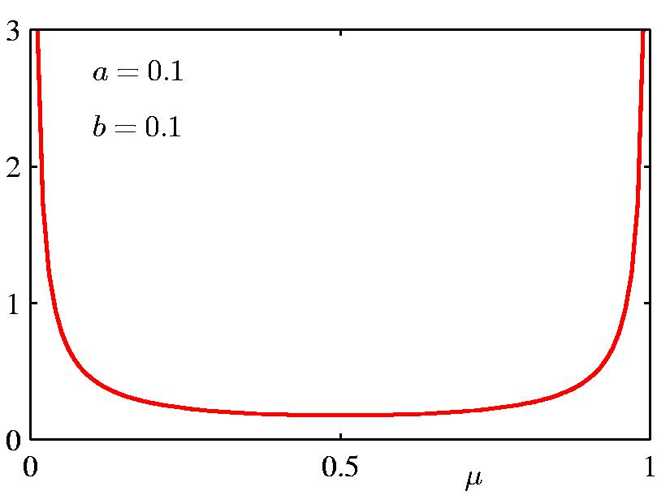
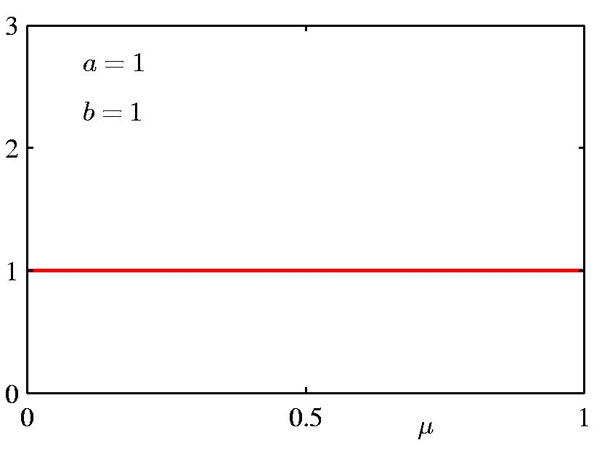
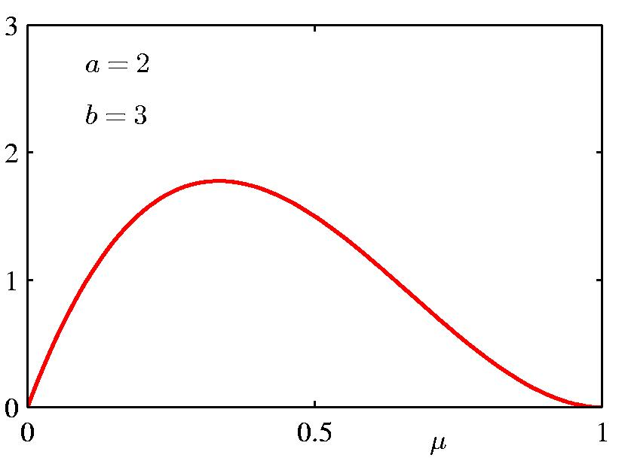
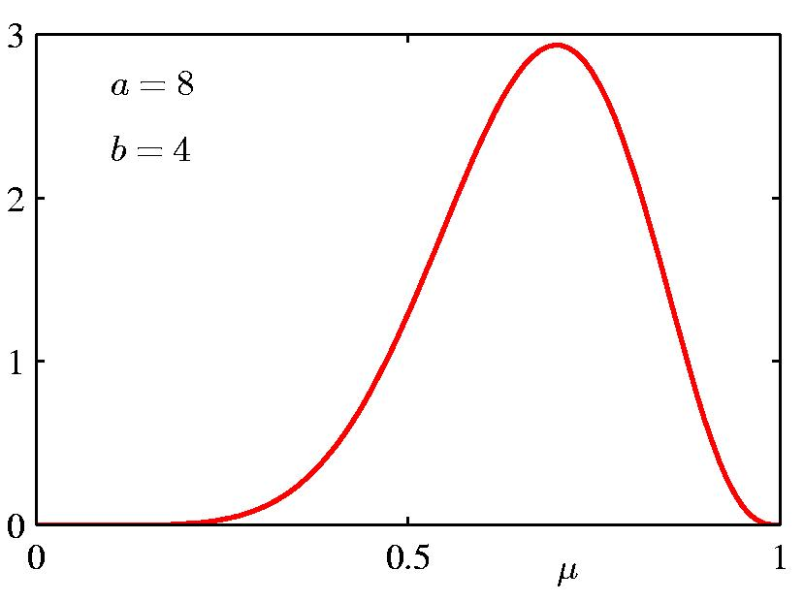
Beta Distribution

Slide 22
Updating the Beta Distribution
So what is the normalization constant α?
Hyperparameter a-1: like a virtual count of initial heads. Hyperparameter b-1: like a virtual count of initial tails.
Beta prior ➔Beta posterior: conjugate prior.
Notes:
h heads, t tails.
Answer: the constant for (h+a-1,t+b-1) = Gamma(h+a-1,t+b-1)/Gamma(h+a-1) Gamma(t+b-1)
Conjugate priors must be exponential. Why?

Slide 23
Conjugate Prior for non-binary variables
Dirichlet distribution: generalizes Beta distribution for variables with >2 values.

Slide 24
Summary
Maximum likelihood: general parameter estimation method.
Choose parameters that make the data as likely as possible.
For Bayes net parameters: MLE = match sample frequency.
Typical result!
Problems:
  not defined for 0 count situation.
  doesn’t quantity uncertainty in estimate.
Bayesian approach:
  Assume prior probability for parameters; prior has hyperparameters.
  E.g., beta distribution.
  Problems:
    prior choice not based on data.
    inferences (averaging) can be hard to compute.
Notes:
should add discussion of Gaussian without parents. Other cases are covered later.

