Slide 1
Bayesian Networks
CMPT 726
Simon Fraser University
CHAPTER 14
Oliver Schulte

Slide 2
Bayes Nets: Motivation
Represent domain knowledge.
  Possibly a lot of it.
Allow for uncertainty.
Represent correlations and causal relations.
Fast answers to types of queries:
  Probabilistic: What is the probability that a patient has strep throat given that they have fever?
  Relevance: Is fever relevant to having strep throat?

Slide 3
Bayesian Network LInks
Judea Pearl's Turing Award
Used in many applications: medical diagnosis, office clip, …
400-page book about applications.
Companies: Hugin, Netica, Microsoft.
Notes:
look up companies on-line

Slide 4
Basic Concepts

Slide 5
Bayesian Network Structure
A graph where:
  Each node is a random variable.
  Edges are directed.
  There are no directed cycles (directed acyclic graph).
Notes:
DAG is equivalent to the existence of a topological ordering.

Slide 6
Example: Bayesian Network Graph
Cavity
Catch
toothache
Notes:
These are easy to draw in the AI space tool. Demo: Projects/group-sharing/presentations/demos/cavity-bn.xml

Slide 7
Bayesian Network
A Bayesian network structure +
For each node X, for each value x of X, a conditional probability P(X=x|Y₁ = y₁,…,Y_{k} = y_{k}) = p for every assignment of values to the parents of X.
Demo in AIspace tool

Slide 8
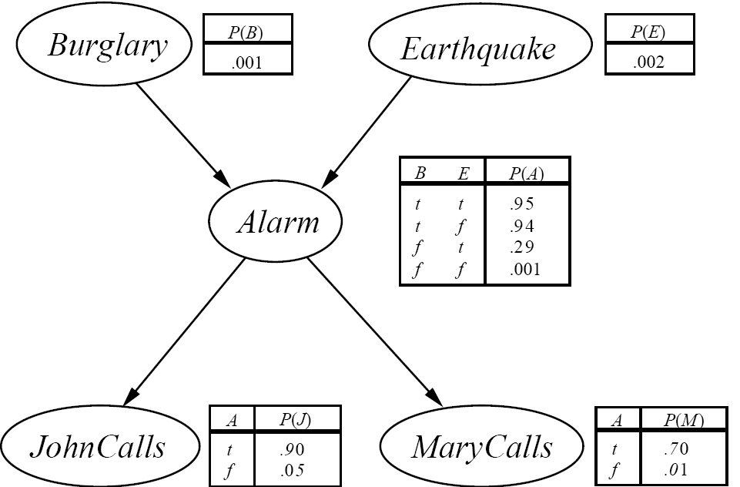
Example: Complete Bayesian Network
Notes:
Example Horn Clauses: Alarm -> JohnClass p:0.9

Slide 9
The Story
You have a new burglar alarm installed at home.
It’s reliable at detecting burglary but also responds to earthquakes.
You have two neighbors that promise to call you at work when they hear the alarm.
John always calls when he hears the alarm, but sometimes confuses alarm with telephone ringing.
Mary listens to loud music and sometimes misses the alarm.

Slide 10
Bayes Nets Encode the Joint Distribution

Slide 11
Bayes Nets and the Joint Distribution
A Bayes net compactly encodes the joint distribution over the random variables X₁,…,X_{n}. How?
Let x₁,…,x_{n} be a complete assignment of a value to each random variable. Then
P(x₁,…,x_{n}) = Π P(x_{i}|parents(X_{i}))
where the index i=1,…,n runs over all n nodes.
This is the product formula for Bayes nets.

Slide 12
Computing The Product
In words, the joint probability is computed as follows.
  For each node X_{i}:
  Find the assigned value x_{i}.
  Find the values y₁,..,y_{k} assigned to the parents of X_{i}.
  Look up the conditional probability P(x_{i}|y₁,..,y_{k}) in the Bayes net.
  Multiply together these conditional probabilities.

Slide 13
Product Formula Example: Burglary
Query: What is the joint probability that all variables are true?
P(M, J, A, E, B) =
P(M|A) p(J|A) p(A|E,B)P(E)P(B)
= .7 x .9 x .95 x .002 x .001

Slide 14
Cavity Example
Query: What is the joint probability that there is a cavity but no toothache and the probe doesn’t catch?
P(Cavity = T, toothache = F, Catch = F) =
P(Cavity= T) p(Toothache = F|Cavity = T) p(Catch = F|Cavity = T)
= .2 x .076 x 0.46
Cavity
Catch
toothache
Notes:
Example calculations:
1-0.76 = 0.924
1-0.46 = .54

Slide 15
Compactness of Bayesian Networks
Consider n binary variables
Unconstrained joint distribution requires O(2^{n}) probabilities
If we have a Bayesian network, with a maximum of k parents for any node, then we need O(n 2^{k}) probabilities
Example
  Full unconstrained joint distribution
    n = 30: need 10⁹ probabilities for full joint distribution
  Bayesian network
    n = 30, k = 4: need 480 probabilities
Notes:
Recall toothache example where we directly represented the joint distribution.

Slide 16
Completeness of Bayes nets
The Bayes net encodes all joint probabilities.
Knowledge of all joint probabilities is sufficient to answer any probabilistic query.
A Bayes net can in principle answer every query.
Notes:
Demo in AIspace using cavity example.

Slide 17
Is it Magic?
Why does the product formula work?
  The Bayes net topological or graphical semantics.
    The graph by itself entails conditional independencies.
  The Chain Rule.

Slide 18
Bayes Nets Graphical Semantics

Slide 19
Common Causes: Spot the Pattern
Cavity
Catch
toothache
Catch is independent of toothache given Cavity.
Notes:
In UBC “Simple Diagnostic Example:
Fever is independent of Coughing Given Influenza.
Coughing is independent of Fever given Bronchitis.

Slide 20
Burglary Example
JohnCalls, MaryCalls are conditionally independent given Alarm.

Slide 21
Spot the Pattern: Chain Scenario
MaryCalls is independent of Burglary given Alarm.
JohnCalls is independent of Earthquake given Alarm.
Notes:
This is typical for sequential data.
In UBC “Simple Diagnostic Example:
Wheezing is independent of Influenza Given Bronchitis.
Coughing is independent of Smoke given Bronchitis.
Influenze is independent of Smokes. [check assignment]

Slide 22
The Markov Condition
A Bayes net is constructed so that:
each variable is conditionally independent of its nondescendants given its parents.
The graph alone (without specified probabilities) entails conditional independencies.
Notes:
1. This can always be achieved by letting a node have enough parents. See text for details on how to construct a Bayesian network.
2. This is also called the Markov condition.
3. Helps with the retrieve relevant problem: from the graph we can tell that certain information is ignorable.
Can work on this using “spot the pattern”.

Slide 23
Exercise
In the AISpace car starting belief network, does the Markov condition entail the following statements?
Conditional on Spark Plugs and Voltage at Plug, Spark Quality is independent of Spark Timing.
Conditional on Spark Plugs and Voltage at Plug, Spark Quality is independent of Car Starts.

Slide 24
Derivation of the Product Formula

Slide 25
The Chain Rule
We can always write
P(a, b, c, … z) = P(a | b, c, …. z) P(b, c, … z)
(Product Rule)
Repeatedly applying this idea, we obtain
P(a, b, c, … z) = P(a | b, c, …. z) P(b | c,.. z) P(c| .. z)..P(z)
Order the variables such that children come before parents.
Then given its parents, each node is independent of its other ancestors by the topological independence.
P(a,b,c, … z) = Π_{x}. P(x|parents)
Notes:
Accompany this with blackboard demonstration of the BN graph.

Slide 26
Example in Burglary Network
P(M, J,A,E,B) = P(M| J,A,E,B) p(J,A,E,B)= P(M|A) p(J,A,E,B)
= P(M|A) p(J|A,E,B) p(A,E,B) = P(M|A) p(J|A) p(A,E,B)
= P(M|A) p(J|A) p(A|E,B) P(E,B)
= P(M|A) p(J|A) p(A|E,B) P(E)P(B)
Colours show applications of the Markov condition.

Slide 27
Explaining Away

Slide 28
Common Effects: Spot the Pattern
Influenza and Smokes are independent.
Given Bronchitis, they become dependent.
Influenza
Smokes
Bronchitis
Battery Age
Charging System OK
Battery Age and Charging System are independent.
Given Battery Voltage, they become dependent.
Battery Voltage
Notes:
From UBC “Simple diagnostic problem”
Does this make sense?

Slide 29
Conditioning on Children produces conditional dependencies
Independent Causes:
A and B are independent.
“Explaining away” effect:
Given C, observing A makes B less likely.
E.g. Bronchitis in UBC “Simple Diagnostic Problem”.
A and B are (marginally) independent, become dependent once C is known.
A
B
C
This pattern requires an extension of the Markov condition known as d-separation.
Notes:
Another example: Wumpus on one square explains stench.

Slide 30
Mathematical Analysis
Theorem: If A, B have no common ancestors and neither is a descendant of the other, then they are independent of each other.
Proof for our example:
  P(a,b) = Σ_{c} P(a,b,c) =
  Σ_{c} P(a) P(b) P(c|a,b) =
  P(a) P(b) Σ_{c} P(c|a,b) =
  P(a) P(b)
A
B
C
Notes:
Not quite a proof because we A,B may have parents. But illustrates general idea.
First step follows from marginilization. Second step follows from product formula.
3rd step follows since P(a), P(b) do not depend on c. Last step follows P(c|a,b) adds up to 1 over possible c values.

Slide 31
Bayes’ Theorem

Slide 32
Abductive Reasoning
Edges are often causal, from cause to effect.
Many important queries are diagnostic, from effect to cause.
This reversal is difficult to capture with logic
Cavity
Toothache
Notes:
But not impossible in logic: see nonmonotonic reasoning. Horn clauses
Black: causal direction.
Red: direction of inference.
(e.g. logical Horn clauses).

Slide 33
Bayes’ Theorem: Another Example
A doctor knows the following.
The disease meningitis causes the patient to have a stiff neck 50% of the time.
The prior probability that someone has meningitis is 1/50,000.
The prior that someone has a stiff neck is 1/20.
Question: knowing that a person has a stiff neck what is the probability that they have meningitis?

Slide 34
Spot the Pattern: Diagnosis
P(Cavity) | P(Toothache|Cavity) | P(Toothache) | P(Cavity|Toothache)
0.2 | 0.6 | 0.2 | 0.6
P(Meningitis) | P(Stiff Neck| Meningitis) | P(Stiff Neck) | P(Meningitis|Stiff Neck)
1/50,000 | 1/2 | 1/20 | 1/5,000
Notes:
How does the last number depend on the first three?

Slide 35
Spot the Pattern: Diagnosis
P(Cavity) | x | P(Toothache|Cavity) | / | P(Toothache) | = | P(Cavity|Toothache)
0.2 |  | 0.6 |  | 0.2 |  | 0.6
P(Meningitis) | x | P(Stiff Neck| Meningitis) | / | P(Stiff Neck) | = | P(Meningitis|Stiff Neck)
1/50,000 |  | 1/2 |  | 1/20 |  | 1/5,000

Slide 36
Explain the Pattern: Bayes’ Theorem
Exercise: Prove Bayes’ Theorem
P(A | B) = P(B | A) P(A) / P(B).

Slide 37
On Bayes’ Theorem
P(a | b) = P(b | a) P(a) / P(b).
Useful for assessing diagnostic probability from causal probability:
P(Cause|Effect) =
P(Effect|Cause) P(Cause) / P(Effect).
Likelihood: how well does the cause explain the effect?
Prior: how plausible is the explanation before any evidence?
Evidence Term/Normalization Constant: how surprising is the evidence?
Notes:
The better the cause explains the effect, the more likely it is.
The more plausible the cause is, the more likely it is.
The more surprising the evidence (the lower its prior probability), the greater its impact.

Slide 38
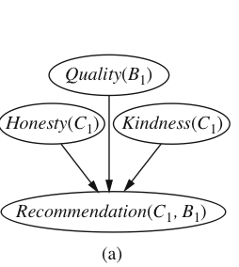
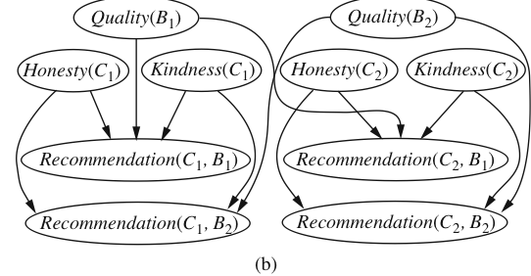
Relational 1st-order Bayes nets
Can we combine 1st-order logic with Bayes nets?
Basic idea: use nodes with 1st-order variables, like Prolog Horn clauses.
For inference, follow grounding approach to 1st-order reasoning.
Important open topic, many researchers working on this, including yours truly.

Slide 39
Summary
Bayes nets represent probabilistic knowledge in a graphical way using conditional probabilities.
Used in many applications and companies.
The graph encodes dependencies (correlations) and independencies.
Supports efficient probabilistic queries.
Bayes’ theorem is a formula for abductive reasoning, from effect to cause.
Notes:
Key concepts:

