Slide 1
Bayes Net Learning
Oliver Schulte
Machine Learning 726
Notes:
If you use “insert slide number” under “Footer”, that text box only displays the slide number, not the total number of slides. So I use a new textbox for the slide number in the master.

Slide 2
Learning Bayes Nets

Slide 3
Structure Learning Example: Sleep Disorder Network
Source: Development of Bayesian Network models for obstructive sleep apnea syndrome assessment Fouron, Anne Gisèle. (2006) . M.Sc. Thesis, SFU.
Notes:
generally we don’t get into structure learning in this course.

Slide 4
Parameter Learning Scenarios
Complete data (today).
Later: Missing data (EM).
Parent Node/ Child Node | Discrete | Continuous
Discrete | Maximum Likelihood Decision Trees | logit distribution (logistic regression)
Continuous | conditional Gaussian (not discussed) | linear Gaussian (linear regression)

Slide 5
The Parameter Learning Problem
Input: a data table X_{NxD}.
One column per node (random variable)
One row per instance.
How to fill in Bayes net parameters?
Day | Outlook | Temperature | Humidity | Wind | PlayTennis
1 | sunny | hot | high | weak | no
2 | sunny | hot | high | strong | no
3 | overcast | hot | high | weak | yes
4 | rain | mild | high | weak | yes
5 | rain | cool | normal | weak | yes
6 | rain | cool | normal | strong | no
7 | overcast | cool | normal | strong | yes
8 | sunny | mild | high | weak | no
9 | sunny | cool | normal | weak | yes
10 | rain | mild | normal | weak | yes
11 | sunny | mild | normal | strong | yes
12 | overcast | mild | high | strong | yes
13 | overcast | hot | normal | weak | yes
14 | rain | mild | high | strong | no
Humidity
PlayTennis
Notes:
What is N? What is D?
PlayTennis: Do you play tennis Saturday morning?
For now complete data, incomplete data another day (EM).

Slide 6
Start Small: Single Node
What would you choose?
Day | Humidity
1 | high
2 | high
3 | high
4 | high
5 | normal
6 | normal
7 | normal
8 | high
9 | normal
10 | normal
11 | normal
12 | high
13 | normal
14 | high
Humidity
P(Humidity = high)
θ
How about P(Humidity = high) = 50%?

Slide 7
Parameters for Two Nodes
Day | Humidity | PlayTennis
1 | high | no
2 | high | no
3 | high | yes
4 | high | yes
5 | normal | yes
6 | normal | no
7 | normal | yes
8 | high | no
9 | normal | yes
10 | normal | yes
11 | normal | yes
12 | high | yes
13 | normal | yes
14 | high | no
P(Humidity = high)
θ
H | P(PlayTennis = yes|H)
high | θ1
normal | θ2
Is θ as in single node model?
How about θ₁=3/7?
How about θ₂=6/7?
Humidity
PlayTennis

Slide 8
Maximum Likelihood Estimation

Slide 9
MLE
An important general principle: Choose parameter values that maximize the likelihood of the data.
Intuition: Explain the data as well as possible.
Recall from Bayes’ theorem that the likelihood is P(data|parameters) = P(D|θ).
Notes:
calligraphic font D in book.

Slide 10
Finding the Maximum Likelihood Solution: Single Node
Humidity | P(Hi|θ)
high | θ
high | θ
high | θ
high | θ
normal | 1-θ
normal | 1-θ
normal | 1-θ
high | θ
normal | 1-θ
normal | 1-θ
normal | 1-θ
high | θ
normal | 1-θ
high | θ
Humidity
P(Humidity = high)
θ
independent identically distributed data! iid
Write down
In example, P(D|θ)= θ⁷(1-θ)⁷.
Maximize θ for this function.
Notes:
binomial MLE

Slide 11
Solving the Equation
Often convenient to apply logarithms to products. ln(P(D|θ))= 7ln(θ) + 7 ln(1-θ).
Find derivative, set to 0.
Notes:
Make notes.

Slide 12
Finding the Maximum Likelihood Solution: Two Nodes
Humidity | PlayTennis | P(H,P|θ, θ1, θ2
high | no | θx (1-θ1)
high | no | θx (1-θ1)
high | yes | θx θ1
high | yes | θx θ1
normal | yes | (1-θ) x θ2
normal | no | (1-θ) x (1-θ2)
normal | yes | (1-θ)x θ2
high | no | θx (1-θ1)
normal | yes | (1-θ) x θ2
normal | yes | (1-θ) x θ2
normal | yes | (1-θ)x θ2
high | yes | θx θ1
normal | yes | (1-θ) x θ2
high | no | θx (1-θ1)
P(Humidity = high)
θ
H | P(PlayTennis = yes|H)
high | θ1
normal | θ2
Humidity
PlayTennis

Slide 13
Finding the Maximum Likelihood Solution: Two Nodes
In example, P(D|θ, θ1, θ2)= θ⁷(1-θ)⁷ (θ1)³(1-θ1)⁴ (θ2)⁶ (1-θ2).
Take logs and set to 0.
Humidity | PlayTennis | P(H,P|θ, θ1, θ2
high | no | θx (1-θ1)
high | no | θx (1-θ1)
high | yes | θx θ1
high | yes | θx θ1
normal | yes | (1-θ) x θ2
normal | no | (1-θ) x (1-θ2)
normal | yes | (1-θ)x θ2
high | no | θx (1-θ1)
normal | yes | (1-θ) x θ2
normal | yes | (1-θ) x θ2
normal | yes | (1-θ)x θ2
high | yes | θx θ1
normal | yes | (1-θ) x θ2
high | no | θx (1-θ1)
In a Bayes net, can maximize each parameter separately.
Fix a parent condition ➔ single node problem.

Slide 14
Finding the Maximum Likelihood Solution: Single Node, >2 possible values.
Day | Outlook
1 | sunny
2 | sunny
3 | overcast
4 | rain
5 | rain
6 | rain
7 | overcast
8 | sunny
9 | sunny
10 | rain
11 | sunny
12 | overcast
13 | overcast
14 | rain
Outlook | P(Outlook)
sunny | θ1
overcast | θ2
rain | θ3
Outlook
In example, P(D|θ1, θ2, θ3)= (θ1)⁵ (θ2)⁴ (θ3)⁵.
Take logs and set to 0.
Replace θ3 by 1- θ1- θ2.
Or use Lagrange multipliers.

Slide 15
Constrained Optimization
Write constraint as g(x) = 0.
e.g., g(θ1, θ2, θ3)=(1-(θ1+ θ2+ θ3)).
Minimize Lagrangian of f: L(x,λ) = f(x) + λg(x)
e.g. L(θ,λ) =(θ1)⁵ (θ2)⁴ (θ3)⁵+λ (1-θ1-θ2- θ3)
A minimizer of L is a constrained minimizer of f.
Exercise: try finding the minima of L given above. Hint: try eliminating λ as an unknown.

Slide 16
Smoothing

Slide 17
Motivation
MLE goes to extreme values on small unbalanced samples.
E.g., observe 5 heads ➔100% heads.
The 0 count problem: there may not be any data in part of the space.
E.g., there are no data for Outlook = overcast, PlayTennis = no.
Day | Outlook | Temperature | Humidity | Wind | PlayTennis
1 | sunny | hot | high | weak | no
2 | sunny | hot | high | strong | no
3 | overcast | hot | high | weak | yes
4 | rain | mild | high | weak | yes
5 | rain | cool | normal | weak | yes
6 | rain | cool | normal | strong | no
7 | overcast | cool | normal | strong | yes
8 | sunny | mild | high | weak | no
9 | sunny | cool | normal | weak | yes
10 | rain | mild | normal | weak | yes
11 | sunny | mild | normal | strong | yes
12 | overcast | mild | high | strong | yes
13 | overcast | hot | normal | weak | yes
14 | rain | mild | high | strong | no
PlayTennis
Outlook
Humidity
Notes:
Discuss first, do they see the problems?
Curse of Dimensionality.
Discussion: how to solve this problem?

Slide 18
Smoothing Frequency Estimates
h heads, t tails, n = h+t.
Prior probability estimate p.
Equivalent Sample Size m.
m-estimate =
Interpretation: we started with a “virtual” sample of m tosses with mp heads.
p = ½,m=2 ➔ Laplace correction =

Slide 19
Exercise
Apply the Laplace correction to estimate
P(outlook = overcast| PlayTennis = no)
P(outlook = sunny| PlayTennis = no)
P(outlook = rain| PlayTennis = no)
Outlook | PlayTennis
sunny | no
sunny | no
overcast | yes
rain | yes
rain | yes
rain | no
overcast | yes
sunny | no
sunny | yes
rain | yes
sunny | yes
overcast | yes
overcast | yes
rain | no

Slide 20
Bayesian Parameter Learning
Short Version

Slide 21
Uncertainty in Estimates
A single point estimate does not quantify uncertainty.
Is 6/10 the same as 6000/10000?
Classical statistics: specify confidence interval for estimate.
Bayesian approach: Assign a probability to parameter values.

Slide 22
Parameter Probabilities
Intuition: Quantify uncertainty about parameter values by assigning a prior probability to parameter values.
Not based on data. Example:
Hypothesis | Chance of Heads | Prior probability of Hypothesis
1 | 100% | 10%
2 | 75% | 20%
3 | 50% | 40%
4 | 25% | 20%
5 | 0% | 10%
Notes:
Yes, these are probabilities of probabilities.

Slide 23
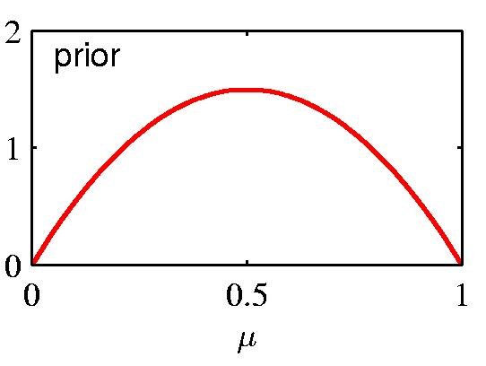
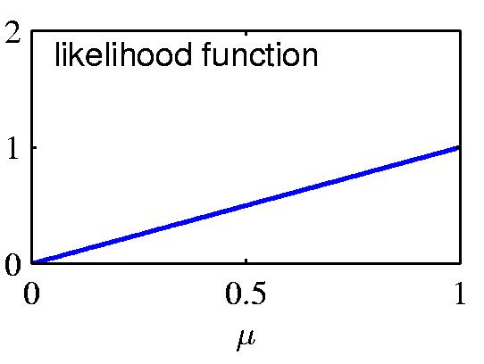
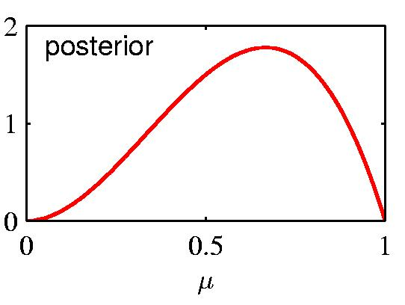
Maximum Posterior Inference
Recall that the maximum posterior estimate for dataset D satisfies argmax_{θ} (P(θ|D))=argmax_{θ} (P(D|θ)xP(θ)
The prior can be used to smooth estimates
e.g. for observing 1 head

Slide 24
Example: Uniform Prior
Suppose we start with a uniform distribution for the chance p that X=1 for a binary variable (think coin flips).
What is the maximum posterior estimates?
Answer: the same as using the Laplace correction.
Solved by Laplace in 1814!

Slide 25
Prior ∙ Likelihood = Posterior

Slide 26
Bayesian Prediction/Inference
What probability does the Bayesian assign to Coin = heads?
I.e., how should we bet on Coin = heads?
Answer:
Make a prediction for each parameter value.
Average the predictions using the prior as weights:
Hypothesis | Chance of Heads | Prior probability | weighted chance
1 | 100% | 10% | 10%
2 | 75% | 20% | 15%
3 | 50% | 40% | 20%
4 | 25% | 20% | 5%
5 | 0% | 10% | 0%
 |  | Expected Chance = | 50%
Notes:
Relationship to BN parameters: assign distribution over numbers

Slide 27
Mean
In the binomial case, Bayesian prediction can be seen as the expected value of a probability distribution P.
Aka average, expectation, or mean of P.
Notation: E, µ.
Example Excel
Notes:
Give example of grades.

Slide 28
Variance
Variance of a distribution:
Find mean of distribution.
For each point, find distance to mean. Square it. (Why?)
Take expected value of squared distance.
Variance of a parameter estimate = uncertainty.
Decreases with more data.
Example Excel

Slide 29
Continuous priors
Probabilities usually range over [0,1].
Then probabilities of probabilities are probabilities of continuous variables = probability density function.
p(x) behaves like probability of discrete value, but with integrals replacing sum.
E.g. .
Exercise: Find the p.d.f. of the uniform distribution over a closed interval [a,b].

Slide 30
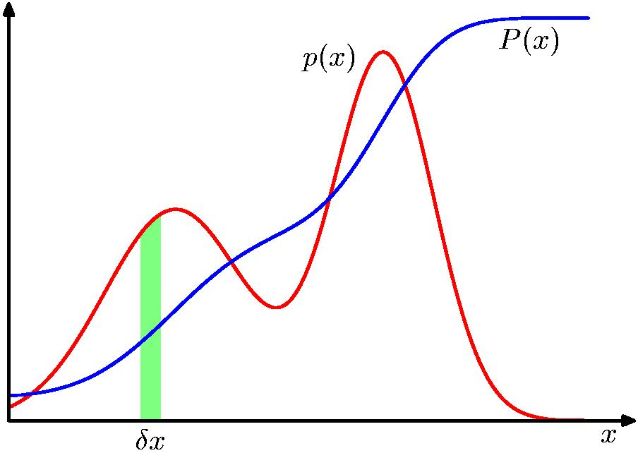
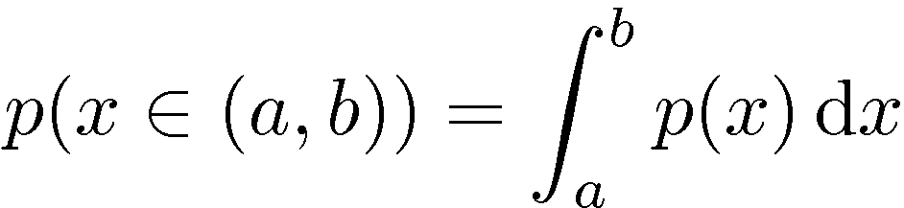
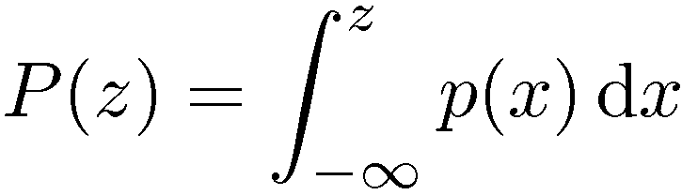
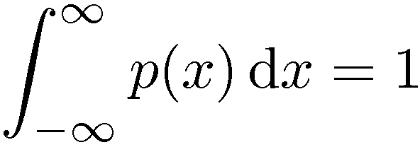

Probability Densities
Notes:
x can be anything

Slide 31
Bayesian Prediction With P.D.F.s
Suppose we want to predict p(x|θ)
Given a distribution over the parameters, we marginalize over θ.

Slide 32
Bayesian Learning

Slide 33
Bayesian Updating
Update prior using Bayes’ theorem. P(h|D) = αP(D|h) x P(h).
Example: Posterior after observing 10 heads
Hypothesis | Chance of Heads | Prior probability
1 | 100% | 10%
2 | 75% | 20%
3 | 50% | 40%
4 | 25% | 20%
5 | 0% | 10%
Notes:
Answer: theta^h x (1-theta)t/2^{-n}.
Notice that the posterior has a different from than the prior.

Slide 34
Prior ∙ Likelihood = Posterior

Slide 35
Updated Bayesian Predictions
Predicted probability that next coin is heads as we observe 10 coins.
Notes:
smooth approach to 1 compared to max likelihood
in the limit, Bayes = max likelihood. This is typical.

Slide 36
Updating: Continuous Example
Consider again the binomial case where θ= prob of heads.
Given n coin tosses and h observed heads, t observed tails, what is the posterior of a uniform distribution over θ in [0,1]?
Solved by Laplace in 1814!

Slide 37
Bayesian Prediction
How do we predict using the posterior?
We can think of this as computing the probability of the next head in the sequence
Any ideas?
Solution:
Laplace 1814!

Slide 38
The Laplace Correction Revisited
Suppose I have observed n data points with k heads.
Find posterior distribution.
Predict probability of heads using posterior distribution.
Result h+1/n+2 = m-estimate with uniform prior, m=2.

Slide 39
Parametrized Priors
Motivation: Suppose I don’t want a uniform prior.
Smooth with m>0.
Express prior knowledge.
Use parameters for the prior distribution.
Called hyperparameters.
Chosen so that updating the prior is easy.

Slide 40
Beta Distribution: Definition
Hyperparameters a>0,b>0.
The Γ term is a normalization constant.
Notes:
note the exponential distribution.

Slide 41
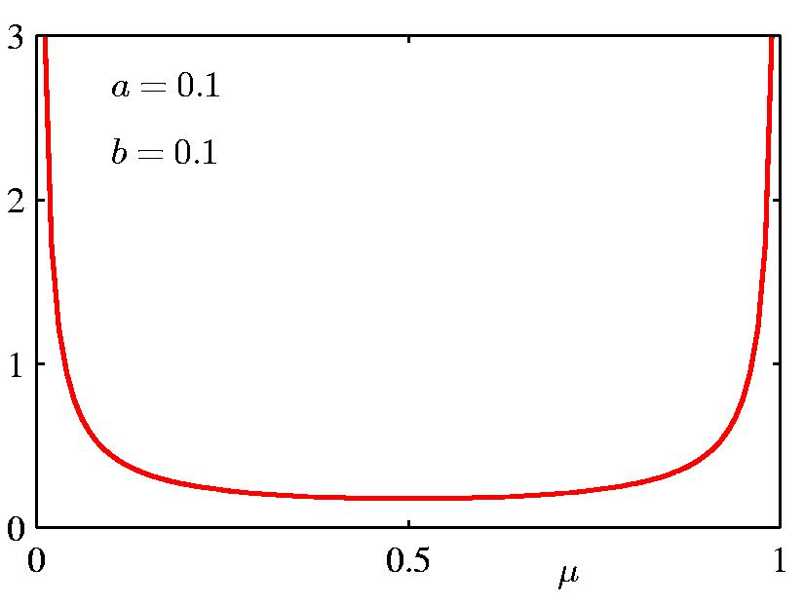
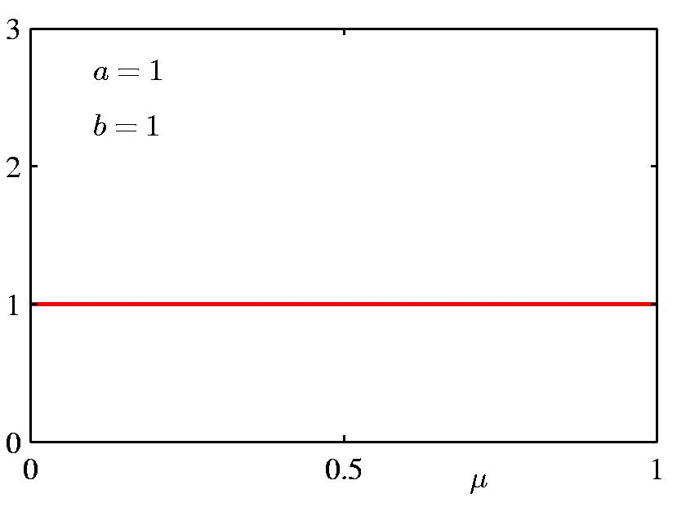
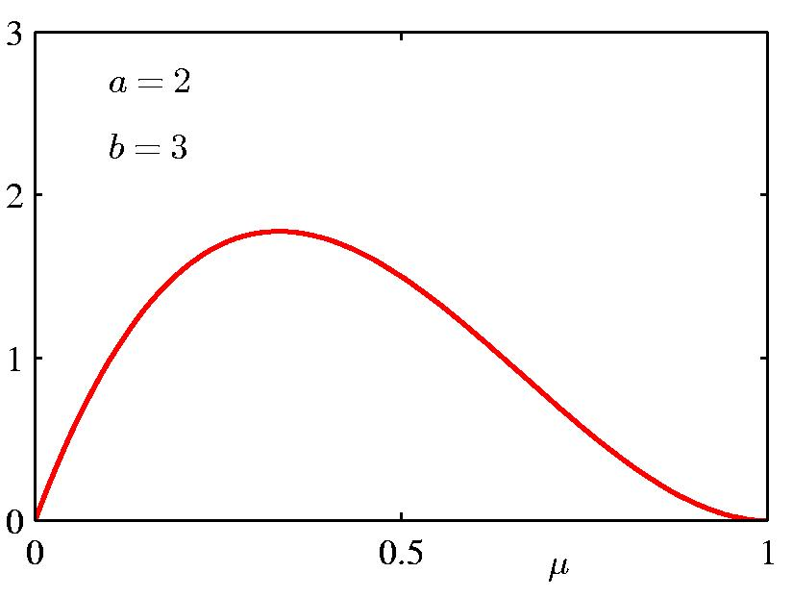
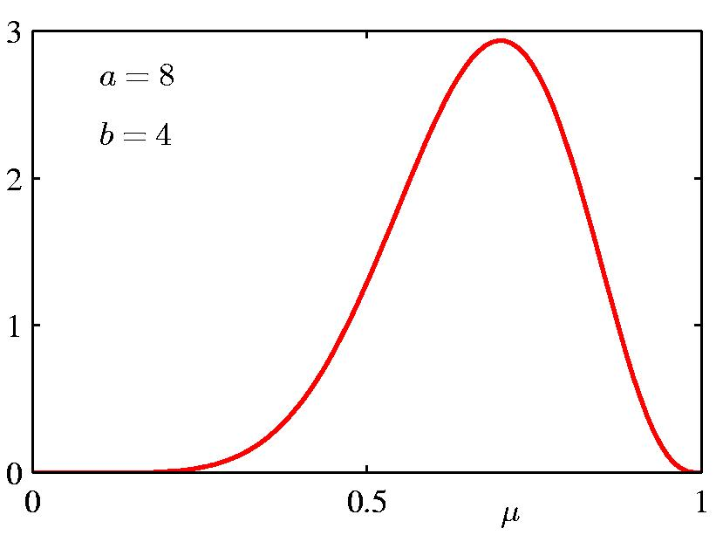
Beta Distribution

Slide 42
Updating the Beta Distribution
So what is the normalization constant α?
Hyperparameter a-1: like a virtual count of initial heads. Hyperparameter b-1: like a virtual count of initial tails.
Beta prior ➔Beta posterior: conjugate prior.
Notes:
h heads, t tails.
Answer: the constant for (h+a-1,t+b-1) = Gamma(h+a-1,t+b-1)/Gamma(h+a-1) Gamma(t+b-1)
Conjugate priors must be exponential. Why?

Slide 43
Conjugate Prior for non-binary variables
Dirichlet distribution: generalizes Beta distribution for variables with >2 values.

Slide 44
Summary
Maximum likelihood: general parameter estimation method.
Choose parameters that make the data as likely as possible.
For Bayes net parameters: MLE = match sample frequency. Typical result!
Problems:
not defined for 0 count situation.
doesn’t quantity uncertainty in estimate.
Bayesian approach:
Assume prior probability for parameters; prior has hyperparameters.
E.g., beta distribution.
Problems:
prior choice not based on data.
inferences (averaging) can be hard to compute.
Notes:
should add discussion of Gaussian without parents. Other cases are covered later.

