Slide 1
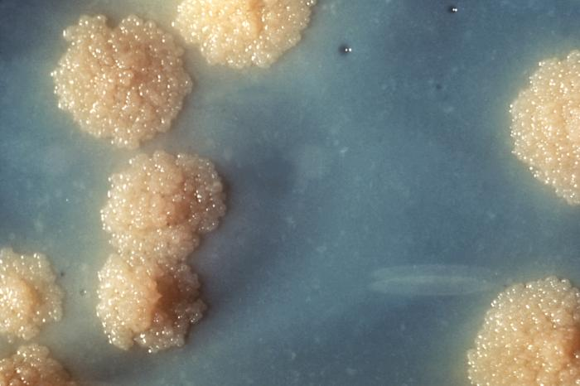
Leonid Chindelevitch
School of Computing Science
Simon Fraser University
Three lessons I learned
from machine learning

Slide 2
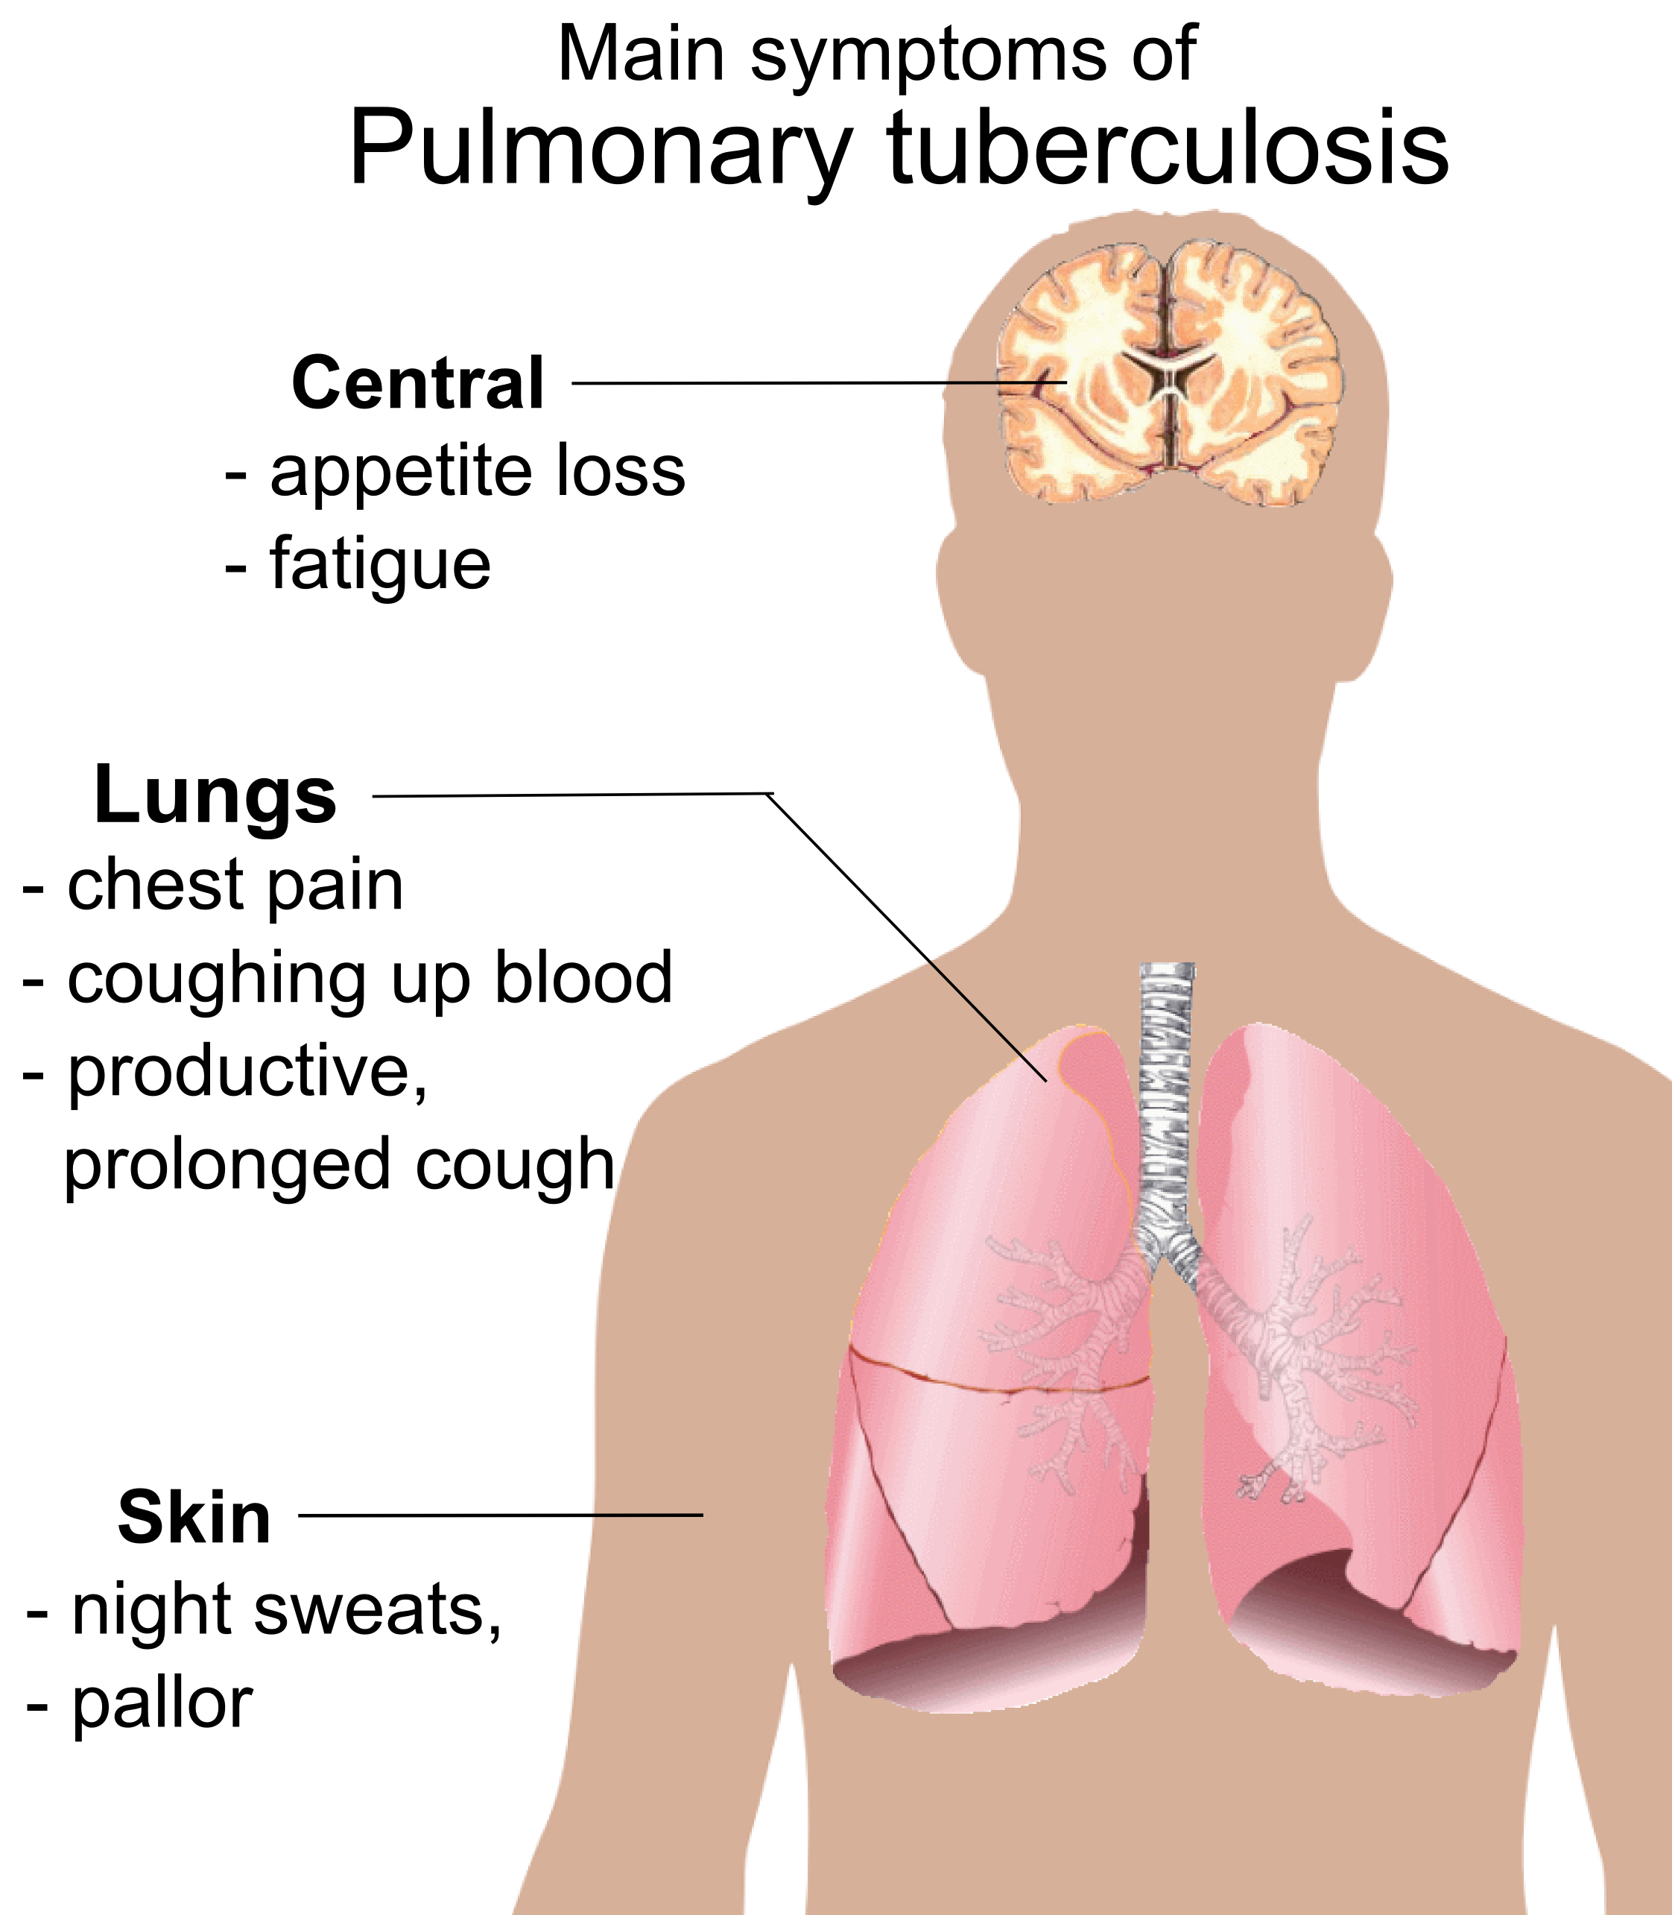
Tuberculosis
Tuberculosis is a bacterial infection caused by Mycobacterium tuberculosis.
Notes:
Usually attacks lungs but can attack any kidney, …, etc.

Slide 3
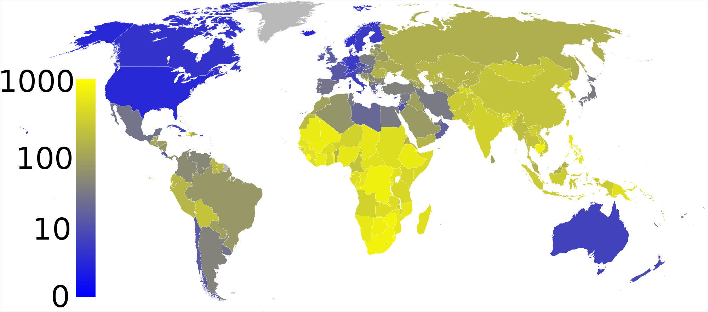
Tuberculosis
Tuberculosis is the most common infectious disease killer today. Its annual toll is 9 million new cases and 1.5 million deaths. Nearly every third person has latent TB!
Notes:
Maps the prevalence of TB per 100,000 people. Note that 1/3 of world’s population has been infected by M. Tuberculosis but most do not cause the disease.

Slide 4
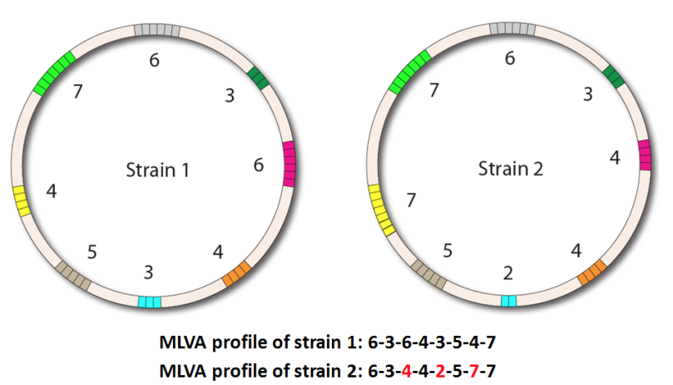
MIRU-VNTR
Mycobacterium interspersed repetitive units – variable number tandem repeats is a technique for fingerprinting strains of TB at up to 24 genetic loci.

Slide 5
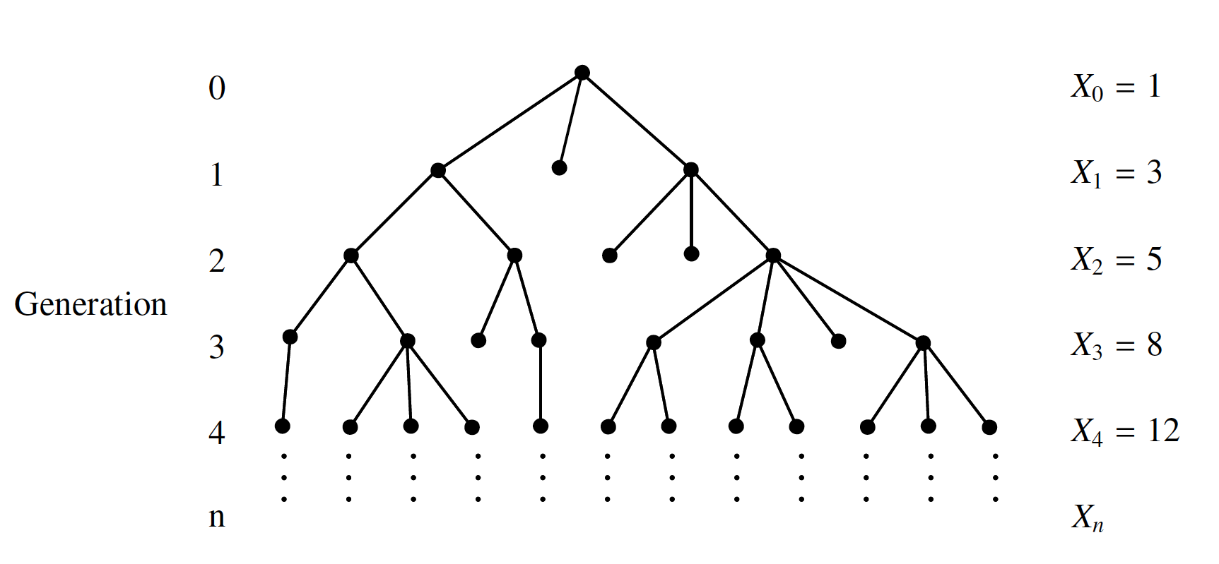
Infection ≈ branching process

Slide 6
Evaluating a TB program: UK
Every reported case is genotyped: MIRU-VNTR
After seeing multiple cases having the same type, a “cluster investigation” can be initiated
This leads to detecting further clustered cases
Question: does this alter cluster growth rates?

Slide 7
The data
1064 cases in a total of just over 100 clusters
For each one, we know: the strain lineage (more on that soon), the cluster level (national/regional/local), the patient’s origin (within or outside the UK), sex and age group, the date of diagnosis, location of the TB (in the lungs or outside), and whether it’s been discovered pre or post cluster investigation

Slide 8
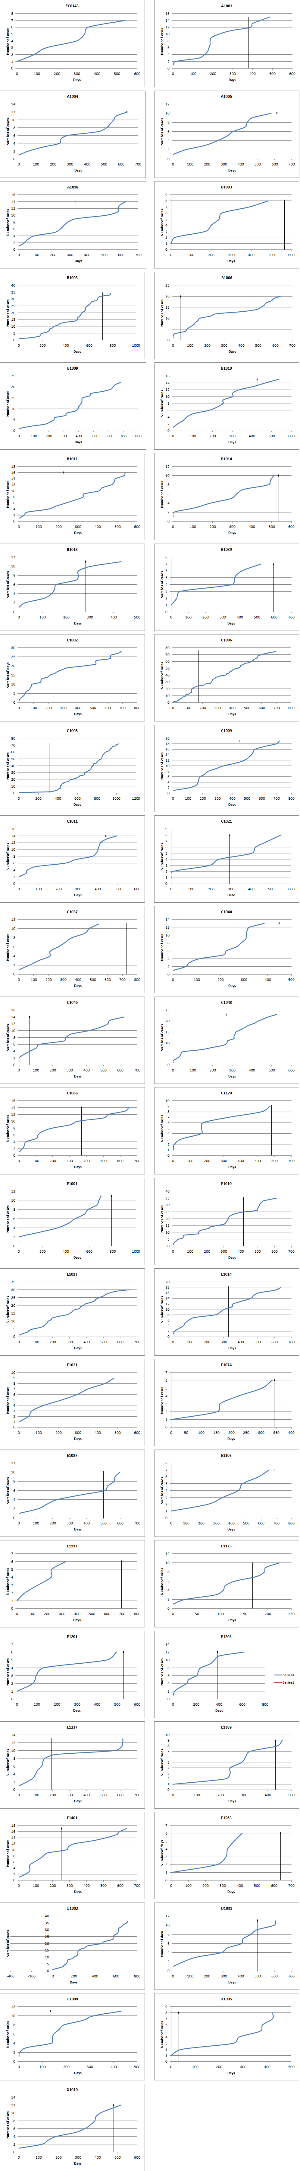
Growth of selected clusters

Slide 9
A linear regression model
Use all the available variables to model delay
Basic regression: T_{j} – T_{j-1} ~ strain + cluster level + + origin[j] + sex[j] + age[j] + lungs[j] + after[j]

Slide 10
A linear regression model
Use all the available variables to model delay
Basic regression: T_{j} – T_{j-1} ~ strain + cluster level + + origin[j] + sex[j] + age[j] + lungs[j] + after[j]
New regression: T_{j} – T_{j-1} ~ strain + cluster level + + origin[j] + sex[j] + age[j] + lungs[j] + after[j] + j
Conclusion: the investigation had no clear effect
Mears et al. Evaluation of the National TB Strain Typing Service. Internal report.

Slide 11
Lesson n. 1
Even when you think your model includes all the information you have available, make sure you are not leaving anything out by mistake!

Slide 12
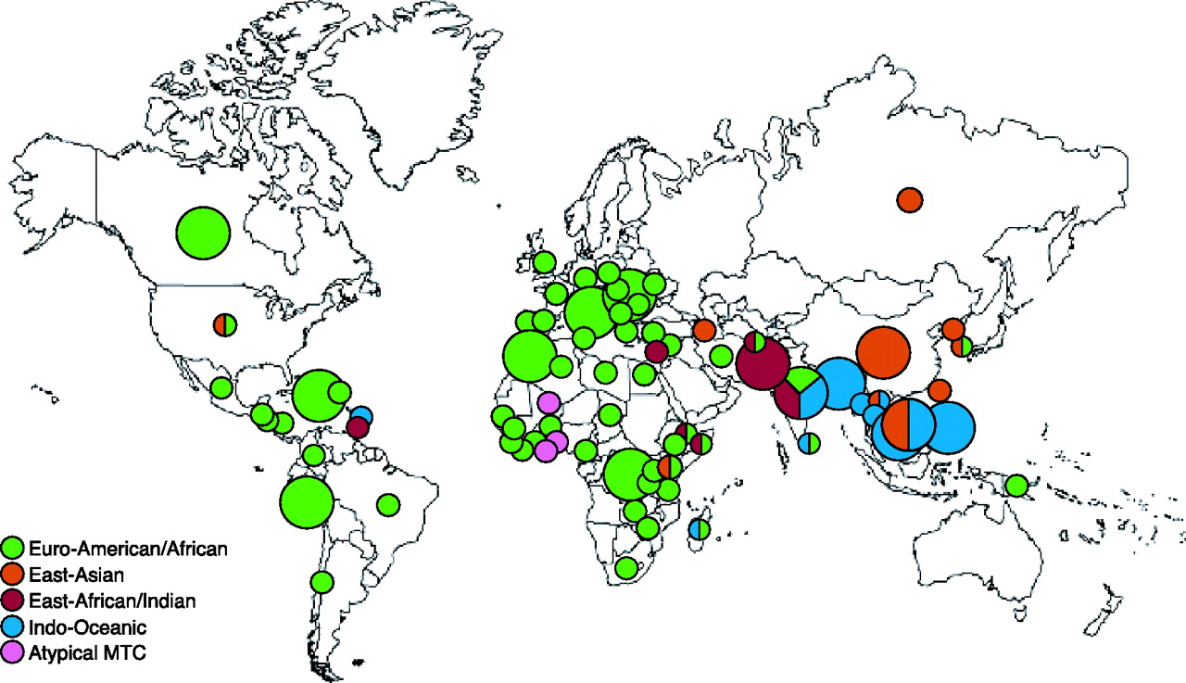
TB lineages vary by geography
Read et al. Major Mycobacterium tuberculosis Lineages Associate with Patient Country of Origin. Journal of Clinical Microbiology (2009), vol. 47 n. 4, 1119-1128
Notes:
The location of initial infection.
Also linked to virulence.

Slide 13
The data
Two sources:
MIRU-VNTRplus: 186 strains
(chosen for their diversity)
NYC DOHMH: 2060 strains
(collected over 10+ years)
Each strain is labelled with one of six lineages:
East African-Indian
East
Asian
Euro-American
Indo-Oceanic
M. Africanum
M.
Bovis

Slide 14
Current classifiers
MIRU-VNTRplus
Up to 89% accuracy using k-nearest neighbours
TB-Insight
Up to 94% accuracy with a Bayesian network

Slide 15
Our approach: StackTB
Objective: To achieve a higher classification accuracy through the application of more sophisticated Machine Learning methods
Strategy: Ensemble together a collection of machine learning algorithms through stacking

Slide 16
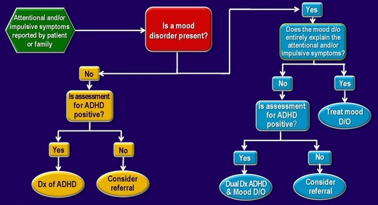
Decision trees

Slide 17
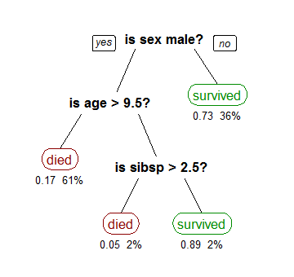
Decision trees

Slide 18
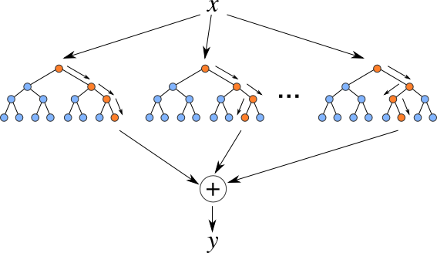
Random forests

Slide 19
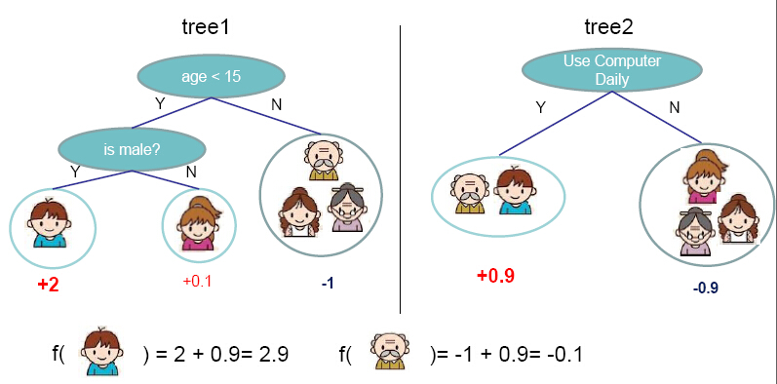
Gradient boosted machines
Source: http://homes.cs.washington.edu/~tqchen/pdf/BoostedTree.pdf
Notes:
Figure from http://homes.cs.washington.edu/~tqchen/pdf/BoostedTree.pdf

Slide 20
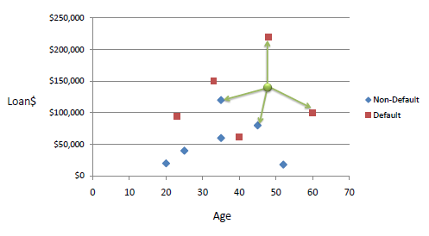
k – Nearest neighbours

Slide 21
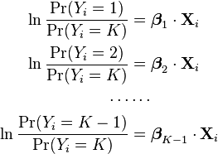
Multinomial logistic regression

Slide 22
Stacking for the final model
Random Forest
Inputs
Gradient Boosted Machine
Multinomial
Regression
Outputs
k Nearest Neighbours

Slide 23
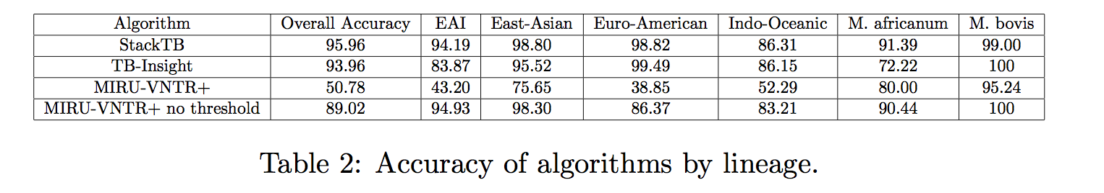
Results
Ensemble methods led to an improvement in classification accuracy over existing methods

Slide 24
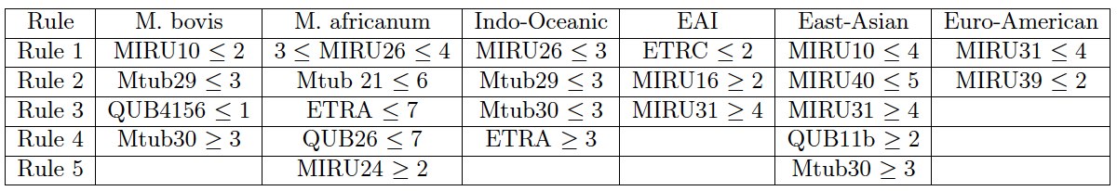
But simple rules also do well!
combine threshold-based rules in a specific order
we achieve nearly 95% accuracy (cf. StackTB, 96%)
trade-offs between accuracy and interpretability

Slide 25
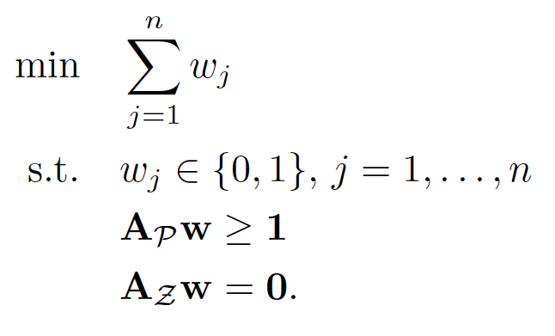
Boolean compressed sensing
Source: Malioutov, D and Varshney, K. Exact Rule Learning via Boolean Compressed Sensing Proceedings of ICML-13 (2013), pp. 765-773.

Slide 26
Lesson n. 2
Do not neglect the opportunity to create a more interpretable predictor if the resulting accuracy loss is within an acceptable range.

Slide 27
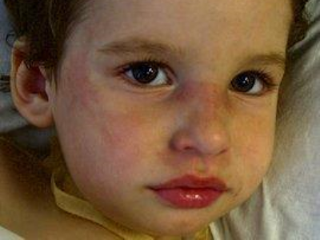
Pediatric vasculitis
A rare childhood disease; vessel inflammation
Patient presentation frequently looks like this:
Source: http://ilearnpeds.com/Assets/MCH/Images/Media/4413-media.jpg

Slide 28
The data
148 observations, 39 of them have the disease
Over 63,000 variables measured for each one (gene expression count data – using RNA-Seq)
Some additional clinical information for each patient (such as the severity of the disease)

Slide 29
The approach
Use univariate association to link probes with the phenotype (presence or absence of PV)
Using penalized ridge/lasso regression identify the best combinations of these predictors
Correlate the resulting gene sets with known gene sets or pathways (enrichment analysis)

Slide 30
Lesson n. 3
Do not promise to find anything significant in a dataset that contains too few positive cases!

Slide 31
Conclusion: the three lessons
Even when you think your model includes all the information you have available, make sure you are not leaving anything out by mistake!
Do not neglect the opportunity to create a more interpretable predictor if the resulting accuracy loss is within an acceptable range.
Do not promise to find anything significant in a dataset that contains too few positive cases!

Slide 32
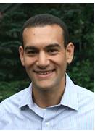
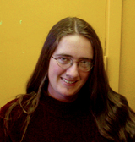












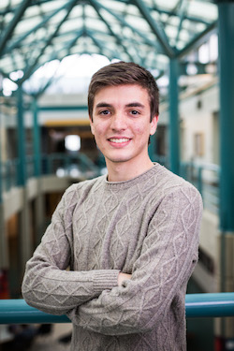

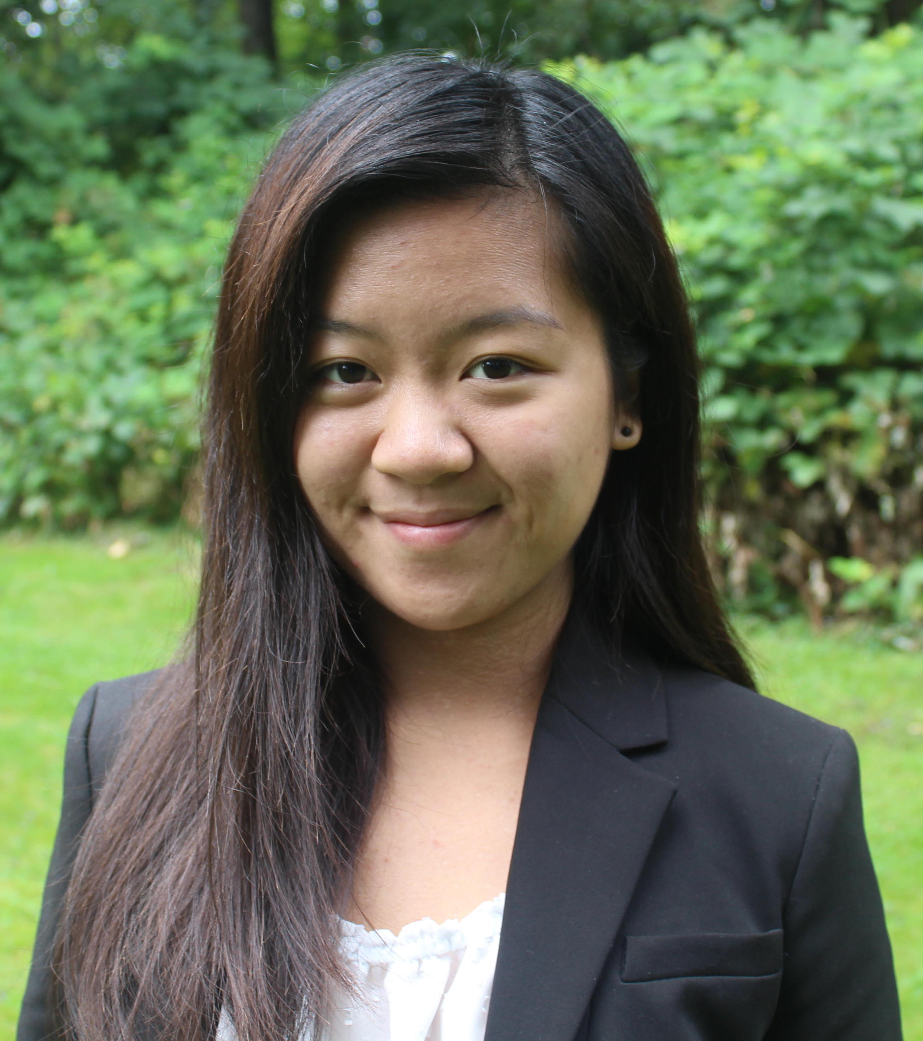

Acknowledgments

