Slide 1
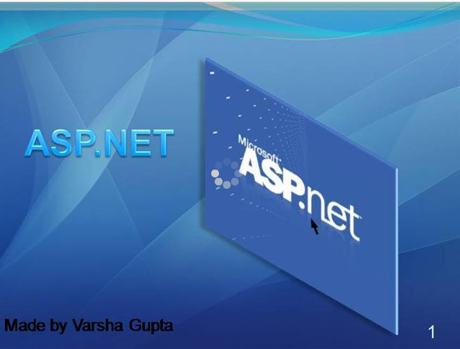
ASP.NET
Slides based off:

Slide 2

Background - Web Architecture
Client
PC/Mac/Unix/...
+ Browser
Request:
http://www.digimon.com/default.asp
Network
HTTP, TCP/IP
Response:
<html>….</html>
Server
Web Server

Slide 3
ASP.NET Overview
ASP.NET provides services to allow the creation, deployment, and execution of
Web Applications and Web Services
Like ASP, ASP.NET is a server-side technology
Web Applications are built using Web Forms
Web Forms are designed to make web-based applications as easy as building Visual Basic applications
Web Form = Visual Drag and Drop tools

Slide 4
ASP.NET Overview
Simple: less code, easier to create and maintain
Multiple, compiled languages
Fast
Scalable
Manageable
Customizable and extensible
Secure
Tool support (Visual Studio.NET)

Slide 5
ASP.NET Overview
Architecture
VB
C++
C#
JScript
…
Common Language Specification
ASP.NET: Web Services
and Web Forms
Windows
Forms
Visual Studio.NET
ADO.NET: Data and XML
Base Classes
Common Language Runtime

Slide 6
Programming Model
Your ASPX Web Interface
Your C# Code
Button code
...
Button
List code
...
List
Text code
...
Text
Browser
ASP.NET
Event handlers

Slide 7
Programming Model
A postback occurs when a page generates an
HTML form whose values are posted back
to the same page
A common technique for handling form data
In ASP and other server-side technologies the state of the page is lost upon postback...
Unless you explicitly write code to maintain state
This is tedious, bulky and error-prone

Slide 8
Programming Model
By default, ASP.NET maintains the state of all server-side controls during a postback
Must use method="post“
(in the HTML Form, method=“get”)
Server-side control objects are automatically populated during postback
No state stored on server
Works with all browsers

Slide 9
Programming Model
Multiple sources of controls
  Built-in (~ 50 built in!)
  3rd party
  User-defined
Controls range in complexity and power: button, text, drop down, calendar, data grid, ad rotator, validation
Can be populated via data binding

Slide 10
Programming Model
Two styles of creating ASP.NET pages
  Controls and code in .aspx file
  Controls in .aspx file, code in code-behind page
    Supported in Visual Studio.NET
Code-behind pages allow you to separate the
user interface design from the code
  Allows programmers and designers to work independently
  <%@ Codebehind=“WebForm1.cs”
  Inherits=WebApplication1.WebForm1” %>

Slide 11
Programming Model
Just edit the code and hit the page
ASP.NET will automatically compile the code into an assembly
Compiled code is cached in the CLR
Subsequent page hits use compiled assembly
If the text of the page changes then the code
is recompiled
  Works just like ASP: edit, save and run

Slide 12
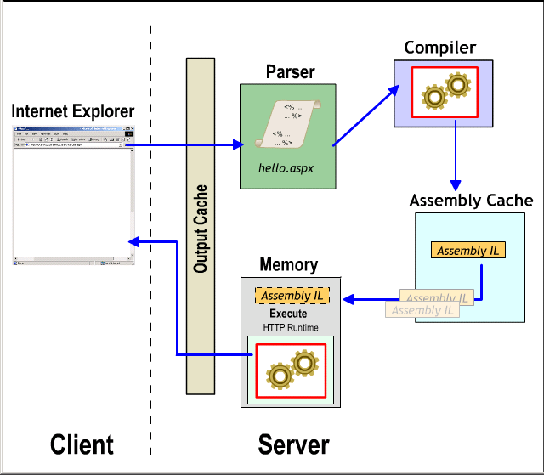
Programming Model

Slide 13
Programming Basics
The most basic page is just static text
  Any HTML page can be renamed .aspx
Pages may contain:
  Directives: <%@ Page Language=“C#” %>
  Server controls: <asp:Button runat=“server”>
  Code blocks:
    <script runat=“server”>…</script>
  Data bind expressions: <%# %>
  Server side comments: <%-- --%>

Slide 14
Programming Basics
Code can respond to page events
  e.g. Page_Load, Page_Unload
Code can respond to control events
  Button1_Click
  Textbox1_Changed

Slide 15
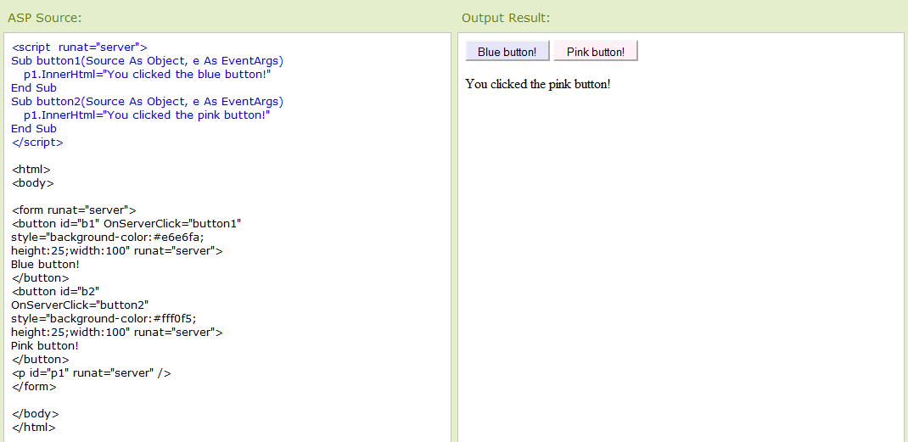
Example:

