Slide 1
Semistructured Data and XML
Notes:
Notes from Widom: add table comparing XML, SQL 7
For all loops in Xquery.
Can translate XML to relational, actually done in systems.
read XML in Silberschatz.

Slide 2
Discussion Question
Think about your personal Itunes library.
Should it be maintained in a database system?
Notes:
Pros:
easy to query
crash recover
Cons:
don’t need concurrent access
small set of records (less than 100K songs)
don’t want to install DBMS
want some portability for different devices

Slide 3
Data Files on the Web
HTML documents
often generated by applications
consumed by humans only
easy access: across platforms, across organizations
only layout, no semantic information
No application interoperability:
HTML not understood by applications
Database technology:
client-server
vendor specific data files.

Slide 4
XML Data Exchange Format
A standard from the W3C (World Wide Web Consortium, http://www.w3.org).
The mission of the W3C
„. . . developing common protocols that promote its evolution and ensure its interoperability. . .“.
Basic ideas
XML = data
XML generated by applications
XML consumed by applications
Easy access: across platforms, organizations.

Slide 5
Paradigm Shift on the Web
For web search engines:
From documents (HTML) to data (XML)
From document management to document understanding (e.g., question answering)
From information retrieval to data management
For database systems:
From relational (structured) model to semistructured data
From storage to transport

Slide 6
The SemiStructued Data Model

Slide 7
Object Exchange Model (OEM)
Bib
&o1
complex object
paper
paper
book
references
&o12
&o24
&o29
references
references
author
year
author
author
page
title
http
author
title
publisher
title
author
author
&o43
&96
&25
1997
firstname
last
lastname
firstname
lastname
first
&243
&206
“Serge”
“Abiteboul”
“Victor”
“Vianu”
122
133
atomic object
with objectID

Slide 8
The Semistructured Data Model
Data is self-describing:
the data description is integrated with the data itself rather than in a separate schema.
Database is a collection of nodes and arcs (directed graph).
Leaf nodes represent attribute data of some atomic type (atomic objects, such as numbers or strings).
Interior nodes represent complex objects, entities, or elements.
Complex objects consist of components (child nodes), connected by arcs to this node.

Slide 9
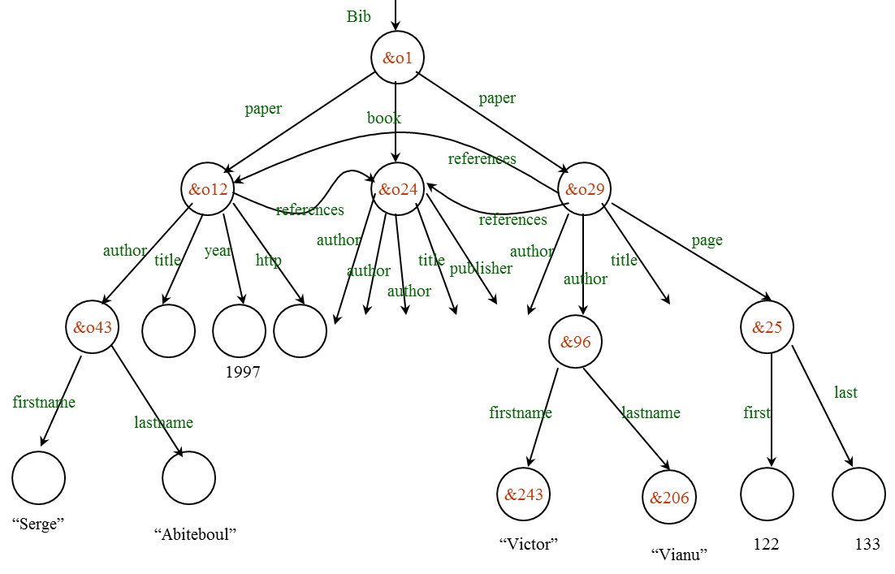
The Semistructured Data Model
Arc labels indicate the relationship between the two corresponding nodes.
The root node is the only interior node without in-arcs, representing the entire database.
All database objects are descendants of the root node.
The graph need not be a tree structure, but is usually acyclic.

Slide 10
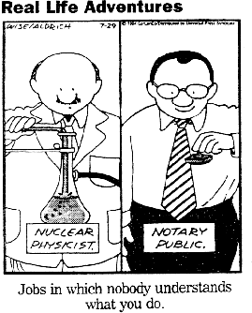
XML
XML Programmer

Slide 11
XML – The Extensible Markup Language
Language
A way of communicating information
Part of the Semantic Web.
Markup
Notes or meta-data that describe your data or language
Extensible
Limitless ability to define new languages or data sets.
Sophisticated query languages for XML are available:
XPath
Xquery
Notes:
XML can be translated to relational data.

Slide 12
XML: An Example
<?XML version="1.0" encoding="UTF-8" standalone="yes"?>
<BOOKLIST>
<BOOK genre="Science" format="Hardcover">
<AUTHOR>
<FIRSTNAME>Richard</FIRSTNAME><LASTNAME>Feynman</LASTNAME>
</AUTHOR>
<TITLE>The Character of Physical Law</TITLE>
<PUBLISHED>1980</PUBLISHED>
</BOOK>
<BOOK genre="Fiction">
<AUTHOR>
<FIRSTNAME>R.K.</FIRSTNAME><LASTNAME>Narayan</LASTNAME>
</AUTHOR>
<TITLE>Waiting for the Mahatma</TITLE>
<PUBLISHED>1981</PUBLISHED>
</BOOK>
<BOOK genre="Fiction">
<AUTHOR>
<FIRSTNAME>R.K.</FIRSTNAME><LASTNAME>Narayan</LASTNAME>
</AUTHOR>
<TITLE>The English Teacher</TITLE>
<PUBLISHED>1980</PUBLISHED>
</BOOK>
</BOOKLIST>
Notes:
Other examples: CSP Aispace, Mondial.

Slide 13
XML – What’s The Point?
You can include your data and a description of what the data represents
This is useful for defining your own language or protocol
Example: Chemical Markup Language
<molecule>
<weight>234.5</weight>
<Spectra>…</Spectra>
<Figures>…</Figures>
</molecule>
XML design goals:
XML should be compatible with SGML
It should be easy to write XML processors
The design should be formal and precise
Notes:
SGML = Standard Generalized Markup Language.

Slide 14
XML – Structure
XML looks like HTML
XML is a hierarchy of user-defined tags called elements with attributes and data
Data is described by elements, elements are described by attributes
<BOOK genre="Science" format="Hardcover">…</BOOK>
attribute
open tag
attribute value
closing tag
element name
data

Slide 15
XML – Elements
<BOOK genre="Science" format="Hardcover">…</BOOK>
XML is case and space sensitive
Element opening and closing tag names must be identical
Opening tags: “<” + element name + “>”
Closing tags: “</” + element name + “>”
attribute
open tag
attribute value
closing tag
element name
data

Slide 16
XML – Attributes
<BOOK genre="Science" format="Hardcover">…</BOOK>
Attributes provide additional information for element tags.
There can be zero or more attributes in every element; each one has the the form:
attribute_name=‘attribute_value’
There is no space between the name and the “=‘”
Attribute values must be surrounded by “ or ‘ characters
Multiple attributes are separated by white space (one or more spaces or tabs).
attribute
open tag
attribute value
closing tag
element name
data
Notes:
refer back to HTML code

Slide 17
XML – Data and Comments
<BOOK genre="Science" format="Hardcover">…</BOOK>
XML data is any information between an opening and closing tag
XML data must not contain the ‘<‘ or ‘>’ characters.
attribute
open tag
attribute value
closing tag
element name
data

Slide 18
XML – Nesting & Hierarchy
XML tags can be nested in a hierarchy (think tree).
XML documents can have only one root tag
Between an opening and closing tag you can insert:
1. Data
2. Elements
3. A combination of data and elements
<root>
<tag1>
Some Text
<tag2>More</tag2>
</tag1>
</root>
XML Examples and Exercises
Notes:
Xml: another example, show Mondial SQL vs. XML

Slide 19
Graphical Data Model for XML
<root>
<tag1>
Some Text
<tag2>More</tag2>
</tag1>
</root>
Node
Type: Element_Node
Name: Element
Value: Root
Node
Type: Element_Node
Name: Element
Value: tag1
Type: Text_Node
Name: Text
Value: Some Text
Node
Node
Type: Element_Node
Name: Element
Value: tag2
Node
Type: Text_Node
Name: Text
Value: More
Notes:
This material is not covered in the book. Show UBC example for xml. Discuss data types.

Slide 20
XML vs. Semistructured Data
Both described best by a graph.
Both are schema-less, self-describing (XML without DTD / XML schema).
XML is ordered, semistructured data is not.
XML can mix text and elements:
<talk> Making Java easier to type and easier to type
<speaker> Phil Wadler </speaker>
</talk>
XML has lots of other stuff: attributes, entities, processing instructions, comments.

Slide 21
XML vs. Relational Databases
 | Relational | XML
Structure | Tables | Hierarchical Graph, Tree
Schema | Fixed before adding data | Flexible, self-describing
Queries | Simple, nice ☺ | Less so
Ordering | None | Implied
Implementation | Native | Add-On
Jennifer Widom
Notes:
Student was asked at job interview: difference between HTML and XML. Better question: diff between XML and relational?

Slide 22
DTD – Document Type Definition
A DTD is a schema for XML data
XML protocols and languages can be standardized with DTD files
A DTD says what elements and attributes are required or optional
Defines the formal structure of the language
More advanced version: XML Schema.
(not on exam)

Slide 23
XML Issues
Database issues:
How are we going to model XML? (graphs).
How are we going to query XML? (XPath, XQuery)
How are we going to store XML (in a relational database? object-oriented? native?)
How are we going to process XML efficiently? (many interesting research questions!)

Slide 24
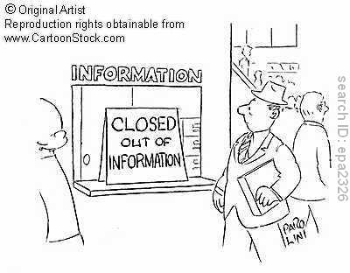
XML-Path = Xpath XML-Query = XQuery

Slide 25
Query Languages for XML
XPath is a simple query language based on describing similar paths in XML documents.
XQuery extends XPath in a style similar to SQL, introducing iterations, subqueries, etc. (not on exam)
XPath and XQuery expressions are applied to an XML document and return a sequence of qualifying items.
Items can be primitive values or nodes (elements, attributes, documents).

Slide 26
XPath
A path expression returns the sequence of all qualifying items that are reachable from the input item following the specified path.
A path expression is a sequence consisting of tags or attributes and special characters such as slashes (“/”).
Absolute path expressions are applied to some XML document and returns all elements that are reachable from the document’s root element following the specified path.
Relative path expressions are applied to an arbitrary node.

Slide 27
Path Expressions
Examples:
DB =
Bib
&o1
paper
book
paper
references
&o12
&o24
&o29
references
references
author
year
author
author
page
title
http
author
title
publisher
title
author
author
&o43
&o44
&o45
&o46
&o52
&96
&25
1997
&o47
&o48
&o49
&o50
&o51
last
firstname
lastname
firstname
lastname
first
&o70
&o71
&243
&206
“Serge”
“Abiteboul”
“Victor”
122
133
“Vianu”
Bib/paper={&o12,&o29}
Bib/book/publisher={&o51}
Bib/paper/author/lastname={&o71,&206}

Slide 28
XPath Example Document
<?XML version=“1.0” standalone =“yes” ?>
<bib>
<book bookID=“b100“> <title> Foundations… </title>
<author> Abiteboul </author>
<author> Hull </author>
<author> Vianu </author>
<publisher> Addison Wesley </publisher>
<year> 1995 </year> </book>
<paper paperID=“p100“> <title>XML and Databases</title>
<author>Ullmann </author> </paper>
<paper paperID=“p200“> <title>XML Query Optimization</title>
<author>Ng </author> </paper>
</bib>
Notes:
paths navigate to nodes, finds sets of nodes.
Lots of existential quantification.
Doesn’t really have universal quantification.
In logic: repeated function expressions.
Ordering can be important.

Slide 29
Path Expressions
Examples:
bib/paper returns <paper paperID=“p100“> <title>XML and Databases</title> <author>Ullmann </author> </paper> <paper paperID=“p200“> <title>XML Query Optimization</title><author>Ng </author> </paper>
bib/book/publisher returns <publisher> Addison Wesley </publisher>
Given an XML document, the value of a path expression p is a set of objects (elements or attribute values).
Notes:
Applied to the above document, the XPath expression /bib/book/author returns the sequence
<author> Abiteboul </author>
<author> Hull </author>
<author> Vianu </author> . . .

Slide 30
Attributes
If we do not want to return the qualifying elements, but the value one of their attributes, we end the path expression with @attribute.
<?XML version=“1.0” standalone =“yes” ?>
<bib>
<book bookID=“b100“> <title> Foundations… </title>
<author> Abiteboul </author>
<author> Hull </author>
<author> Vianu </author>
<publisher> Addison Wesley </publisher>
<year> 1995 </year> </book>
the XPath expression
/bib/book/@bookID
returns the sequence
“b100“ . . .

Slide 31
Wildcards
We can use wildcards instead of actual tags and attributes: * means any tag, and @* means any attribute.
// looks for any descendants.
Examples
/bib/*/author returns the sequence <author> Abiteboul </author>
<author> Hull </author>
<author> Vianu </author> <author>Ullmann </author>
<author>Ng </author>
/bib//author returns the same in this case

Slide 32
Conditions and Other Constructs
/bib/paper[2]/author[1] : choose the second paper, first author: <author>Ng </author>
/bib/paper[author = “Ng” ] : find all papers such that there exists an author Ng. <paper paperID=“p200“> <title>XML Query Optimization</title>
<author>Ng </author> </paper>
/bib/(paper|book)/title : find the titles of each element that is a paper or a book. <title> Foundations… </title> <title>XML and Databases</title> <title>XML Query Optimization</title>
XPath examples
Notes:
for second paper: notice the physical data dependence.
The existential quantification is typical for XPath.
Show UBC aispace Bayes net example.
More union examples: http://msdn.microsoft.com/en-us/library/ms256074.aspx
On inventory.xml, try /bookstore/book[author/first-name="Mary"]: returns books meeting the condition, not Mary.

Slide 33
Exercise
Evaluate
/bib/*/title
/bib//title
/bib/*[publisher = “McGraw”]
<?XML version=“1.0” standalone =“yes” ?>
<bib>
<book bookID =“b100“> <title> Foundations… </title>
<author> Abiteboul </author>
<author> Hull </author>
<author> Vianu </author>
<publisher> Addison Wesley </publisher>
<year> 1995 </year> </book>
<paper paperID=“p100“> <title>XML and Databases</title>
<author>Ullmann </author> </paper>
<paper paperID=“p200“> <title>XML Query Optimization</title>
<author>Ng </author> </paper>
</bib>
Notes:
1. <title> Foundations… </title>
<title>XML and Databases</title>
<title>XML Query Optimization</title>
2. same.
3. empty.

Slide 34
Summary
The Object Exchange Data Model
The world consists of objects.
Complex objects comprise other objects as parts.
XML: Mark-up language that supports semi-structured data.
nested tags, consistent with nested objects.
XML data: attribute values + free-form text
XPath: query languge for XML

