Slide 1
Google File System
A real massive distributed file system
Hundreds of servers and clients
  The largest cluster has >1000 storage nodes, over 300 TB of disk storage, hundreds of clients
Metadata replication
Data replication
Design driven by application workload and technological environment
Avoided many of the difficulties traditionally associated with replication by designing for a specific use case

Slide 2
Specifics of the Google Environment
FS is consists of hundreds of storage machines, built of inexpensive commodity parts
Component failures are a norm
  Application and OS bugs
  Human errors
  Hardware failures: disks, memory, network, power supplies
Millions of files, each 100 MB or larger
Multi-GB files are common
Applications are written for GFS
Allows co-design of the file system and applications
Notes:
What is co-design?

Slide 3
Specifics of the Google Workload
Google applications:
  Data analysis programs that scan through data repositories
  Data streaming applications
  Archiving
  Indexing applications that produce (intermediate) search results
Most files are mutated by appending new data – large sequential writes
Random writes are very uncommon
Files are written once, then they are only read
Reads are sequential
Large streaming reads and small random reads
High bandwidth is more important than low latency

Slide 4
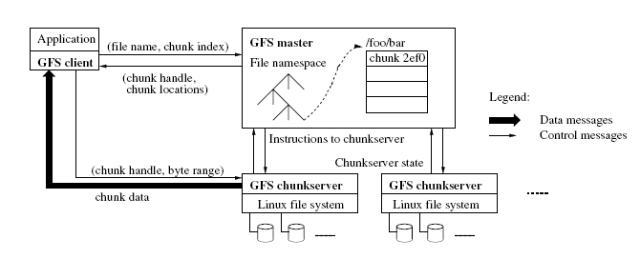
GFS Architecture

Slide 5
GFS Architecture (cont.)
Single master
Multiple chunk servers
Multiple clients
Each is a commodity Linux machine, a server is a user-level process
Files are divided into chunks
Each chunk has a handle (an ID assigned by the master)
Each chunk is replicated (on three machines by default)
Master stores metadata, manages chunks, does garbage collection, etc.
What is metadata?
Clients communicate with master for metadata operations, but with chunkservers for data operations
No additional caching (besides the Linux in-memory buffer caching)
Notes:
What is metadata?
- Data about data
- For every file store chunk IDs – this is essential to recovering the file

Slide 6
Client/GFS Interaction
Client:
  Takes file and offset
  Translates it into the chunk index within the file
  Sends request to master, containing file name and chunk index
Master:
  Replies with the corresponding chunk handle and location of the replicas (the master must know where the replicas are)
Client:
  Caches this information
  Contacts one of the replicas (i.e., a chunkserver) for data

Slide 7
Master
Stores metadata
  The file and chunk namespaces
  Mapping from files to chunks
  Locations of each chunk’s replicas
Interacts with clients
Creates chunk replicas
Orchestrates chunk modifications across multiple replicas
  Ensures atomic concurrent appends
  Locks concurrent operations
Deletes old files (via garbage collection)

Slide 8
Metadata On Master
Metadata – data about the data:
  File names
  Mapping of file names to chunk IDs
  Chunk locations
Metadata is kept in memory
File names and chunk mappings are also kept persistent in an operation log
Chunk locations are kept in memory only
  They will be lost during the crash
  The master asks chunk servers about their chunks at startup – builds a table of chunk locations

Slide 9
Why Keep Metadata In Memory?
To keep master operations fast
Master can periodically scan its internal state in the background, in order to implement:
  Garbage collection
  Re-replication (in case of chunk server failures)
  Chunk migration (for load balancing)
But the file system size is limited by the amount of memory on the master?
  This has not been a problem for GFS – metadata is compact

Slide 10
Why Not Keep Chunk Locations Persistent?
Chunk location – which chunk server has a replica of a given chunk
Master polls chunk servers for that information on startup
Thereafter, master keeps itself up-to-date:
  It controls all initial chunk placement, migration and re-replication
  It monitors chunkserver status with regular HeartBeat messages
Motivation: simplicity
Eliminates the need to keep master and chunkservers synchronized
Synchronization would be needed when chunkservers:
  Join and leave the cluster
  Change names
  Fail and restart

Slide 11
Operation Log
Historical record of metadata changes
Maintains logical order of concurrent operations
Log is used for recovery – the master replays it in the event of failures
Master periodically checkpoints the log
Checkpoint is a B-tree data structure
  Can be loaded into memory
  Used for namespace lookup without extra parsing
Checkpoint can be done on the background

Slide 12
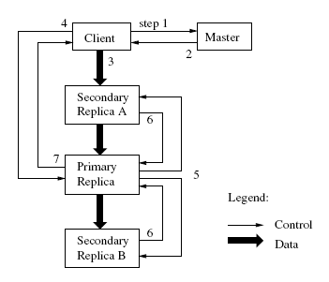
Updates of Replicated Data (cont.)
Client asks master for replica locations
Master responds
Client pushes data to all replicas; replicas store it in a buffer cache
Client sends a write request to the primary (identifying the data that had been pushed)
Primary forwards request to the secondaries (identifies the order)
The secondaries respond to the primary
The primary responds to the client

Slide 13
Failure Handling During Updates
If a write fails at the primary:
  The primary may report failure to the client – the client will retry
  If the primary does not respond, the client retries from Step 1 by contacting the master
If a write succeeds at the primary, but fails at several replicas
  The client retries several times (Steps 3-7)

Slide 14
Primary Replica in GFS
Each mutation (modification) is performed at all the replicas
Modifications are applied in the same order across all replicas
Master grants a chunk lease to one replica – i.e., the primary
The primary picks a serial order for all mutations to the chunk
The client pushes data to all replicas
The primary tells the replicas in which order they should apply modifications

Slide 15
Data Consistency in GFS
Loose data consistency – applications are designed for it
Applications may see inconsistent data – data is different on different replicas
Applications may see data from partially completed writes – undefined file region
On successful modification the file region is consistent
Replicas are not guaranteed to be bytewise identical (we’ll see why later, and how clients deal with this)

Slide 16
Implications of Loose Data Consistency For Applications
Applications are designed to handle loose data consistency
Example 1: a file is generated from beginning to end
  An application creates a file with a temporary name
  Atomically renames the file
  May periodically checkpoint the file while it is written
  File is written via appends – more resilient to failures than random writes
Example 2: producer-consumer file
  Many writers concurrently append to one file (for merged results)
  Each record is self-validating (contains a checksum)
  Client filters out padding and duplicate records

Slide 17
Atomic Record Appends
Atomic append is a write where
  The primary chooses the offset where the append happens
  Returns the offset to the client
This way GFS can decide on serial order of concurrent appends without client synchronization
If an append fails at some replicas – the client retries
As a result, the file may contain multiple copies of the same record, plus replicas may be bytewise different
But after a successful update all replicas will be defined – they will all have the data written by the client at the same offset

Slide 18
Non-Identical Replicas
Because of failed and retried record appends, replicas may be non-identical bytewise
Some replicas may have duplicate records (because of failed and retried appends)
Some replicas may have padded file space (empty space filled with junk) – if the master chooses record offset higher than the first available offset at a replica
Clients must deal with it: they write self-identifying records so they can distinguish valid data from junk
If clients cannot tolerate duplicates, they must insert version numbers in records
GFS pushes complexity to the client; without this, complex failure recovery scheme would need to be in place

Slide 19
Data Flow
Data flow is decoupled from control flow
Data is pushed linearly across all chunkservers in a pipelined fashion (not necessarily from client to primary and from primary to secondary)
Client forwards data to the closest replica; that replica forwards to the next closest replica, etc.
Pipelined fashion: while the data is incoming, the server begins forwarding it to the next replica
This design ensures good network utilization

Slide 20
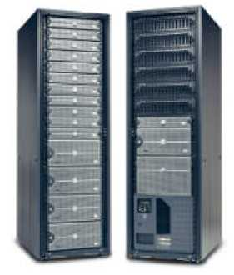
Load Balancing
Goals:
  Maximize data availability and reliability
  Maximize network bandwidth utilization
Google infrastructure:
  Cluster consists of hundreds of racks
  Each rack has a dozen machines
  Racks are connected by network switches
  A rack is on a single power circuit
Must balance load across machines and across racks

Slide 21
Fault Tolerance
Fast recovery
  No distinction between normal and abnormal shutdown
  Servers are routinely restarted by “killing” a server process
  Servers are designed for fast recovery – all state can be recovered from the log
Chunk replication
Master replication
Data integrity
Diagnostic tools

Slide 22
Chunk Replication
Each chunk is replicated on multiple chunkservers on different racks
Users can specify different replication levels for different parts of the file namespace (default is 3)
The master clones existing replicas as needed to keep each chunk fully replicated

Slide 23
Single Master
Simplifies design
Master can make sophisticated load-balancing decisions involving chunk placement using global knowledge
To prevent master from becoming the bottleneck
  Clients communicate with master only for metadata
  Master keeps metadata in memory
  Clients cache metadata
  File data is transferred from chunkservers

Slide 24
Master Replication
Master state is replicated on multiple machines, so a new server can become master if the old master fails
What is replicated: operation logs and checkpoints
A modification is considered successful only after it has been logged on all master replicas
A single master is in charge; if it fails, it restarts almost instantaneously
If a machine fails and the master cannot restart itself, a failure detector outside GFS starts a new master with a replicated operation log (no master election)
Master replicas are master’s shadows – they operate similarly to the master w.r.t. updating the log, the in-memory metadata, polling the chunkservers

Slide 25
Detecting Stale Replicas
A replica may become stale if it misses a modification while the chunkserver was down
Each chunk has a version number, version numbers are used to detect stale replicas
A stale replica will never be given to the client as a chunk location, and will never participate in mutation
A client may read from a stale replica (because the client caches metadata)
  But this window is limited, because cache entries time out

Slide 26
GFS Summary
Real replicated file system
Uses commodity hardware – hundreds of commodity PCs and disks
Two levels of replication:
  Metadata is replicated via replicated masters
  Data is replicated on replicated chunkservers
Designed for specific use case – for Google applications
  And applications are designed for GFS
This is why it is simple and it actually works

