Slide 1
Learning
CMPT 310
Simon Fraser University
Oliver Schulte
Notes:
If you use “insert slide number” under “Footer”, that text box only displays the slide number, not the total number of slides. So I use a new textbox for the slide number in the master.

Slide 2
The Big Picture: AI for Model-Based Agents
Planning
Decision Theory
Game Theory
Action
Reinforcement Learning
Knowledge
Learning
Logic
Probability
Heuristics
Inference
Machine Learning
Statistics

Slide 3
Motivation
Building a knowledge base is a significant investment of time and resources.
Prone to error, needs debugging.
Alternative approach: Learn rules from examples.
Grand Vision: Start with “seed rules” from expert, use examples to expand and refine.

Slide 4
Overview
Many learning models exist.
Will consider two representative ones that are widely used in AI.
  Learning Bayesian network parameters.
  Learning a decision tree classifier.

Slide 5
Examples
Program By Example
Excel Flash Fill
Kaggle Data Science Competitions

Slide 6
Learning Bayesian Networks

Slide 7
Structure Learning Example:
Sleep Disorder Network
Source: Development of Bayesian Network models for obstructive sleep apnea syndrome assessment Fouron, Anne Gisèle. (2006) . M.Sc. Thesis, SFU.
Notes:
generally we don’t get into structure learning in this course.

Slide 8
Parameter Learning
Common Approach
Expert specifies Bayesian network structure (nodes and links).
Program fills in parameters (conditional probabilities).
Notes:
Motivation: humans are good with causality, bad with numbers.

Slide 9
Parameter Learning Scenarios
Complete data (today).
Later: Missing data (EM).
Parent Node/ Child Node | Discrete | Continuous
Discrete | Maximum Likelihood Decision Trees | logit distribution (logistic regression)
Continuous | conditional Gaussian (not discussed) | linear Gaussian (linear regression)

Slide 10
The Parameter Learning Problem
Input: a data table X_{NxD}.
  One column per node (random variable)
  One row per instance.
How to fill in Bayes net parameters?
Day | Outlook | Temperature | Humidity | Wind | PlayTennis
1 | sunny | hot | high | weak | no
2 | sunny | hot | high | strong | no
3 | overcast | hot | high | weak | yes
4 | rain | mild | high | weak | yes
5 | rain | cool | normal | weak | yes
6 | rain | cool | normal | strong | no
7 | overcast | cool | normal | strong | yes
8 | sunny | mild | high | weak | no
9 | sunny | cool | normal | weak | yes
10 | rain | mild | normal | weak | yes
11 | sunny | mild | normal | strong | yes
12 | overcast | mild | high | strong | yes
13 | overcast | hot | normal | weak | yes
14 | rain | mild | high | strong | no
Humidity
PlayTennis
Notes:
What is N? What is D?
PlayTennis: Do you play tennis Saturday morning?
For now complete data, incomplete data another day (EM).
Load into Weka.

Slide 11
Start Small: Single Node
What would you choose?
Day | Humidity
1 | high
2 | high
3 | high
4 | high
5 | normal
6 | normal
7 | normal
8 | high
9 | normal
10 | normal
11 | normal
12 | high
13 | normal
14 | high
Humidity
P(Humidity = high)
θ
How about P(Humidity = high) = 50%?

Slide 12
Parameters for Two Nodes
Day | Humidity | PlayTennis
1 | high | no
2 | high | no
3 | high | yes
4 | high | yes
5 | normal | yes
6 | normal | no
7 | normal | yes
8 | high | no
9 | normal | yes
10 | normal | yes
11 | normal | yes
12 | high | yes
13 | normal | yes
14 | high | no
P(Humidity = high)
θ
H | P(PlayTennis = yes|H)
high | θ1
normal | θ2
Is θ as in single node model?
How about θ₁=3/7?
How about θ₂=6/7?
Humidity
PlayTennis

Slide 13
Maximum Likelihood Estimation

Slide 14
MLE
An important general principle: Choose parameter values that maximize the likelihood of the data.
Intuition: Explain the data as well as possible.
Recall from Bayes’ theorem that the likelihood is
P(data|parameters) = P(D|θ).
Notes:
calligraphic font D in book.

Slide 15
Finding the Maximum Likelihood Solution: Single Node
Humidity | P(Hi|θ)
high | θ
high | θ
high | θ
high | θ
normal | 1-θ
normal | 1-θ
normal | 1-θ
high | θ
normal | 1-θ
normal | 1-θ
normal | 1-θ
high | θ
normal | 1-θ
high | θ
Humidity
P(Humidity = high)
θ
independent identically distributed data! iid
Write down
In example, P(D|θ)= θ⁷(1-θ)⁷.
Maximize θ for this function.
Notes:
binomial MLE

Slide 16
Solving the Equation
Often convenient to apply logarithms to products.
ln(P(D|θ))= 7ln(θ) + 7 ln(1-θ).
Find derivative, set to 0.
Exercise: try finding the minima of L given above.
Notes:
Solution: Derivative is
7/theta – 7/(1-theta)
Set to 0 means that
7/theta = 7/1-theta.
This entails that theta = 1-theta, so theta = ½.

Slide 17
Finding the Maximum Likelihood Solution: Two Nodes
Humidity | PlayTennis | P(H,P|θ, θ1, θ2
high | no | θx (1-θ1)
high | no | θx (1-θ1)
high | yes | θx θ1
high | yes | θx θ1
normal | yes | (1-θ) x θ2
normal | no | (1-θ) x (1-θ2)
normal | yes | (1-θ)x θ2
high | no | θx (1-θ1)
normal | yes | (1-θ) x θ2
normal | yes | (1-θ) x θ2
normal | yes | (1-θ)x θ2
high | yes | θx θ1
normal | yes | (1-θ) x θ2
high | no | θx (1-θ1)
P(Humidity = high)
θ
H | P(PlayTennis = yes|H)
high | θ1
normal | θ2
Humidity
PlayTennis

Slide 18
Finding the Maximum Likelihood Solution: Two Nodes
In example,
P(D|θ, θ1, θ2)= θ⁷(1-θ)⁷ (θ1)³(1-θ1)⁴ (θ2)⁶ (1-θ2).
Take logs and set to 0.
Humidity | PlayTennis | P(H,P|θ, θ1, θ2
high | no | θx (1-θ1)
high | no | θx (1-θ1)
high | yes | θx θ1
high | yes | θx θ1
normal | yes | (1-θ) x θ2
normal | no | (1-θ) x (1-θ2)
normal | yes | (1-θ)x θ2
high | no | θx (1-θ1)
normal | yes | (1-θ) x θ2
normal | yes | (1-θ) x θ2
normal | yes | (1-θ)x θ2
high | yes | θx θ1
normal | yes | (1-θ) x θ2
high | no | θx (1-θ1)
In a Bayes net, can maximize each parameter separately.
Fix a parent condition ➔ single node problem.

Slide 19
Finding the Maximum Likelihood Solution: Single Node, >2 possible values.
Day | Outlook
1 | sunny
2 | sunny
3 | overcast
4 | rain
5 | rain
6 | rain
7 | overcast
8 | sunny
9 | sunny
10 | rain
11 | sunny
12 | overcast
13 | overcast
14 | rain
Outlook | P(Outlook)
sunny | θ1
overcast | θ2
rain | θ3
Outlook
In example,
P(D|θ1, θ2, θ3)=
(θ1)⁵ (θ2)⁴ (θ3)⁵.
MLE solution for 2 possible values can be generalized, but needs more advanced math.
General solution: MLE = observed frequencies.
Notes:
Lagrange multipliers.

Slide 20
Decision Tree Classifiers
Notes:
If you use “insert slide number” under “Footer”, that text box only displays the slide number, not the total number of slides. So I use a new textbox for the slide number in the master.

Slide 21
Multiple Choice Question
A decision tree
helps an agent make decisions.
uses a Bayesian network to compute probabilities.
contains nodes with attribute values.
assigns a class label to a list of attribute values.

Slide 22
Classification
Predict a single target or class label for an object, given a vector of features.
Conditional probability P(label|features).
Example: predict PlayTennis given 4 other features.
Day | Outlook | Temperature | Humidity | Wind | PlayTennis
1 | sunny | hot | high | weak | no
2 | sunny | hot | high | strong | no
3 | overcast | hot | high | weak | yes
4 | rain | mild | high | weak | yes
5 | rain | cool | normal | weak | yes
6 | rain | cool | normal | strong | no
7 | overcast | cool | normal | strong | yes
8 | sunny | mild | high | weak | no
9 | sunny | cool | normal | weak | yes
10 | rain | mild | normal | weak | yes
11 | sunny | mild | normal | strong | yes
12 | overcast | mild | high | strong | yes
13 | overcast | hot | normal | weak | yes
14 | rain | mild | high | strong | no

Slide 23
Decision Tree
Popular type of classifier. Easy to visualize.
Especially for discrete values, but also for continuous.
Learning: Information Theory.
Notes:
aka classification tree
Use demos to explain DT learning.

Slide 24
Decision Tree Example
Notes:
try aispace demo. Load ‘LikesTV’. Use test new example button.

Slide 25
Exercise
Find a decision tree to represent
A OR B, A AND B.
(A AND B) OR (C AND notD AND E).
Notes:
, A XOR B
A XOR B is true if and only if one of A or B is true, but not both.

Slide 26
Example: Rate of Reboot Failure
Notes:
Estimates rate lambda of hardware failure at time t.

Slide 27
Big Decision Tree for NHL Goal Scoring
Notes:
in Weka, go to Classify, right-click in “results” window. Can load model from sports-rl/datafiles/

Slide 28
Decision Tree Learning
Basic Loop:
A := the “best” decision attribute for next node.
For each value of A, create new descendant of node.
Assign training examples to leaf nodes.
If training examples perfect classified, then STOP.
Else iterate over new leaf nodes.

Slide 29
Entropy

Slide 30
Multiple Choice Question
Entropy
measures the amount of uncertainty in a probability distribution.
is a concept from relativity theory in physics.
refers to the flexibility of an intelligent agent.
is maximized by the ID3 algorithm.

Slide 31
Uncertainty and Probability
The more “balanced” a probability distribution, the less information it conveys (e.g., about class label).
How to quantify?
Information Theory: Entropy = Balance.
S is sample, p₊ is proportion positive, p₋ negative.
Entropy(S) =
-p₊log2(p₊) - p₋log2(p₋)

Slide 32
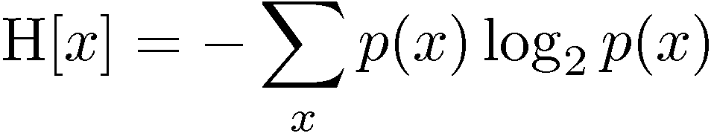
Entropy: General Definition
Important quantity in
  coding theory
  statistical physics
  machine learning

Slide 33
Intuition

Slide 34
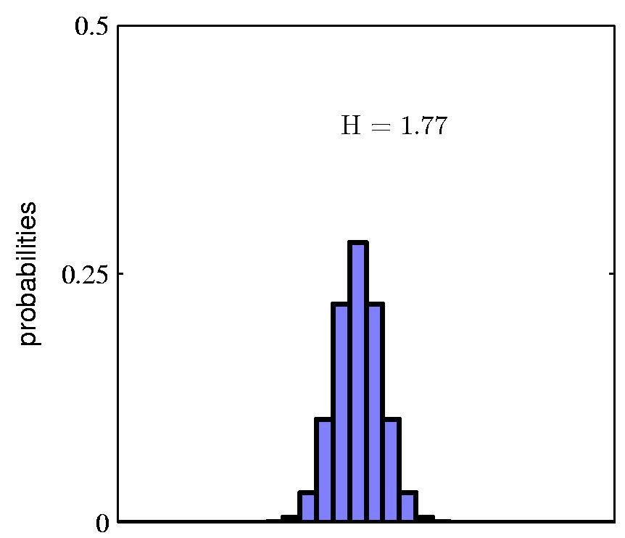
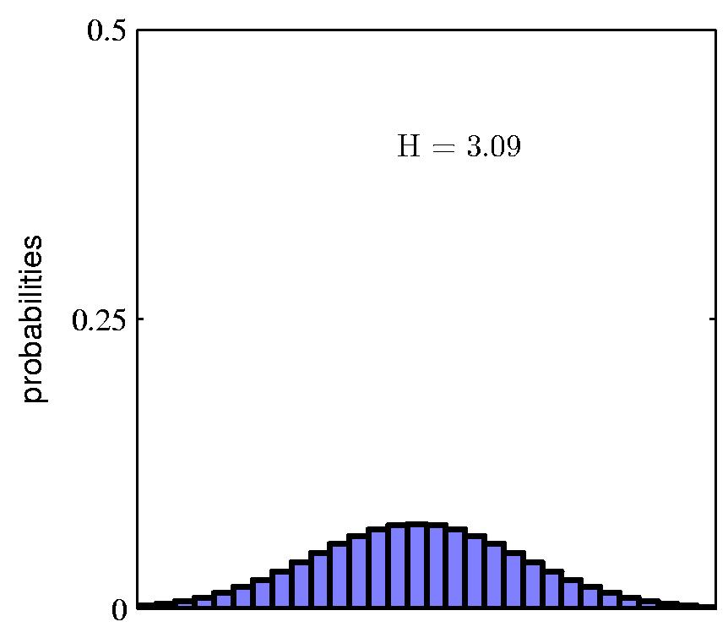
Entropy
Notes:
Histogram for discrete values, think grades.

Slide 35
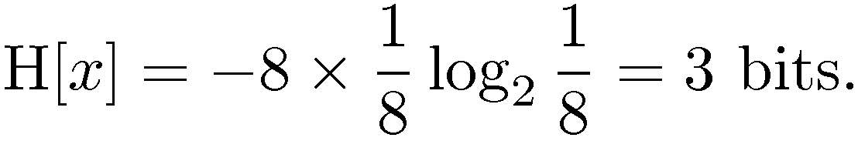
Coding Theory
Coding theory: X discrete with 8 possible states (“messages”); how many bits to transmit the state of X?
Shannon information theorem: optimal code length assigns –log₂ p(x) to each “message” X = x.
All states equally likely

Slide 36
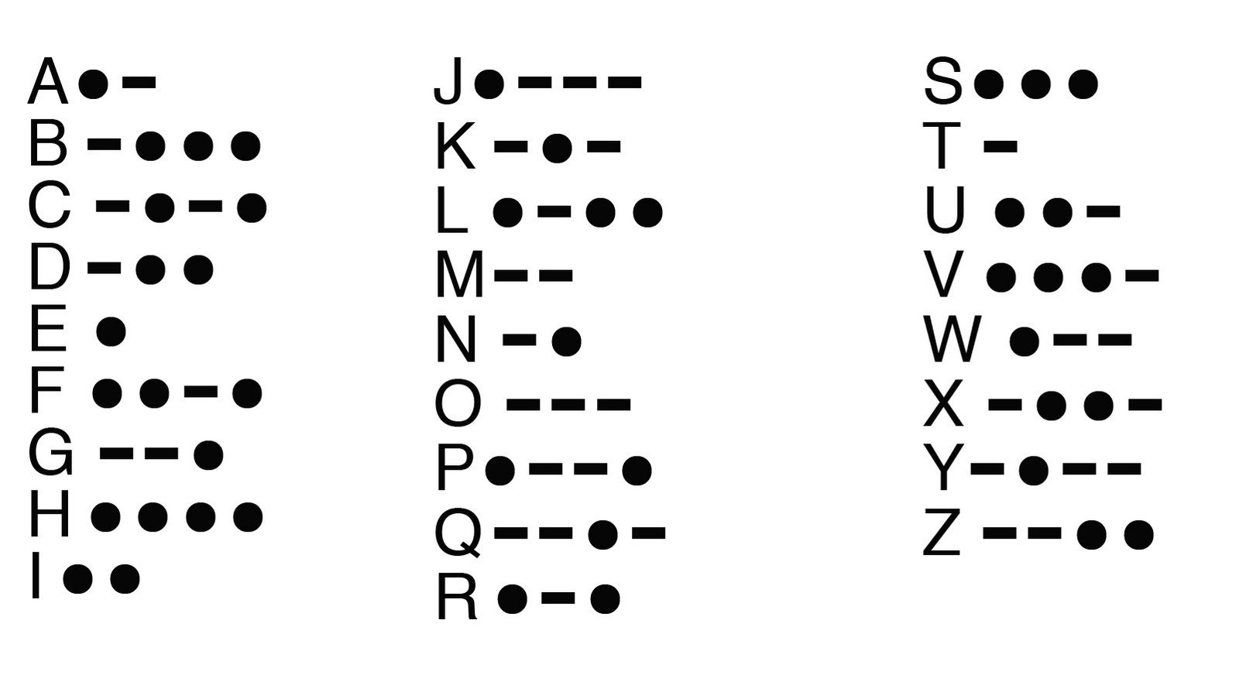
Zipf’s Law
General principle: frequent messages get shorter codes.
  e.g., abbreviations.
  Information Compression.
Notes:
Morse Code example. Morse Code has “stop” character.

Slide 37
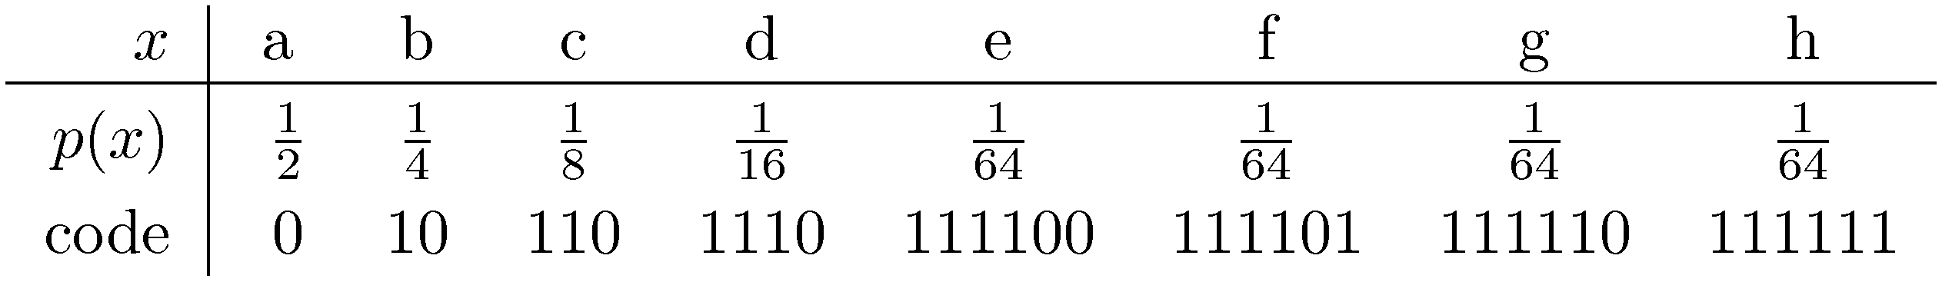
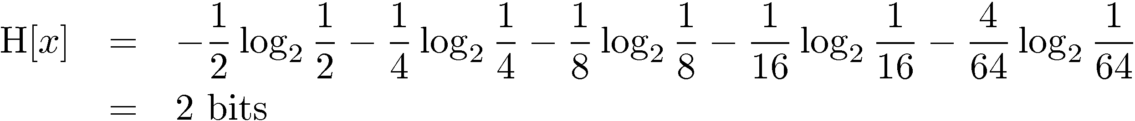
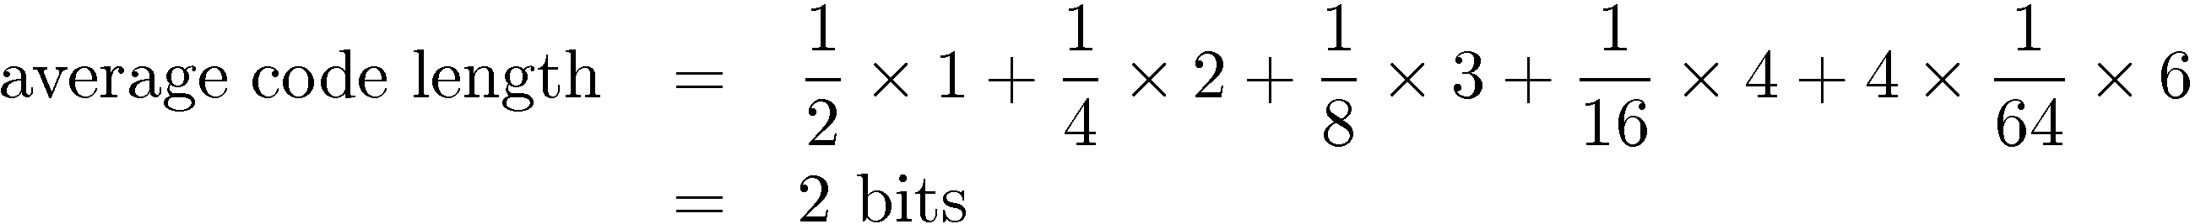
Another Coding Example
Notes:
Assumes no “stop” character between messages, like Huffmann encoding tree.

Slide 38
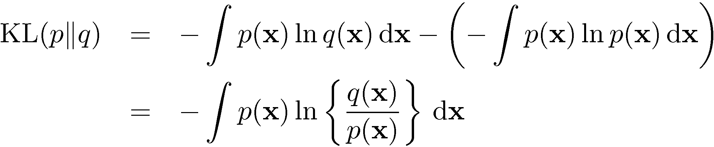


The Kullback-Leibler Divergence
Measures information-theoretic “distance” between two distributions p and q.
Distributions can be discrete or continuous.
Aka cross-entropy.
Code length of x in wrong distribution
Code length of x in true distribution

Slide 39
Information Gain
ID3 Decision Tree Learning

Slide 40
Splitting Criterion
A new attribute value changes the entropy.
Want to split on attribute that has the greatest reduction in entropy, averaged over its attribute values.
Gain(S,A) = expected reduction in entropy due to splitting on A.

Slide 41
Example
Notes:
gain of humidity is greater

Slide 42
Playtennis Example
Notes:
try id3 in weka, recovers original tree.
do example in LikesTV problem.
select test examples using tool. Show how test error is different from training error.

